Slide 1
Procure to Pay Project
Tips and Tricks – Changing Email Notification Preferences

Slide 2
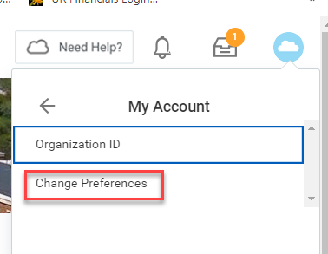
Tips and Tricks – Changing Email Notification Preferences.
Workday is set to send a number of notifications to your Outlook email.
If you would like to change how many email notifications you get, it is very simple to do so from your Procurement Dashboard.
Click on the Cloud icon, then click on My Account.
Then click on Change Preferences

Slide 3
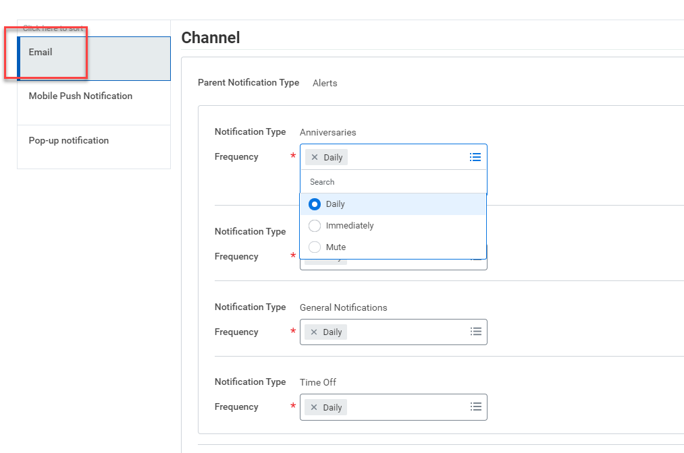
Tips and Tricks – Changing Email Notification Preferences
Scroll down and click on each tab to add or remove notification preferences.
You can choose to get one daily notification, an immediate email, or to mute emails altogether. There are many notifications types to set.
Click on the three lines to open up the box of choices.
When complete, click on the OK.

Slide 4
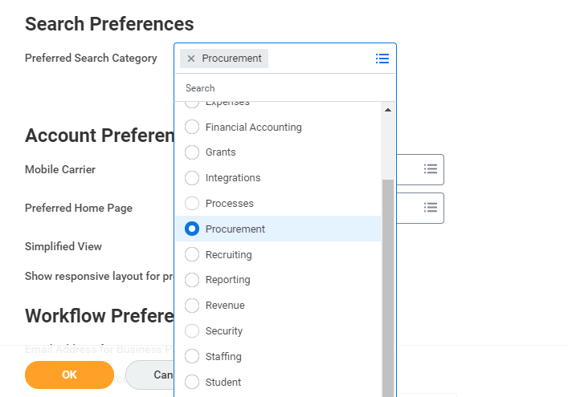
Tips and Tricks - Changing Email Notification Preferences
You can also set the system to search in a particular Workday module. The default setting is to display search results in the Common module.
You can choose to have the system set to search in Procurement or All of Workday instead. If you often search and have to click on the word Procurement, changing this setting will reduce clicks in the future.
Once you have made your changes simply click OK.

Slide 5
Tips and Tricks - Changing Email Notification Preferences
You can revise your preferences at any time.

Slide 6
Questions?

