Slide 1

Monthly P2P Workshop
February 2021

Slide 2

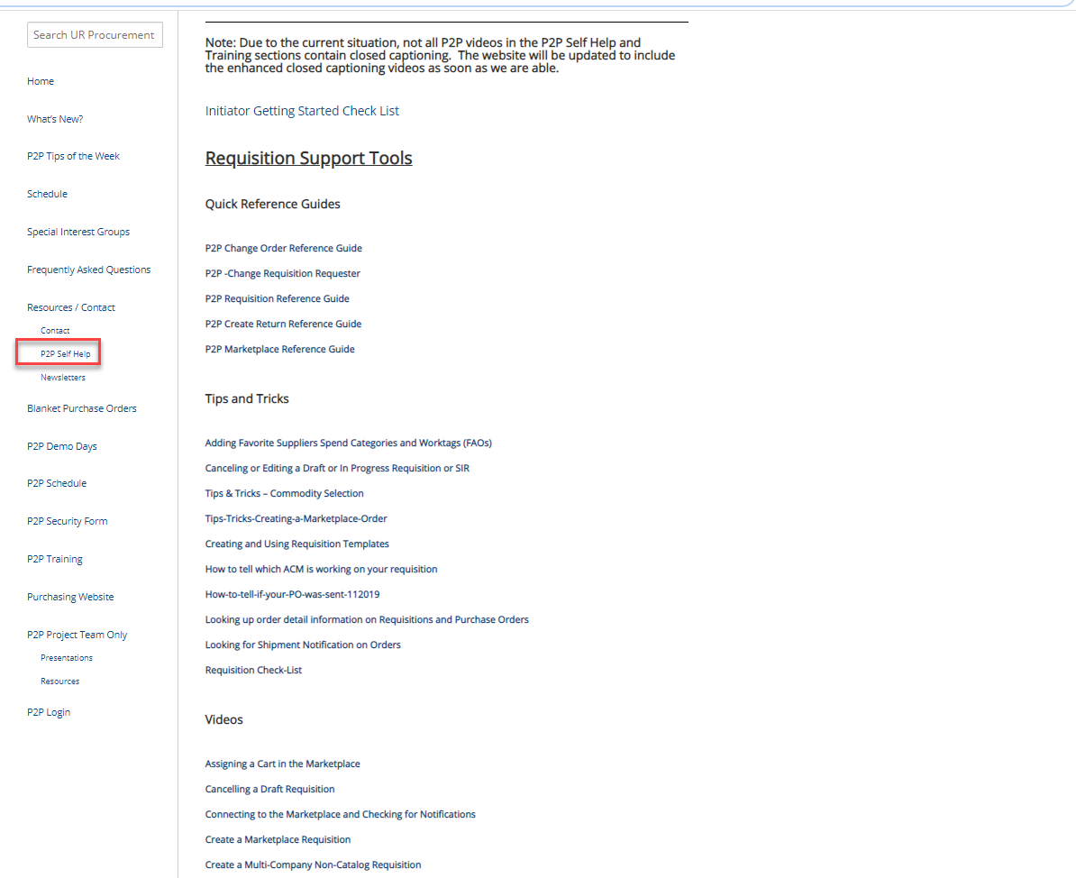
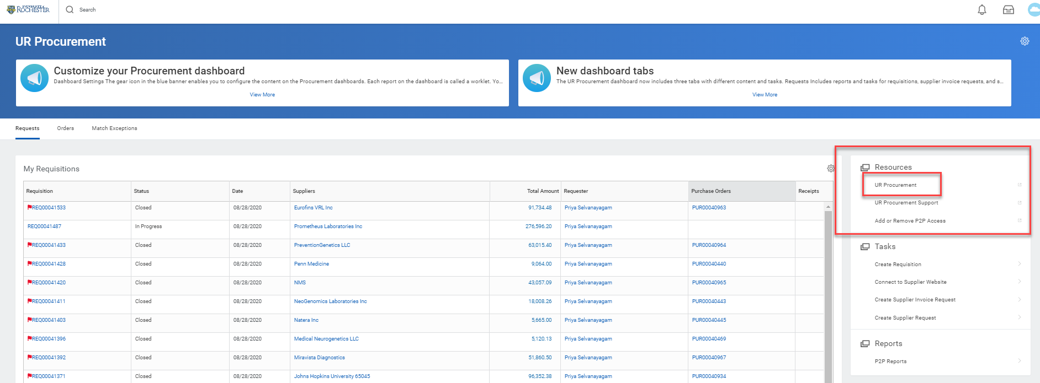
UR Procurement Website – P2P Self Help
Not sure how to create a catalog requisition, set a delegation or resolve an invoice match exception?
Visit the UR Procurement Website P2P Self Help Section. It provides Quick Reference Guides, Videos and Tips and Tricks to support your use of the P2P System.
Utilize the Searchable Directory to quickly search and find documentation.
You can also access the website from within Workday under the Resources section

Slide 3

February 2021 Monthly Workshop Topics
Canceling Draft Requisitions
Receipt Reminders
Demos and Questions

Slide 4
Tips and Tricks – Canceling a Draft or In Progress Requisition or SIR
If you have started a SIR or a Requisition that is in Draft status or is In Progress and you decide it is no longer needed, it is very easy to cancel the transaction.
The first thing to do is to find the document number. You can check your dashboard for My Requisitions or My Supplier Invoice Requests.
If you use your My Requisition or My Supplier Invoice Request Worklets, it is a simple matter of using the action button and selecting Cancel.
If you know the number and you type it into the search bar, you can also get to the action button to cancel the transaction

Slide 5
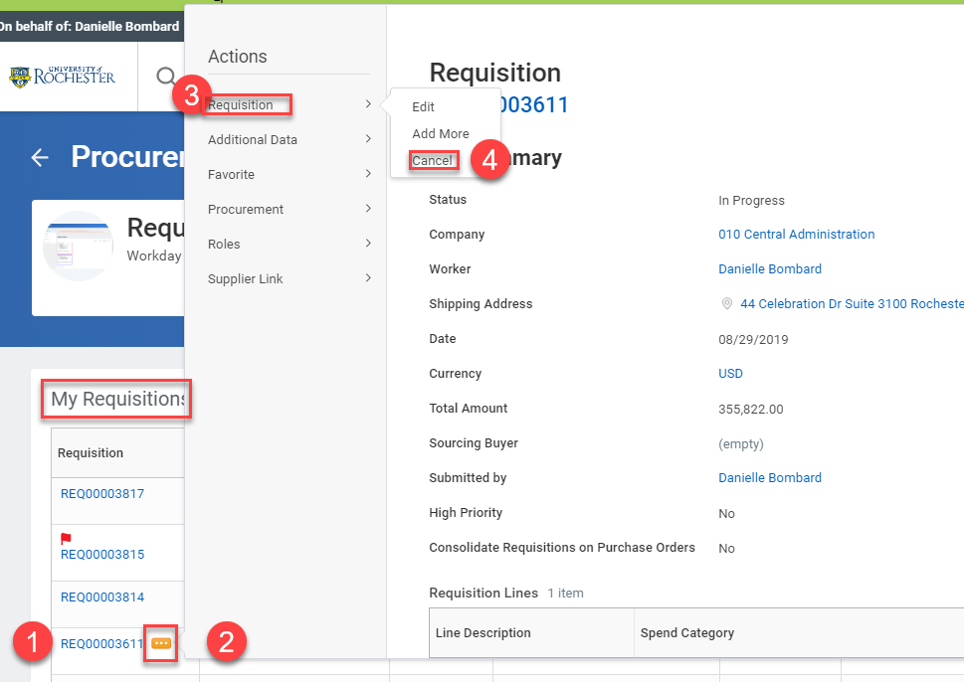
Tips and Tricks – Canceling a Draft or In Progress Requisition or SIR
To use the My Requisitions or My Supplier Invoice Request Worklets on your dashboard, simply find the correct transaction, hover, click on the Action button, hover over Requisition and select Cancel.
Be sure to Click OK to complete the task.

Slide 6
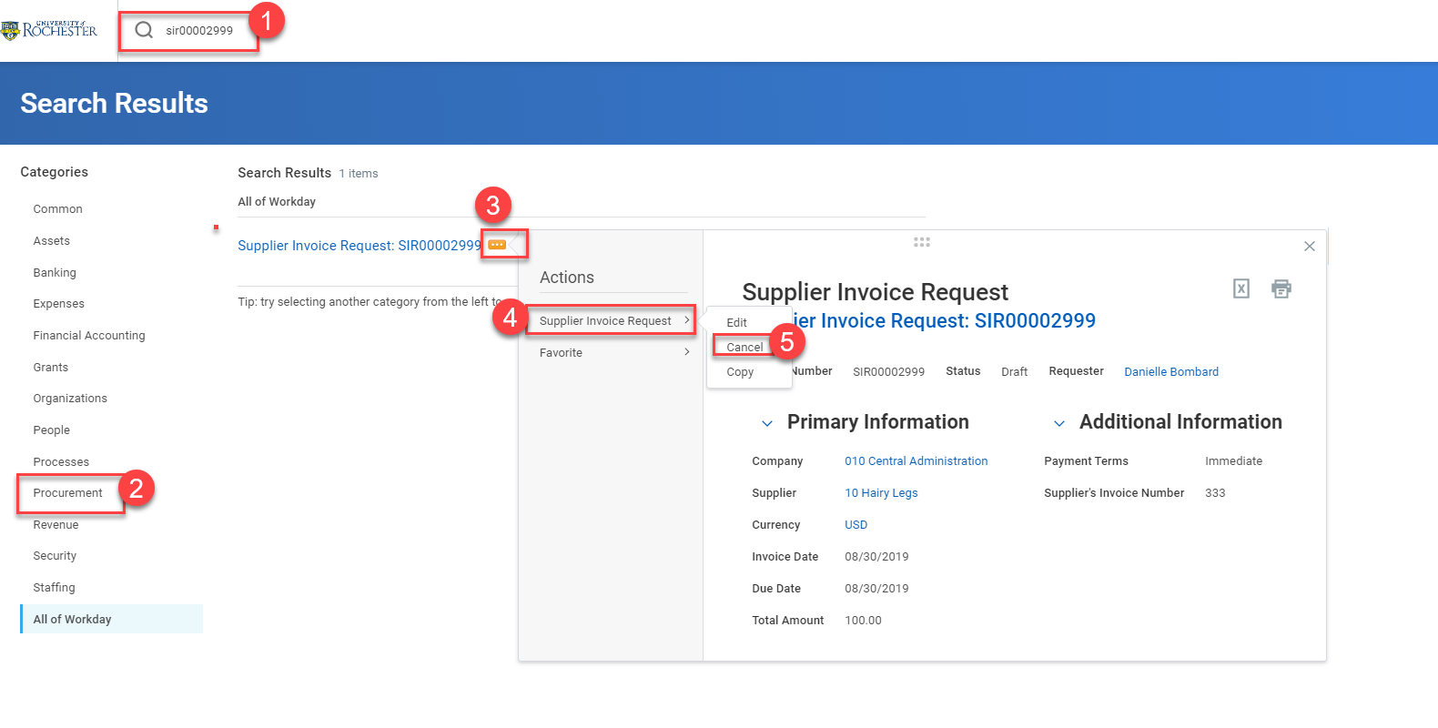
Tips and Tricks- Canceling a Draft or In Progress Requisition or SIR
To use the global search bar type the full document number, including letters, into the search bar and hit enter.
Then select All of Workday or Procurement and the blue number will appear.
The related action button is just to the right of the number if you hover there. Click the button, hover over Supplier Invoice Request or Requisition and select Cancel. Be sure to click OK to conclude the task.

Slide 7
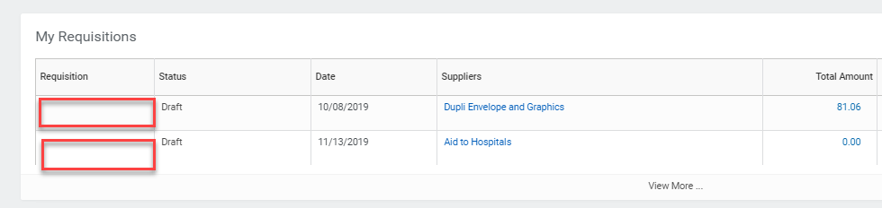
Tips and Tricks – Canceling a Draft Requisition That Has No Number
What do you do if you have started a Requisition that is in Draft status and you can see it on your Worklet, but it has no number?
There is a way to edit or cancel it. It just requires a few more steps than editing or canceling one with a number.

Slide 8
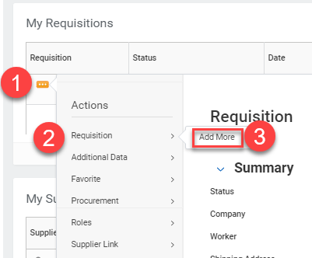
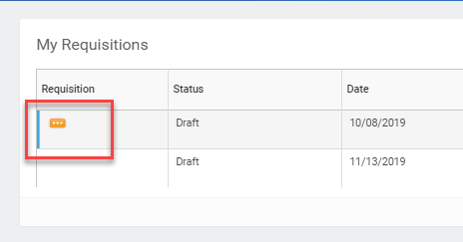
Tips and Tricks – Canceling a Draft Requisition That Has No Number
If you hover your mouse in the blank space for the number and move it around a bit, an action button will appear.
When it appears, click on it.
Then hover over the word Requisition and click on Add More.

Slide 9
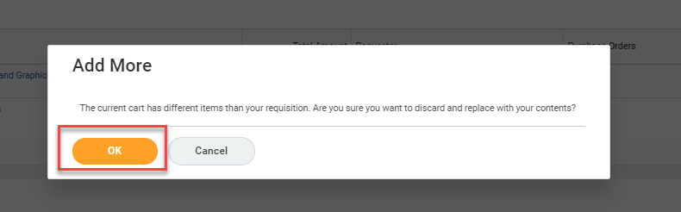
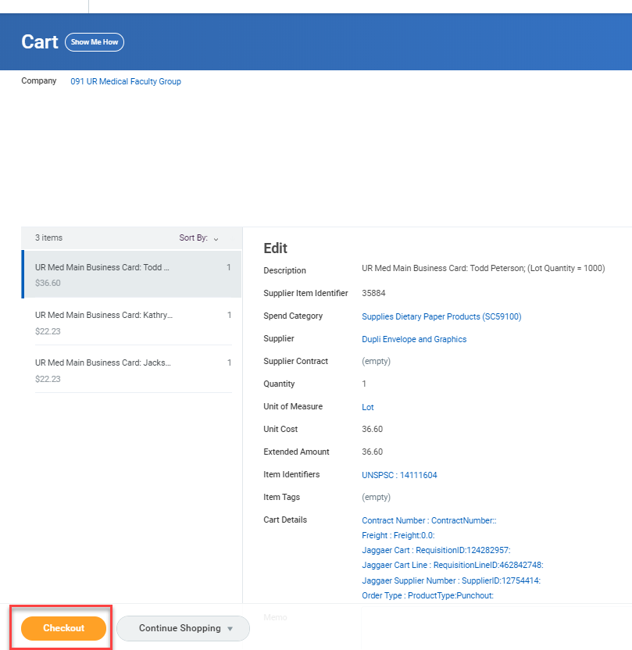
Tips and Tricks – Canceling a Draft Requisition That Has No Number
The next screen will ask if you want to replace items. Click on OK.
You will be taken to your cart.
Click on Checkout.

Slide 10
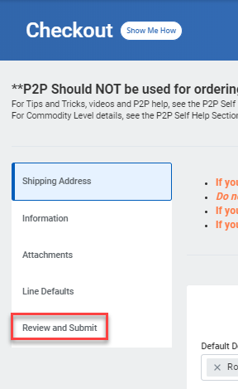
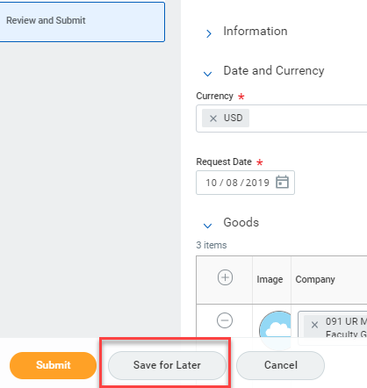
Tips and Tricks- Canceling a Draft Requisition That Has No Number
At the Checkout Screen, click on Review and Submit.
In the next screen click on Save For Later. This will assign a number to the requisition.

Slide 11
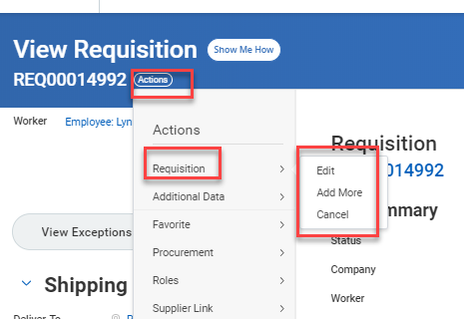
Tips and Tricks- Canceling a Draft Requisition That Has No Number
Now that your Requisition has a number, you can click on the Action button and select Cancel.

