Slide 1
Procure to Pay Project
Tips and Tricks – Un-assigning Carts in the Marketplace

Slide 2
Tips and Tricks – Un-assigning Carts in the Marketplace
Assigning Carts in the Marketplace should only be done if you do not have time to complete the process of submitting your order. You cannot assign carts to approvers for approval.
Carts can only be assigned to other Initiators.
Approvers do not have access to the Marketplace to retrieve carts. Approvals are handled in Workday and happen automatically.

Slide 3
Tips and Tricks – Un-assigning Carts in the Marketplace
If you have previously assigned a cart to someone in the Marketplace you can retrieve the cart and un-assign it. It will come back to you to process.
First you need to connect back out to the Marketplace. Start by typing Create Requisition in the global Search box and fill in your ship-to and Worktag (FAO). Click OK and in the next screen choose Connect to Supplier Website.

Slide 4
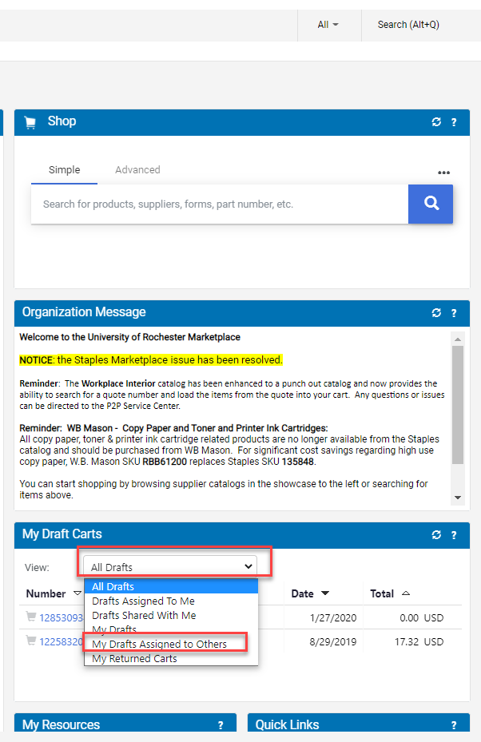
Tips and Tricks- Un-assigning Carts in the Marketplace
Once you connect to the Marketplace look for the My Draft Carts Worklet.
A drop down menu will give you the option of viewing My Drafts Assigned to Others. Click on that.

Slide 5
Tips and Tricks- Un-assigning Carts in the Marketplace
Click on the correct cart number. In the next screen there will be an Action column on the right. Click the arrow and select Unassign.
This will bring you back to the Cart Details. Click View Cart Details and then click Send to Workday. Process the requisition as usual.

Slide 6
Questions?

