Slide 1

Procure to Pay Project
Tips and Tricks – How to tell if an invoice has been paid.

Slide 2
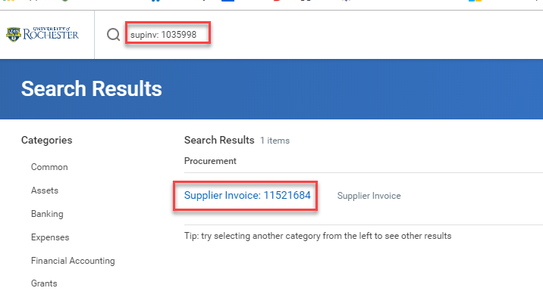
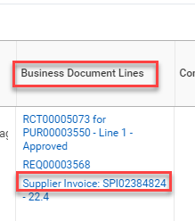
Tips and Tricks – How to tell if an invoice has been paid.
If you are wondering if an invoice has been paid it is very easy to determine.
The first thing you need to find is the supplier invoice number. If you have the number you can search for it in the global search bar using the prefix supinv: followed by the supplier’s invoice number. If you don’t know it you can find the invoice number on the Purchase Order line in the business document line column
Once the blue number pops up you can click on it to see the invoice.

Slide 3
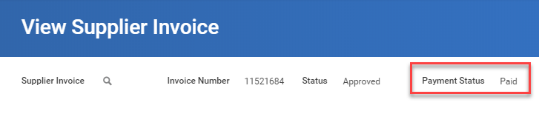
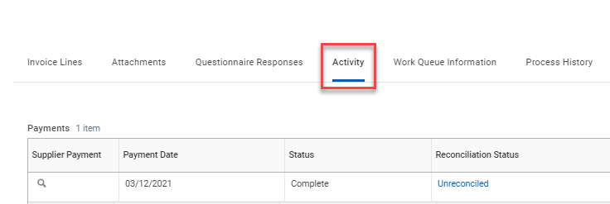
Tips and Tricks – How to tell if an invoice has been paid.
You can immediately see whether or not an invoice has been paid by looking just under the blue bar. Payment Status will say Paid or Unpaid.
If the invoice has been paid there will be a Activity tab on the line that you can click to view details.

Slide 4

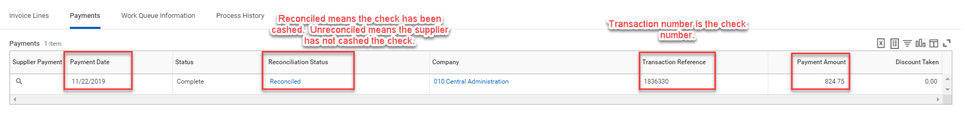
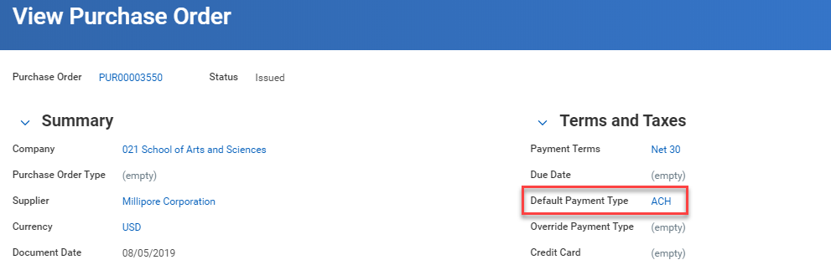
Tips and Tricks- How to tell if an invoice has been paid.
In the payment tab you will be able to view the payment date, the check number if applicable, the amount, and whether or not the check has been cashed.
If there is no transaction number the supplier is set to receive electronic payments. You can check the Purchase Order to see the default payment type for a supplier. ACH and EFT are electronic payments.

Slide 5

Questions?

