Slide 1

Monthly P2P Workshop
April 2021

Slide 2

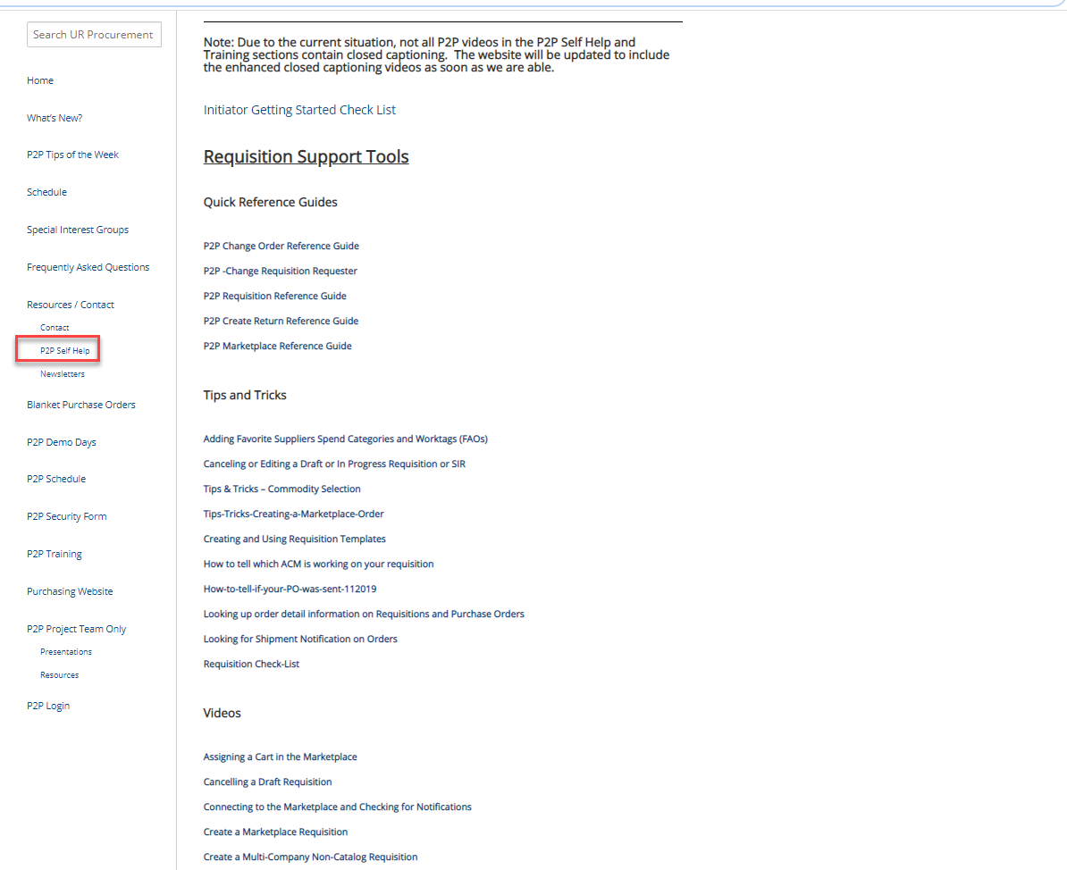
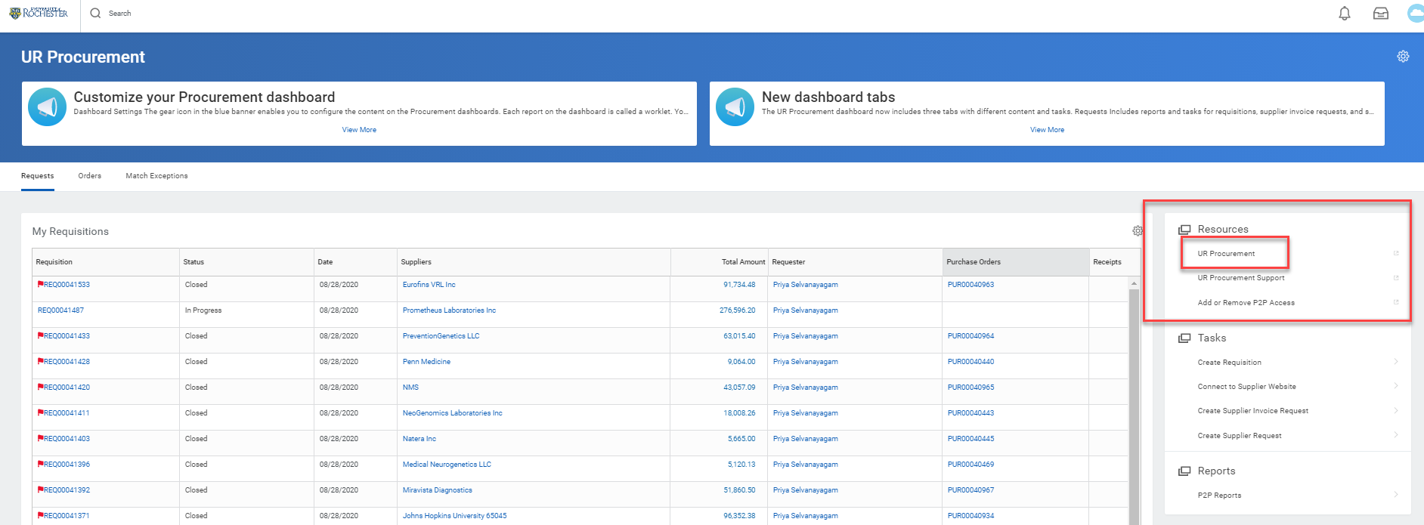
UR Procurement Website – P2P Self Help
Not sure how to create a catalog requisition, set a delegation or resolve an invoice match exception?
Visit the UR Procurement Website P2P Self Help Section. It provides Quick Reference Guides, Videos and Tips and Tricks to support your use of the P2P System.
You can also access the website from within Workday under the Resources section

Slide 3

April 2021 Monthly Workshop Topics
Adding Shortcuts and Favorites
Ordering with Templates and Copying Requisitions
Setting a default Ship-To address

Slide 4
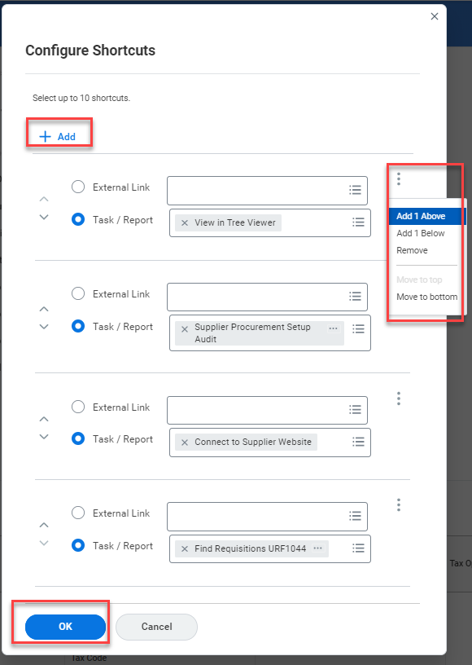
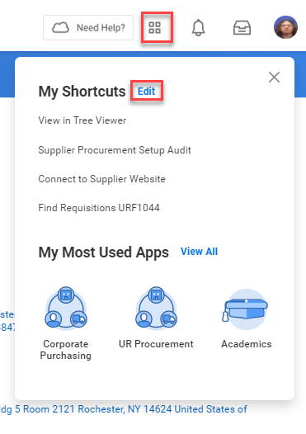
April 2021 Monthly Workshop Topics
Adding Favorites and Shortcuts
Workday provides a number of ways to save and use Tasks, Reports, and Objects. Items such as Spend Categories, FAO’s (Worktags), Suppliers, and Reports can all be saved as favorites for easy access.
In additions to saving favorites, Workday has a Short Cuts feature that will allow you to save up to 10 Tasks or Reports on your Home Page.
Short Cuts can be accessed by clicking the four squares next to your Bell Notifications Icon. Edit and add & arrange items here.

Slide 5
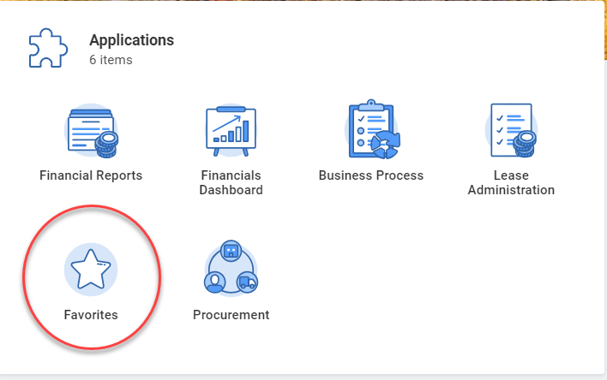
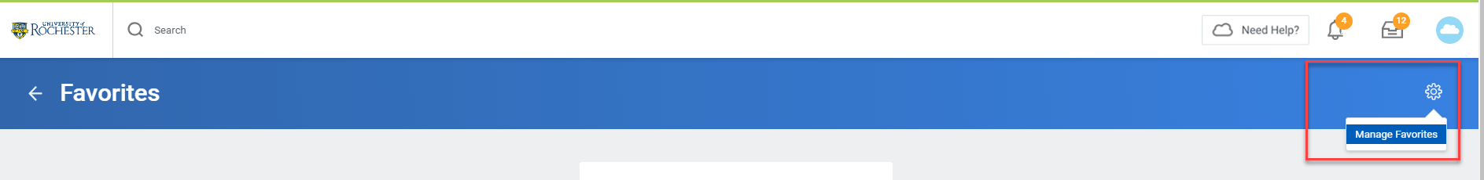
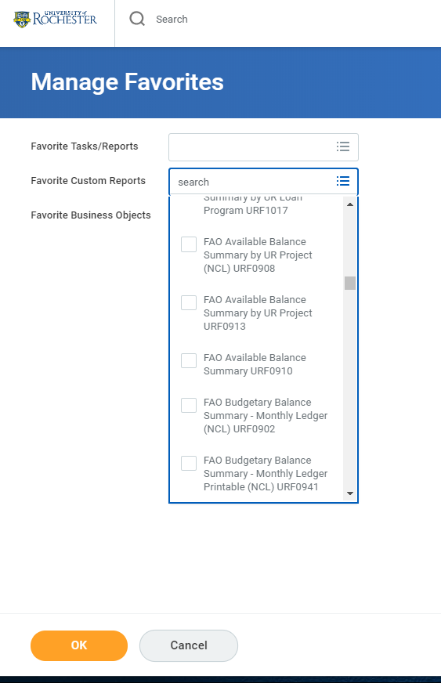
April 2021 Monthly Workshop Topics
You can add favorites by clicking on your Favorites Icon and then clicking the gear in the upper right. Select Manage Favorites.
Tasks and Reports, Custom Reports (URF), and Objects such as FAO’s can be added.
If you do not find a report in the top box, try the middle box.

Slide 6
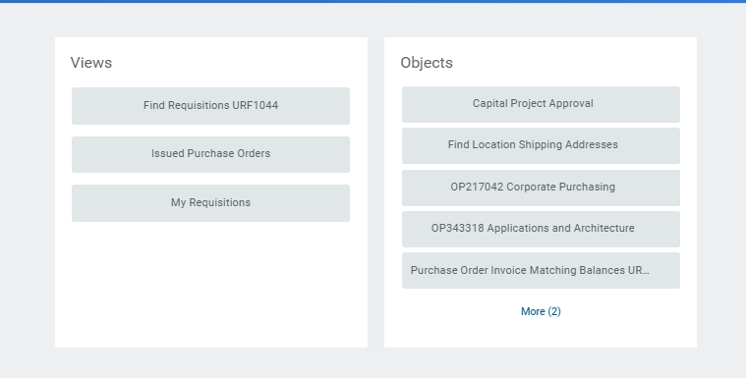
April 2021 Monthly Workshop Topics
To access saved reports, click on the Favorites Icon and then just click on the name of the report you wish to run.

Slide 7
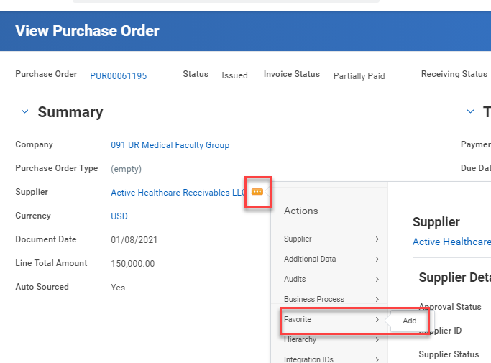
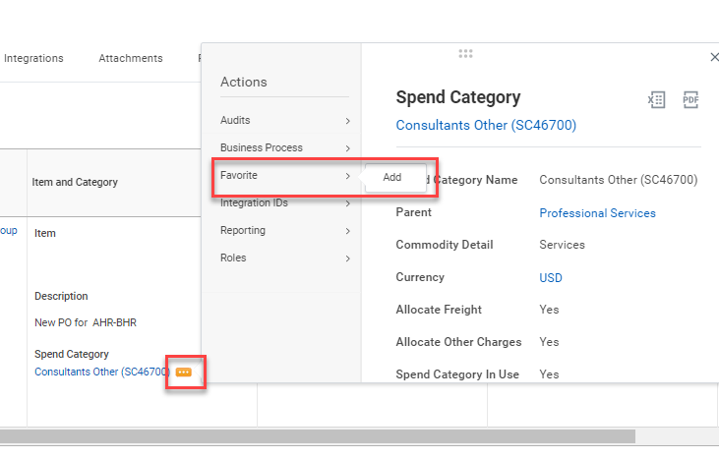
April 2021 Monthly Workshop Topics
You can also add favorites by clicking the actions button next to whatever object (i.e. Supplier, Spend Category, Worktag) you wish to save when viewing Requisitions, Purchase Orders, or Pcard transactions.

Slide 8
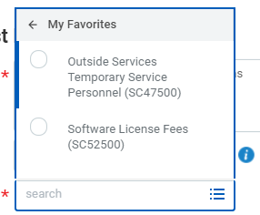
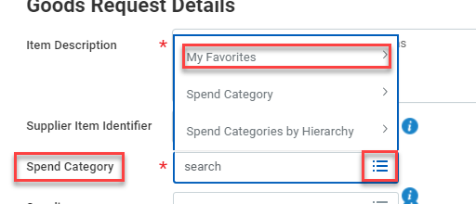
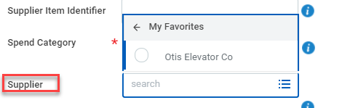
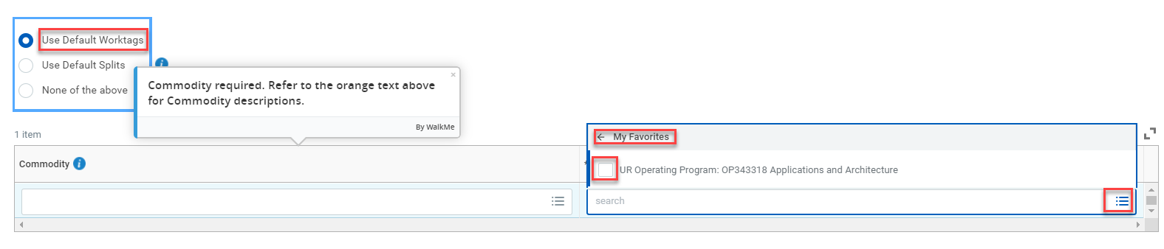
April 2021 Monthly Workshop Topics
When creating a Requisition or SIR it is simple to choose from your favorites. When you click into the field for a Spend Category, Worktag, or Supplier, just click on the three bars and choose My Favorites. Your saved items will show up in this area.

Slide 9
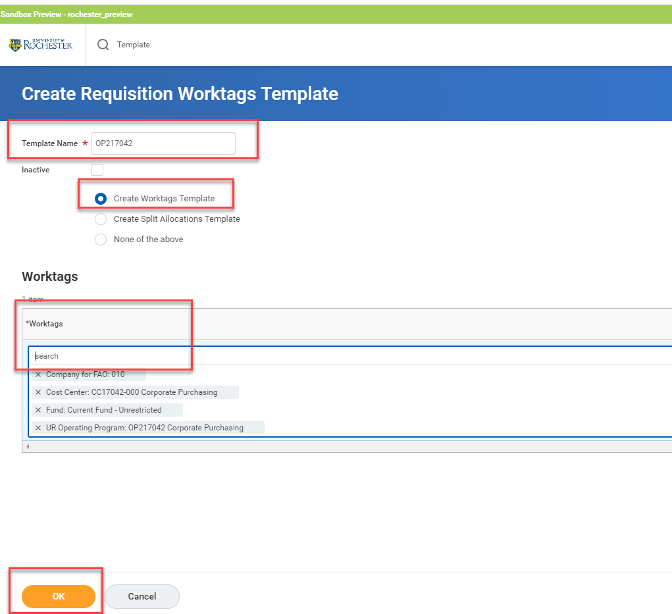
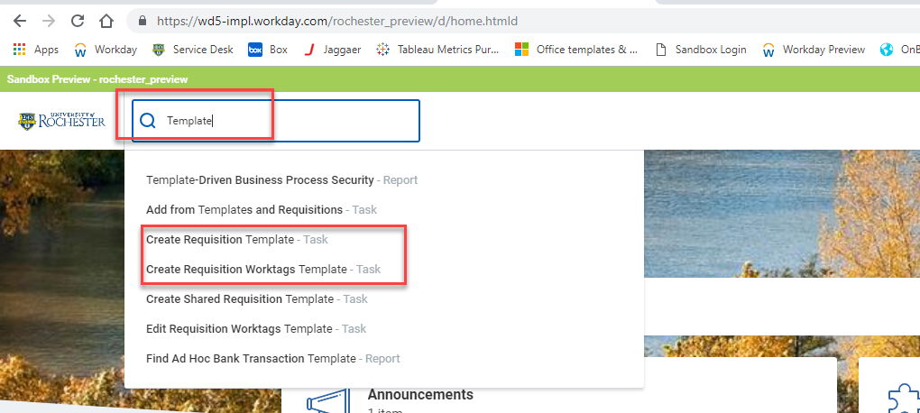
April 2021 Monthly Workshop Topics
If you use certain Worktags (FAOs), Splits, or you order the same goods often, it will save time to create Templates.
In the global search bar type the word Template and choose the type of Template you would like to create.
To Create a Worktags or a Split Allocations Template you need to give it a name.
Search for the Worktag, or set up your Splits, then click OK.

Slide 10
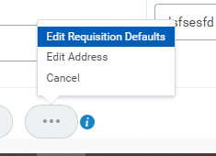
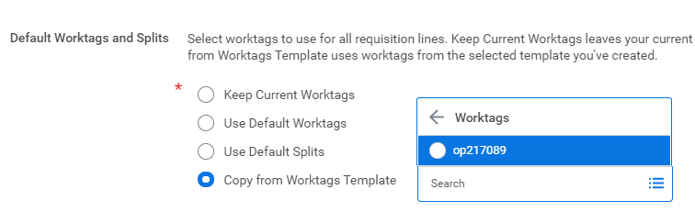
April 2021 Monthly Workshop Topics
To use the template you have to Edit Defaults when checking out your requisition.
Click on the three dots at the bottom of the checkout screen and choose Edit Requisition Defaults.
In the Edit screen select Copy from Worktags Template and select Worktags or Split Allocations. This is probably a better option for splits since it is easy to save FAOs as favorites.

Slide 11
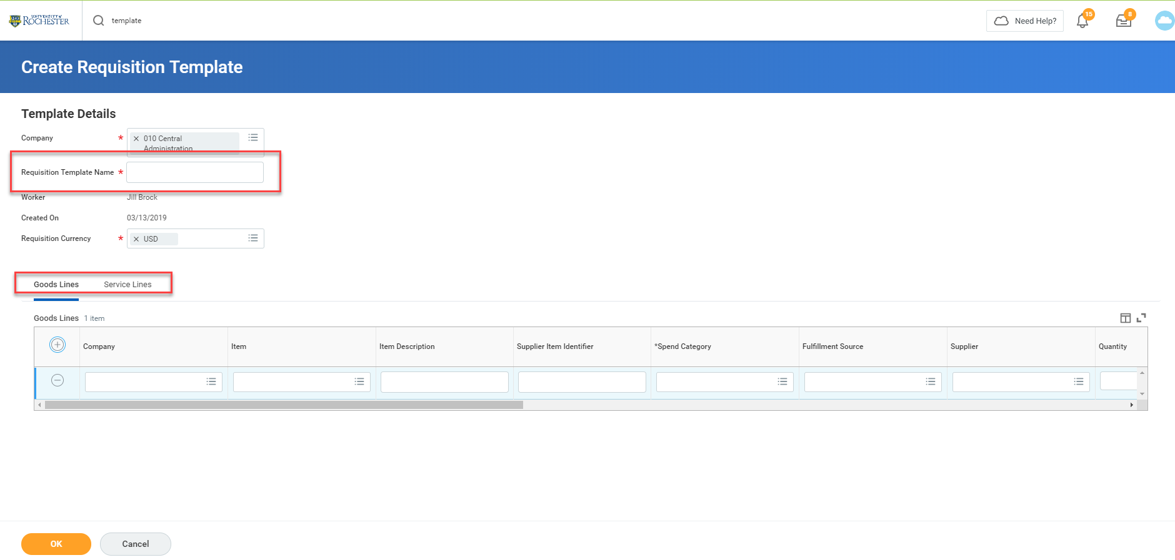
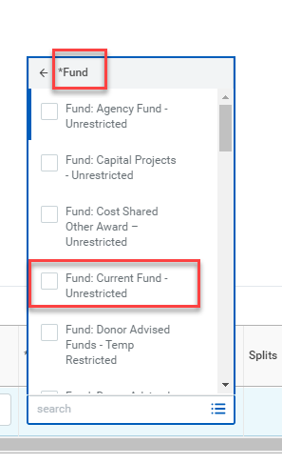
April 2021 Monthly Workshop Topics
To save time on frequently ordered goods or services create a Requisition Template. You must put in a company number and name your template.
Add as many goods or service lines as you like. You can add in as much detail as you choose. If prices change you can edit the template later.
If you vary the FAOs you will use, you can simply select Fund: Currrent Fund-Unrestricted. That will allow you to save the Template, but will allow you to add FAOs later. If you will always use the same FAO enter it in the Additional Worktags field.

Slide 12
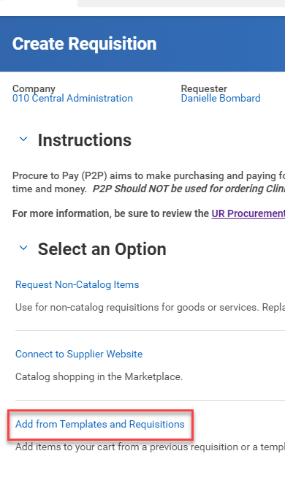
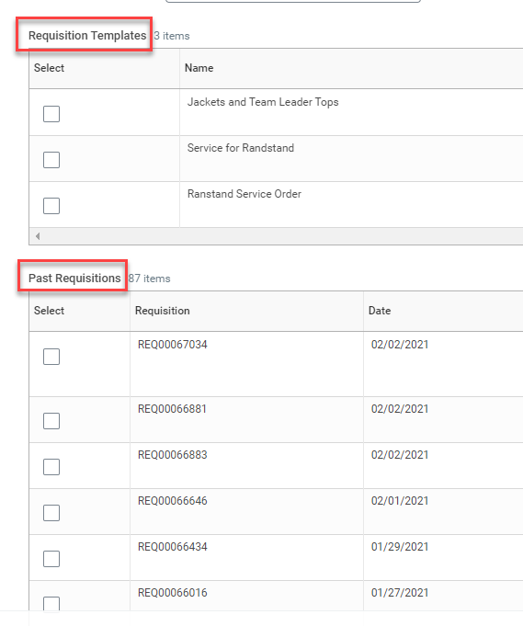
April 2021 Monthly Workshop Topics
To use your template you will start by typing or selecting Create Requisition.
Instead of choosing Request Non-Catalog Item you will choose Add from Templates and Requisitions.
In the next screen you have the option of choosing your Template or you can select a prior Non-Catalog Requisition to copy. Just check the box and select Add to Cart. In the checkout screen you can adjust anything you choose.

Slide 13
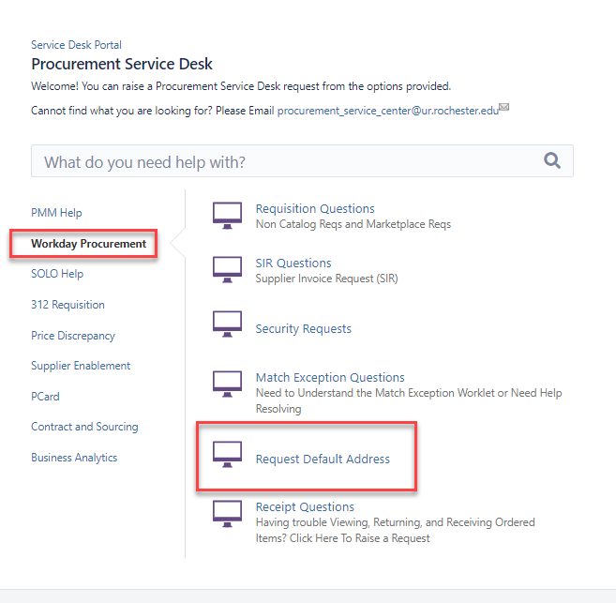
April 2021 Monthly Workshop Topics
Another time saver is to set a Default Ship-To Address so you don’t have to search for it each time. Please copy your default address from a prior PO and paste it into an email to the P2P Service Center (procurement_service_center@ur.rochester.edu). You can also create a ticket directly in Service Desk at Service.rochster.edu/procurement. Ask us to please set your address as your default.
We can only set one default address per person. If you use a number of addresses, consider setting the one you use most often as your default and changing it as needed.

