Slide 1

P2P Super User Group
December 8, 2020
Notes:
Jim Dobbertin – Introduction and Kick Off

Slide 2

Topics
Super User Feedback
P2P Updates
Buying and Paying Guide Updates
P2P Design Change Updates
P2P Tips
P2P Reminders
Marketplace Updates
Workday Development Updates
Spend Category Recommendations on Requisitions
Supplier Discovery and Spend Navigator
P2P Monthly Workshops
2
Notes:
Carl Tietjen and Liz Milavec

Slide 3


P2P Super Users
What is working well?
Suggestions for Improvement
3
Notes:
Debbie Flotteron

Slide 4

P2P Updates
Orders with International Ship To Addresses
P2P Requisitions with a foreign ship to address are still unable to be transmitted to the supplier without manual intervention which could delay the receipt of the order by the supplier. We are continuing to work with the Jaggaer Integration Team to address this.
In the interim, while we continue to work with Jaggaer, you can consult the P2P Service Center for ordering alternatives to avoid delays with the order transmission. We will continue to provide updates as we have them.
Catalog Requisitions >=$50,000
A custom validation was recently implemented that will require a commodity for any catalog requisition that is => $50,000.
Laboratory Product Sales (LPS) Pipette Repairs
We are working with LPS on a quoting solution in the Marketplace catalog to replace the SOLO process for pipette repair orders. Stay tuned for updates in the upcoming newsletter.
4

Slide 5
P2P Updates
Website Updates
P2P Self Help Section
What To Do When Someone Leaves the Department
Blanket Purchase Order Section
Blanket Purchase order Guidelines
New Videos in the P2P Self Help Purchase Order Section
Changing the contact name on a Purchase Order if someone leaves the department
Closing a line on a PO because something was canceled by the supplier.
5

Slide 6

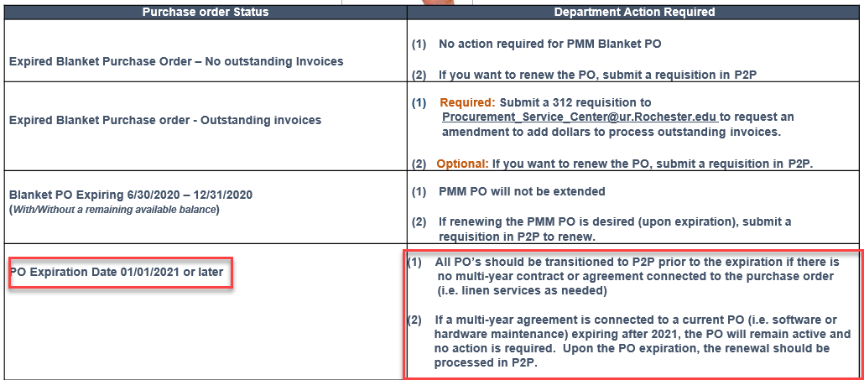
P2P Updates
PMM/P2P Blanket Purchase Order Guidelines Updated
6
Notes:
Debbie Flotteron

Slide 7
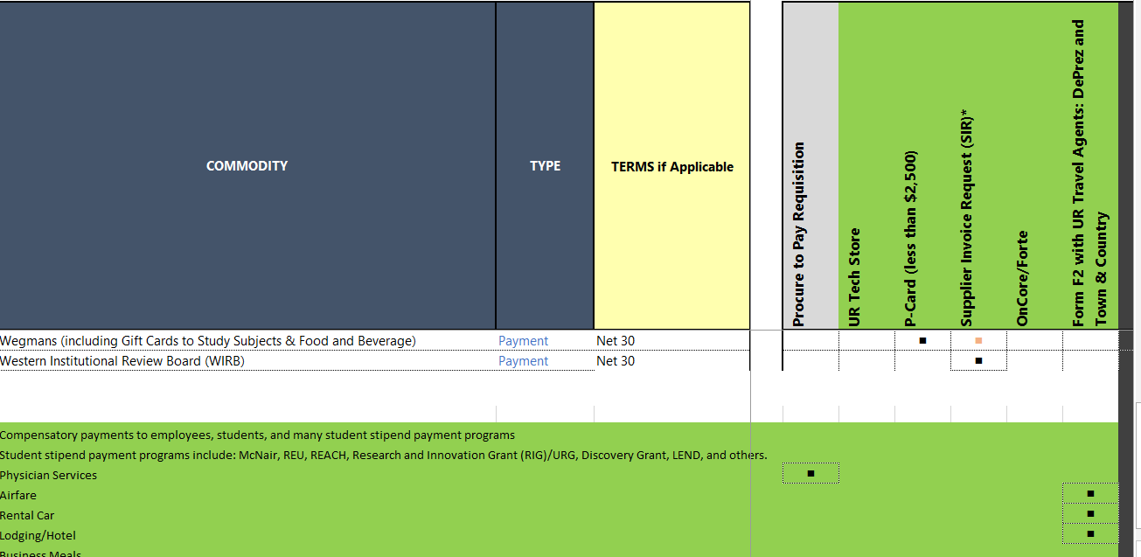
Buying and Paying Guide Updates
There will be forthcoming updates to the Buying and Paying Guide to align with Business Expense and Travel Reimbursement policy. See some highlights below in green
7

Slide 8
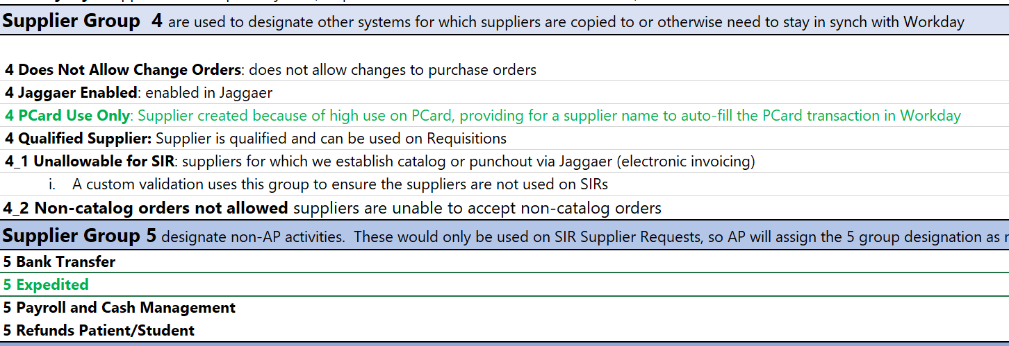
Buying and Paying Guide Updates
There will be forthcoming updates to the Buying and Paying Guide to align with system updates. See some highlights below in green
8

Slide 9

Super User – Design Change Updates
Capital Unrestricted Fund FAO Project
Scope
All Capital Projects - Unrestricted Fund FAO’s
Excludes Expense Projects
Capital Project requisitions should not be mixed with Operating Programs.
Design includes requisitions only (SIR’s excluded)
Timeline
Due to recent design configuration requirement that was identified and allow time to update the configuration and complete testing of the workflow as well as security design, the go-live date of December 18th has been moved to January 18, 2021.
Training sessions have been scheduled the week prior to go-live for initiators and approvers.
9

Slide 10
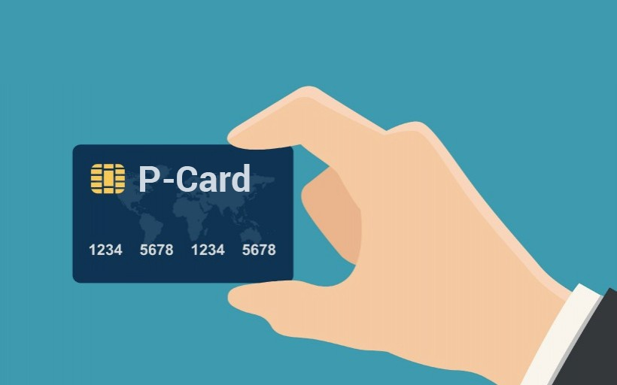
Super User – Design Change Updates
Pcard in Workday Project
Project Objectives
Extension of the P2P implementation: streamline entry and approval activities
Utilize electronic approval workflow and routing for all P2P transactions
Improve Pcard user and approver experience
Automate Pcard transactions into Workday on a daily basis (versus monthly pull/push)
Improve overall policy compliance in the areas of required attachments and approvals
Improve our payment flexibility (potential mid-month or weekly settlements), which can improve our rebate

Slide 11

Super User – Design Change Updates
Pcard in Workday Project
Benefits for Departments
Daily upload improves the timeliness of recording a growing volume of our expenses
Improve departmental user experience of having one less system to log into to complete/investigate their financial transactions
Transaction enrichment (adding receipts/attachments, editing FAO and SC, adding additional detail, and approvals) done in Workday
Eliminate US Bank lockouts from performing required activities (accounting code enrichment, adding attachments, approving) at the end of the month)
Fewer attachment difficulties and more uptime for approvals
Decrease the volume of journal entries needed
Better visibility into transaction details (supporting documents/attachments) for inquiries and audits

Slide 12
Super User – Design Change Updates
Pcard in Workday Project Status and Timeline
Project Go-Live 2/1/2021
Project Status and Activities
Configuration and Testing Completed
New MyPath module development target completion 12/28/2020. This will be required for all cardholders and managers.
Optional instructor led Zoom training sessions will be held in January – registration will be in MyPath
UR Procurement Website updated to include Pcard documentation
Policy updates were approved and will be forthcoming in the next Pcard Newsletter

Slide 13

Super User Tips
13
It is a best practice to create receipts for your purchase order as soon as you receive a good or can verify a service has been completed
Creating Receipts in Workday is required for most transactions. Invoices for transactions that require receipts will not be paid until the receipts are entered delaying payment to the supplier..
It is best practice to review your Match Exception Worklet weekly to review any exceptions that require your action. Delays in invoice payment to suppliers could result in credit holds and held orders across the University.
13

Slide 14

Super User Tips
Receipt Guidelines
Invoice Match Exception Guidelines
Following is a list of Match Exceptions and who they are routed to:
P2P requires a 3-Way Match for most transactions prior to an invoice being paid. See the table below for details
Receipt Type | Dollar Value | Receiving Required
Goods (Catalog) | < $2,500 | No
Goods (Non-Catalog) | >$0 | Yes
Grant Purchase (GR5XXXX) | >$0 | Yes
Spend Category = Trackable | >$0 | Yes
Service | >$0 | Yes
Invoice Match Exception Type | Exception Routes To:
Freight | Purchasing
No PO Line for Invoice Line | Requestor
Quantity | Requestor
Price Discrepancy (unit cost) | Purchasing
Receipt | Requestor
Service PO Out of Money | Requestor
14

Slide 15
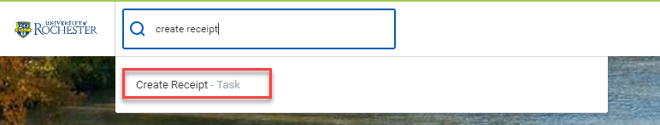
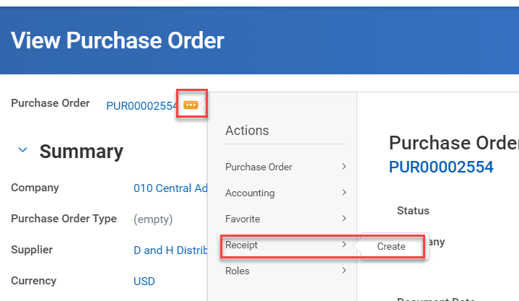
Super User Tips
Creating Receipts
Creating receipts can be done multiple ways
Type Create Receipt in the global search bar and select the task.
Use the related action button after the PO number
15

Slide 16

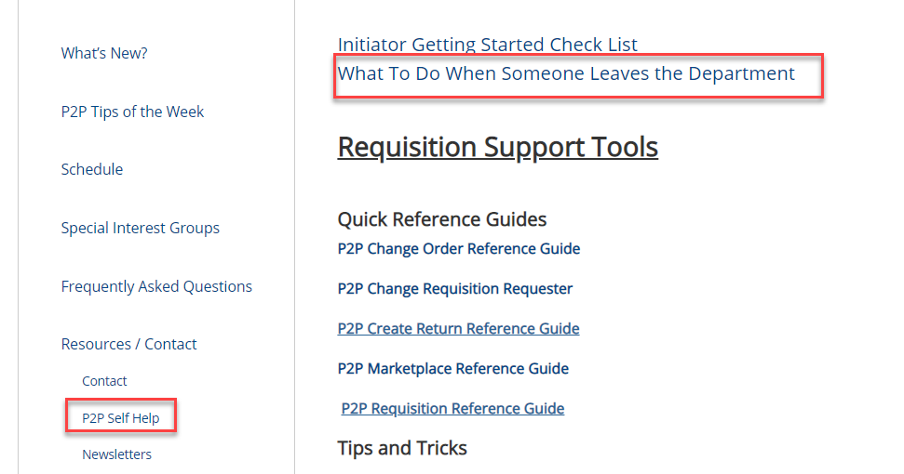
Super User Tips
What to Do When Someone Leaves Your Department
If an initiator leaves your department, following are steps you should take
Employee Leaving Submit a Request to Remove Roles prior to Leaving Position
Employee Replacing Departing Employee Submit a Request to Add Initiator Roles
Transfer Tasks on initiated transactions to another staff member (replacement)
If the employee leaving has been an initiator, all of their current tasks in Workday will need to be
transferred to another user (replacement) so invoice match exceptions and other notifications can go to
the correct individual to resolve them
Change the contact person on Purchase Orders Initiated by Departing Employee
This will allow match exceptions to route to the new individual.
Manager Change Invoice Exception Worklet to View Invoice Match Exceptions
The manager of the departing employee should change their Match Exception Worklet to view invoice
match exceptions for the departed employee
16

Slide 17

Super User Reminders
Reminders:
You should no longer be submitting 312 requisitions to Purchasing. Instead you should be submitting non-catalog requisition via P2P.
The only SOLO orders should be for RR Donnelly and Medline. All other SOLO supplier orders should be done in the P2P Marketplace. SOLO access was terminated on 11/30.
F4 Forms should no longer be submitted to Accounts Payable except for Human Subject Payments and multi-company requests. Departments should submit a SIR via P2P instead.
Patient-Care/Clinical Supply items should not be processed in P2P. You should continue your current ordering methods outside of P2P.
Due to the current COVID-19 impact on the organization, non-catalog requisitions are being reviewed based on the following criteria which could impact turnaround time.
Requisitions for Companies 010, 020, 021, 022, 023, 024, 030, 070, 080 >=$25,000
Non-Clinical Requisitions for Companies 040, 060, 090, 091, 092 >= $50,000
Non-Clinical Requisition 050 >=$100,000
17

Slide 18
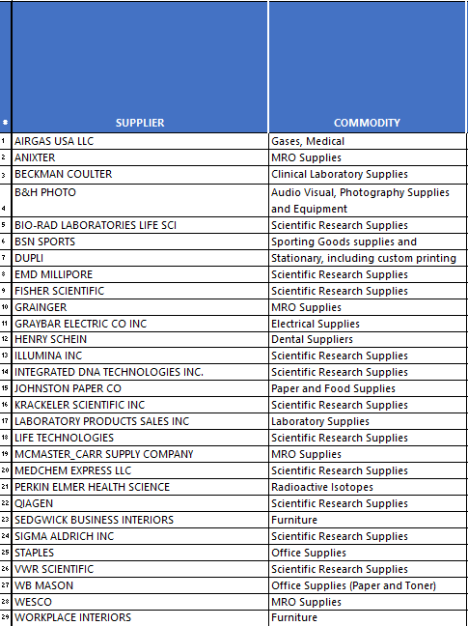
Marketplace Status
29 Live Catalogs in the Marketplace
18

Slide 19
Marketplace Status
Supplier Catalog Updates
Supplier Catalogs in Process
Supplier Catalogs in Process
Amazon –
We are still testing the Amazon catalog.. Stay tuned for updates on a go-live date.
Supplier Catalogs On Deck
Suppliers On Deck
Agilent Technologies Inc
Avanti Polar Lipids Inc
Bethyl Laboratories Inc
Boston Bioproducts Inc
Braintree Scientific Inc
Cambridge Isotope Labs
Cayman Chemical Company
Cell Signaling Technology
Chembridge Corp
Dharmacon
Eppendorf North America Inc
GE Life Science
Genescript
Gemini Bioproducts
Gold Biotechnology
Hardy Diagnostics
Hampton Reserarch
InvivoGen
Suppliers On Deck
Jackson Immuno Research Laboratories Inc
Lifespan Biosciences Inc
Lonza Walkersville Inc
Meso Scale Diagnostics LLC
Miltenyi Biotec Inc
Nu-Way
Origene Technolgies Inc
PartsSource
Peprotech Inc
Polysciences Inc
Promega Corporation
Proteintech Group Inc
Roboz Surgical Instrument Co
Takara Bio USA Inc
Thorlabs
Universal Medical Inc POB 467
USA Scientific
Vector Laboratories Inc
World Precision Instruments
19

Slide 20
Workday Development Updates
Workday has engaged UR as a design partner on the procurement enhancements utilizing machine learning and other technologies.
Workday Spend Category Recommendation
Workday Spend Category Recommendation is a Workday Procurement feature that uses Machine Learning to recommend spend categories at transaction creation based on transaction attributes, such as item description.
The system determines suggestions instantaneously once a user tabs out of text entry.
For non-grid tasks, such as Request Non-Catalog Items, the recommendations are displayed above the Spend Category field and in the Suggested sub-folder of field.
For grid tasks, such as Edit Requisition, the recommendations are shown in the Suggested sub-folder of field only.
20
Notes:
Debbie Flotteron

Slide 21
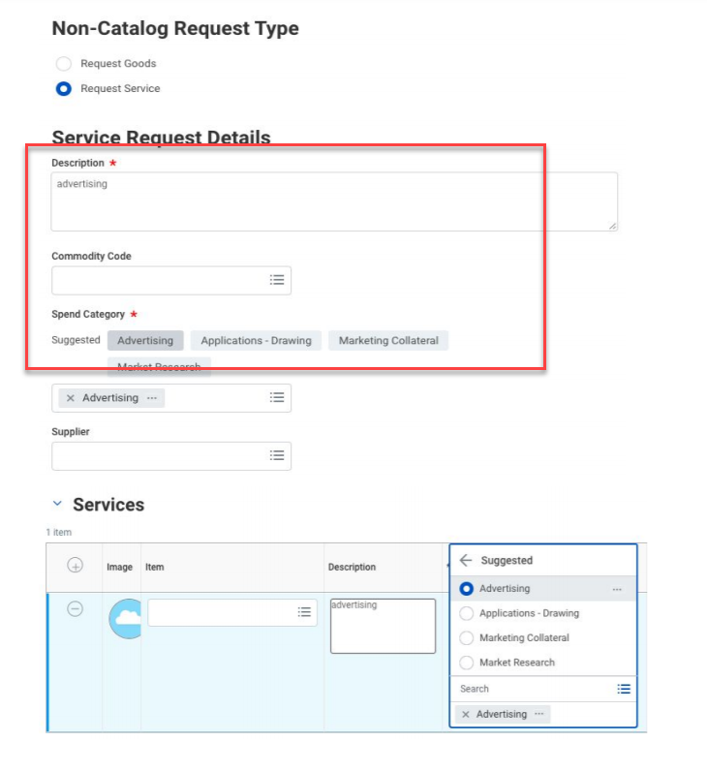

Workday Development Updates
The Spend Category Recommendation feature will support Requisitions only and applies state-of-the art natural language processing and prediction machine learning techniques based on supplier invoice data
21
Notes:
Debbie Flotteron

Slide 22
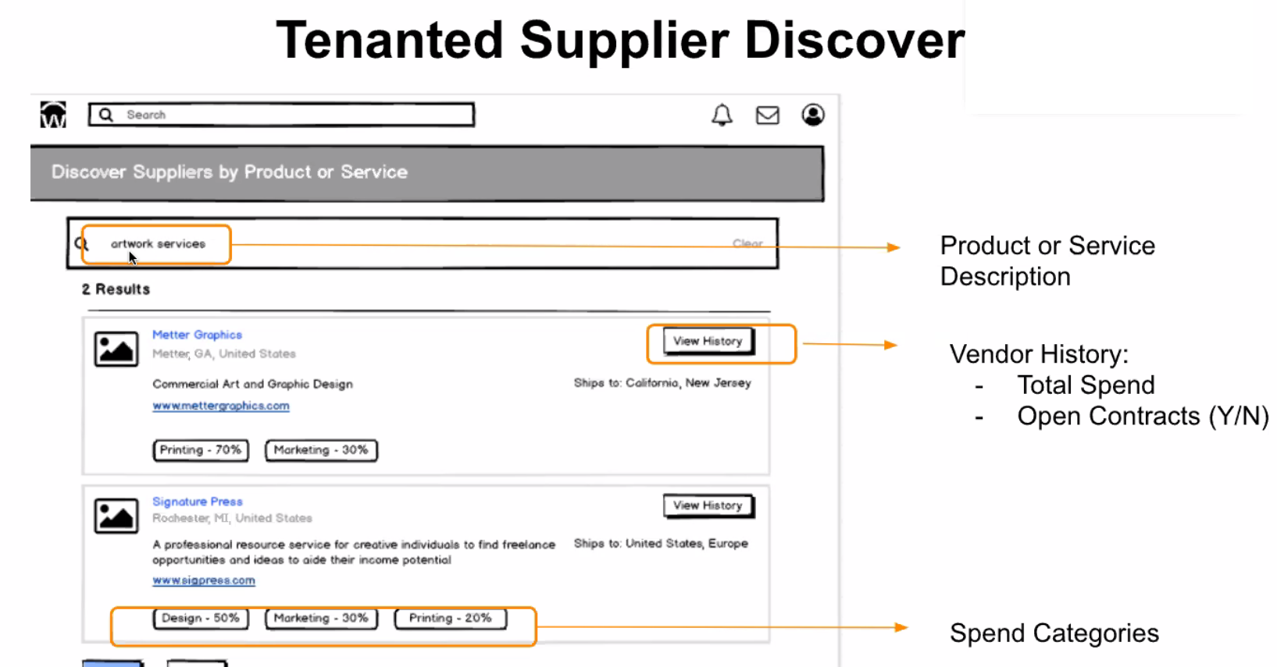
Workday Development Updates
Supplier Discovery is in early discussion development. A preview of this is below:
22
Notes:
Debbie Flotteron

Slide 23
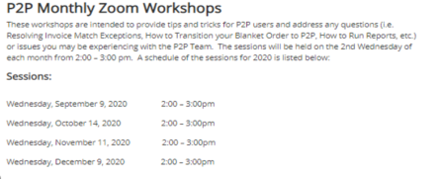
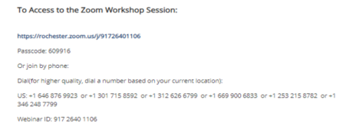

Monthly P2P Workshops
New P2P Zoom Workshops started in September and are held on the 2nd Wednesday of the month from 2 – 3pm. The workshops are intended to provide tips and tricks for P2P users and address any questions (i.e. Resolving Invoice Match Exceptions, How to Transition your Blanket Order to P2P, How to Run Reports, etc) The schedule and zoom access information can be found on the Training Website.
Next Workshop: December 9, 2 – 3pm
Topics:
Previewing the Supplier Record
Viewing Additional Details on Requisitions
What to do if Someone Leaves your Department
23

Slide 24

Super User Meeting
Next Meeting: January 5, 2021

