Slide 1

Procure to Pay Project
Tips and Tricks – How to tell which invoices still need receipts on a PO.

Slide 2
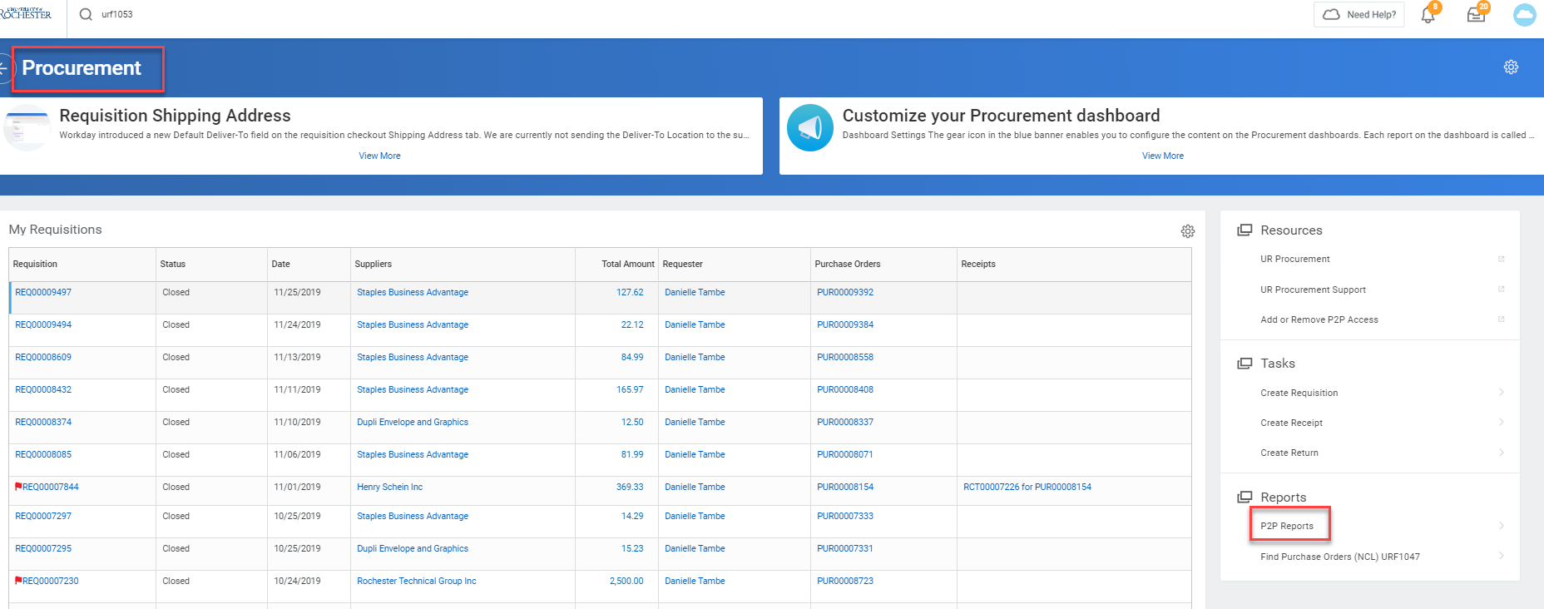
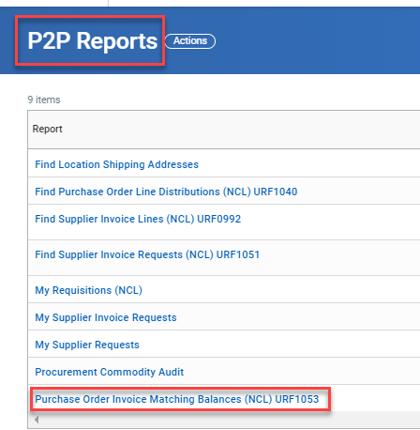
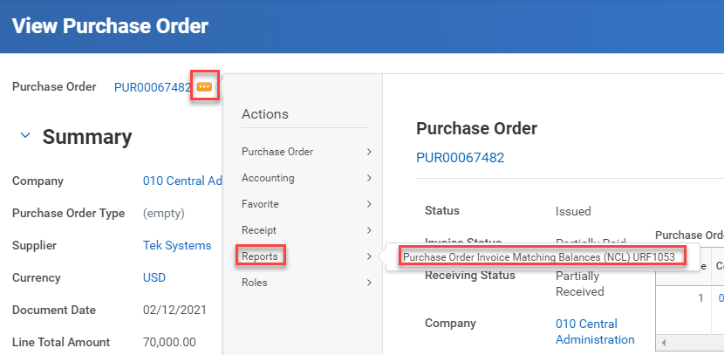
Tips and Tricks – How to tell which invoices still need receipts on a PO.
Some Purchase Orders will end up having a large number of invoices attached. It can be difficult to determine which invoices still require receipts so that matching can occur and invoices can get paid.
  There is a report that can be run to help determine which invoices still need receipts: URF1053 Purchase Order Invoice Matching Balances (NCL).
  This report can be accessed under P2P Reports on the Procurement Dashboard, off of the PO Actions, or by typing URF1053 in the global search bar.

Slide 3
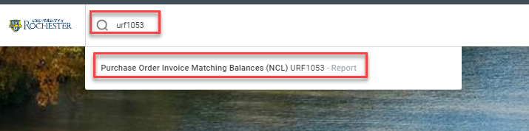
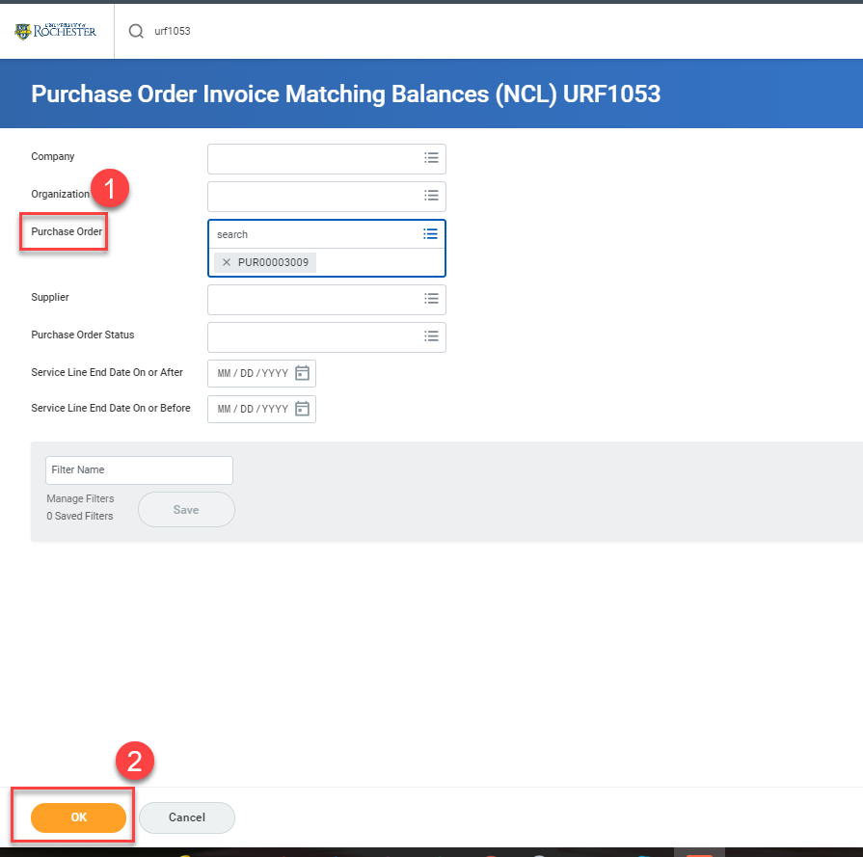
Tips and Tricks – How to tell which invoices still need receipts on a PO.
  If you type the report number in the global search bar, click on the report name when it appears.
Then fill in the Purchase Order number(s) that you wish to review.
Click OK to run the report.

Slide 4
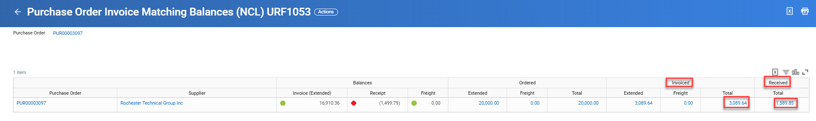
Tips and Tricks- How to tell which invoices still need receipts on a PO.
When the report runs you will see columns for the Invoiced amount on the PO and the Amount received. You can easily see if your invoiced amount matches your received amount.

Slide 5
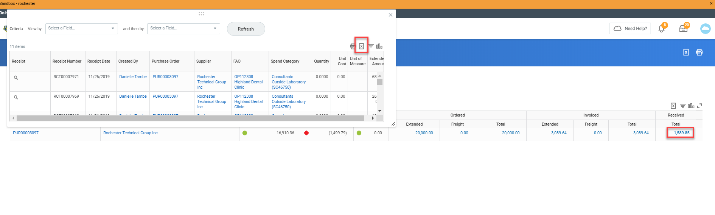
Tips and Tricks- How to tell which invoices still need receipts on a PO.
You can click on the blue numbers and open a window with details that you can export to Excel for easy comparisons. Click on the square with the X next to the printer icon to export the data.

Slide 6
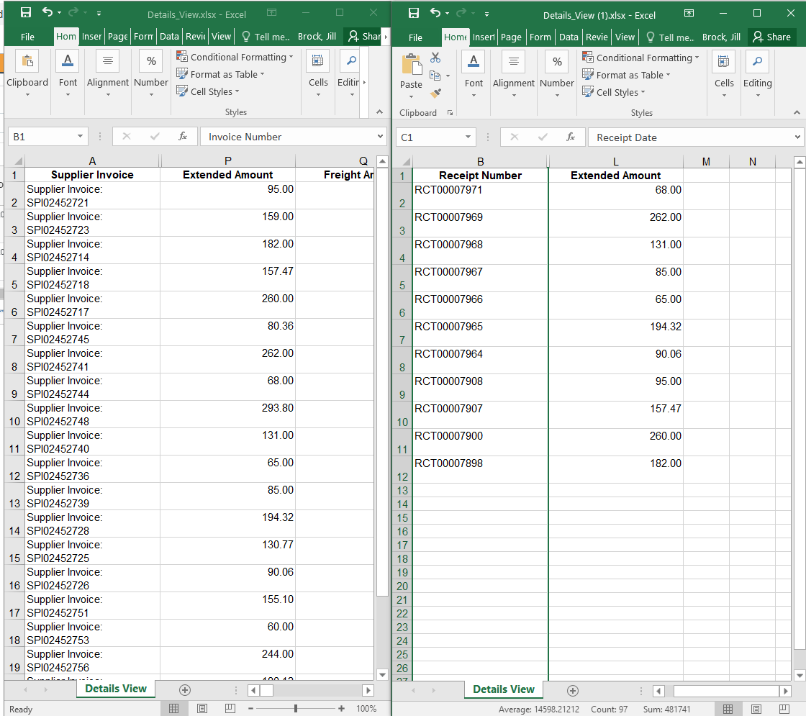
Tips and Tricks- How to tell which invoices still need receipts on a PO.
Once you have the spreadsheets side by side to compare you should be able to determine which invoices still require receipts.

Slide 7

Questions?

