Slide 1

Monthly P2P Workshop
June 2021 – Editing Transactions

Slide 2

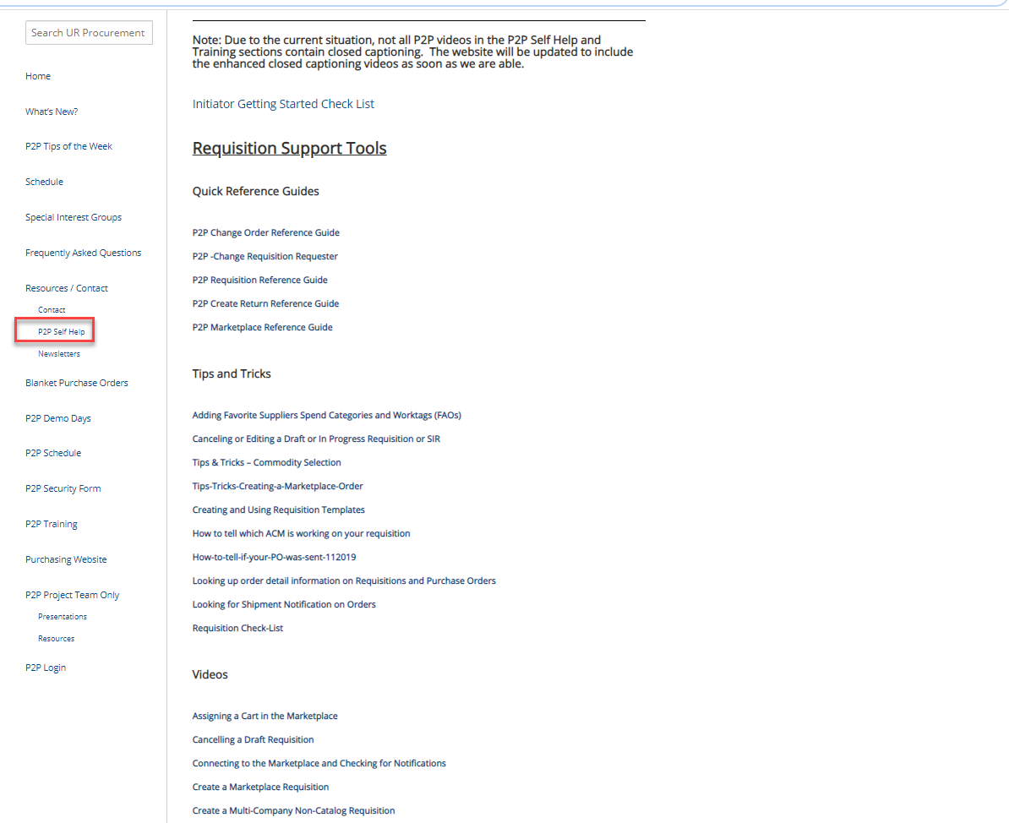
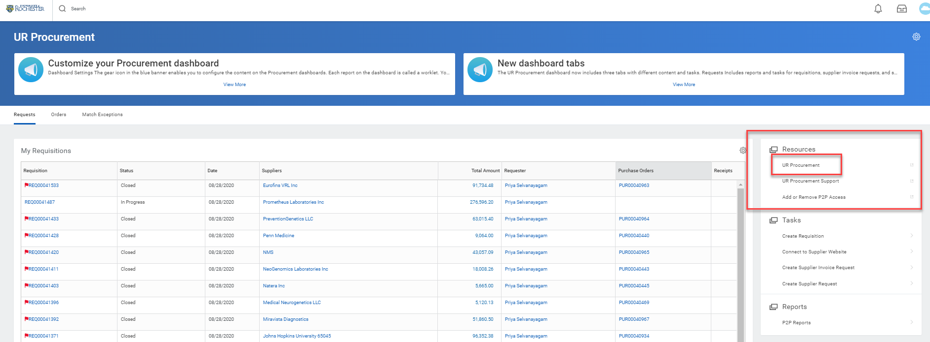
UR Procurement Website – P2P Self Help
Not sure how to create a catalog requisition, set a delegation or resolve an invoice match exception?
Visit the UR Procurement Website P2P Self Help Section. It provides Quick Reference Guides, Videos and Tips and Tricks to support your use of the P2P System.
You can also access the website from within Workday under the Resources section

Slide 3

June 2021 Monthly Workshop Topics
    Finding Transactions
    Editing Requisitions
    Editing SIRs
    Editing Pcard Transactions
    Receipts and Change Orders – Not Editable

Slide 4
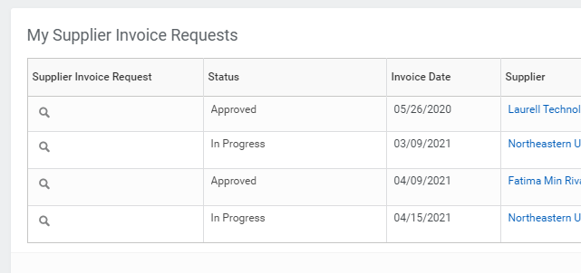
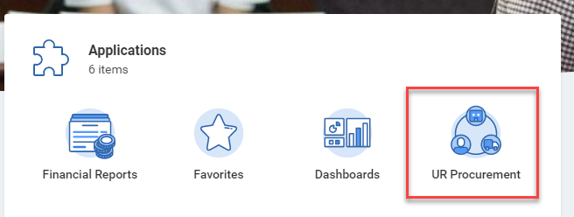
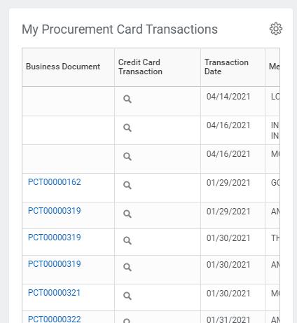
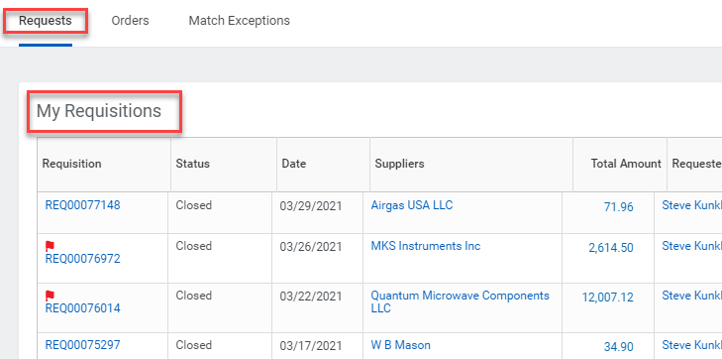
June 2021 Monthly Workshop Topics
Finding Your Transactions
A number of Worklets and Reports have been developed that will allow you to quickly locate your transactions.
In UR Procurement you have Worklets for Requisitions, Supplier Invoice Requests, and you can add a Worklet for your Pcard Transactions.

Slide 5
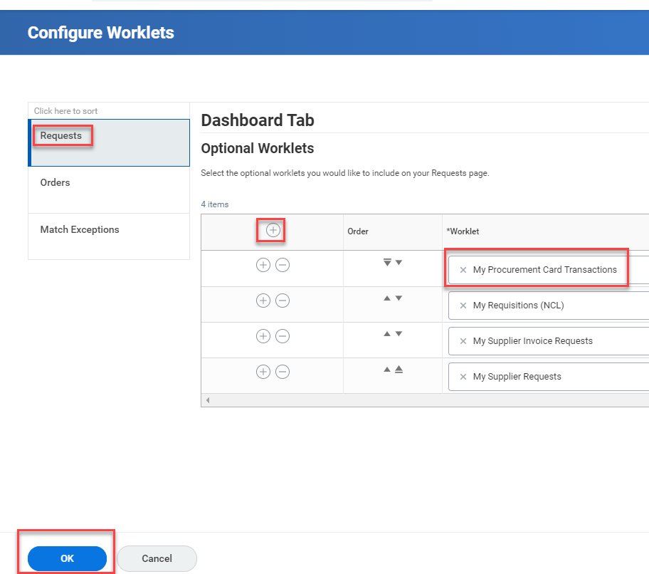
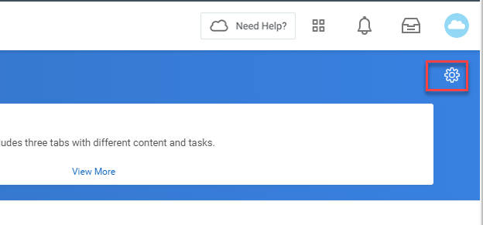
June 2021 Monthly Workshop Topics
If you wish to add My Procurement Card Transactions to your UR Procurement Dashboard, click the gear in the blue bar. In Configure Worklets be sure you are on the Requests Tab.
Add a Row by clicking the + sign and search for My Procurement Card Transactions.
Click OK.

Slide 6
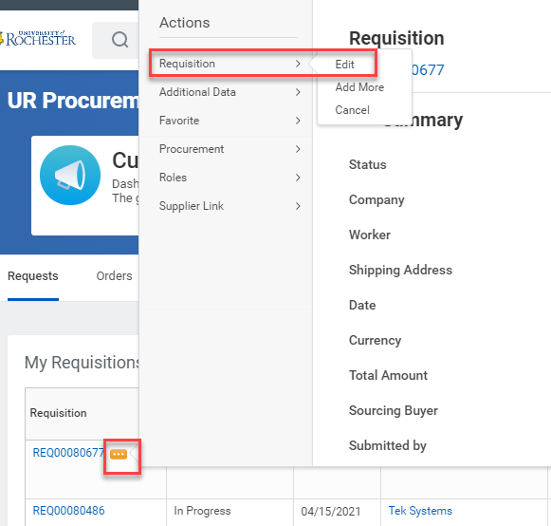
June 2021 Monthly Workshop Topics
Editing Requisitions
In order to Edit a Requisition you should find the My Requisitions Worklet, locate the number of the Requisition you wish to edit and hover over the blue number.
Click the Actions button that appears and when the window opens, hover over the word Requisition in the Actions column and select Edit.
You can do this anywhere you see a blue requisition number. If you know the number you can type it in the global search bar and hit enter, then click Procurement. You can also do this off of a report.

Slide 7
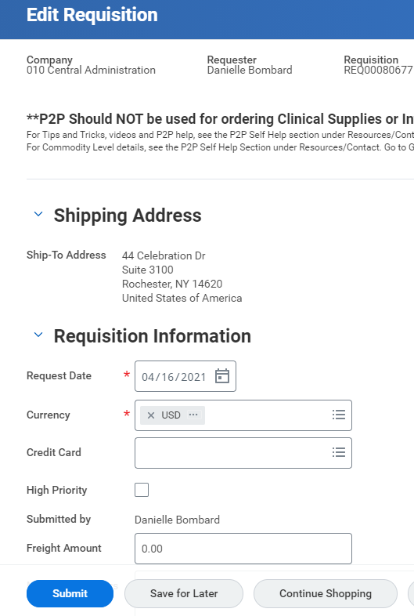
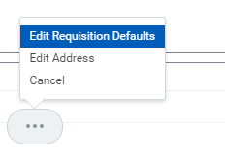
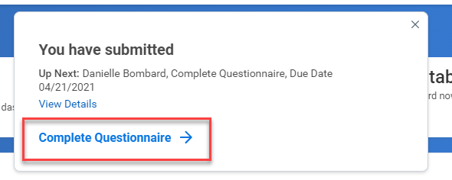
June 2021 Monthly Workshop Topics
Editing Requisitions
You can change anything on an In Progress or Draft Requisition. Please keep in mind that if you edit an In Progress requisition the transaction goes back to the beginning and will have to be approved by all approvers once again.
To edit the address or default Worktags for all lines, click the button with three dots at the bottom of the screen.
When your changes are complete, click Submit.
The system will route you to the questionnaire(s) again and all of your answers will still be there. If nothing has changed, just click Submit.

Slide 8
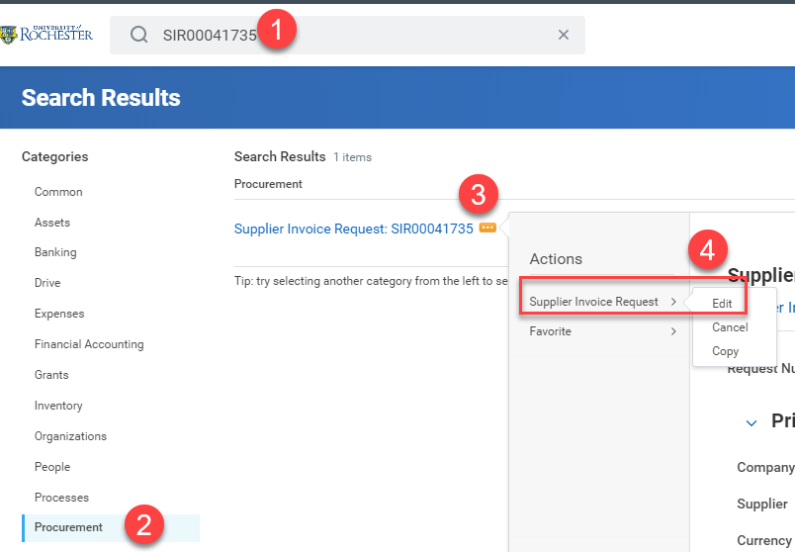
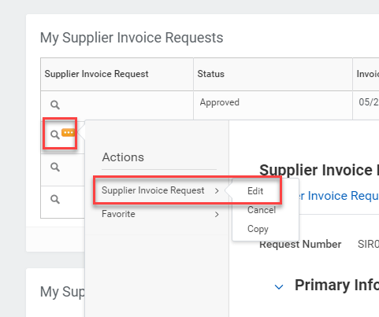
June 2021 Monthly Workshop Topics
Editing a SIR (Supplier Invoice Request)
Editing a SIR is possible for a Draft or In Progress SIR in same way as a Requisition. If a SIR is Approved, you must contact Accounts Payable for any changes.
On the Worklet hover over the magnifying glass to get the Actions button to appear.
You can also search for the number in global search bar or find it on a report. Any blue link is active and will have an Actions button available.

Slide 9
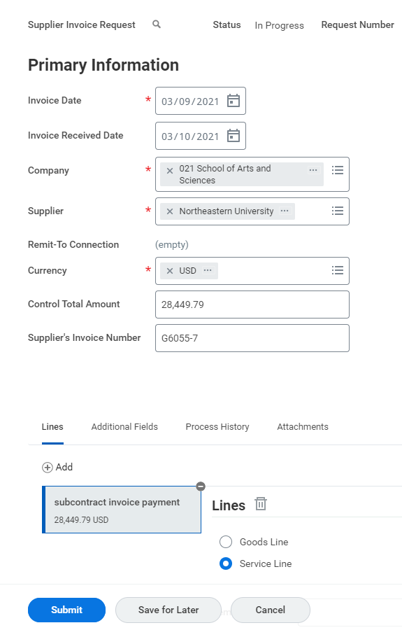
June 2021 Monthly Workshop Topics
Editing a SIR (Supplier Invoice Request)
Just as with a Requisition, you can change anything when you edit a SIR.
When your changes are complete you click Submit and you will be routed to the questionnaire(s). You can change answers or simply click Submit again.
Editing will bring the transaction back to the beginning and will require approval again.

Slide 10
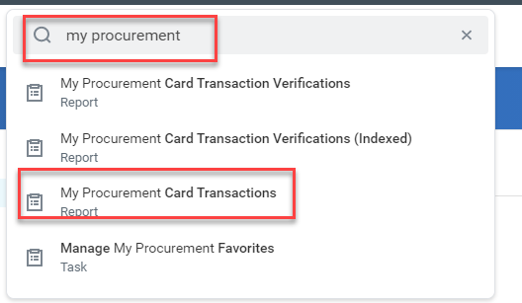
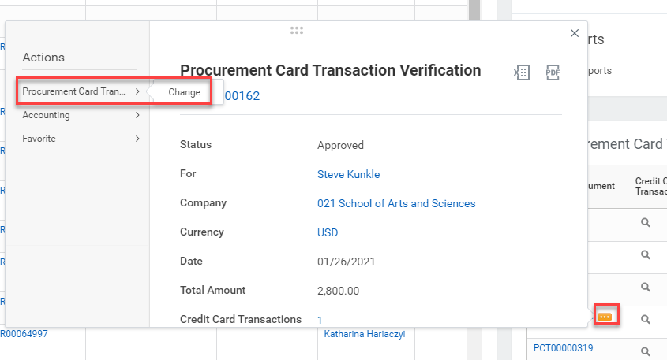
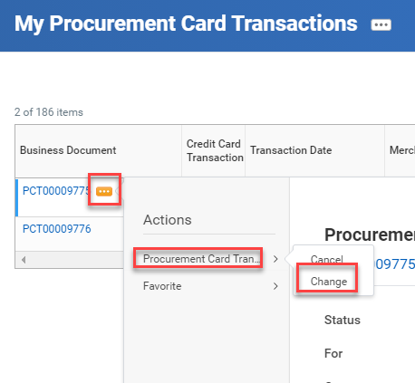
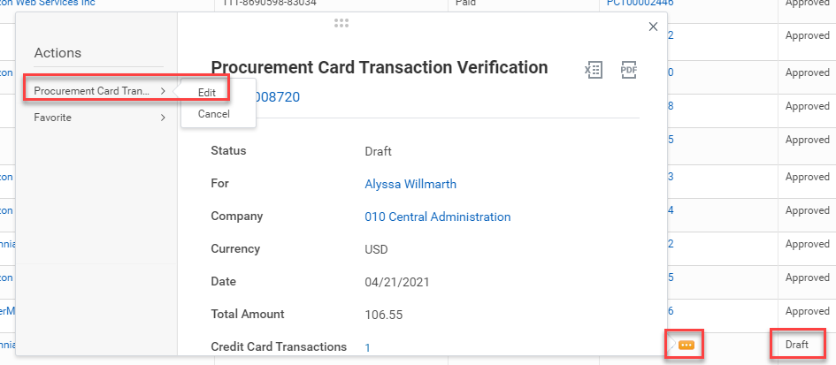
June 2021 Monthly Workshop Topics
Editing a Pcard Verification
You can access a Draft or In Progress Pcard Verification by running the My Procurement Card Transactions report, or by finding the PCT number on your My Procurement Card Transactions Worklet. If a transaction is in Draft status you will have the option to Edit instead of Change.
With Pcard transactions you can edit Approved or Paid transactions.

Slide 11
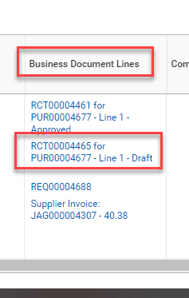
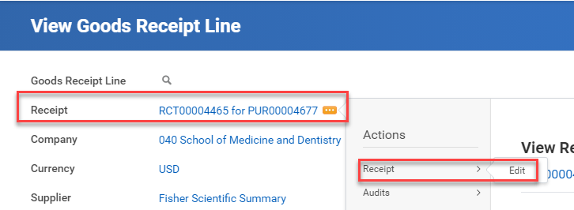
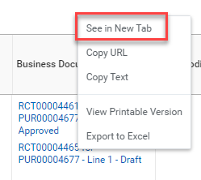
June 2021 Monthly Workshop Topics
Change Orders and Receipts
Some people have security settings that allow them to edit Receipts. Many people do not have that ability.
To see if you have the ability to edit receipts find the Business Documents Line column on your Purchase Order line.
Locate the Draft Receipt and right click to See in a New Tab.
Hover over the blue RCT number and click the Actions button. Under Actions hover over the word Receipt. If you have the ability to Edit, the word will appear. Click on Edit to edit and fully submit your Receipt.

Slide 12
June 2021 Monthly Workshop Topics
If you do not have the ability to Edit a Draft Receipt you will need to contact the P2P Service Center and have the receipt canceled. Draft Receipts will prevent you from properly doing receipts to resolve Match Exceptions. If you have a Match Exception notice for receipts, but you don’t have the option of creating a receipt, you have a draft receipt on your Purchase Order that will need to be Edited or Canceled.
You can call 275-2012 or send an email to procurement_service_center@ur.Rochester.edu and ask to have the receipt canceled. Please provide the Receipt number and the Purchase Order number.
Draft Change Orders cannot be edited. If you have a Draft Change Order you must contact the P2P Service Center to cancel the draft.

Slide 13
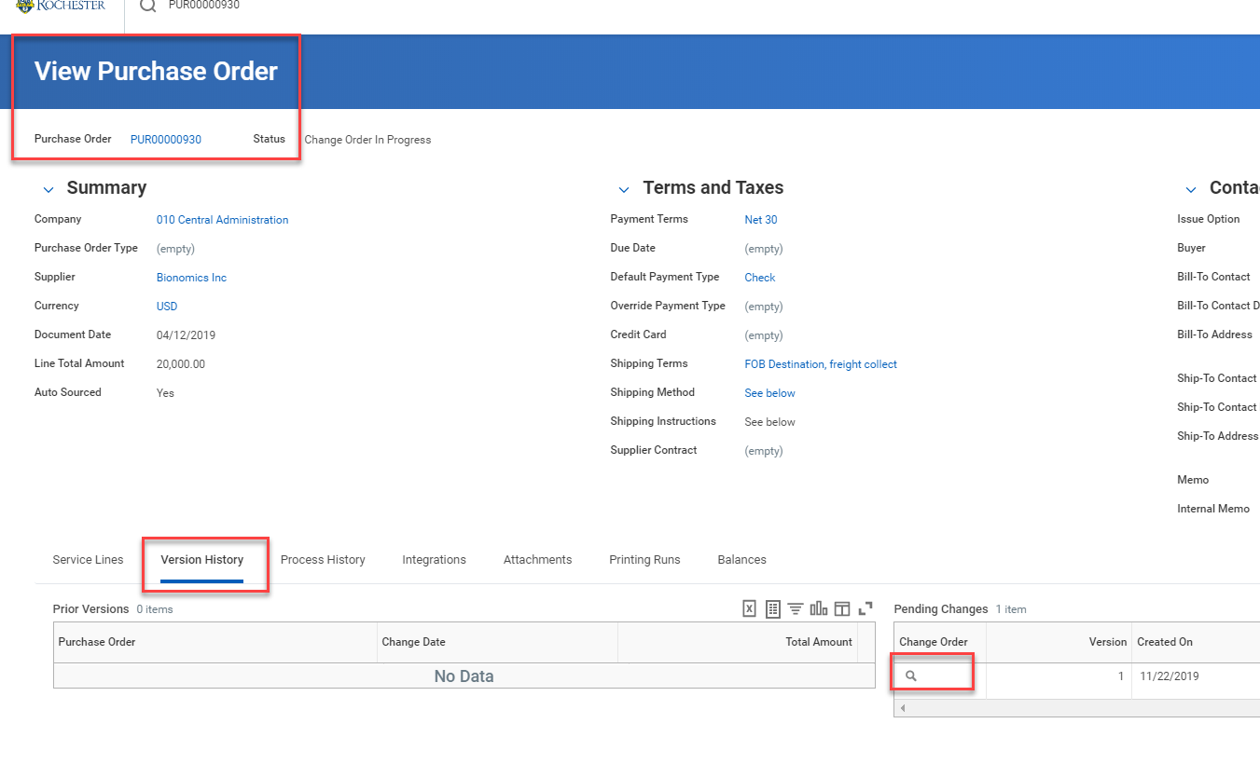
June 2021 Monthly Workshop Topics
Draft Change Orders
Finding a Change Order is a little tricky, but you can see the status if you know where to look.
Locate your Purchase Order via a Worklet or a Report and click on the blue number to get to the View Purchase Order Screen. From there click on the Version History tab and view the status of your Change Order under Pending Changes.
If the status of the Change Order says Draft, you will need to have the P2P Service Center cancel the draft and you will have to redo the Change Order.

