Slide 1

P2P User Group
July 6, 2021
Notes:
Jim Dobbertin – Introduction and Kick Off

Slide 2

Topics
User Feedback
P2P Updates
P2P Tips
What Do You Think?
Workday Future Enhancements
P2P Reminders
Marketplace Updates
P2P Monthly Workshops
P2P Website Updates
2
Notes:
Carl Tietjen and Liz Milavec

Slide 3


P2P Users
What is working well?
Suggestions for Improvement
3
Notes:
Debbie Flotteron

Slide 4

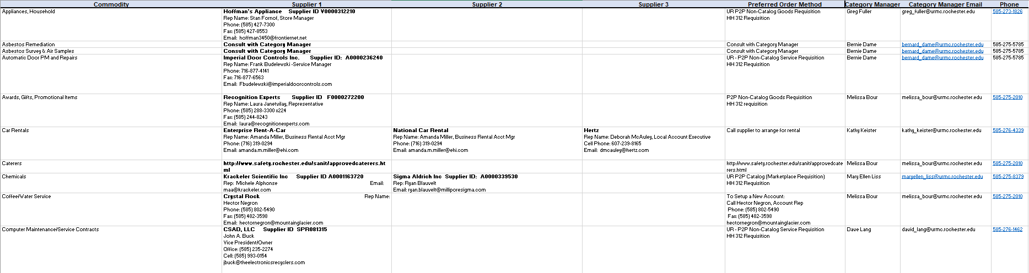
P2P Updates
Buying and Paying Guide
The Buying and Paying Guide has been updated to include a Commodity and Preferred Supplier listing. This tab includes the commodity, preferred suppliers with the Workday Supplier ID and contact information as well as the preferred procurement method. If you do not find a commodity and need further assistance, please contact the P2P Service Center.
4

Slide 5
P2P Updates
Jaggaer Upgrade—July 25th
The Jaggaer (Marketplace) Upgrade will occur on July 25, 2021 - Some changes will occur in the look of the shopping dashboard. In addition, the suppliers who provide Advanced Shipping Notifications will now offer a downloadable version. Additional details regarding these changes will be provided in the upcoming weeks.
5

Slide 6

P2P Tips
Create Supplier Request Task
The Create Supplier Request task should only be used for new SIR supplier requests. If you need to request a new requisition supplier, consider contacting Purchasing to assist with identifying an existing qualified supplier or to work with you to qualify a new supplier.
Receipts in Draft Status
Receipts left in draft status may cause delays when invoices need to get paid. Please look at the Business Documents Line column on your POs to check for draft receipts. Contact the P2P Service Center to have them cancel the draft receipts.
Viewing Capital Requisitions
If you have created a requisition that is for a Capital Project the FAO may get changed to a PR FAO you do not have visibility to. You can still see the requisition by running the non NCL version of the My Requisitions report. However, the process history of the document may not be visible. If this happens, please contact the P2P Service Center and explain you no longer have access to the process history because the FAO has been changes. The P2P Team can give you an update as to where the requisition is in the approval process.
6

Slide 7
P2P Tips
Editing SIRs and Requisitions
When viewing Requisitions and SIRs on your UR Procurement Dashboard please be very careful not to select Edit unless you truly mean to edit the document. It is easy to click the actions button and select edit by mistake. If you edit an In Progress requisition or SIR it will return the document to a draft status and when you click submit the document will have to go through all of the financial approvals again. If you have clicked Edit by mistake, the P2P Service Center cannot undo that action. The document will have to be approved again.
7

Slide 8
P2P Tips
Default Browser
Jaggaer, the company that hosts our Marketplace, no longer supports the version of Internet Explorer used by the University. If you cannot connect to the Marketplace, please switch to Chrome, Edge, Firefox, or Safari. If I.E. is your default browser this can be reset via your computer settings. If you do not have the security to change this setting, please ask your department I.T. support person to assist you.
8

Slide 9

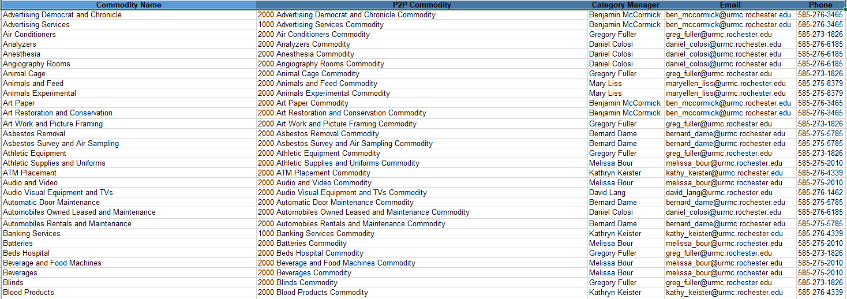
What Do You Think?
Change OrdersXh13
Would the following commodity listing be helpful in the Buying and Paying Guide?
9

Slide 10

P2P Reminders
Reminders:
Patient-Care/Clinical Supply items (i.e. Medline) should not be processed in P2P. You should continue your current ordering methods outside of P2P.
The only 312 requisitions you should be submitting to Purchasing are for 3rd party leases (i.e. Banc of America, Pantheon) or patient care/clinical supply items. All other requisitions should be submitted via P2P.
The only SOLO orders should be for RR Donnelly and Medline. All other SOLO supplier orders should be done in the P2P Marketplace.
F4 Forms should no longer be submitted to Accounts Payable except for Human Subject Payments and multi-company requests. Departments should submit a SIR via P2P instead.
10

Slide 11
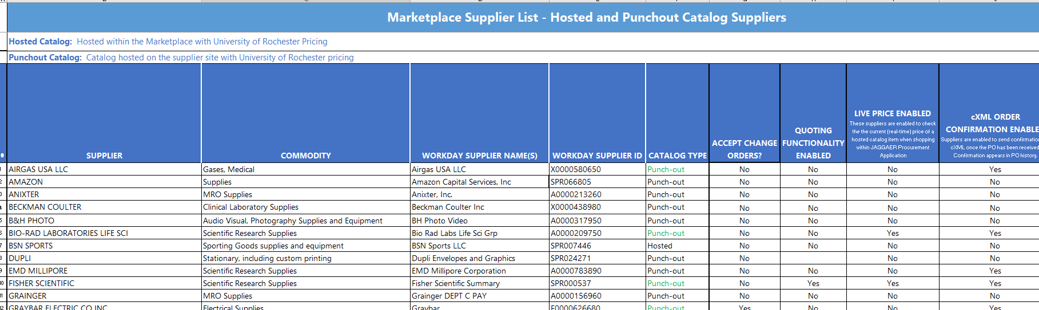
Marketplace Status
30 Live Catalogs in the Marketplace
A listing of all current supplier catalogs can be found in the Buying and Paying Guide
Supplier Catalog in Progress
Audio Video Corp
Supplier Catalogs On Deck
Thorlabs
Newport Corporation
Edmund Industrial Optics
Horizon Discovery Biosciences Limited (Dharmacon)
11

Slide 12

Monthly P2P Workshops
Next Monthly Workshop; July 14 2 – 3pm
To access the workshop utilize the following link:
https://rochester.zoom.us/j/91726401106
Passcode: 609916
July Workshop Topic:
Viewing Supplier Invoices
August Workshop Topic:
How to Resolve Invoice Match Exceptions
12

Slide 13

UR Procurement Website
Recent updates to the UR Procurement Website:
Buying and Paying Guide
We welcome feedback on how we can better support you and organize the content
13

Slide 14

Super User Meeting
Next Meeting: August 3, 2021

