Slide 1

Procure to Pay Project
Tips and Tricks – Creating a Marketplace Order.

Slide 2
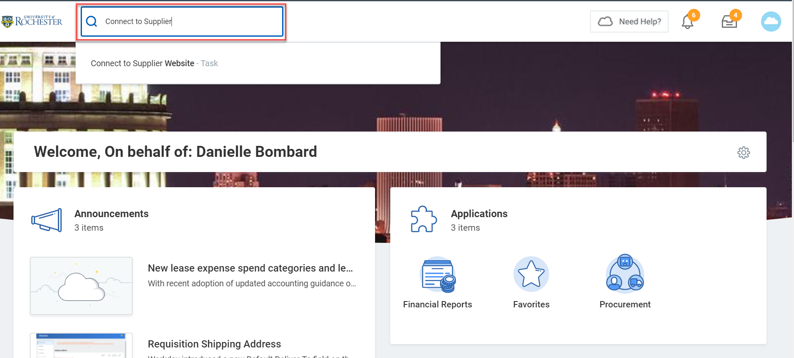
Tips and Tricks – Creating a Marketplace Order
From the Home page type “Connect to Supplier” in the Global Search box and select Connect to Supplier

Slide 3
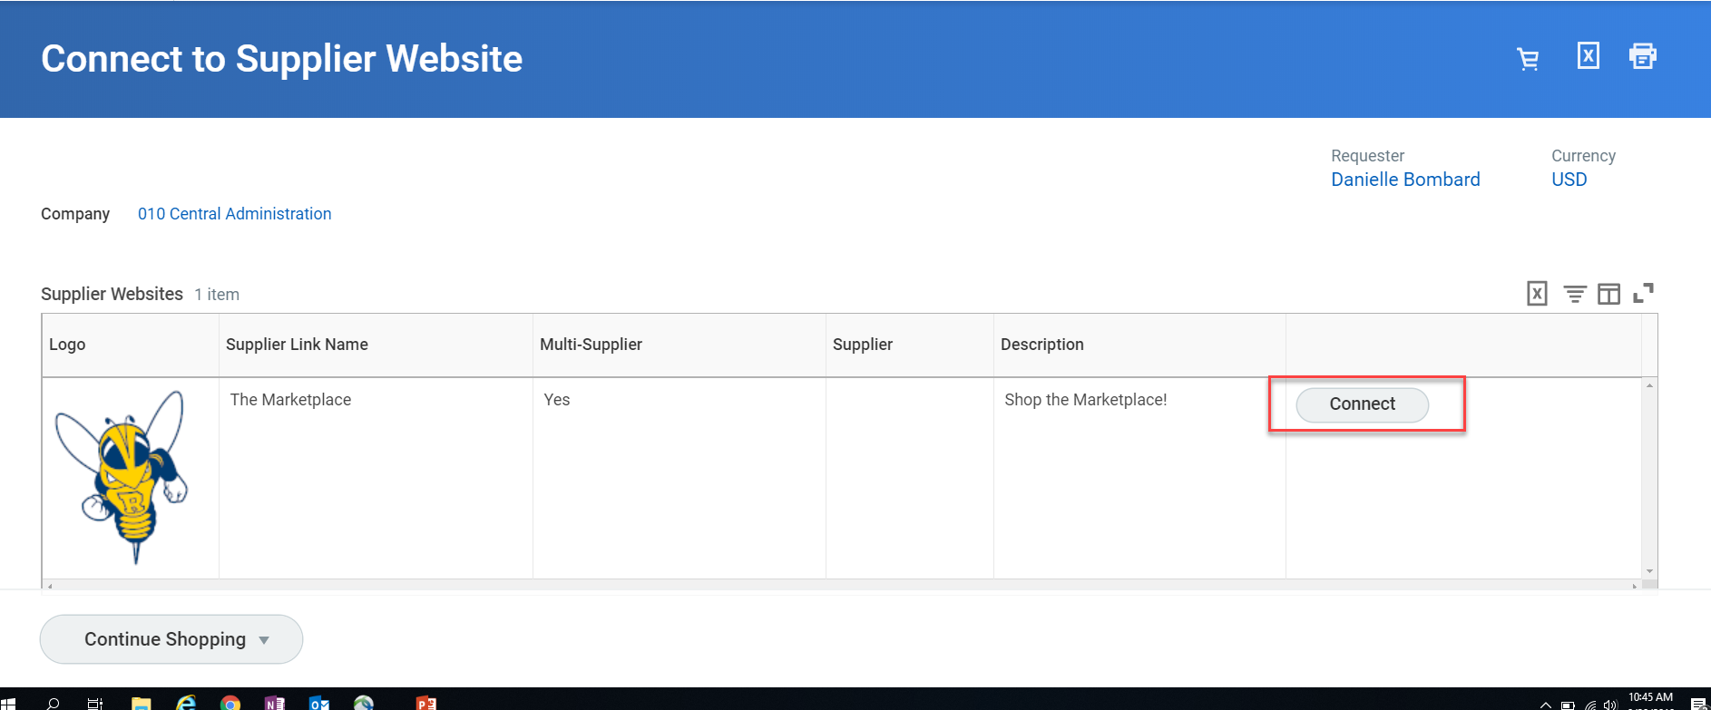
Tips and Tricks – Creating a Marketplace Order
Select “Connect”. This will take you out of Workday and into the Marketplace.

Slide 4
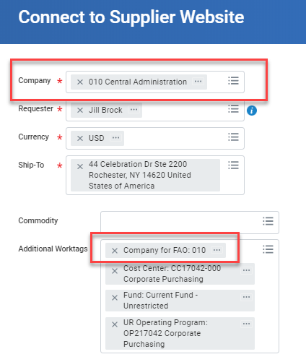
Tips and Tricks – Creating a Marketplace Order
Shipping Address
If you need a different ship-to address, you can search by Building or Street name.
Do not use an Alternate Address on Marketplace suppliers.
If you do not have a default Ship-To address automatically populating, reach out to the P2P Service Center at 275-2012 to request having one assigned to your account. You can always override it but having a default is a time-saver. Also reach out to the P2P Service Center is you have trouble locating your address.
A commodity is not required for Marketplace orders.
Type in your FAO number (Worktag) in the Additional Worktags field and hit enter. Confirm your company matches the company tied to the FAO. If you must change the company, do it in the top box, not in the Additional Worktags box.
When complete, hit OK at the bottom of the screen.

Slide 5
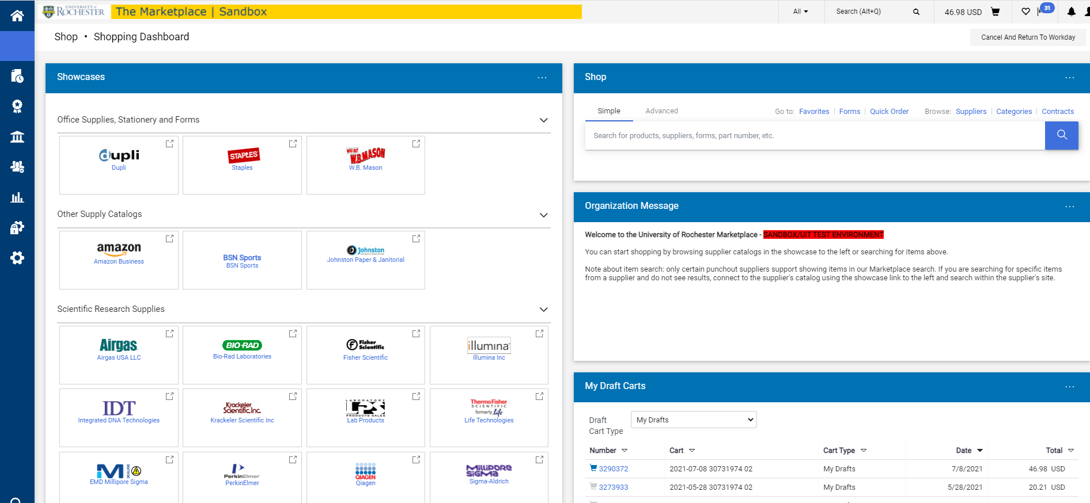
Tips and Tricks-Creating a Marketplace Order
The Marketplace is where to find a list of catalog suppliers that are set up by their commodity. Here you can view Punchout and Hosted Catalogs.

Slide 6
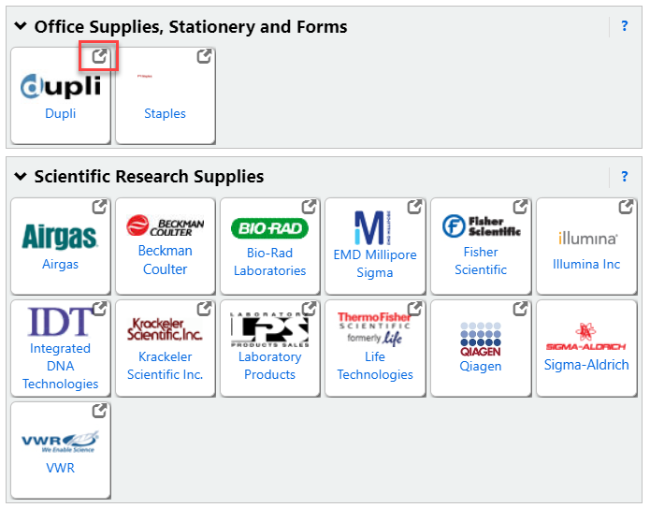
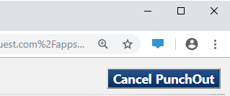
Punchout Catalogs
Suppliers with Punchout Catalogs will have “punchout” symbol in the upper right hand corner of their stamp.
Selecting a Punchout Supplier will redirect you to the suppliers website.
If you choose the wrong Punchout, click Cancel Punchout at the top to return to the Marketplace.
Don’t use the browser back button.
Notes:
Use the Buying & Paying Guide to determine which commodities are purchase from which Supplier and the catalog type (Hosted or Punchout).
Most of our Suppliers will be set up as a Punchout Catalog. The catalogs will look the same as the current SOLO Supplier websites, but they will all be launched from the Marketplace. Mostly like you are using favorite to keep track of the Suppliers web sites.
If you choose the wrong Punchout, click Cancel at the top to return to the Marketplace.
Don’t use the browser back button!

Slide 7
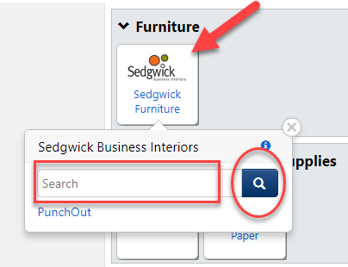
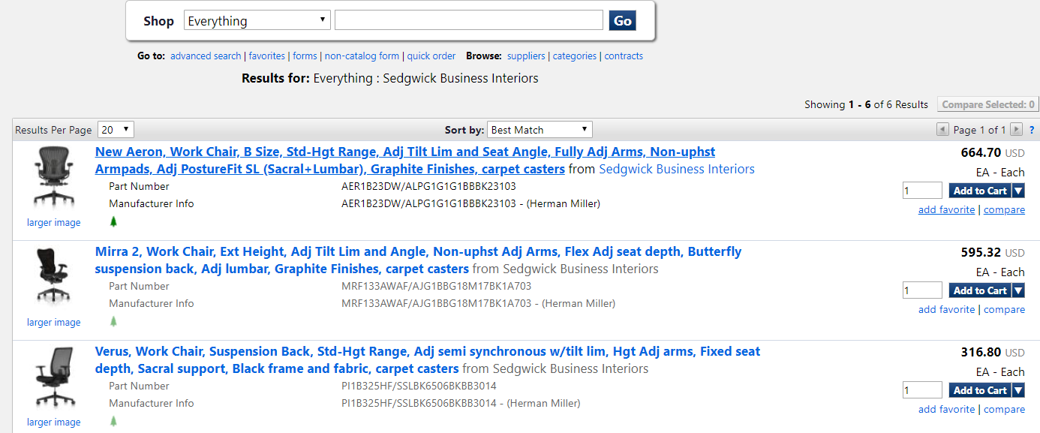
Hosted Catalogs
Hosted Catalogs are suppliers that have their products hosted in the Marketplace. You will not be redirected to the supplier’s website.
Notes:
Start with the Hosted catalog, notice whichever hosted supplier you choose, the blue navigation bar will be on the left side with the University of Rochester logo at the top.

Slide 8
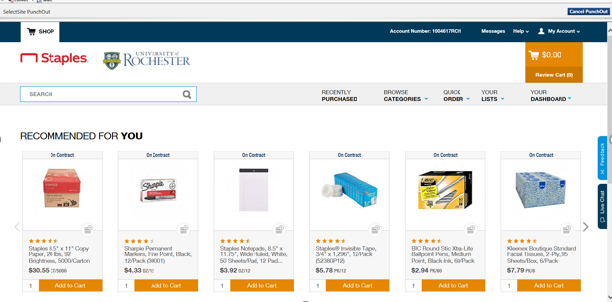
Tips and Tricks- Choosing A Commodity on A Non-Catalog Requisition (cont’d)
Choosing a Punchout Supplier will take you to the supplier’s website where you will be able to select items to order.

Slide 9
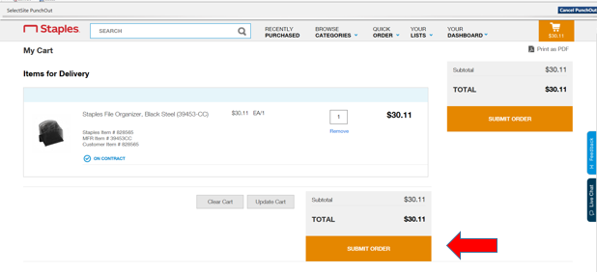
Tips and Tricks – Creating a Marketplace Order
Once your order is complete, “Submit Order” and it will return you to the Marketplace homepage.

Slide 10
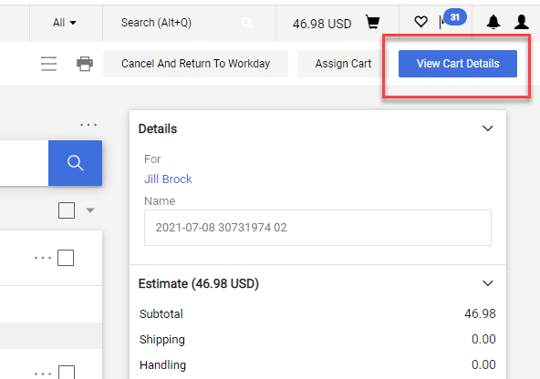
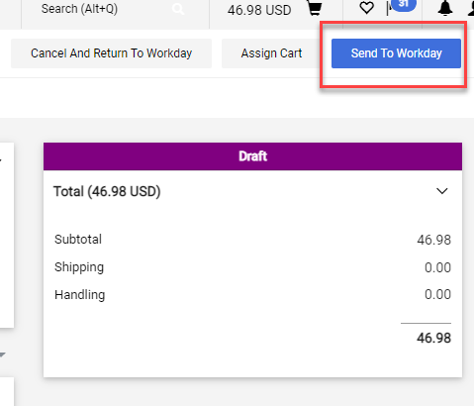
Tips and Tricks – Creating a Marketplace Order
This is the final review of your order before you send it to Workday. Select “View Cart Details”.
Select “Send to Workday” to exit the Marketplace and complete the checkout process in Workday.

Slide 11
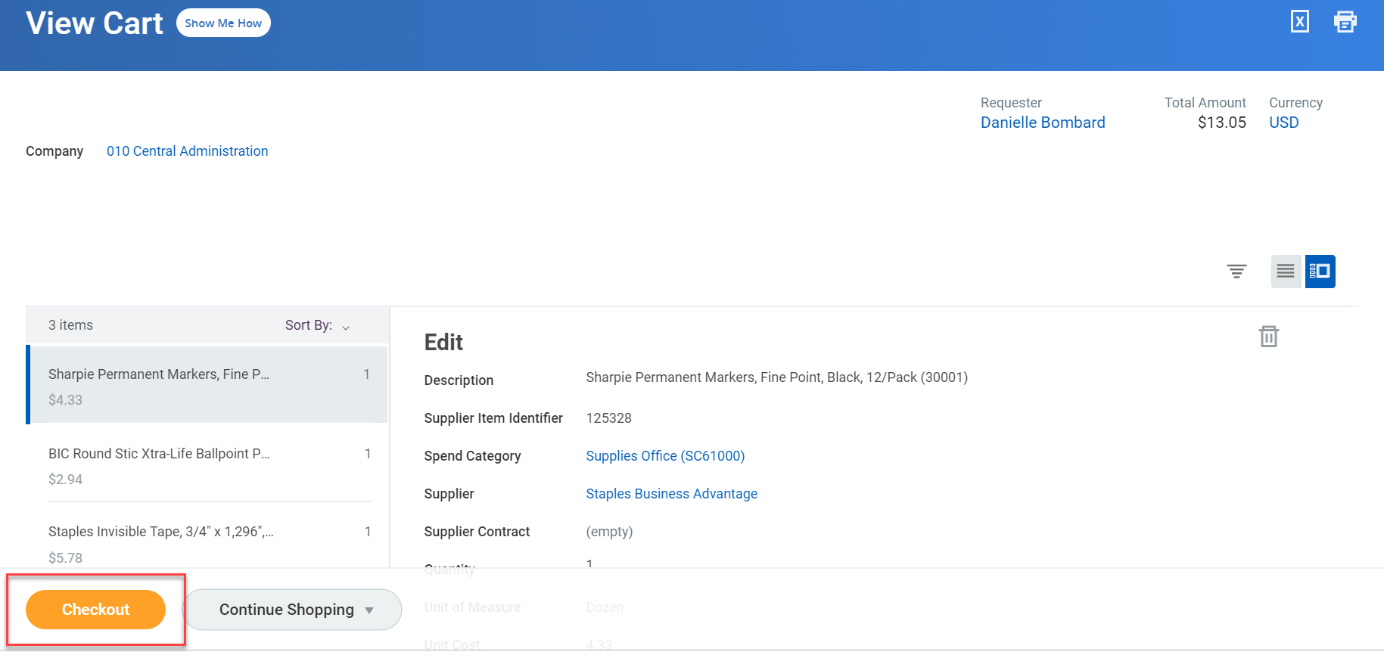
Tips and Tricks – Creating a Marketplace Order
Once back in Workday you will complete the process by selecting “Checkout”.

Slide 12
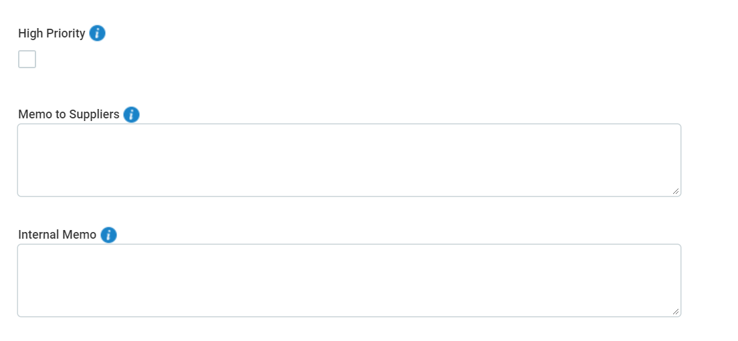
Tips and Tricks – Creating a Marketplace Order
Information
Here you will be able to set your order to rush by clicking on “High Priority” box (additional fee may be required)
Memo to Suppliers in the marketplace will not see the memo field because this is an electronic transaction.
Internal Memo field will be visible to approvers or Procurement, but will not be on the PO

Slide 13
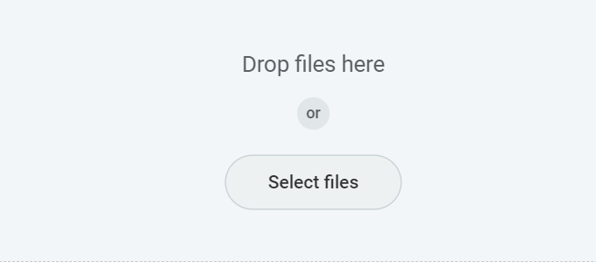
Tips and Tricks – Creating a Marketplace Order
Attachments
You may need to provide an attachment if your area requires it, such as a Capital Requisition Data Sheet.
Most Marketplace orders <$50,000.00 do not require an Attachment.
If an order is for $25,000.00 or more you will be routed to the SSPJCI questionnaire after submitting your requisition in Workday.
.msg files are not supported as external attachments. If you need to attach an email please make sure it is not set as an external attachment.
A document, such as a quote can be uploaded on this page by clicking on “Select Files” and clicking on applicable document

Slide 14
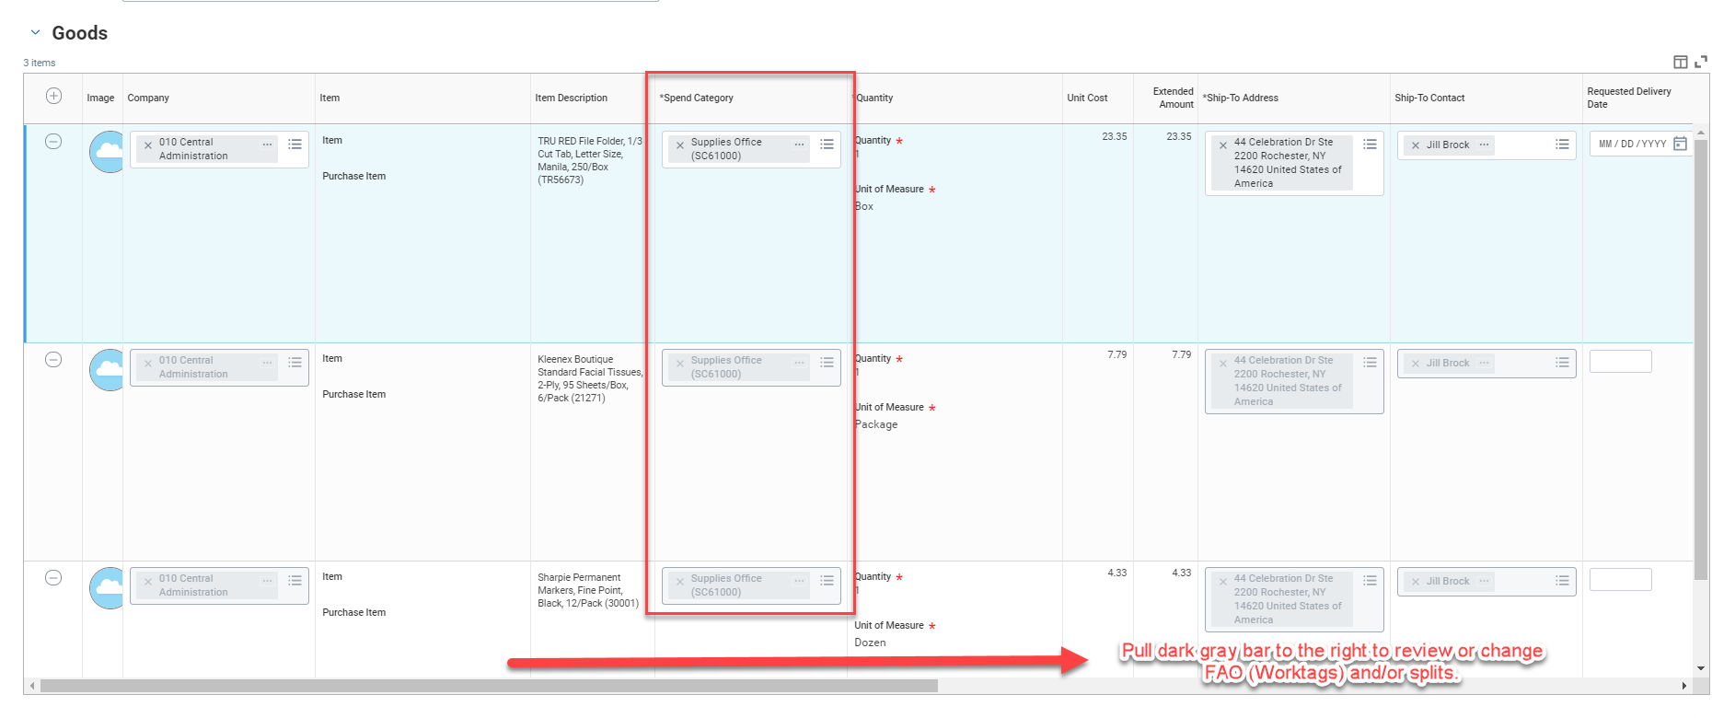

Tips and Tricks – Creating a Marketplace Order
Make sure to check all of your lines for correct spend categories. Not all Marketplace items will return one. Fill them in or correct them as needed.
Pull the bottom bar to the right to add splits or change FAO information.
Hit submit when completed and fill out the questionnaire.

Slide 15
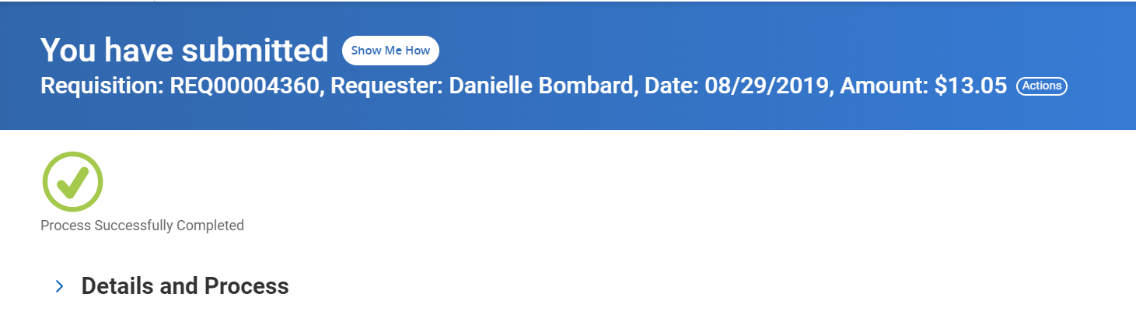
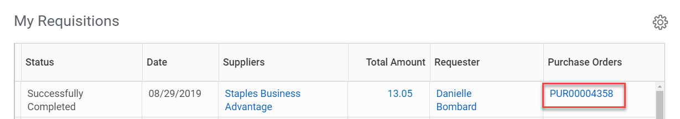
Tips and Tricks – Creating a Marketplace Order
Success!!
Now you can view the PO# in your Procurement Dashboard in the “My Requisitions” table.

Slide 16

Questions?

