Slide 1

P2P User Group
August 3, 2021
Notes:
Jim Dobbertin – Introduction and Kick Off

Slide 2

Topics
User Feedback
P2P Updates
Pcard Updates
P2P Tips
What Do You Think?
P2P Reminders
Marketplace Updates
P2P Monthly Workshops
P2P Website Updates
2
Notes:
Carl Tietjen and Liz Milavec

Slide 3


P2P Users
What is working well?
Suggestions for Improvement
3
Notes:
Debbie Flotteron

Slide 4

P2P Updates
Jaggaer Upgrade
On July 25, 2021 Jaggaer performed the 21.2 system upgrade. The Marketplace will look slightly different now. The stickers for the various supplier websites are larger, but are in the same order as prior to the upgrade.
4

Slide 5
P2P Updates
Jaggaer Upgrade
There are also difference in the view of shopping cart processing. While the same buttons exist (View Cart Details and Send to Workday) they are in a slightly different location. Instead of appearing to the right of the cart information, the buttons are now located above the cart information.
5

Slide 6
P2P Updates
Jaggaer Upgrade
The Marketplace Reference Guide and Creating a Marketplace Order Tips and Tricks have been updated with new screenshots to reflect the updated look.
Both of these guides are available under P2P Self Help/Requisition Support Tools.
https://www.rochester.edu/adminfinance/urprocurement/p2p-resources/
6

Slide 7
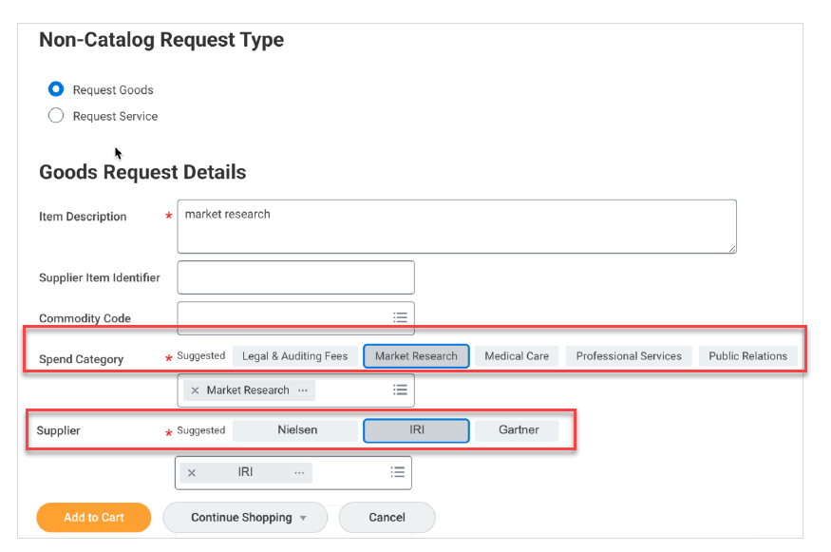
P2P Updates
Workday Supplier Discovery Functionality
We are continuing to partner with Workday on the Supplier Discovery functionality that has the capability to suggest potential suppliers and/or spend categories when creating a requisition. Additional testing and development is on going.
Your thoughts and feedback are welcomed!
7

Slide 8
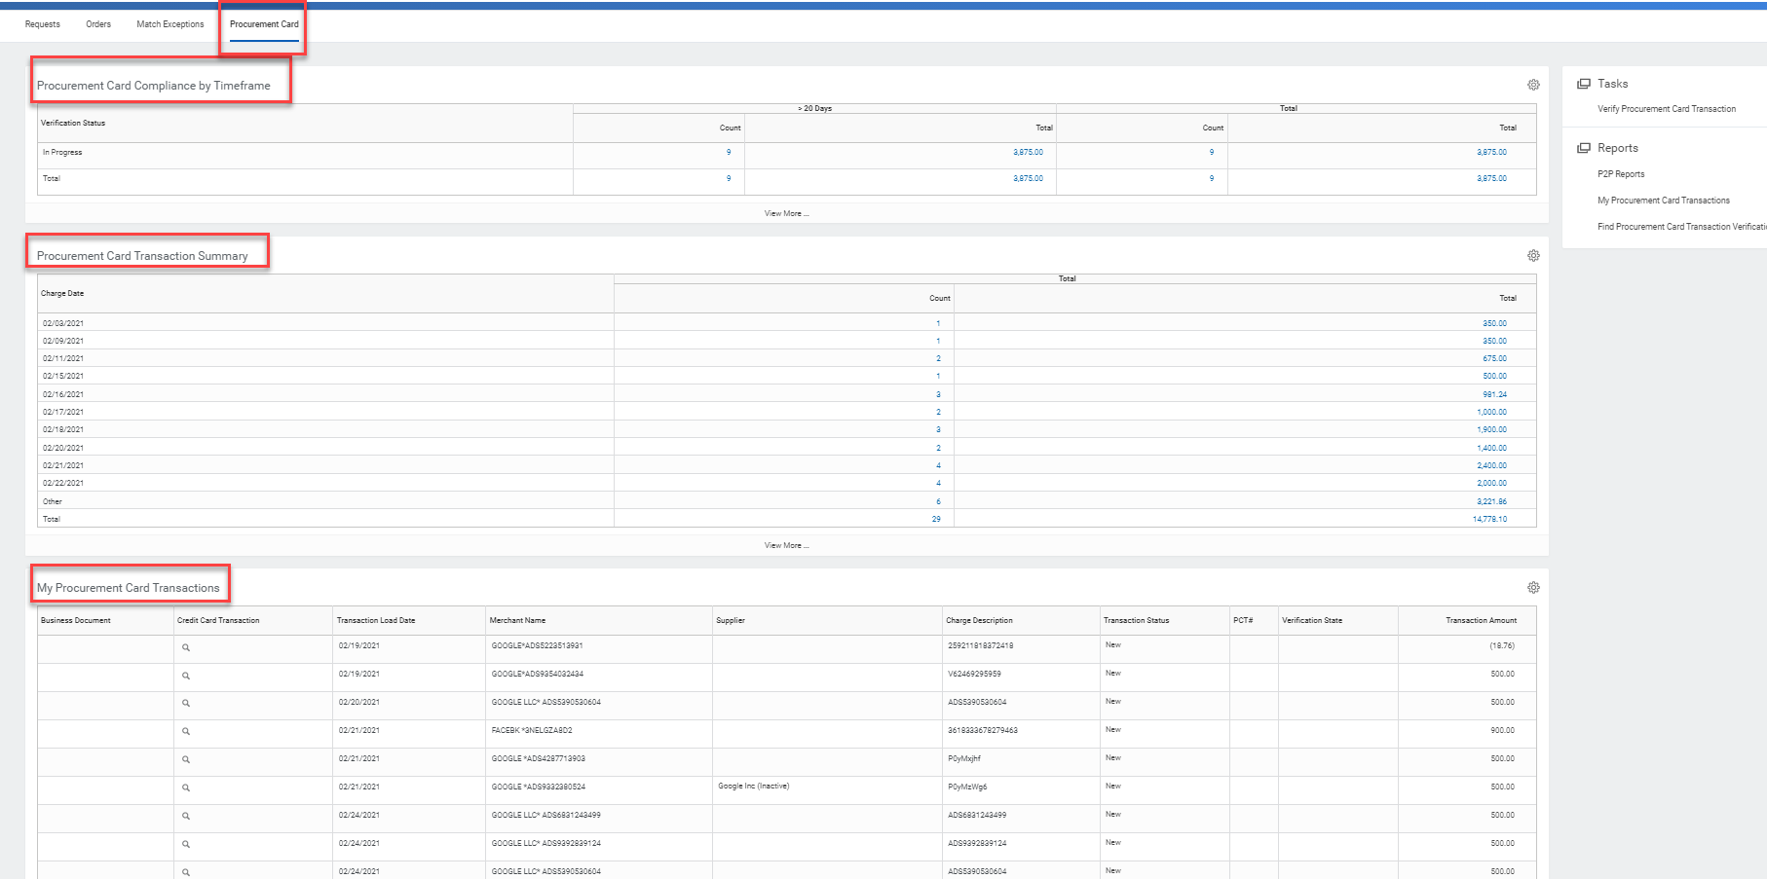
P2P Pcard Updates
A new Pcard Dashboard is being developed to provide visibility to pcard transactions.
Transactions >20 Days nearing the 30 day window for approval compliance
Procurement Card Transaction Summary
My Procurement Card Transactions
We welcome your feedback!
8

Slide 9

P2P Tips
Requisitions with Progress Payments
If you have a quote from a supplier that identifies progress payments (i.e. 50% upon PO and 50% upon delivery), you will need to make sure your requisition is setup correctly in order for the invoices to be paid. There is documentation available on the UR Procurement Website https://www.rochester.edu/adminfinance/urprocurement/wp-content/uploads/2020/06/P2P-Progress-Payments-Blanket-PO-QRG.docx or the P2P Service Center can provide assistance.
Suggested Suppliers
If you need to purchase something but don’t know who to contact or what supplier to use, check out the Commodity and Supplier List and Commodity and Contact Tabs in the Buying and Paying Guide located in the P2P Self Help section on the UR Procurement Website.
9

Slide 10
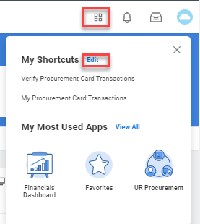
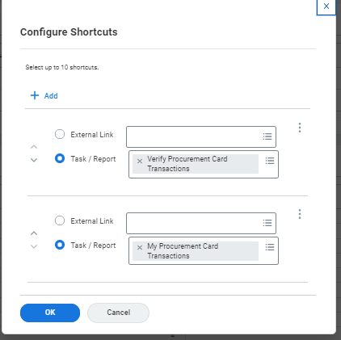

P2P Tips
Shortcuts
Did you know that you can setup up to 10 shortcuts to frequently used tasks, reports or URL’s in P2P? You an access it on your home screen by selecting the 4 squares and then select “edit” to get to the configuration screen
Go to the Adding and Using Shortcuts Video on the UR Procurement Website to assist with utilizing this feature.
Favorites
Did you know that you can set FAO’s, Spend Categories, Vendors and Reports as favorites? In most instances you can select the ‘related actions button” after the FAO, Spend Category or Vendor and select “Favorite” and then “Add”
Visit the Tip and Trick on Setting Favorites on the UR Procurement Website.
10

Slide 11

What Do You Think?
We are looking to implement a process to mass cancel draft requisitions on a monthly basis that meet either of the following criteria:
>30 days old
In progress requisitions for requisitioners with a “Terminated Worker” status
11

Slide 12
What Do You Think?
We are looking for your feedback to enable a new email notification available for PO confirmation/Acknowledgement.
Email notice that a Marketplace supplier has submitted an order acknowledgment. It provides the status of items on the order, indicating whether an item has been accepted, rejected or backordered.
Marketplace Supplier email notifications currently in place:
PO line item Ship Notice
Email notice that a Marketplace supplier has shipped all or part of an order. The system will generate this email at the time the electronic shipment notification has been received.
PO line item Backorder notice
Email notice that a Marketplace supplier has identified a specific line item as on backorder. The system will generate this email if the line is partially or fully backordered. In addition to the backorder notification, suppliers may also provide an Expected Ship Date.
PO line item Cancellation notice
Email notice that a Marketplace supplier has identified a specific line item as cancelled. The system will generate this email if the line status is changed manually or automatically.
12

Slide 13

P2P Reminders
Reminders:
Patient-Care/Clinical Supply items (i.e. Medline) should not be processed in P2P. You should continue your current ordering methods outside of P2P.
The only 312 requisitions you should be submitting to Purchasing are for 3rd party leases (i.e. Banc of America, Pantheon) or patient care/clinical supply items. All other requisitions should be submitted via P2P.
The only SOLO orders should be for RR Donnelly and Medline. All other SOLO supplier orders should be done in the P2P Marketplace.
F4 Forms should no longer be submitted to Accounts Payable except for Human Subject Payments and multi-company requests. Departments should submit a SIR via P2P instead.
13

Slide 14
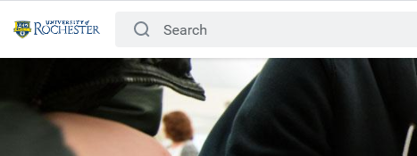
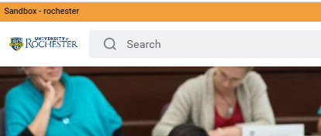
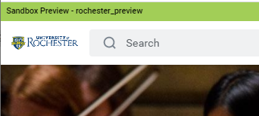
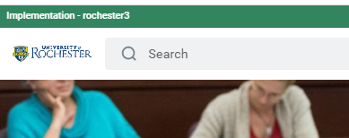
P2P Reminders
Reminders:
Be careful of using saved bookmarks to access P2P! We have found some P2P requisitions and SIRs being done in test environments.
Best login link to use is on the P2P Login tab on the UR Procurement website.
Check the banner color! Test sites have orange or green colored banners on the main home screen. If you see a colored banner above the UR Logo, you are in a test site. Test site banners looks like this:
14

Slide 15
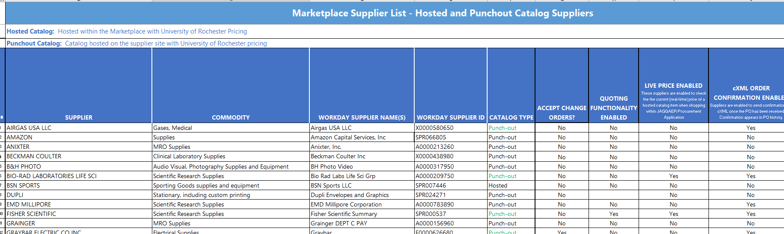
Marketplace Status
30 Live Catalogs in the Marketplace
A listing of all current supplier catalogs can be found in the Buying and Paying Guide
Supplier Catalog in Progress
Audio Video Corp
Thorlabs
Dupli - Ability to request a quote and then find and add quote to your cart
Supplier Catalogs On Deck
Newport Corporation
Edmund Industrial Optics
Horizon Discovery Biosciences Limited (Dharmacon)
15

Slide 16

Monthly P2P Workshops
Next Monthly Workshop; August 11 2 – 3pm
To access the workshop utilize the following link:
https://rochester.zoom.us/j/91726401106
Passcode: 609916
August Workshop Topic:
Resolving Invoice Match Exceptions
September Workshop Topic:
Managing Service Order Expirations and Available Funds
16

Slide 17

UR Procurement Website
Recent updates to the UR Procurement Website:
Marketplace Reference Guide
Creating a Marketplace Order Tips and Tricks
We welcome feedback on how we can better support you and organize the content
17

Slide 18

Super User Meeting
Next Meeting: September 7, 2021

