Slide 1
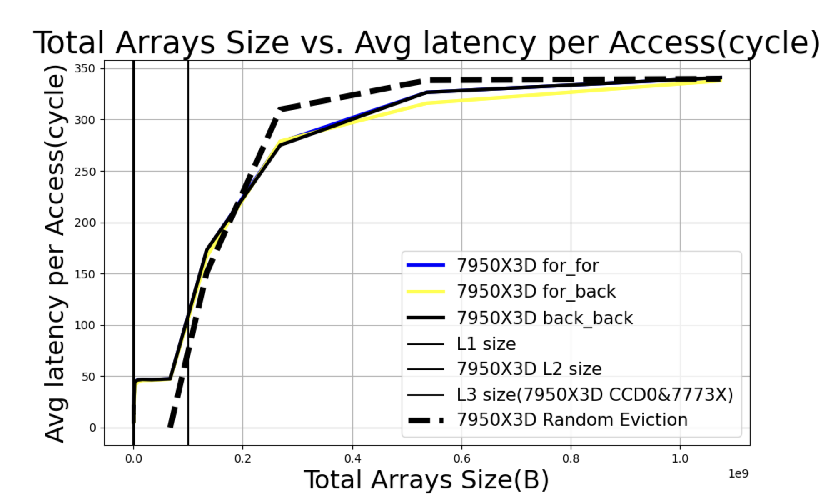

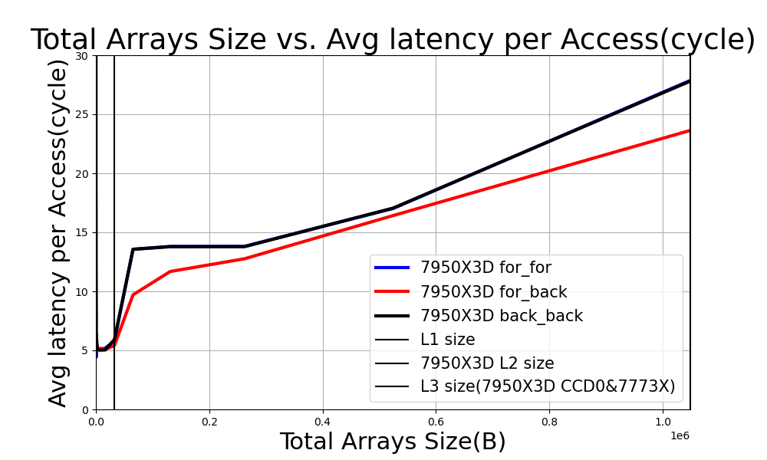
Measuring Data Access Latency in Large CPU Caches
Dual Access Order Stream-in-Cache Benchmark (SiC)
  Cyclic: data is repeatedly traversed in the same order
  Sawtooth: the order is reversed each time the data is traversed
Partitioned LLC rather than Shared LLC
L2 and L3’s replacement policy are clearly different
https://github.com/sauceeeeage/Stream_In_Cache
https://www.amd.com/en/products/processors/technologies/3d-v-cache.html

