Slide 1
Go-Live Update
January 2024

Slide 2
myURHR Engagement Activities Timeline
2023
2024
Jun | Jul | Aug | Sep | Oct | Nov | Dec | Jan | Feb | Mar | Apr | May | Jun | Jul | Aug | Sep | Oct | Nov | Dec
Test & Training Development Phase
Deploy Phase
Support Phase
Readiness Survey
Readiness Survey
Go Live
Recognition
myURHR Change Network Monthly Meetings
Demo Days
Demo Days
myURHR Readiness Tour
Reinforcement
Leadership
Presentations
Leadership
Presentations
Leadership
Presentations
Support
Training
User Acceptance Training & Testing
Day in the Life Testing
myURHR Communications: Newsletters, Videos, Website, etc.
University of Rochester Human Resources
Notes:
In case you haven’t heard, the University is shifting the myURHR go-live from spring 2024 to fall of this year.
You can see the go-live star is now located in the fall timeframe.
This will allow the project team more time to resolve open items and to more efficiently test Workday and UKG, the two market-leading software programs that will power myURHR.
You may notice some new additions here on the timeline too, including Day in the Life Testing, another round of Demo Days, and a myURHR Readiness Tour.

Slide 3
Engagement Activities
Day in the
Life Testing
Readiness Checklist
myURHR tool that outlines pre-startup processes and specifications that will bring the community to a state of readiness.
Testing carried out by end-users to validate whether myURHR is working as expected.
Demo Days 2.0
Training
Offers a sneak peek into myURHR business workflows for targeted audiences.
Instructor-led training, eLearnings, and quick reference cards will be available.
myURHR Readiness Tour
Support
Includes self-service and Help Desk support to provide assistance to the community with myURHR.
Opportunity for the Change team to meet with as many stakeholders as possible to share mini-demos and collect feedback.
University of Rochester Human Resources
Notes:
This next slide explains some of the new activities in further detail.
Day in the Life Testing is to validate myURHR is functioning properly and different business flows are working as expected.
This testing exercise will continue for several weeks.
Then, in the spring, the myURHR project team will launch Demo Days 2.0, featuring new topics and demonstrations.
Although this is a new series of Demo Days, it will have the same format as last year, but will be targeted to more specific audiences.
Depending on your role, you might be interested in attending sessions such as Timekeeping, Effort Reporting and Certification, and Payroll Accounting Adjustments and Payroll Costing Allocations. Employee Self-Service will also be covered again.
The project team is in the beginning planning stages and I will share more information regarding timing and topics when they are available.
A reminder, if you were not able to attend Demo Days in the fall of 2023, all of the recordings are accessible on the myURHR web pages.
Over the summer, the myURHR Readiness Tour will provide an opportunity for the project team to personally connect with as many stakeholders as possible to share mini-demos, answer questions, and collect feedback.
As the year progresses, the project team will also provide various checklists.
There will be checklists for managers, department coordinators, faculty and staff, and others.
Each checklist will include items to cross off a to-do list or items to review before go-live along with actions to take at go-live.
Training will be delivered over the summer and fall months to accommodate various schedules.
You will have July, August, and September to complete training for your role and for what best fits your schedule.
Although it kicks off in July, the majority of faculty and staff will begin training in August.
Over the coming months, I will share more specific information on how much time you’ll need for training according to your job duties in myURHR.
And last, but certainly not least, the project team will share plans about support for the community as we all use myURHR.

Slide 4
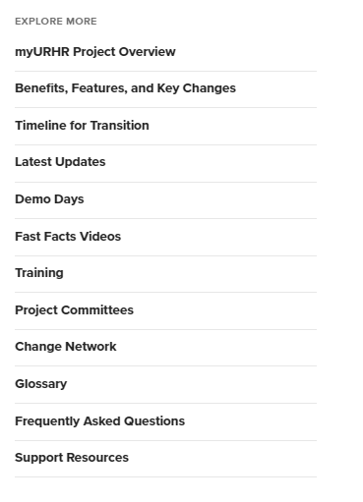
myURHR Resources
https://www.rochester.edu/human-resources/professional-success/myurhr/
Email project team at myurhr@rochester.edu
Interact with myURHR Champions and Super Users
Watch for updates in newsletters & other communications (@Rochester, URMC This Week)
Stay tuned for myURHR Demo Days 2.0, training opportunities & go-live events
myURHR Feedback Form: https://www.rochester.edu/human-resources/professional-success/myurhr/feedback-form/
Notes:
As always, you can stay up to date on the myURHR project by visiting the web pages.
If you have a question, use the myurhr@rochester.edu email address or submit a feedback form via the myURHR web pages.
You can always reach out to any Champion or Super User with questions and comments.

