Slide 1

Service Centers

Slide 2
What are Service Centers?
Service Centers are Units within Cost Centers (departments) that charge for goods or services in direct support of the research or academic missions of the University and recover costs through charges/fees to internal and external users
    To the extent that these fees are charged to federally funded grants and contracts, federal cost principles must be taken into consideration in establishing these rates
All Service Centers are expected to recover no more than the aggregate costs of their operations through charges to users (i.e., cannot make a profit).
All Service Centers must be able to demonstrate compliance with federal requirements, and cannot use fee structures that discriminate against federal funding sources

Slide 3
Service Center Budgets
Updated annually
Timing is similar to other operating budgets
  January – mid-February
  Service center budgets due to Dean’s Office/in Axiom a couple weeks early of budget system close to allow for Dean’s Office review
Budget should be based on
  Historical data
  Current FY projections
  Known changes necessary for next FY
  Considerations:
    Inflation
    Personnel
    User base and its volume

Slide 4
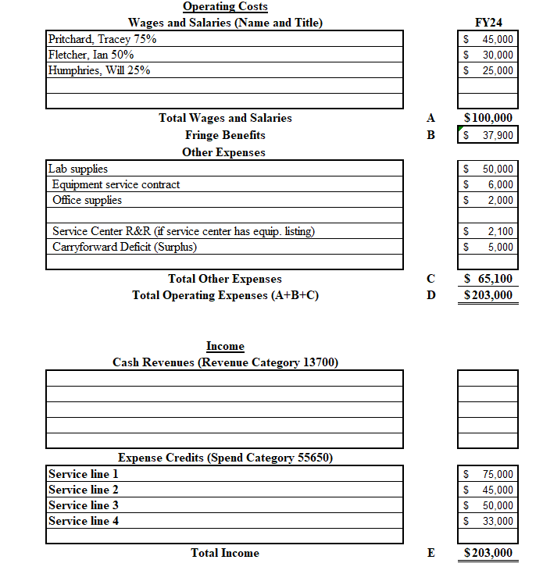
How do I put together a budget and rate structure together for a service center?
Notes:
Reference FY24 budget template

Slide 5
What are Allowable Direct Costs that can be included in a budget for a Service Center?
  Salaries and fringe benefits
  Materials and supplies
  Maintenance and repair, including equipment maintenance agreements
  Equipment depreciation (service center R&R)
  Rentals and leases, including equipment leases
  Training specific to the Service Center
  Purchased services/professional fees (e.g. consultants)
Notes:
All of this is included on the Service Center Guidelines on the Finance Website under ORACS Policies, Procedures & Forms – reference website

Slide 6
What are Unallowable Direct Costs that should not be included in a budget for a Service Center?
  Alcoholic beverages
  Airfare in excess of coach
  Bad debt or uncollectible billings
  Capital equipment purchases
  Entertainment (including meals/beverages for employees)
  Donations or contributions
  Gifts (includes employee recognition)
  Memberships
  Salaries over the NIH Cap
  Grant deficit write-offs
  Subsidies
**For a complete list of unallowable costs please refer to 2 CFR 200
Notes:
All of this is included on the Service Center Guidelines on the Finance Website under ORACS Policies, Procedures & Forms – reference website

Slide 7
Potential rate structure(s):
  Consumption and Output Usage Bases – costs are distributed on the basis of a unit of measurement, such as hours, pounds, or gallons. When measures of consumption are unavailable or impractical, the basis of allocation may be to measure the output of the Service Center on a per unit cost.
    Consumption (e.g. billable hours)
    Output (e.g. number of black boxes) **most common**
Notes:
Reference FY24 budget template

Slide 8
Potential rate structure(s):
  Cost of Sale Usage Base – applicable for those centers which are product rather than service oriented. Since the cost is known for each product for sale, an appropriate markup should be established to recoup the operating costs associated with the disbursement of the products. The markup is added to the cost of the product and the resulting price is what the Service Center should charge.
  Detailed instructions for calculating each of these rates are included on the Service Center budgeting template.
  If there is more than one service line, one service cannot subsidize another.
    Service lines and the associated rate must be based on actual costs associated with that service line.

Slide 9
What are Service Center Administrators’ accounting expectations?
  Budget development – includes Excel template and Axiom (these two must match)
  Monthly review of the FAO ledgers
    monitoring for projected deficit or surplus
    monitoring for unallowable charges and making corrections
    prepare mid-year adjustments if necessary
  Service center balances need to be within +/- 15% of total budget at all times with goal of breakeven.
  Add all employees’ budgeted effort to the Service Center FAO
  Record retention: 7 years

Slide 10
What are Service Center Administrators accounting expectations?
  Billing should be completed on an monthly basis, using manual JEs (small scale) or URFinancials integrations (large scale) with a specific unique memo identifier for the Service Center.
  Be able to produce backup records in a timely manner that provides account numbers showing both the debit and credit amounts and all backup for the calculations and FAOs charged.

Slide 11
  Processing monthly JEs:
  Service Center (SC) ledger accounts, spend and revenue categories
    Expense recorded as:
      Ledger account: 65610 SC Charges
      Spend Category:
        55650 SC Charges
        55660 SC Fully Costed Charges (exempt from indirects – due to F&A charges included in the rates)
    Revenue recorded as:
      Ledger account:
        65610 SC charges (internal customers)
        46800 Miscellaneous Revenue (external customer)
      Revenue category:
        55650 SC charges (Spend Category for internal customers)
        55660 SC Fully costed charges (internal customer and exempt from indirects)
        13700 Miscellaneous Revenue (Revenue Category for external customers)
  SC space should be updated as employees work on SC activities

Slide 12
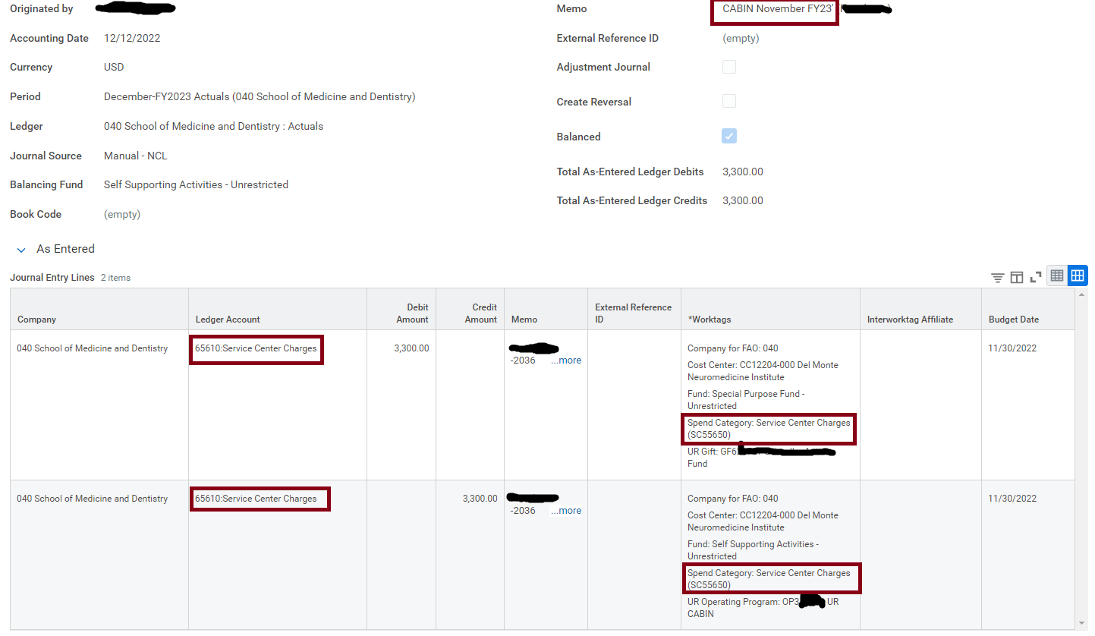
Sample journal entry:

Slide 13
Service Center Space Considerations
  URSpace should be updated annually (at the least) including room and occupant data.
    This will make the space survey which occurs every 4 years considerably easier.
  If possible, separate space from other research activity is best.

Slide 14
Appendix
Service Center Policy: http://www.rochester.edu/adminfinance/finance/Departments/ORACS/as sets/pdf/service-center-policy-april-2018.pdf
Service Center Guidelines:
    http://www.rochester.edu/adminfinance/finance/Departments/ORACS/assets/pdf/service-center-guidelines-april-2018.pdf
Service Center Additional Information Form:
  http://www.rochester.edu/adminfinance/finance/assets/pdf/service- center-additional-information-form.pdf

