Slide 1
Research Administrator Meeting
January 30, 2024

Slide 2
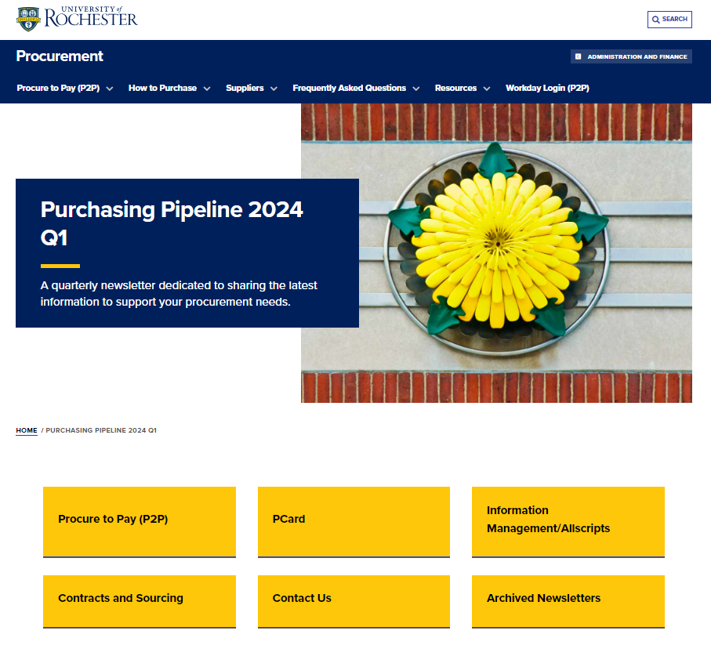
Purchasing Newsletter
Purchasing is consolidating communications into a single newsletter to be published on a quarterly basis
The newsletter (Purchasing Pipeline) will be posted on the UR Procurement website with a focus to share the latest information to support your procurement needs.
We will no longer be distributing separate newsletters (i.e. P2P, Pcard) with the exception of Supplier Diversity.
A communication will be sent out this week when the newsletter is available.
2

Slide 3
Supplier Diversity Policy
Highlights
Supplier Diversity Policy is located on the University Policy and Purchasing Websites and was effective January 1, 2024.
This policy will ensure the University complies with federal, state, and county legal requirements including contracting requirements under NYS Executive Law 15-A1, with regard to doing business with diverse suppliers.
All University departments and divisions have the following responsibilities and may seek assistance from Purchasing and/or Facilities to comply with them:
To engage diverse suppliers in bidding opportunities
To pursue opportunities to increase diversity across all business relationships regardless of the nature, length of relationship, or any other factors by engaging diverse suppliers in bidding opportunities.
At least one diverse supplier must be invited to participate in the bid process.
Departments will maintain a record using the Supplier Price Justification (SPJ) Questionnaire to document these efforts, including the bid process result summary.
3

Slide 4
Supplier Diversity Policy
Supplier Diversity Policy Benefits
Having a policy in place helps the University comply with Federal and New York State grant requirements
Help the University stay competitive by aligning with best practice
Best
Practice
Grants
Demonstrate the commitment and build trust with the diverse business community
Diversify supply chain to mitigate disruptions and mitigate the risk of not meeting the MWBE/Small Business goals required by the Federal government and New York state
Transparency
Risk Mitigation
Foster economic empowerment by supporting diverse suppliers in local community
Community Investment
Brand Reputation
Enhance the University's brand reputation by adhering to the policy
4

Slide 5
DIVERSE SUPPLIERS RESOURCES Supplier Diversity Newsletters - Procurement (rochester.edu)
Diverse Supplier Resources
MWBEs must have a valid certification for RFP participation
New York State
NEW YORK STATE CONTRACT SYSTEM (newnycontracts.com)
It is required by New York State that MWBEs must be New York State certified in order to be part of the State Grant projects
Monroe County
Master Listing MC MWBE 3-27-2023
All MWBEs are certified by Monroe County
UR/SupplierGateway
SupplierGateway
SupplierGateway is the preferred supplier to manage the University’s diverse supplier spend and certification validations. All University employees can sign up and access the database
5

Slide 6
Supplier Diversity Policy
Questions:
If you have questions regarding the policy or need assistance with identifying diverse suppliers to participate in bidding opportunities for policy compliance, see contacts below:
SupplierDiversity@Rochester.edu
Yi-Li van den Berg, Director Supplier Diversity, Corporate Purchasing
Yanli_Vandenberg@urmc.rochester.edu
Mario Roque, Diversity Director, UF&S
mroque@facilities.rochester.edu
Upcoming Q&A Sessions will be announced
6

Slide 7
P2P Supplier Price Justification Questionnaire Changes
Background
The Supplier Price Justification Questionnaire is required for all requisitions $25,000 or greater.
This questionnaire provides justification as to the selection of the supplier and cost reasonableness for the transaction.
Currently there are two questionnaire versions (grant and non-grant)
Questionnaire Enhancements
Single version of the questionnaire
Simplification of diverse supplier questions on the current grant questionnaire
Updates to align to Supplier Diversity Policy
7

Slide 8
Research Administrator Group

