Slide 1
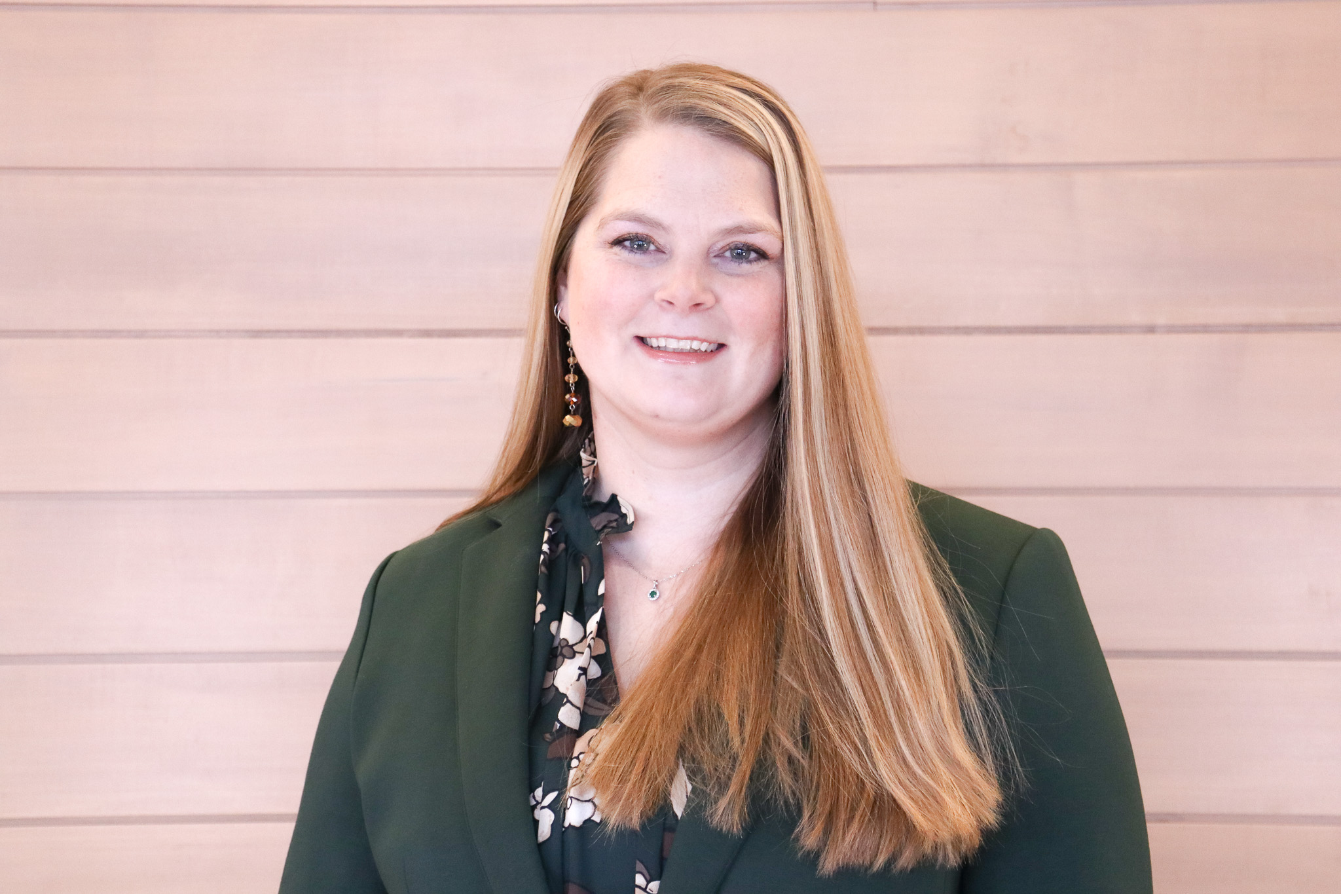
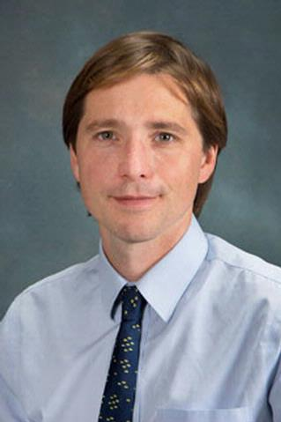

The Office of Clinical Research
(OCR)
Ashlee Lang, MPH, Director
Chris Palma, MD, Sc.M., Faculty Advisor
Notes:
My name is Ashlee Lang and I’m the Director of the Office of Clinical Research (OCR). We are part of the Research Services branch under the faculty advisement of Dr. Chris Palms

Slide 2


OCR: Who We Are
Director: Ashlee Lang
Administrative Assistant: Karen Ely
CTMS Team: James Delmonico, Deborah Lamay, Gary Morton (Oncology)
Training Team: Meredith Perrin
Finance Team: Rebecca Dennis, Megan Wutzke (Participant Payments), Erica Longbine
Feasibility Team: Caledonia Banker
Notes:
Formed in May 2018, the Office of Clinical Research (OCR) is a team of 8 research professionals who provide tools and services to URMC faculty and staff in support of clinical trials.

Slide 3
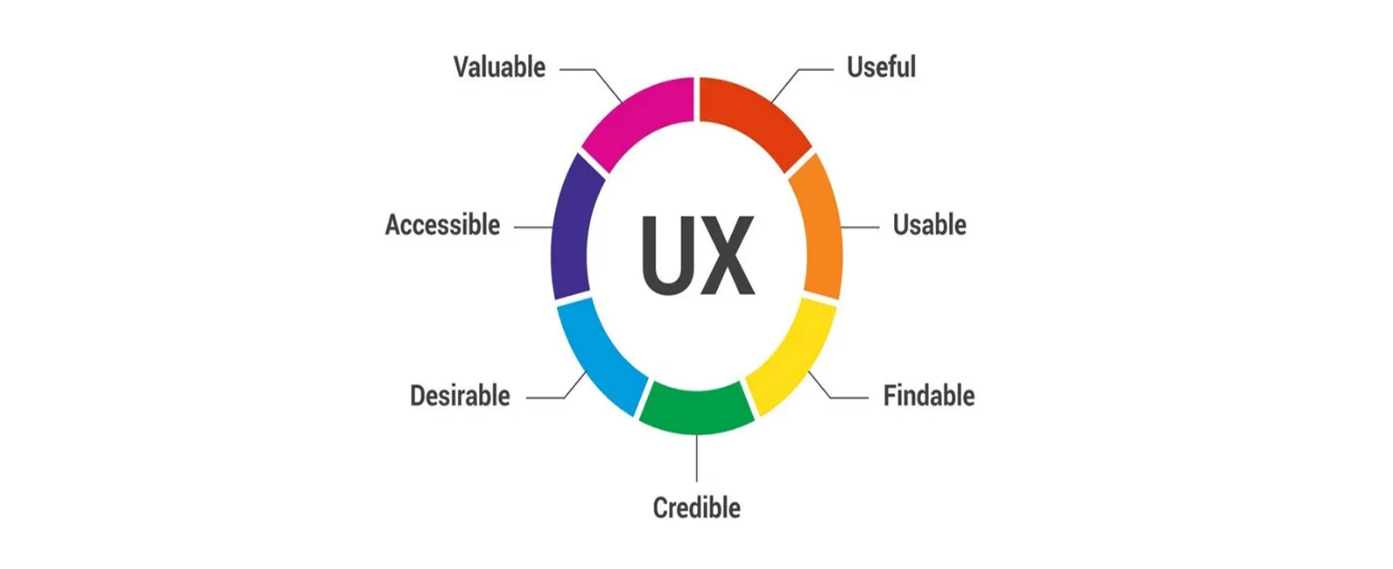
OCR: What We Do
The OCR provides tools and services to help URMC faculty and staff with the administration of clinical trials. By streamlining the processes behind clinical research, we empower our clinical research teams to do more high-impact clinical trials that can advance clinical discovery and offer patients and community members more options and opportunities. We also make it easier for researchers to comply with clinical trial rules and regulations and produce successful outcomes.
Our 4 primary areas of focus include:
OnCore
Feasibility
Research Finance
Participant Payments
Notes:
By streamlining and right-sizing the processes behind clinical research, we empower our clinical research teams to take on more high-impact clinical trials and increase enrollment. The OCR has become a center for operational excellence providing tools and services to help URMC faculty and staff with the administration of clinical trials.
CLICK TO SHOW TEXT
Our primary focus areas include; 1) support of our Clinical Trial Management System (CTMS):OnCore, 2) feasibility assessments 3) research financial services and 4) participant payments

Slide 4
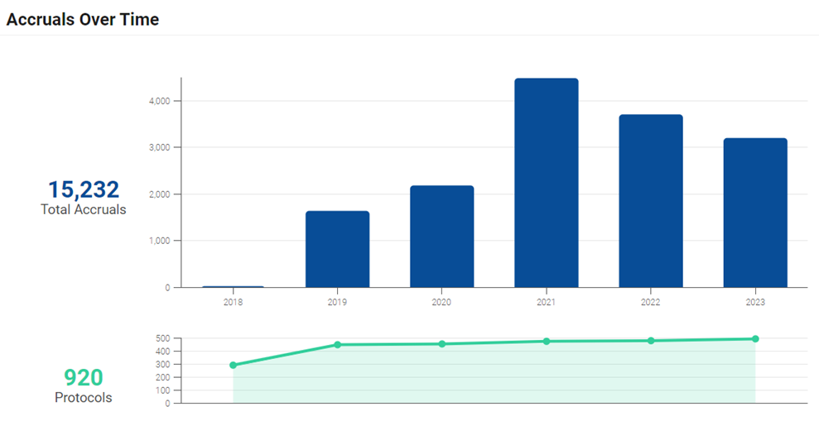
OnCore
Number of Patients on Trials in OnCore
Phase 1 was initiated in 2018 offering URMC researchers the option to use OnCore to support
Phase 2 will be implemented over the next 18 months to roll out an institutional policy with tiered requirements for OnCore use
Notes:
The initial implementation of OnCore in 2018 was optional and available to any URMC research team interested in utilizing our CTMS services. Since 2018 we have had 920 protocols and over 15,000 patient accruals through OnCore. Heading into the next 18 months, we will be implementing an institutional policy with tiered requirements for the use of OnCore to support our ultimate goal of having all clinical trials at URMC using OnCore services.

Slide 5
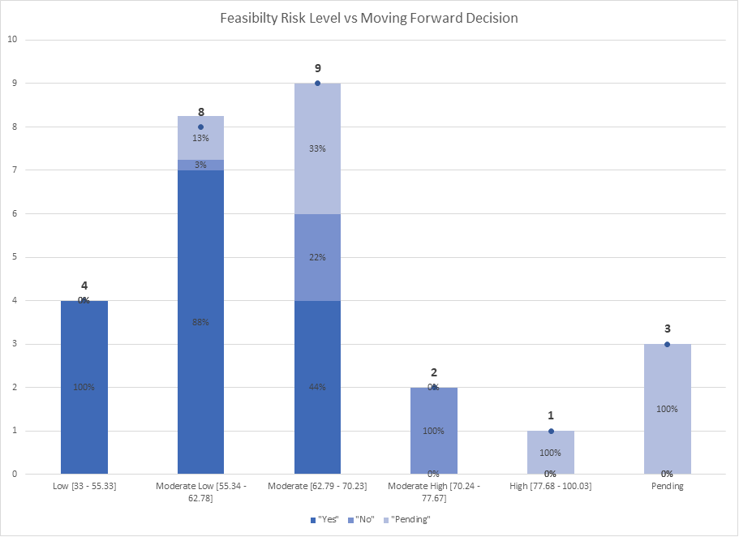
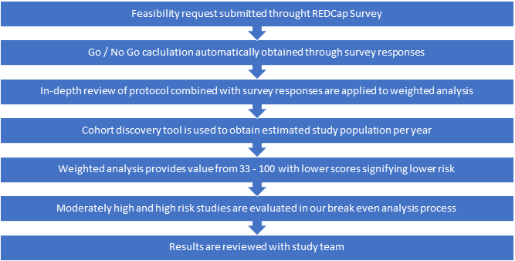
Feasibility
Our team helps assess the feasibility of proposed clinical studies and develop meaningful metrics to help guide how URMC study teams manage clinical studies
  Assist with completion of feasibility surveys
  Tailored feasibility and breakeven analysis
  Cohort discovery with TriNetX and Slicer-Dicer (Epic)
Notes:
FIRST GRAPHIC IS FEASIBILITY FLOW CHART
Our Feasibility services were initiated in 2021 and were developed based on an identified institutional need to better assess the feasibility of a trail based on recruitment estimates and internal resource availability. At the time, Investigators and research team lacked tools to help them evaluate what was needed for a successful trial.
The process begins with the research team completing a feasibility request through a RedCap survey. A quick 5 question “Go or No-Go” analysis allows for an immediate determination which takes into consideration the sponsors willingness to accept our indirect costs, study holdback limits, use of non-approved platforms or vendors, sponsor acceptance of URMC IDS pharmacy fees and any past experiences working with this sponsor/CRO. For all ‘Go’ protocols, our feasibility team them does an in-depth review of the protocol and provides a weighted analysis based on a 33-100 scale with 33 being the lowest and 100 being the highest risk. This weighted assessment, along with a cohort analysis, done through TriNetX or Slicer-Dicer, is provided to the study team for review. Any protocol resulting in a moderately-high or high risk is automatically sent along for a Break-Even analysis.
CLICK TO CHANGE GRAPHIC FOR BAR GRAPH
Here is a chart showing the feasibility assessments completed to-date and their corresponding risk level. The stop-light of green = study moved forward and red = study did not move forward (and yellow = study still under evaluation) shows us that research teams are seriously reviewing our feasibility assessment and it is positively affecting those trials they choose to move forward with!

Slide 6
Research Finance and Participant Payments
Pre-Award Services: Medicaid/Medicare coverage, analyze the study cost and timeline, negotiate budgets with sponsors, and enter budget information into OnCore.
Post-Award Services: Invoicing, revenue reconciliation, review of subject accounts, Participant Payments, and more.
Participant Payments is a safe, secure automated system that helps immediately pay subjects after each clinical study visit. Integrated with OnCore, Participant Payments eliminates manual and inefficient processes, so research teams can spend less time on administrative tasks and focus on patient care.
Notes:
And finally, our Research Financial Services and Participant Payments services! Our finance team offers URMC researchers support with pre-award services in development of Coverage Analysis, Analysis of study costs and timelines, budget negotiations and OnCore study builds. Following study activation, our finance team can assist with invoicing, subject account review, revenue reconciliation and participant payments.
Participant payments is an OnCore application that provides URMC research patients with a secure, automated system of payment for their participation in a clinical study. Since Participant payments is part of the CTMS, is eliminated much of the burden from the study team in processing, tracking and administering participant payments.
CLICK FOR FINAL BAR GRAPH
We’ll end with this impactful graph which shows the average study budgets over the last 3 years: the Blue bar represents the initial budget provided by the Sponsor/CRO and the RED bar represents the final budget that OCR Finance team was able to negotiate. The large YELLOW bar in the middle represents the delta or difference between what the sponsor initially proposed (BLUE) and what OCR Finance was able to negotiate as a final budget (RED).

Slide 7
Thank you!
Office of Clinical Research: OCR_Research@URMC.Rochester.edu

