Slide 1
Federal and New York State Minority/Women Owned Business Participation in Grants/Contracts
Presented by:
ORPA, Laurie Naber and
Purchasing, Debbie Flotteron and Dan Leyrer

Slide 2

Why?
Federal Government – Federal Regulations
52.219-8 - Utilization of Small Business Concern
52.219-9 - Small Business Subcontracting Plan
New York State – Executive Law
Article 15-A

Slide 3

Communication Process
Who – PI and Department Admin
What – New Contract Proposal
When – As soon as RFA/PAR identified
Where – ORPA/Purchasing

Slide 4
Division of Duties
Department
ORPA
Purchasing
HR

Slide 5

Department
Identify RFA/PA/RFP
Alert ORPA
Discuss MBWB with Purchasing

Slide 6

ORPA
Advise Department
Review application
Submit application
Federal Contract – submit exclusion letter
Submit JIT Form 4 to NYS upon notification of funding
Provide contract terms and FAOs to Purchasing

Slide 7

Federal Contract Proposal
RFP/RFA
Negotiate a Small Business Plan
Contracts greater than $650,000
Purchasing Reports to Federal Government

Slide 8

New York State Grant/Contract
RFA/RFP
Request from Agency
Previously acquired contracts

Slide 9
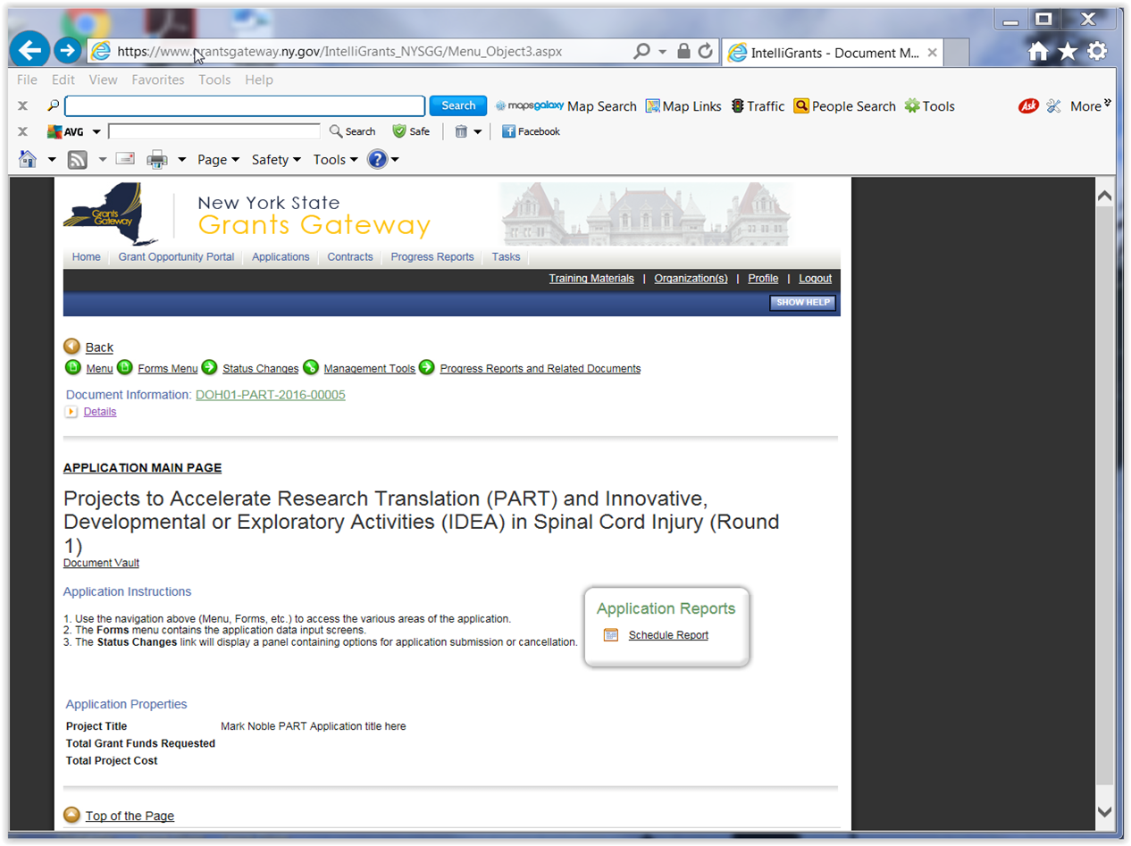
NYS Grants Gateway

Slide 10
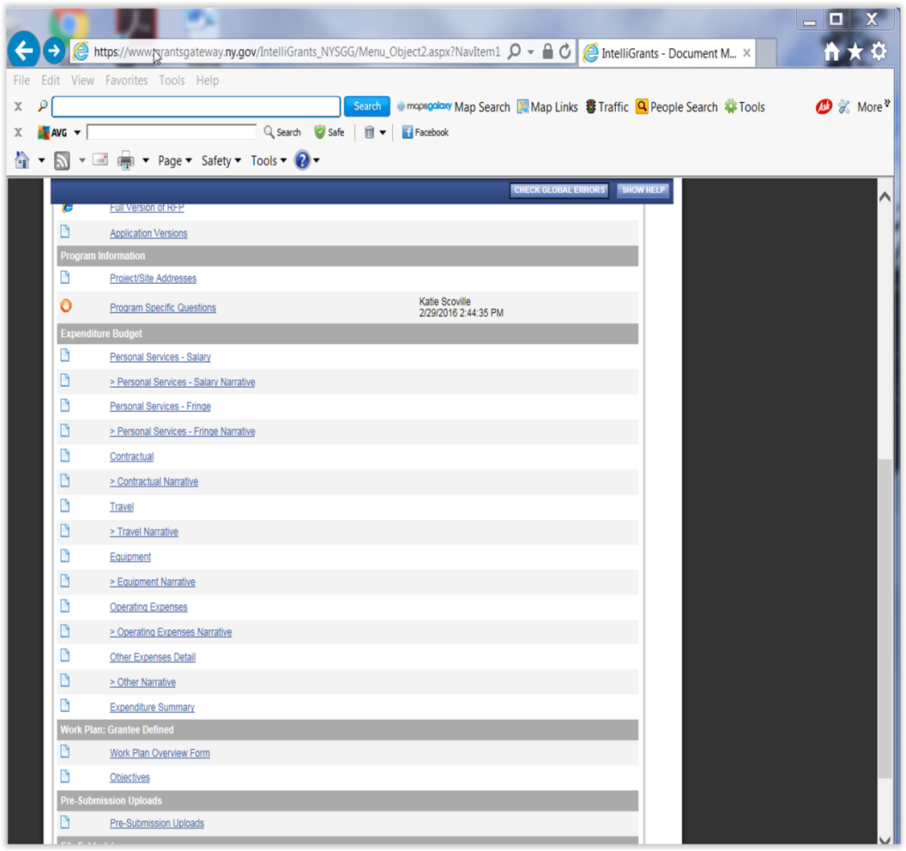
NYS Grants Gateway

Slide 11
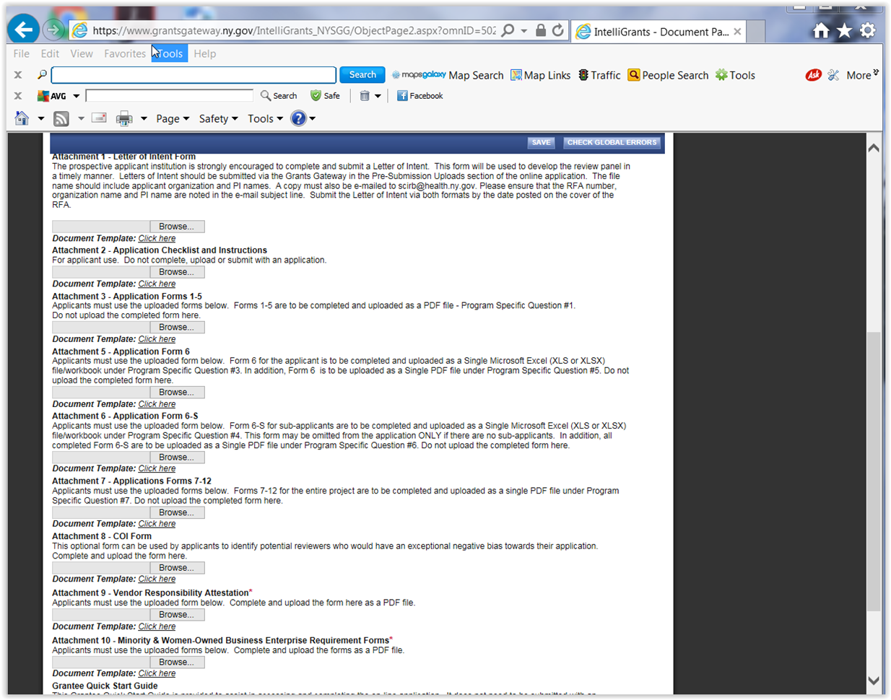
NYS Grants Gateway

Slide 14

PURCHASING
Small Business Liaison Officer – Dan Leyrer
Minority Supplier Sourcing
  https://www.urmc.rochester.edu/purchasing/guidelines/supplier-diversity.cfm
Sign off on Subcontracting Plans for Subcontracting Goals
Federal and New York State Reporting
UR Representation at Minority Supplier Matchmaker Events

Slide 15
Federal and New York State Business Plans
What is required from the department ?
  Non-salary expenses to assist with sourcing to Small and MWBE business concerns
What is required from ORPA?
  Information after the award (i.e. reporting requirements, account information)

Slide 16
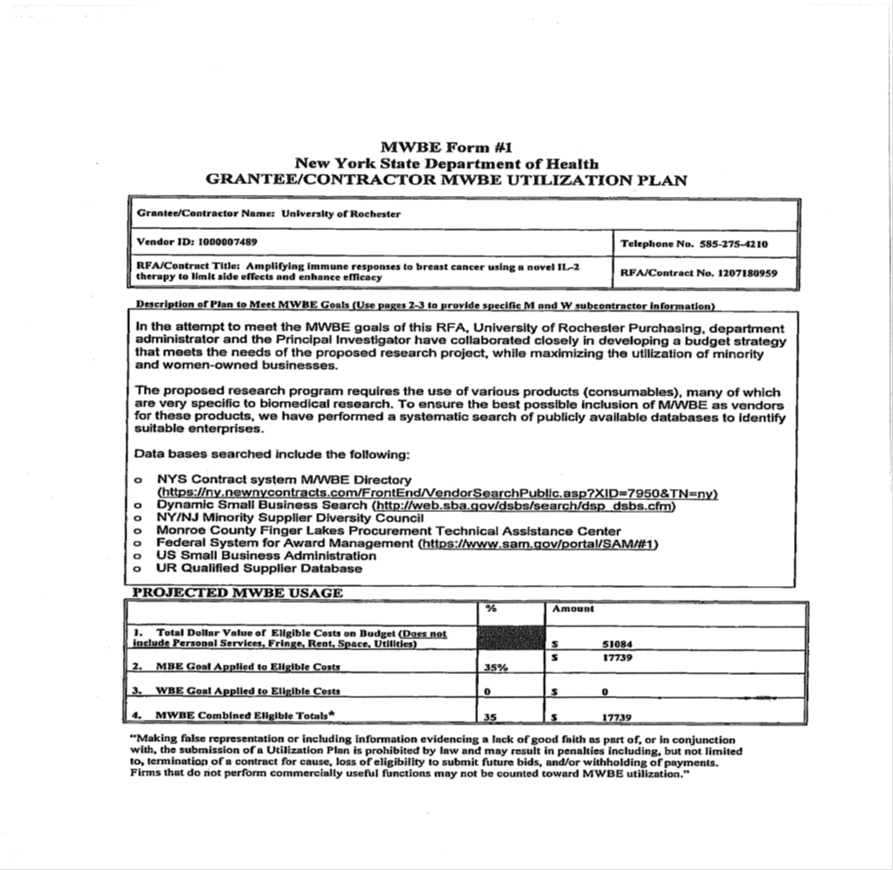

Slide 17
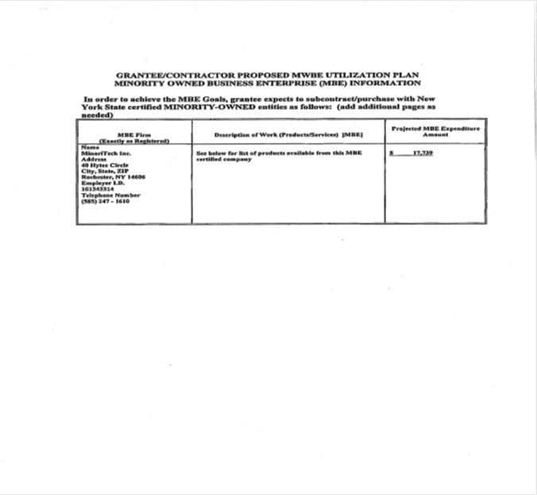
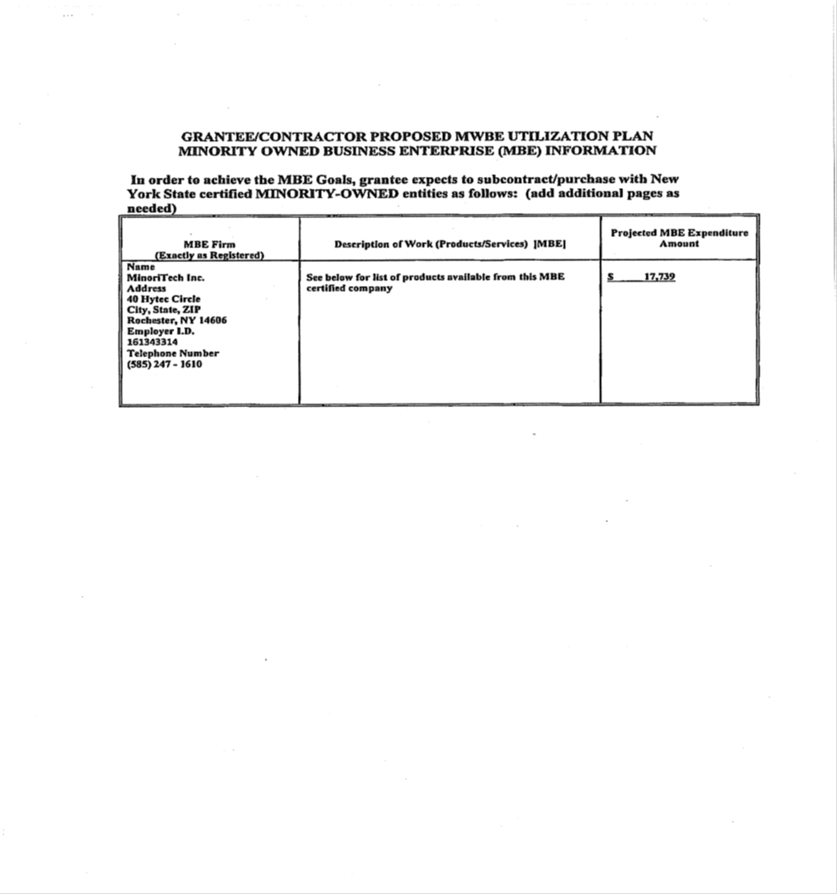

Slide 18
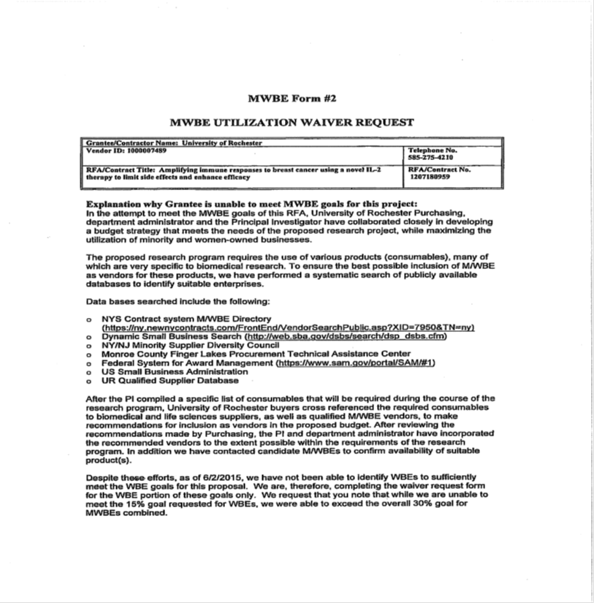

Slide 19
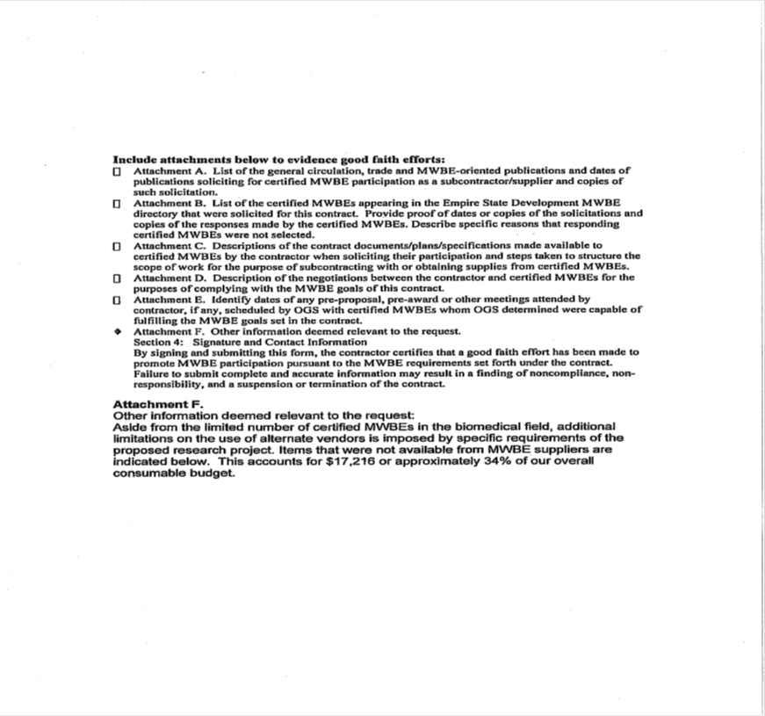

Slide 20
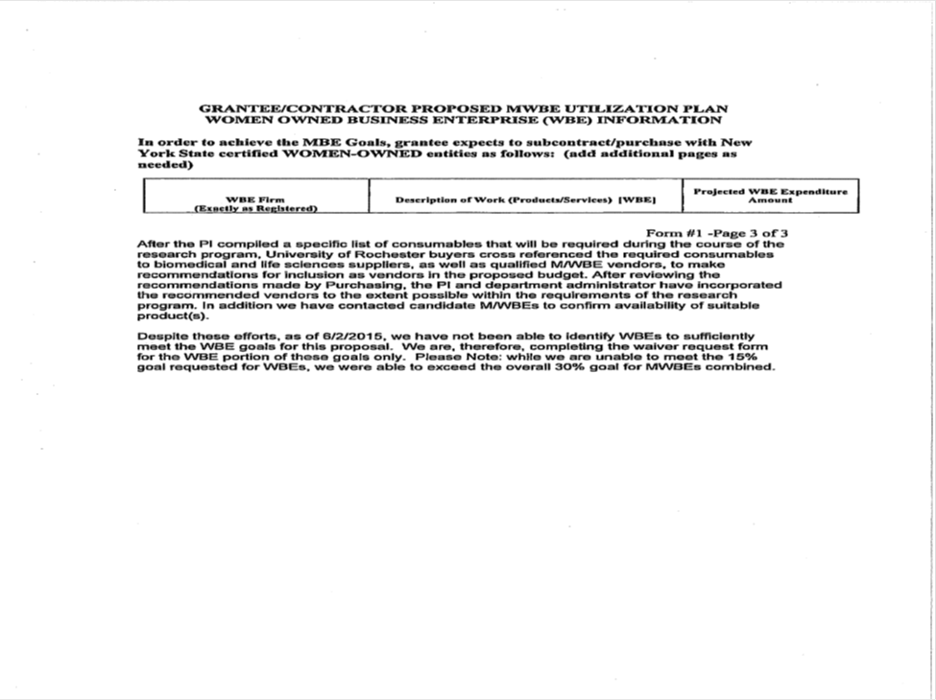

Slide 21
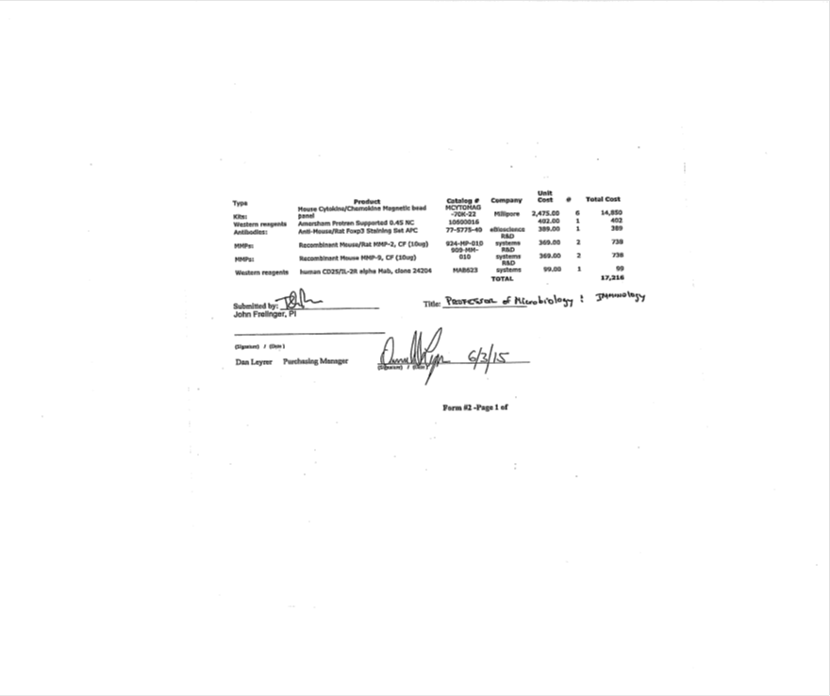

Slide 22
New York State Forms
Empire State Development
Form #/Name | Responsible to Complete and Submit | Assistance | Resources
OCSD-1 M/WBE Participation/Equal Employment Opportunity Policy Statement | Person Submitting the Plan | Purchasing Signs the document
OCSD-2 Staffing Plan Contractor shall complete this form only for the anticipated work force to be utilized on the State Contract. (Required only of Contracts Valued at $250,000 or more) | ORPA at JIT | TBD
OCSD - 3 M/WBE Utilization Plan This document must contain a detailed description of the supplies and/or services to be provided by each certified Minority and Women-Owned Business Enterprise (M/WBE) under the contract) | Person Submitting the Plan | Purchasing Assistance identifying MWBE | UR Qualified MWBE Supplier List
OCSD-4 Information Only Definition of Good Faith Efforts

Slide 23
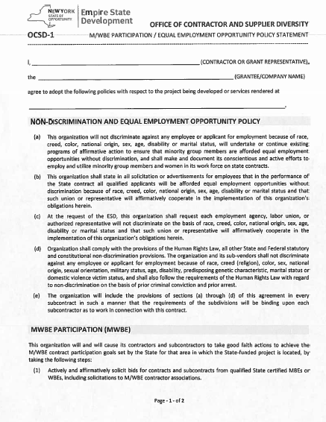
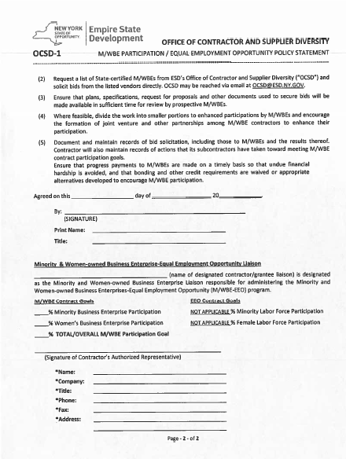

Slide 24
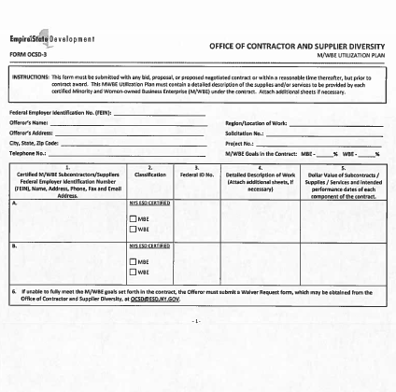
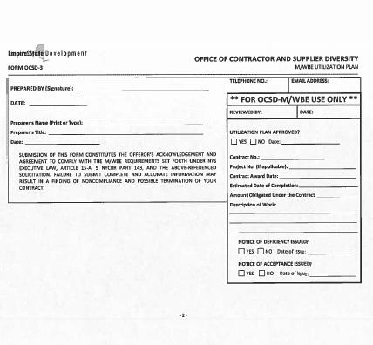

Slide 25
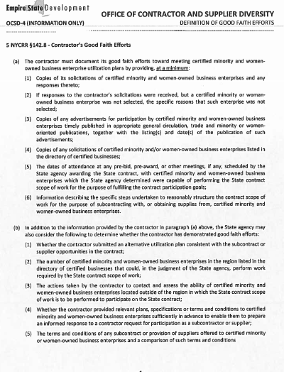

Slide 26
UR Qualified MWBE Vendor List
Name and Address | Classification | New York State Certified | Commodity
Town and Country Travel | WBE | Yes | Travel Services
732 Pittsford Victor Road
Pittsford, NY 14534
Phone: 585-381-2850
Fax: 585-381-1987
Laboratory Product Sales | WBE | Yes | Lab Supplies
1665 Buffalo Road
Rochester, NY 14624
Phone: 585- 247-4720, ext 22
Fax: 585-247-6686
Email: Frank@LPSinc.com
Cara Medical | WBE | Yes | Medical Supplies
739 Englewood Avenue
Buffalo, NY 14223
Phone: 800-772-2272
Fax: 716-838-2362
Email: Info-Caramedical.com
Website: cara-medical.com
The complete list is available as a handout and can be sent electronically

Slide 27
Thank You!

