Slide 1

Who is responsible for compensating the cost in case of lost or damage to the goods during Transit?
  Use UR contracted Shippers – UR negotiated rate (FOB Destination, Freight Collect)
    Cardinal/Optifreight (UR Preferred)
      No declared value – Max. $100 via FedEx (<150 lbs)
      Declared value – incremental fee
      Supplier quote will not include freights/insurance. Cardinal/Optifreight will bill UR directly.
      Contact: Cara Park at Cardinal/Optifreight, Park, Cara cara.park@cardinalhealth.com
    Other contracts for big value shipment: Clinical Lab and Pharmacy
  Use Supplier contracted Shippers – direct-ship (FOB Destination, Freight Prepaid)
    Freight and insurance included in the supplier’s pricing – 3~6% incremental fee.
    Supplier will be responsible for the cost of lost or damaged the shipment
    Medline, Roche, Illumina, Fisher, VWR, BD, ….etc.
  UR-held Cargo Insurance
    Deductible $1000 with a cap of $2M/claim
    Non-hazardous, non-Toxic materials…etc.
    Contact: Kristin McCann, Senior Insurance Administrator, Legal Counsel.

Slide 2
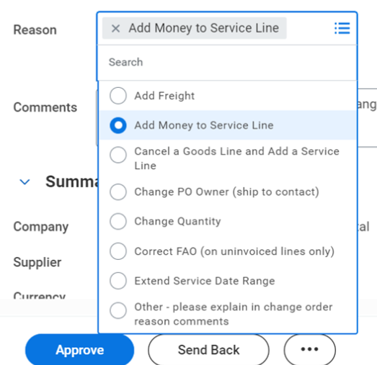


Definition of Delivery Terms in Workday

