Slide 1

SUPPLIER DIVERSITY FOR GRANTS UPDATES
Yi-Li van den Berg
March, 2024
1

Slide 2

RECAP - THE WEBSITE
Words to action: Supporting minority, women, and veteran-owned businesses - Office of the President (rochester.edu)
Federal and New York State Grants - Procurement (rochester.edu)
Objectives of the website
  Streamline the process
  Provide consistent communications on University’s MWBEs/Small Businesses commitments and efforts to government agencies
  Comply with Federal and State supplier diversity requirements for a grant
Highlights of the website
  Outline departments and Corporate Purchasing’s responsibilities
  Corporate Purchasing oversees the University's supplier diversity initiatives, provides assistance with grants related to supplier diversity mandates and signs required forms
  Department to inform Corporate Purchasing when a contract is awarded
  5 days lead-time

Slide 3
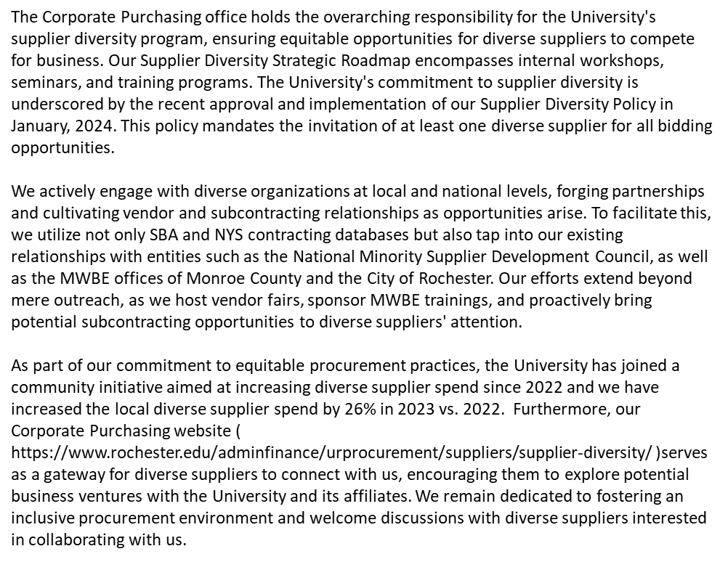
CONSISTENT COMMUNICATIONS
Positive reputation
Clarity and understanding
Compliance and risk mitigation
Alignment with goals and requirements

Slide 4
GUEST SPEAKERS
MWBE/SDVOB and Compliance/Reporting Team
NYS Department of Health
April 30, 2024
Virginia Smith
February 27, 2024
Notes:
Did we solicit peer universities?

Slide 5
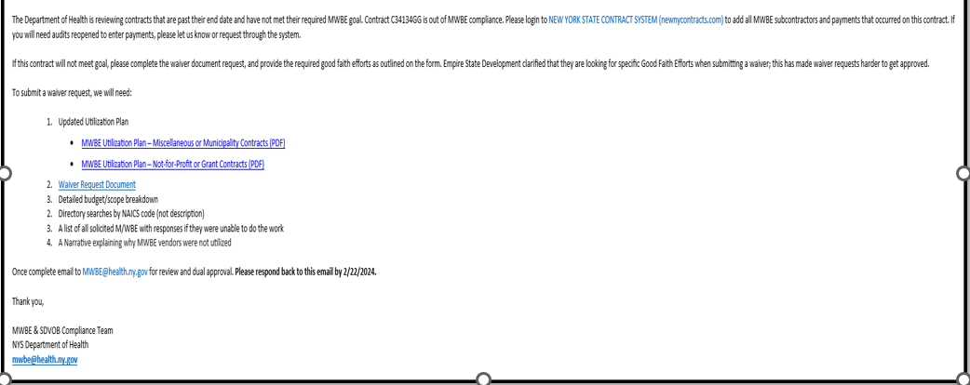
COMPLIANCE

Slide 6
DIVERSE SUPPLIERS RESOURCES
Supplier Diversity Newsletters - Procurement (rochester.edu)
New York State
NEW YORK STATE CONTRACT SYSTEM (newnycontracts.com)
It is required by New York State that MWBEs must be New York State certified in order to be part of the State Grant projects
Monroe County
Master Listing MC MWBE 3-27-2023
All MWBEs are certified by Monroe County
UR/SupplierGateway
SupplierGateway
SupplierGateway is the preferred supplier to manage the University’s diverse supplier spend and certification validations. All University employees can sign up and access the database

Slide 7

THANK YOU
  Yi-Li van den Berg
  Director, Supplier Diversity
  Corporate Purchasing & Supply Chain
  Cell: 585-622-5421
  Email: yanli_vandenberg@urmc.rochester.edu

