Slide 1

Office of Research Integrity, Stewardship & Ethics (ORISE)
Sonya Maria Hadrigan, APRN, MLS, CIP
AVP Research Integrity

Slide 2
Research Integrity: Building Trust
The ORISE team is responsible for co-creating a University-wide framework for research integrity, building a unified structure across policies, processes, and cultural norms.
This includes working across schools and departments at all stages of researchers’ careers to ensure the ethical conduct of research is embedded in everyday practices, not just during crises.
ORISE works collaboratively with the Office of Counsel and partner offices under the Office of the Vice President for Research to support several mission-critical functions.

Slide 3
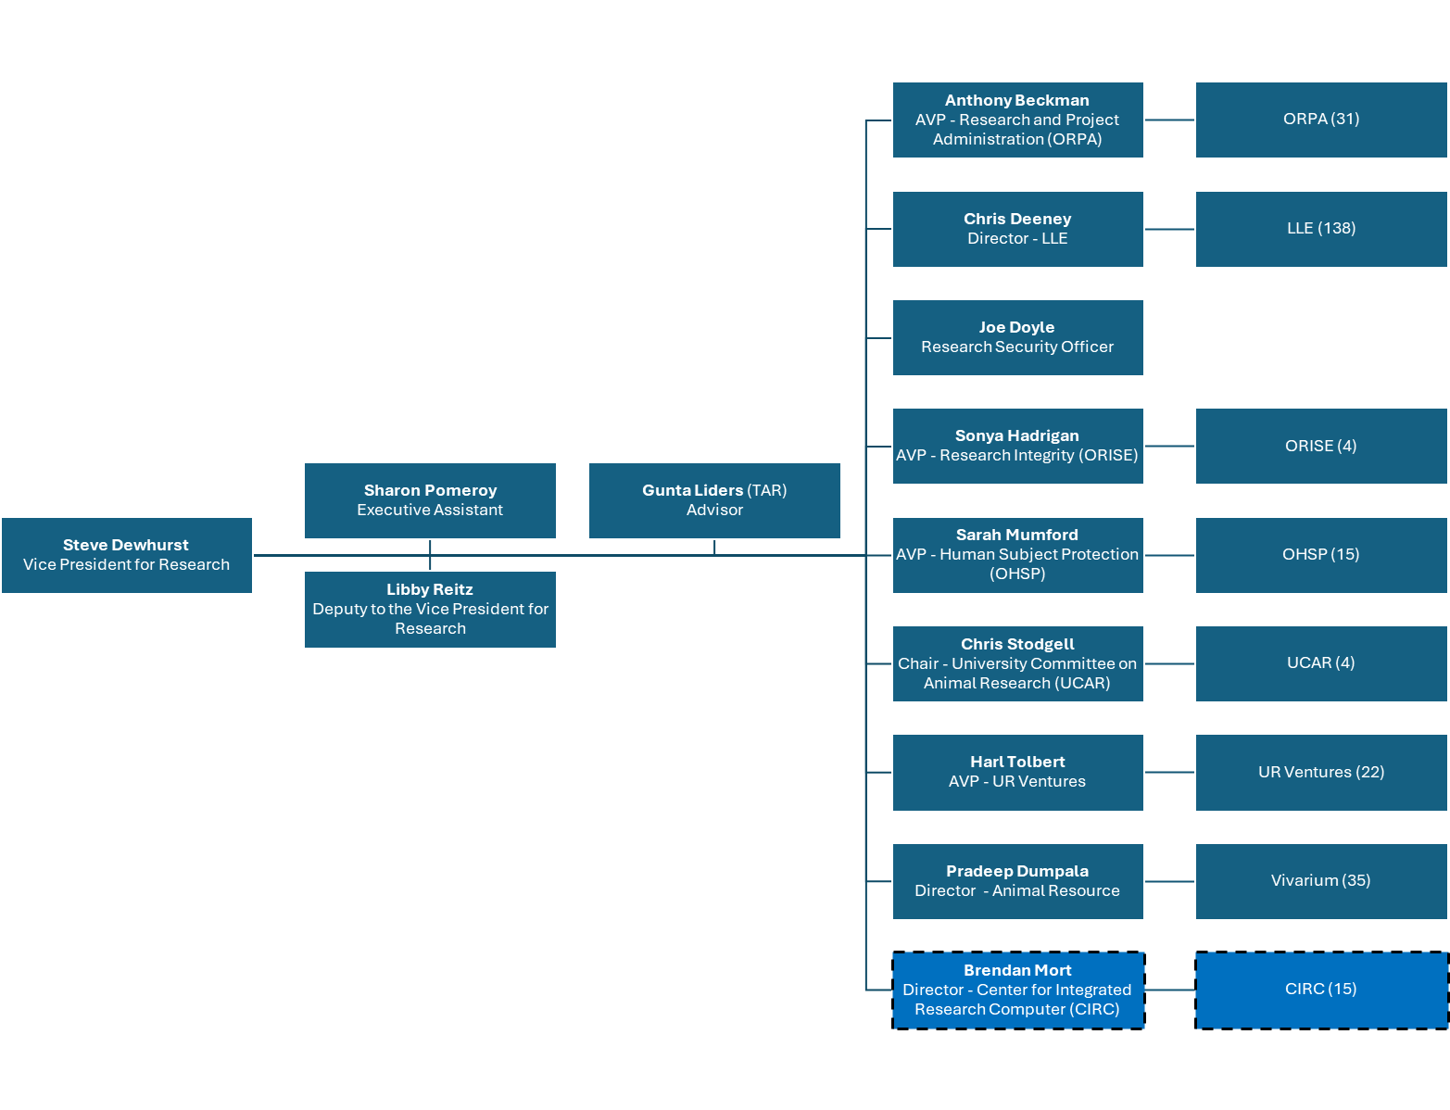

Slide 4
LEGEND
Office of
Research Integrity, Stewardship, & Ethics
Position filled
Position pending creation in HR
Part-time Consultants & Temporary Staff
RECR
Zoe Hammatt
COI
Gunta Liders
Position not funded
Sonya Hadrigan
Associate Vice President
Research Integrity/
Research Integrity Officer
Office
Sharon Pomeroy
Dept Coordinator
Kelly O’Keefe
Research Integrity Director
Office of
Responsible Conduct of Research
Office of
Research Conflict of Interest/Commitment
TBD
Compliance Officer,
Research Integrity
Patricia Guinan
COI Administrator
TBD
COI Administrator
TBD
Compliance Officer,
Research Integrity
ORISE Centralized Functions
Research Conflicts of Interest/Commitment (COI/C)
Research COI/C Committee(s) Management
Responsible & Ethical Conduct of Research education programming
Research Misconduct Proceedings
Research Integrity Committee Management
Data Stewardship & Governance
QA/Monitoring/Compliance Reviews for these areas
TBD
RECR Education & QA Analyst
January 5, 2026

Slide 5

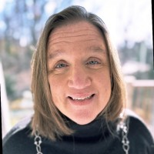
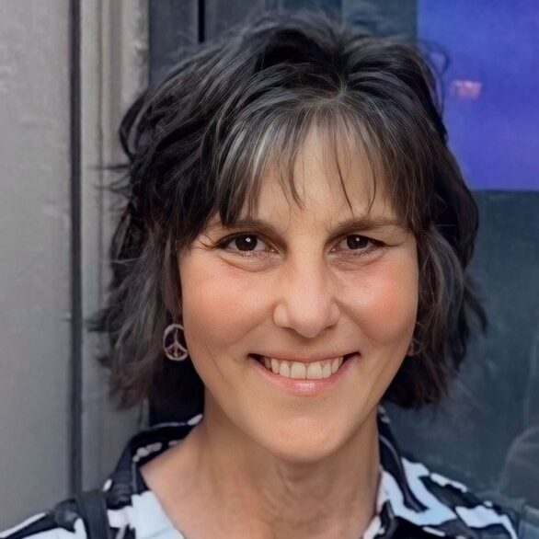
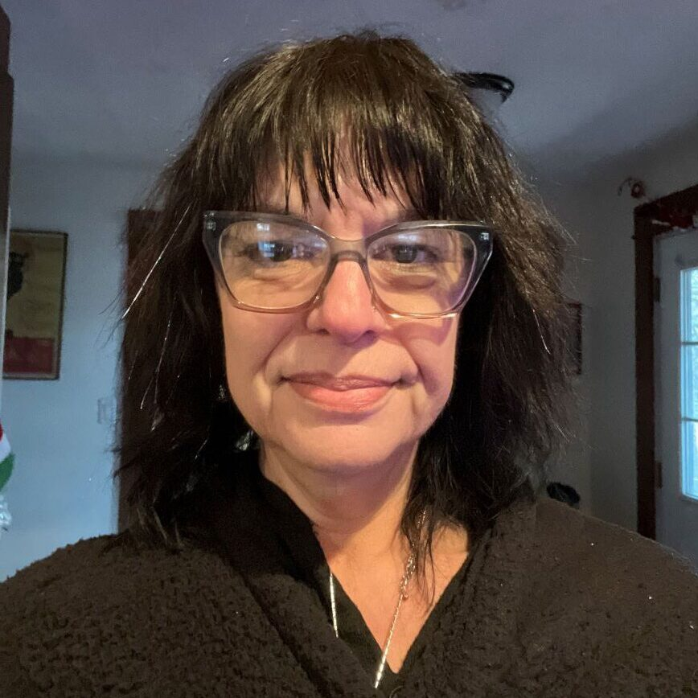
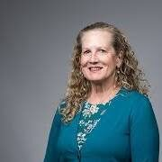
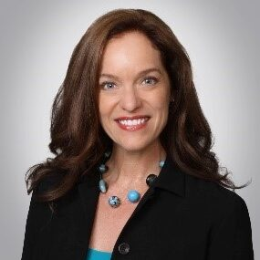
Meet the ORISE Team
Kelly O’Keefe
Research Integrity Director
Patty Guinan
COI Administrator
Sharon Pomeroy
Department Coordinator
Gunta Liders
Advisor
Zoe Hammatt
Advisor

Slide 6
Core Responsibilities
Management of research misconduct allegations and proceedings
Questionable and Detrimental Research Practices
Authorship Disputes
Serve as University’s Research Integrity Officer (RIO)
Sonya Hadrigan, AVP, Research Integrity
Oversight of research conflicts of interest/commitment (COI/C) and related committees
Responsible and Ethical Conduct of Research (RECR) education
In collaboration with the University Libraries, SMD Bioethics Center, GEPA, Office for Undergraduate Research and others!
Support for data stewardship and governance
QA, monitoring, and compliance reviews related to these areas

Slide 7
Current Priorities
Responsible and Ethical Conduct of Research
IND 501 – Expansion – Spring 2026
RECR Seminar Series
Virtues in Research Integrity: April 7, 2026
Responsible Data Stewardship: April 28, 2026
Integrity Workshops
AI
Authorship
Humanities Research
Data Stewardship & Research Integrity Tools
LabArchives
iThenticate
Proofig
ImageTwin
Policies, Forms, & Guidance
University Policy on Research Misconduct- Effective January 1, 2026
Faculty Policy on Conflict of Commitment and Conflict of Interest in Research
Survey Forms- Effective 2026 Annual Disclosure Process
Authorship & Dispute Resolution Guidance - Finalizing
Ethico (myCM) Research Complaint Forms
Communication and Outreach
ORISE Website
Partnerships & Collaborations
Advertising and Marketing Strategies

Slide 8
ORISE Contact Information:
ORISE website
ORISE@rochester.edu | (585) 276-0485
COI@rochester.edu
Hylan Hall
140 Trustee Road, 5th Floor

Slide 9
Questions?

