Slide 1

Sponsored Research Internal Controls, Compliance Reviews,
Brief Update – March 31, 2026
Note: CLASP PRESENTATION – February 24, 2026 – Slides posted on ORPA site, CLASP Toolkit
Office of University Audit (OUA):
Christopher W. Butler, Chief Audit Executive
Shirley Brown, Audit Manager
Kimberly Davis, Sr. Internal Auditor

Slide 2
Sponsored Program Award Management – Roles & Responsibilities; Partners
ORPA (Office of Research and Project Administration) – includes pre-award activities, identification of funding opportunities, grant and contract operations, training, and research outreach.
Faculty Members/Investigators
ORACS (Office of Research Accounting and Costing Standards) - Post-award activities:
Prepares and submits financial reports, Cash management, works with departments for the award close-out process.
Global Engagement, Legal Counsel, ORISE, Deans’ Offices, Accounts Payable, Purchasing, Administration & Finance, etc.
myURHR Administrators Best Practice Workgroup
Department / Research Administrator: Awareness of issues – Share in policy development – Proactively maintain up-to-date knowledge – Inform faculty of rules and regulations – “Gate keeper”
2

Slide 3
Sponsored Research - Expected Key Internal Controls
Internal Control | UR Policy | Link to document | Comments
1a. Management of Effort Commitments: “Required Internal Control related to Management of Faculty Member/Investigator Effort Commitment” | University’s Effort Reporting Policy: Section D and Appendix | https://www.rochester.edu/orpa/_assets/pdf/policy_EffortReportingPolicy.pdf Supplementary OUA expectations document, “Required Department Internal Controls for Sponsored Research Effort Reporting Policy” Compliance: 03162026-Required-Departmental-Internal-Controls-for-Sponsored-Research-Effort-Reporting1.pdf | Reviewed by University Audit as part of our Sponsored Research audits
1b Changes to Previously Certified Effort Payroll Accounting Adjustments (PAAs) (Previously “Reallocations”) | University’s Effort Reporting Policy: Section E6 | Supplementary OUA expectations document, “Required Department Internal Controls for Sponsored Research Effort Reporting Policy” Compliance: 03162026-Required-Departmental-Internal-Controls-for-Sponsored-Research-Effort-Reporting1.pdf | Reviewed by University Audit as part of our Sponsored Research audits
1c. Certification of Effort | University’s Effort Reporting Policy: Section E |  | ORACS kicks off this process and reviews
2. Fiscal Management (FAO controls) |  | OUA Guidance Document: https://www.rochester.edu/adminfinance/audit/wp-content/uploads/2024/06/FAOManagement-InternalControls-Feb2017.pdf | Reviewed by University Audit as part of our Sponsored Research audits
3

Slide 4
Sponsored Program Award Management – Effort Reporting Policy Controls
“Required Department Internal Controls for Sponsored Research Effort Reporting Policy” - The attached document is now part of the ORPA website – it links to the OUA website.
https://www.rochester.edu/orpa/policies/#sra
03162026-Required-Departmental-Internal-Controls-for-Sponsored-Research-Effort-Reporting1.pdf
4

Slide 5
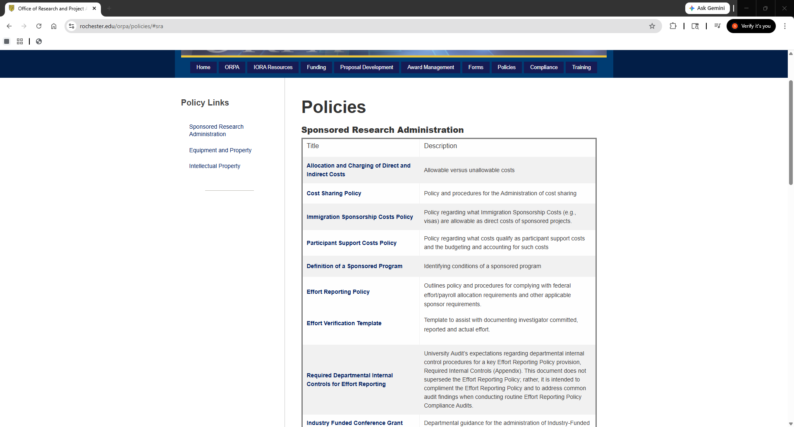
Sponsored Program Award Management – Effort Reporting Policy Controls
5

Slide 6
1a. Effort Reporting Policy Compliance - Management of Faculty Member/Investigator Effort
Commitment - Definitions
Effort | Source | Description
Committed | Per the Award | Effort promised in the award (agreed to by the Sponsor and PI); IORA system and also government web sites to obtain this information directly from the awards.
Reported | Per myURHR Workday | Effort/payroll allocation in myURHR (Workday) URHCM0391b Effort Distribution by Fiscal Period used to obtain effort/payroll allocations for selected researchers. (This report includes Salary Over the Cap and Cost Sharing)
Actual Devoted | Per the Researcher Interview | Actual work performed according to the faculty member/investigator or other responsible person with suitable means of verifying effort. All Total University Effort (TUE) - Sponsored Research, proposal writing, teaching, professional development, administrative duties, clinical practice regardless of when (daytime, evening, weekends) or where (on site, at home, traveling) the activities occur. Total University Effort is not based on a specified number of hours (e.g., 40 hours per week). Cannot have greater than 100% effort.
6

Slide 7
Sponsored Program Award Management – Roles & Responsibilities; Partners
Workday Report – new - URHCM0391b: Reported Effort by Pay Period
By worker/faculty member/investigator
Total University Effort: TUE has all effort Clinical, Research, Academics, teaching, administrative, etc.
Includes Salary Over Cap identified by:
Field ‘FAO” with OP account # and Field “Grant” with GR account#
on the same line with SC 57550
Includes mandatory or voluntary Cost Sharing, which is identified by:
Field ‘FAO” with OP account # and Field “Grant” with GR account#
on the same line (there is no spend category for cost sharing)
Can click/drill into the effort percent to see dollars
Payroll Accounting Adjustments (PAAs) – see instructions
You should be able to see all effort regardless of the home department – see instructions
7

Slide 8
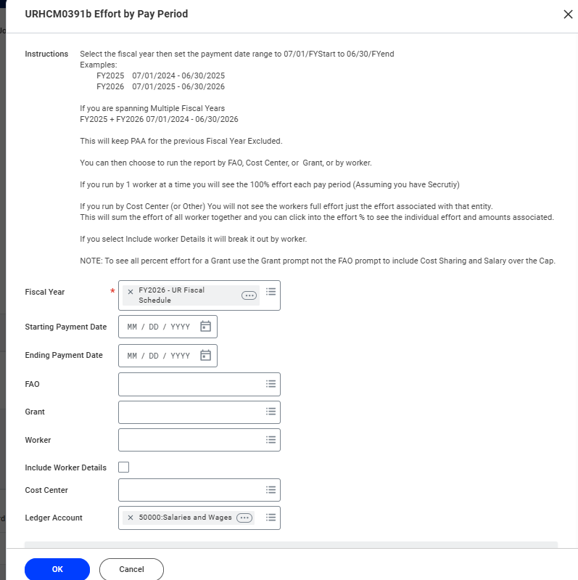
Sponsored Program Award Management – Roles & Responsibilities; Partners
Workday Report – new - URHCM0391b: Reported Effort by Pay Period
8

Slide 9
Sponsored Program Award Management – URHCM0391b example
Worker | Notes | FAO | Grant | Spend Category | 12/31/2025 | 01/31/2026 | 02/28/2026 | 03/31/2026
FACULTY name A |  | GR111111 | GR111111 Name XXX | Faculty Full Time Salaries (SC57600) | 10.00% | 10.00% | 10.00% | 10.00%
FACULTY name A |  | GR111112 | GR111112 Name XXX | Faculty Full Time Salaries (SC57600) | 10.50% | 10.50% | 10.50% | 10.50%
FACULTY name A |  | GR111113 | GR111113 Name XXX | Faculty Full Time Salaries (SC57600) | 4.00% | 4.00% | 4.00% | 4.00%
FACULTY name A |  | GR111114 | GR111114 Name XXX | Faculty Full Time Salaries (SC57600) | 14.00% | 14.00% | 14.00% | 0.00%
FACULTY name A |  | GR111115 | GR111115 Name XXX | Faculty Full Time Salaries (SC57600) | 16.00% | 16.00% | 16.00% | 16.00%
FACULTY name A | Salary over cap example | OP222222 | GR333333 Name XXX | Faculty HHS Salary Cap (SC57550) | 5.00% | 5.00% | 5.00% | 5.00%
FACULTY name A | Cost Sharing example | OP444444 | GR666666 Name XXX | Faculty Full Time Salaries (SC57600) | 7.00% | 7.00% | 7.00% | 7.00%
FACULTY name A |  | OP333333 | (Blank) | Faculty Full Time Salaries (SC57600) | 33.50% | 33.50% | 33.50% | 47.50%
Total |  |  |  |  | 100.00% | 100.00% | 100.00% | 100.00%
9

Slide 10
Sponsored Research – Pcards – Reminders
Audit Procedure: OUA will review:
Charges to Sponsored Projects: All costs incurred on a sponsored project must be reasonable, necessary, allowable and appropriate to the specific account charged.
Monthly credit limits to determine if they are being followed (obtained from Nate Hodge).
A transaction that exceeds the UR’s single purchase limit ($5,000 per purchase) has to be approved by Nate Hodge, Pcard Program Administrator, Procurement.
Check expenditures to Pcard Policy Appendix – 5A Approved and Restricted Use – examples:
Cell Phones/Smartphones:
Any such device used for University business that has wireless capability and connects to the University network must be properly vetted and encrypted through University IT to prevent the possibility of cyberattacks/hacking.
Best Practice Purchase Method: Purchase through UR Tech Store.
Computers:
May include: desktops, laptops, and tablet devices. Any such device used for University business must be properly imaged & encrypted by University IT to prevent the possibility of cyberattacks/hacking.
Such devices must also follow the standard capital asset tag process with Plant Accounting, even when the item may not meet the capital purchase threshold.
Best Practice Purchase Method: Purchase through UR Tech Store.
10

Slide 11
Sponsored Research – Subawards – important requirements
Audit Procedure: UR, as, the Pass-through-Entity (PTE) issues a subaward to another entity (subrecipient). This subrecipent sends invoices to UR for payment.
OUA will select a sample of awards for review - Run Workday Report URF0400 for Spend Category SC 57150
Subcontracts for FYXX for a cost center. For awards selected for review, OUA will ensure the following
controls are in place:
UR Subward Manual - Section F Fiscal Monitoring: https://www.rochester.edu/orpa/_assets/pdf/train_submanual.pdf
THIS SECTION IS UNDER REVIEW: Page 30 - The UR PI must approve subawardee invoices prior to submitting them to ORACS for payment. The UR PI’s review indicates that the invoice corresponds with the technical performance of the subrecipient.
Given the importance of the UR PI’s oversight, the UR PI cannot delegate this responsibility in WorkDay/UR Financials, unless the PI has manually signed the corresponding invoice.
(note: some exceptions have been granted)
Invoices are reviewed for accuracy and for compliance with the terms of the subagreement
Page 31 - Ensure the request for payment includes the following certification from either the site’s Principal Investigator or financial representative: “I certify to the best of my knowledge and belief that the information provided herein is true, complete, and accurate. I am aware that the provision of false, fictitious, or fraudulent information, or the omission of any material fact, may subject me to criminal, civil, or administrative consequences including, but not limited to violations of U.S. Code Title 18, Sections 2, 1001, 1343 and Title 31, Sections 3729-3730 and 3801-3812.”
This exact statement is required by the Uniform Code 2 CRF §200.415(a) – no partial or other statement can be accepted
Note: the certified should provide clear documentation of their name and title.
11

Slide 12
Sponsored Research – Domestic & Foreign Travel
OUA reviews expense reports and other transactions from a Federal Auditor’s perspective to ensure compliance with the University’s Sponsored Research Policies and Federal Regulations.
Incorporates the increased scrutiny by Federal agencies of universities’ use of Federal Funds to help ensure expense transactions, including those from employee expense reports, are appropriate and thoroughly documented to substantiate the charges made to Federally Sponsored Research
NOTE: the following applies to FAO “OP” accounts, as well as “GR” accounts, unless specific to the 2 CFR Part 200 Uniform Administrative Requirements, Cost Principles, and Audit Requirements for Federal Awards (“Uniform Guidance”)
Business Expense and Travel Reimbursement Policy – note: sign into Box Account
after click on link: https://rochester.app.box.com/s/qfjtx5e4mmhrk699vc06ckb70ulrvfco
12

Slide 13
Sponsored Research – Domestic & Foreign Travel
Travel reminders:
For conferences, a full copy of the agenda must be included, indicating which meals were provided.
1 trip to an expense report
Foreign Travel – see slides (applies to FAO “OP” as well as “GR” accounts)
Multiple grants being charged – document the benefit to each grant
Personal Travel – see slides for details
Car Rentals and miles – business purpose
Meals – see slides for details
Costs the government deems unrelated to University business (alcohol, entertainment) or excessive costs (business/first class travel, luxury hotels, and upgrades) cannot be charged to Sponsored Research projects.
13

Slide 14
Sponsored Research – Domestic & Foreign Travel
One Conference/One Trip per Expense Report: limited to a single conference to maintain clarity and transparency. (Frequent violations here!)
Upfront Supporting Documentation as an attachment in Workday: This should be required as part of the approval process for travel expense reports, and should include:
Agendas/itineraries: UR’s Business Expense and Travel Reimbursement Policy: When attending a conference or meeting, a full copy of the agenda must be included, indicating which meals were provided.
Substantiate the allowability of direct cost charges to awards when charging days that are outside of the conference/event dates. Note: It is an acceptable University practice to allow travel-related charges on a grant for 1 day before the conference and 1 day after.
Substantiate the allocation of direct costs to multiple grants, including the benefit to each grant and the basis for allocation.
When personal travel is involved, include:
Further explanation as to the dates and documentation to clearly separate the personal travel from the business travel, and a statement to confirm that no personal expenses were charged to UR grants or other UR accounts.
Documentation to support the Personal Travel Component at the Beginning or End of the Trip”:
”Lodging, meals, and incidentals incurred during the personal component cannot be reimbursed (from grant or department funds)
Document the comparison of the airfare cost that was incurred to what the airfare cost would have been otherwise (i.e., if the traveler did not add on the personal travel component).
The excess of the actual airfare against the “would be” airfare cannot be allocated to the sponsored project.”
14

Slide 15
Sponsored Research – Domestic & Foreign Travel
3. Direct Cost Principles:
Ensure all charges to Sponsored Research Accounts, including travel expense reports, adhere to the cost principles. For costs to be allowable, they must be necessary, reasonable -- prudent person test, allocable (can’t be assigned based on funds availability, award expiration date), and treated consistently with like costs/like circumstances.
4. Personal/Social Events:
Exclude personal/social events from grant charges that are included in registration, as they are not allowable as direct costs. If a personal/social networking event is listed separately in the registration with a specified or itemized cost, do not charge it to a grant. At the Department’s discretion, the cost can be charged to an operating account (OP).
In the event family members are also traveling with the UR Employee, fees for rental cars beyond mid-size, and incidentals such as child/infant car seats or additional drivers insurance are considered personal expenses, and are not reimbursable by the Sponsor or UR.
5. Per Diem Guidelines:
Ensure all faculty and staff are aware of Per Diem guidelines, including adjustments for meals provided by conferences and travel days. (Refer to “Workday Expenses, Reference Guides, How to Enter per Diem Meals”)
15

Slide 16
Sponsored Research – Domestic & Foreign Travel
Pre-Award Spending Federal Costing Rules:
Expenses incurred more than 90 calendar days pre-award require prior approval of the Federal Awarding Agency.
All costs incurred before the Federal awarding agency makes the Federal award are at the recipient's risk (i.e., the Federal awarding agency is not required to reimburse such costs if, for any reason, the recipient does not receive a Federal award or if the Federal award is less than anticipated and inadequate to cover such costs.
7. Foreign Travel:
UR’s Business Expense and Travel Reimbursement Policy:
“Receipts in foreign languages should be translated if the type of expense is not clear, indicating the type of purchase (e.g., meal, transportation, etc.) and the US dollar equivalency”.
To help ensure support documents are easily reviewable by internal (and potentially external) parties, we recommend the department require travelers to foreign countries to provide some additional translation for key details and elements of foreign language receipts, such as, for example, the name of the airlines, airport, other travelers on the trip, etc.
UR’s Malign Foreign Talent Recruitment Programs & Foreign Talent Recruitment Programs Policy.
8. Meals and Conf (while NOT on travel status)
In general, meals and working session ancillary foods and beverages are NOT allowed by Federal Sponsors UNLESS the employee working on research is on Travel Status. Local dinners with Lab personnel, ordering meals in for “lab meetings and discussions,” and ANYTIME spouses, or other family members, are present, those meals are NOT reimbursable by Sponsors, and only possibly allowed on Non-Federal sponsored projects if they are specifically budgeted and approved.
Local conferences MUST be included in the Proposal budget to be reimbursable by the Sponsor.
16

Slide 17
Sponsored Research University Audit Contacts
Christopher W. Butler, CPA
Chief Audit Executive, Office of University Audit
University of Rochester, Box 278931, Rochester, NY 14627
Phone: (585) 275-1099; Fax (585) 256-3444
E-Mail: chris.w.butler@rochester.edu
Kimberly A. Davis, MBA
Senior Internal Auditor
University of Rochester, Box 278931, Rochester, NY 14627
Phone: (585) 275-0671; Fax: (585) 256-3444
E-mail: kdavis56@ur.rochester.edu
Shirley F. Brown, CIA, CISA, MBA, MMM
Audit Manager
University of Rochester, Box 278931, Rochester, NY 14627
Phone: (585) 313-3866; Fax: (585) 256-3444
E-Mail: Shirley.brown@Rochester.edu
17

