Slide 1
MWBE & SDVOB Requirements on NYS Department of Health Contracts for the University of Rochester
Presented by Allyson McAuliffe & Karissa Joos

Slide 2
Topics in today’s discussion
Why is there an MWBE/SDVOB requirement on NYS contracts?
What are the NYS MWBE and SDVOB goals for a grant?
What obligations must be fulfilled to meet these goals?
Waivers – approval vs denial
How can URMC demonstrate efforts to comply?
What happens when goals are not met & the waiver is denied?
Q&A & Contact Information

Slide 3
Timeline of the MWBE Program
1988
The NYS MWBE Program is established under NYS Executive Law Article 15-A
2010
A Disparity Study is published using data from the previous 5 years. The findings from this study indicate MWBEs are being disproportionately excluded from state contracting opportunities, and the goal is raised to 10%
2011
The goal is raised from 10% to 20%, with Gov. Andrew Cuomo doubling the goal set the previous year by Gov. David Paterson
2014
Gov. Andrew Cuomo announces the MWBE goal will be raised from 20% to 30%, making this the highest MWBE utilization requirement in the country
2016
the most recent disparity study is published, again enforcing the need for the MWBE Program and its benefits to NYS communities.
2020
NYS finally achieves above 30% MWBE Utilization statewide

Slide 4
Why is there an MWBE requirement on NYS contracts?
The Disparity Studies found statistically significant gaps in the utilization of MWBEs vs non-MWBEs on state contracts.
The goal of the MWBE program is to close these gaps by promoting equality of economic opportunities for MWBEs and eliminating barriers to their participation in state contracting.
For all NYS contracts greater than or equal to $25,000, or construction contracts greater than or equal to $100,000, MWBE goal must be considered.

Slide 5
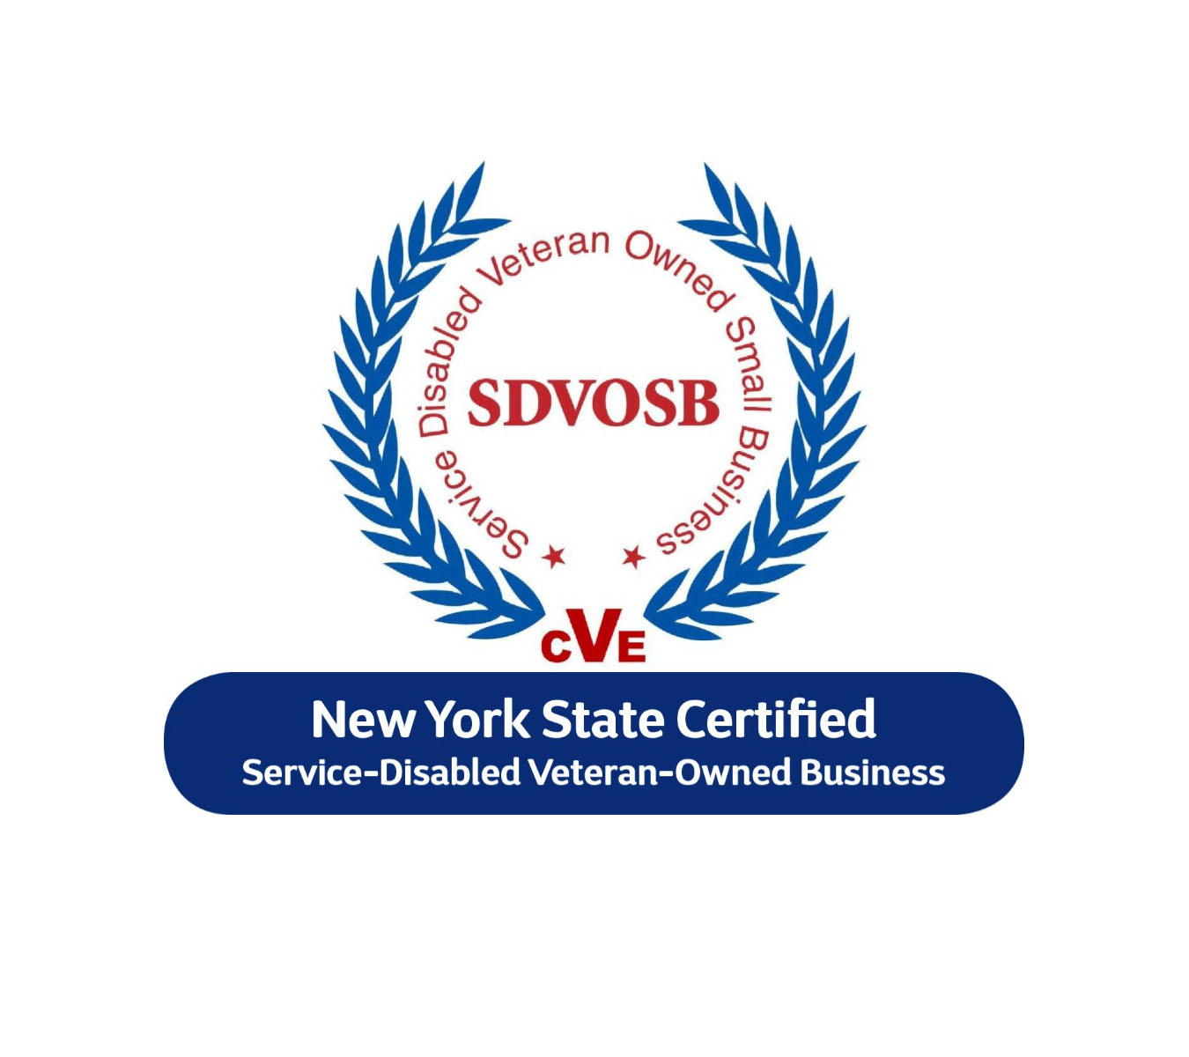
Why is there an SDVOB requirement on NYS contracts?
Established by Article 3 of the NYS Veterans’ Services Law
The goal of the SDVOB program is to encourage and support eligible Service-Disabled Veteran-Owned Businesses to play a greater role in the state's economy by increasing their participation in New York State's contracting opportunities

Slide 6
Standard MWBE & SDVOB Goals on NYS Contracts
MWBE Goal for the State, DOH, and on most of your contracts is 30% of your eligible expenses, 15% MBE and 15% WBE. This is stated in the Attachment M of your grant contracts.
SDVOB Goal for the State, DOH and on (some of) your contracts (Statewide Health Care Facility Transformation Program, or SHCFTP) 6% of your contract’s eligible expenses

Slide 7
Eligible Expenses: Capital vs Non-capital
Capital grants (usually construction contracts on healthcare facilities – SHCFTP are examples of these): only acquisition costs and debt relief can be taken out of goal calculation
Non-capital grants: should be evaluated for eligible expenses – anything that cannot be purchased from an MWBE or SDVOB can be excluded from goal

Slide 8
Category of Expense | Eligible (y/n)?
Local non-profit or not-for-profit providing services or materials Speaker fees Data pull | Y – for this to be considered a N, we would need explanation on why they were the only option for what they were providing
Travel* Educational Materials: purchase of XYZ accredited curriculum. Must be purchased from XYZ Industries.** Postage Utilities Personal Services Animals/Animal Care Core Facilities: Gene Expression Analysis** | N *only if a travel agency is used would a “travel” expense be eligible **these examples is different than below because there is reference to something specific that can only be bought from 1 vendor, or that is not found in the Directories.
Refreshments Educational Materials Marketing Office, Medical, Program* or Lab Supplies Copying or Printing Core Facilities | Y *this can be similar to the above Education Materials example

Slide 9
What obligations must be fulfilled to meet these goals?

Slide 10
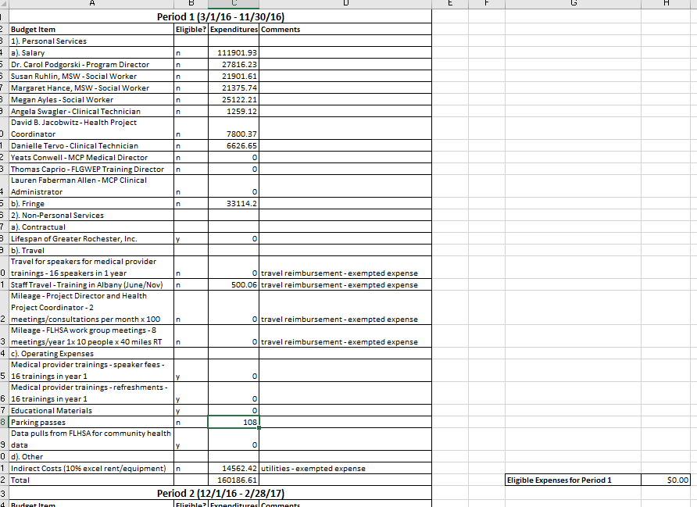
1. Accurate evaluation of eligible expenses (on non-capital contracts)
The only things that should be eligible expenses are things that can be provided by MWBEs.
Expenses like Personal Services, Utilities, stipends, or sole-source equipment should not be included in eligible expenses.

Slide 11
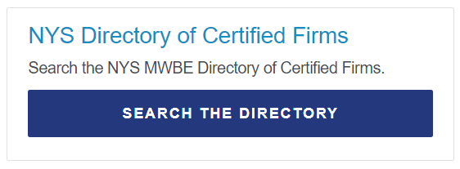
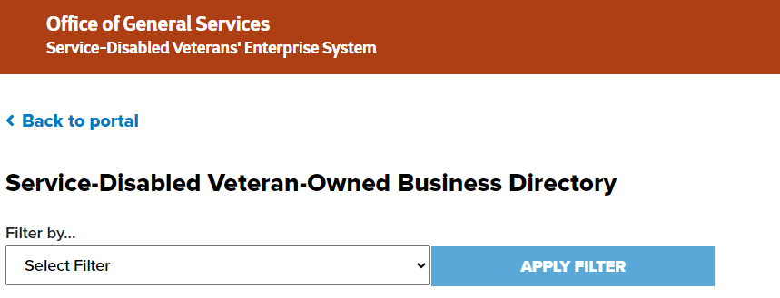
2. Outreach to MWBEs & SDVOBs
Resources & best practices: work with University’s supplier diversity office
Searching the MWBE & SDVOB Directories
Documentation of procurements
Keeping record of outreach attempts & conversations with MWBEs and SDVOBs
If you are concerned about meeting your goals at any point during the contract, please reach out to us

Slide 12
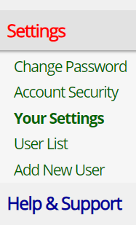
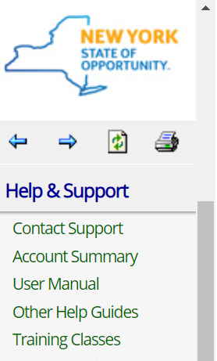
3. Ensuring your contact information is up-to-date
The users on your vendor account in the NYS Contract System can be managed through your profiles. There are guides on this available in Help & Support
Our SDVOB tracker is currently a very manual process – be sure to tell us directly if contact information for these notifications should be updated.

Slide 13
4. MWBE/SDVOBs Obligations versus Project Obligations
If using an MWBE/SDVOB over a non-certified competitor, documentation of this choice is strongly recommended
Documenting any issues meeting goal is a recommended best practice that benefits both the prime vendor and DOH

Slide 14
5. Responding to Quarterly Reporting Notifications
The NYS Contract System has an option for “No Payments Made” if MWBEs were not paid during an audit period
Currently there is no site to report SDVOB payments like there is for MWBE.
Instead, we send out the Reporting Form from mwbe@health.ny.gov for you to complete, sign, then send back to us.
Even if you haven’t made any SDVOB payments for the quarter, please respond to these notifications

Slide 15
Waiver Approval
Waivers get approved when there is no doubt a prime vendor made every effort possible to contract with MWBEs/SDVOBs, but it was not possible due to a variety of circumstances.
Waivers usually consist of the following:
Waiver forms completed & signed
A detailed budget breakdown
Directory searches by NAICS/NIGP/CSI codes and business description for each eligible expense
For any results from these searches, solicitation responses from the MWBE/SDVOBs if they were unable to do work on this contract & why
A narrative/explanation of why the goal wasn’t met
Please note: a waiver cannot be automatically approved at time of submission. It must go through a multi-tier review process before it can be approved.

Slide 16
Waiver Denial
Denials occur when we cannot be certain every effort was made to contract with MWBEs/SDVOBs.
We have had to deny waivers based on lack of documentation – this is why it’s so important to gather & keep documentation throughout the life of the contract.

Slide 17
How can the University demonstrate efforts to comply?
Communication & asking questions.
Regular outreach efforts to MWBEs and SDVOBs.
Keeping documentation in case a waiver is needed.
Work with your Supplier Diversity Office

Slide 18
What happens when goals are not met & the waiver is denied?
An update to your Vendor Responsibility profile explaining the situation
Per the Attachment M: “Where New York State Department of Health determines that Contractor is not in compliance with the requirements of the Contract and Contractor refuses to comply with such requirements, or if Contractor is found to have willfully and intentionally failed to comply with the MWBE participation goals, Contractor shall be obligated to pay to the New York State Department of Health liquidated damages.”
Per the Attachment V: “In accordance with 9 NYCRR § 252.2(s), any Contractor found to have willfully and intentionally failed to comply with the SDVOB participation goals set forth in the Contract, shall be found to have breached the contract and Contractor shall pay damages as set forth therein.”

Slide 19
In Conclusion
Keep open communication with us – we are happy to answer questions & work with you.
Keep documentation of good faith efforts to meet goals throughout the life of your contracts
We all have a vested interest in the success of your contracts and achieving MWBE & SDVOB goals.
Collaboration with your Supplier Diversity office & their resources

Slide 20
Helpful Links
2016 Disparity Study
Article 15A of NYS Executive Law
Article 3 of NYS Veterans’ Serivces Law
NYS MWBE Directory
NYS SDVOB Directory
9 CRR-NY 252.2
Division of Minority and Women-Owned Business Development (DMWBD) Annual Fiscal Report 2022-23
Reauthorization of Article 15-A FAQ

Slide 21
Questions & Contact Information
Our MWBE inbox: mwbe@health.ny.gov
Our MWBE phone number: 518-918-8842
Our main office line: 518-474-7896
Our MWBE website: https://health.ny.gov/funding/mwbe/
Presenters
Allyson McAuliffe (Vendor Outreach); allyson.mcauliffe@health.ny.gov
Karissa Joos (Assistant Director, Financial Administration); Karissa.joos@health.ny.gov

