Slide 1
Compliance support from Miner library
Linda hasman, msls
Edward G. Miner library

Slide 2
NIH Public Access policy support
What is NIH Public Access Policy?
  All peer-reviewed articles resulting from NIH support must be loaded into PubMed Central within 3-months of acceptance.
How can Miner help?
  Monitor your department’s non-compliant papers/authors
  Facilitate contacting publishers
  Upload (or assist) loading your manuscripts
  Classes
  Stay on top of new compliance policies
    Wait! What? New policies???

Slide 3
Agency | Article | Data
ACL/ NIDILRR (HHS/NIH) | PMC | TBD
AHRQ | PMC | TBD
ASPR (HHS) | PMC | Scientific data repositories (data.gov data registry)
CDC | CDC Stacks (NIHMS system) | Multiple solutions + data registry
FDA | PMC | Disciplinary data repositories, where available
NASA | PMC | NASA archives, or other repository
NIST | PMC | EDI registry of datasets
NIH | PMC | Varied
NSF | NSF-PAR | Varied
VA | PMC | Varied
Notes:
WH directive from the Office of Science and Technology in 2013 mandating that federal agencies who award more that $100 million in research funds need to come up with a plan to make data and resulting publications accessible to the public.

Slide 4
MyNCBI/MyBibliography help
My NCBI is a tool that offers many useful features:
Saving PubMed searches. (and automatically have search results sent to you).
Saving Collections of citations found in PubMed.
Customization of the filters and results display in PubMed.
My NCBI has a tool named My Bibliography which allows you to save your citations either directly from PubMed or by manually entering them. Once citations are in My Bibliography you can easily:
Monitor whether your publications comply with the NIH Public Access Policy
Start the compliance process for journal articles
Associate your publications to awards
MyNCBI
Notes:
<Live demo>

Slide 5
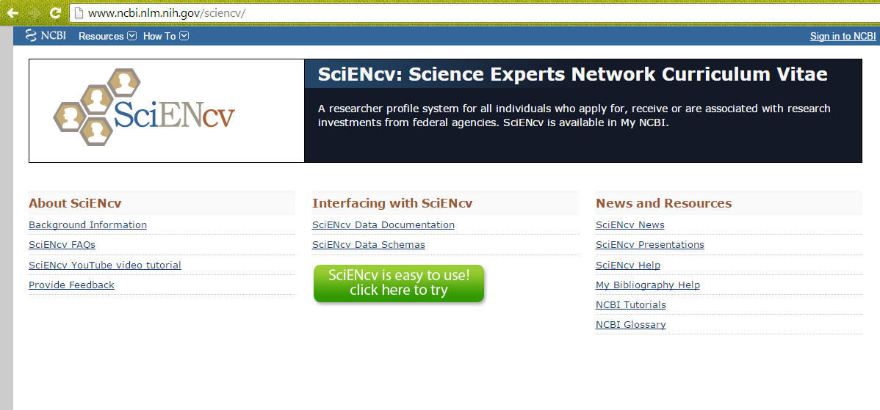
Science Experts Network Curriculum Vitae: SciENcv
SciENcv is a tool for biosketch management and generation.
SciENcv is located in My NCBI, a personal research dashboard from NCBI.

Slide 6
SciENcv/biosketch/myncbi…oh my!
Miner can help:
  Guidance on setting up biosketch
  Use biosketch to create SciENcv
  Link eRA to MyNCBI/MyBibliography
  Help create public links to MyBibliography
Notes:
Biosketch is designed to highlight accomplishments, not a list of publications
→Guidance with – create, format, import publications and grants, how to separate authored vs. unauthored publications
-->

Slide 7
Data management support: plans
What is a data management plan?
  A data management plan provides an outline detailing how a researcher plans to manage data during and after a research project including how it will be organized, maintained and shared.
Why do you need one?
  More and more funding agencies are now requiring researchers to submit a formal data management plan (DMP) when applying for grants including the National Science Foundation (NSF) and National Institutes for Health (NIH).
Notes:
Varying degrees of detail for each

Slide 8
Data management Support
Provide assistance:
  Organizing data
    Advice on file naming and file formats
  Documenting data
    Metadata schema
  Storing and citing data
    Assist with finding the appropriate repository
Notes:
→Yes, I will come to your desk and help you clean up your filing system for projects
Help find an appropriate metadata schema – depends on the type of data. For instance, biological data will be different from survey data and require different schemas.
Organizing data – this, if you’ll recall, goes back to an earlier slide on data sharing standards.

Slide 9

Miner library compliance support
How to request
How to request:
  Contact me
    Linda Hasman
    linda_hasman@urmc.rochester.edu
    275-3399
  Ask A Librarian
Notes:
<Live demo>

Slide 10
Miner library compliance support lead time
NIH Public and other public access policies
  Couple days to a week
MyNCBI/Biosketch/SciENcv
  Couple days to a week
Data Management
  Week to two weeks
Notes:
This is not set in stone – feel free to contact me anytime

Slide 11
Miner library compliance support fees
Free

Slide 12
Other services from miner
Expert literature searches
Endnote and RefWorks support
Blackboard classes
Bio 101 series
Library Liaison
Notes:
<Live demo>

Slide 13
Questions?
Linda Hasman, MSLS
Linda_Hasman@urmc.rochester.edu
275-3399

