Slide 1

Annual Update
2023

Slide 2
Agenda Topics
Fixed Asset Policy Changes
Effort Reporting in WorkDay
Faculty Sabbaticals
SciENcv
NIH Foreign Subawards
NSPM-33 Update and Draft Standard Requirements
TikTok Prohibition
CHIPS and Science Act Requirements
Foreign Corrupt Practices Act
Recent Research Security Guidance
Subcontract monitoring: special award terms and conditions
UR GEMS
2 CFR 200 Training
Integrity Hotline

Slide 3
Fixed Asset Policy Changes
Effective 7/1/24, the UR capitalization threshold for purchases will increase to $5,000 per unit.
Indirect costs will be applied to expenditures for items with a purchase price of less than $5,000, billed on or after 7/1/24.
For all future proposal submissions, proposal budgets should be prepared such that they reflect the new $5,000 capitalization threshold.
Equipment purchased prior to 7/1/24 for less than $5,000 will still need to be tracked in URSpace if the equipment is being utilized for the intended purpose.

Slide 4
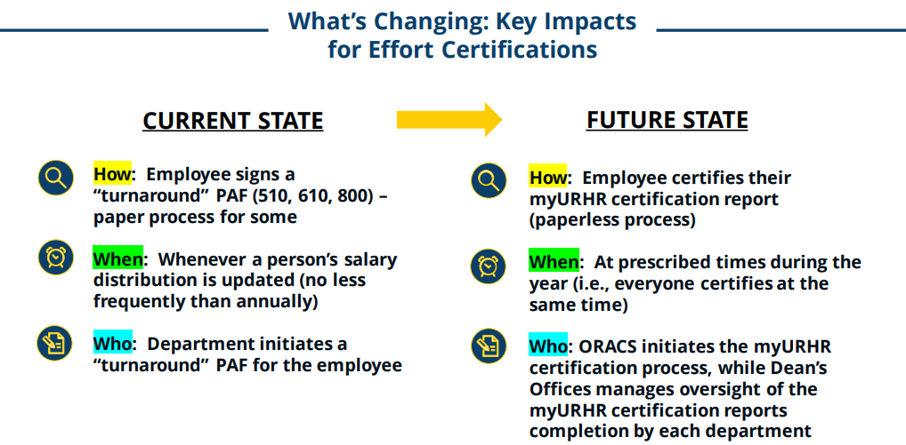
Effort Reporting in WorkDay

Slide 5
Faculty Sabbaticals
Matters to Consider Before Requesting Dean’s Office approval
Will the Principal Investigator/Key Personnel be disengaged from his/her project(s) for more than 3 months, or will effort be reduced by 25% or more?
  Approval from sponsor(s) may be needed.
    Early career awards, NIH MIRA awards might not allow the proposed arrangement.
  Consider whether a substitute PI may be required.
  Consider alternate graduate mentor and funding source(s).

Slide 6
Faculty Sabbaticals
Matters to Consider Before Requesting
Dean’s Office approval
Is research to be done at another third party entity/institution, during the sabbatical?
  ALL research must be disclosed on the Investigator’s Current and Pending Support statements.
  Is there overlap with the UR sponsored projects?
  Are there Intellectual Property restrictions that might conflict with UR policies or sponsored research?
  Is there a request to sign a Non-Disclosure Agreement and does its terms conflict with obligations to UR and/or sponsors?

Slide 7
Faculty Sabbaticals
Matters to Consider Before Requesting
Dean’s Office approval
Will the sabbatical work involve an appointment or an affiliation with a foreign entity?
  Discuss details with the Dean’s Office and consult the Guidance on International Appointments and Affiliations
Finally, if sponsored programs are involved, contact your ORPA RA.

Slide 8
NSF Now Requires SciENcv
Beginning on October 20, 2023, NSF requires SciENcv for the preparation of the Biographical Sketch and Current and Pending (Other) Support documents.
The fillable PDF template available now will no longer be accepted.

Slide 9
What is SciENcv ?
“A researcher profile system for all individuals who apply for, receive, or are associated with research investments from federal agencies”
Generates a biographical sketch (biosketch) for NIH, NSF and Dept of Ed
Generates Current & Pending Support for NSF
Integrates with existing researcher profiles (NCBI MyBibliography and ORCiD)
Integrates with funder systems (eRA Commons and NSF Research.gov)
Delegated access for staff to access and populate documents
PI/Key Personnel electronically certify the content is accurate (NSF)

Slide 10
SciENcv Helpful Tools and Videos
NSF Senior Personnel Documents
FAQs on NSF Other Support
NSF SciENcv Biosketch Tutorial video
NSF Biographical Sketch and Current and Pending (Other) Support: SciENcv and NSF Formats (January 2023 Webinar)
SciENcv Help Manual, NSF specific section

Slide 11
NIH Foreign
Subawards/Consortium Agreements
Effective January 2, 2024 the NIH “will not support any agreement” that does not include the new requirement for foreign subrecipients to “provide access to lab notebooks, data and documentation supporting research outcomes” as described in the annual progress report and to do so in alignment with the progress report’s submission (once per year).

Slide 12
NIH Foreign
Subawards/Consortium Agreements
Access may be electronic
The requirement was prompted by a DHHS OIG Audit and a GAO audit of NIH.
NIH has stressed that this is not a “new” requirement, but a clarification.
Applies to ALL foreign subawards, not just countries of concern

Slide 13
NIH Foreign
Subawards/Consortium Agreements
UR/ORPA will require that foreign subrecipients, at the application stage, submit language in their letters of intent indicating awareness and willingness to abide.
UR/ORPA will update existing NIH subawards to foreign subrecipients within 60 days of the effective date (1/2/24).

Slide 14
NSPM-33 Research Security Program
Status Update
Institutions continue to wait for final issuance of NSPM-33 research security program requirements.
  Draft issued in March 2023; Final regulations expected Q1 2024
  UR will have a one-year implementation period from the final issuance date and will be required to provide a status update 120 days from issuance.
UR VPR Office issued status update regarding NSPM-33 and implementation matters.
  Particular focus on cybersecurity and foreign travel requirements
  International Visitor Working Group meetings have begun
NSPM-33 Working Group and applicable subcommittees will coordinate implementation of requirements.

Slide 15
NSPM-33 Draft Standard Requirements
(Minimum)
Cybersecurity – Required controls must be implemented (IT and IT Cybersecurity leading effort)
  Potential for significant impact to researchers
  IT and Information Security are conducting inventory and “proof of concept” activities to determine compliance needs.
  Will include other security policy / control changes
Foreign Travel – Requires organizational record (pre-registration), prior authorization and security briefings as needed
  University may need to modify travel policies to provide that prior registration of University-sponsored or supported international travel is mandatory for faculty.

Slide 16
NSPM - 33 Draft Standard Requirements
(Minimum)
Research Security Training - mandatory tailored training to “covered individuals”
Export Control - Training to “relevant” personnel
International visitor review will be incorporated into Research Security Program.
Final standards will (hopefully) bring clarity on risk-based approaches and scope / definition issues.

Slide 17
FAR Clause 52.204-27 – TikTok Prohibition
Responds to national security and user privacy concerns regarding TikTok application
New FAR Clause applies to University contracts (not grants at this time) and prohibits use of TikTok or other ByteDance Limited applications on devices (cell phones; computers) used in connection with work under a federal contract. Includes personally-owned devices as well. UR issued compliance notice on August 31, 2023.
UR PIs are asked to certify compliance.

Slide 18
FAR Clause 52.204-27 – TikTok Prohibition
Individuals are prohibited from having, or using, TikTok or any successor application or service by ByteDance Limited on any IT equipment or system used under a federal contract that contains FAR clause 52.204-27 (including on a personal device).
Individuals who have the TikTok application on a personally owned device (computer or cell phone), and who use or intend to use such device in the performance of a federal contract that contains FAR clause 52.204-27, must remove the TikTok application.
Individuals using a fully managed device should contact UR IT for assistance in blocking / removing application.

Slide 19
New for 2024 – CHIPS and
Science Act Requirements
Major appropriations for semiconductor manufacturing and research; includes key research security provisions; not yet fully implemented
Annual reporting to NSF on foreign support: Gifts and contracts of $50,000 (cumulative) or more from a foreign source associated with a “foreign county of concern” (China, North Korea, Russia and Iran). Copies to be provided to NSF.
  This is in addition to current gift/contract reporting to the Department of Education.
Requires federal agencies to establish policies requiring covered individuals to certify they are not part of a “malign foreign talent recruitment program” (MFTRP).
  New Common Form for Bio Sketch and Current and Pending (Other) Support include MFTRP certification. Not yet implemented.

Slide 20
Foreign Corrupt Practices Act (FCPA)
University issued FCPA guidance in 2023.
Very broad prohibitions
  Employees may not pay / offer to pay “anything of value” to a “foreign official” in order to influence the foreign official’s actions or decisions.
  Applies in all University activities – pay close attention to research activities, fieldwork, business activities

Slide 21
Foreign Corrupt Practices Act (FCPA)
“Foreign Official” – Could be faculty / administrators at university or hospital overseen by foreign government, or employees at government agencies / government research institutions
“Anything of Value” - cash, non-cash gifts, loans, entertainment expenses, travel, meals, employment opportunities, scholarships or educational programs, uncompensated uses of the University’s facilities, and charitable donations. There is no monetary threshold under the FCPA.

Slide 22
Foreign Corrupt Practices Act (FCPA)
Legitimate payment for goods and services are permissible
  Follow established processes (UR Purchasing for procurement of goods and services, ORPA for subawards)
Gifts may not be given with the intent to influence a foreign official in a manner prohibited by the FCPA.
Conduct due diligence on third parties; review Transparency International resources.
Contact Global Engagement / Office of Counsel with questions.

Slide 23
Recent Research Security Guidance
VPR website includes two new important guidance documents:
  International Appointments and Affiliations (including during academic leave)
  Foreign Talent Recruitment Programs (a focus of CHIPS and Science Act of 2022)
Federal agencies are placing significant focus on these areas.
More updates to come – Export Controls, Key Disclosure Issues, Information Security for International Travelers

Slide 24
Subcontract monitoring –
Special award terms and conditions
During the Risk Assessment process performed by Director of Research Compliance and either Assistant Controller or Controller, special terms and conditions might be written into subcontracts to other-than-low-risk subcontract entities.

Slide 25
Subcontract monitoring –
Special award terms and conditions
Some examples of other-than-low-risk entities are:
Entities with 2 CFR 200 audit reports containing potentially relevant audit findings (e.g., internal control weaknesses and/or questioned costs);
Foreign entities that do not have 2 CFR 200 audits and who are not familiar with U.S. federal regulations; and
Small start-up companies that do not have 2 CFR 200 audits and who might not have certain basic internal controls (such as segregation of duties) because of their size.

Slide 26
Subcontract monitoring –
Special award terms and conditions
Some examples of special terms and conditions are:
Invoices to contain actual hours worked multiplied by the person’s imputed rate of pay (using current salary). Hours to be “signed off” by the employee. Imputed rate of pay to be “signed off” by the entity’s controller.
Providing proof of receipt and proof of cost for all equipment purchased using the subcontract funding
Providing an updated 2 CFR 200 audit report by a specific date, or else the subcontract will be terminated.

Slide 27
URGEMS
  URGEMS (University of Rochester General Encumbrance Management System) has been a shadow system available at the University for over a decade. It is used to track and manage transaction details that shadow the UR Financials system, for both grant and non-grant accounts.
  Over the past few years, there was a lack of technical support for this system. SMD has invested resources so that we can provide system upgrades and enhancements to reinvigorate URGEMS.

Slide 28
URGEMS Timeline
Early 2023
  SMD Core URGEMS group established
Summer 2023 – present
  Core Team partnered with University IT to fix system “bugs”, update the platform and test functionality.
Winter and Spring 2024
  Univ IT is working on enhancements.
Spring and Summer 2024
  Core Team to provide office hours and hands on training

Slide 29
2 CFR 200 Training
As part of ensuring compliance with 2 CFR 200 procurement regulations, a 10 minute MyPath training is available.
All CLASP certified administrators should complete the MyPath training.
Additionally, all individuals who have been delegated the authority to purchase goods/services on federal projects should complete the training to become acquainted with the 2 CFR 200 procurement requirements.

Slide 30
2 CFR 200 Training
Please ask your Principal Investigators – who have active federal projects - to provide you the names of who they have given authority to procure goods/services on these projects.
Send me the names and I will compare to the MyPath course completion roster. For any name not on the roster, I will then send an email request to the person to complete the training.
jmaiman@ur.Rochester.edu

Slide 31
2 CFR 200 Training
What is covered in the 10 minute MyPath training?
Principle of Larger Transactions Requiring More Diligence
  Micro Purchases (less than $25,000)
  Simplified Acquisition Threshold ($25,000 - $249,999)
  Competitive Proposal Threshold ($250,000 or greater)
Completion of the SPJCI Form

Slide 32

Integrity Hotline
The University’s Integrity Hotline (585-756-8888) is available to all University community members who would like to communicate any ethics, compliance or conduct concerns.

