Slide 1

NIH Training Grants 2018
Proposal to Closeout
Brenda Kavanaugh, Associate Director
Office of Research & Project Administration

Slide 2
Objectives
Institutional Training Grants (T)
    Proposal Development
    Post Award Management
    Closeout

Slide 3
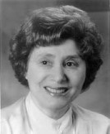
Ruth L. Kirschstein
1927-2009
First female Director of an
NIH Institute
Later, Deputy Director and
Acting Director of NIH
Her work led to the Polio vaccine that virtually eliminated the disease
Strong advocate for research training, especially inclusion of underrepresented individuals in science
Congress renamed the program in her honor in 2002

Slide 4
What is an NIH “Institutional training grant”?
Assistance award (T32, T34, T35, T36, T90)
Awarded to eligible institutions
  “to develop or enhance research training opportunities for individuals, selected by the institution, who are training for careers in specified areas of biomedical, behavioral and clinical research”
  NRSA = National Research Service Award

Slide 5
Why does NIH award institutional training grants and why do we want them?
Enhances predoctoral and postdoctoral research training
Helps ensure adequate numbers of diverse and highly trained scientists to assume leadership roles related to the Nation’s biomedical and behavioral research agenda
Provides stipend and tuition support for graduate students and post-docs

Slide 6
Acceptable Training Activities
  Basic Biomedical
  Clinical
  Behavioral
  Social
  Other if relevant to the NIH Mission

Slide 7
NIH Institutional Training Grant:
“A grant of a different color”
Proposal stage - different forms, different budget guidelines, significant amount of data required for submission, xTRACT
Post-award process – more forms, x-Train, payback agreements, tracking of slots, strict policy for allowable expenses and rebudgeting, unliquidated obligations, challenging close-out process

Slide 8
NIH Institutional Training Grant:
(T award) Deadlines https://grants.nih.gov/grants/guide/contacts/parent-T32-institutional-research.html
Institute | Jan 25 | May 25 | Sept 25 | Short-term trainee allowed? | Travel Costs? | Letter for > $500k needed? | other
NCI | X | X | X | N | Contact | Y
NEI |  | X |  | Contact | Contact | N | AIDS Sept 7
NHLBI | X all |  | X Resub only | Yes, summer | Up to $1400 per | Y | AIDS May 7
NHGRI | R | New | R | N | Contact | Y | New submitted May 25. Competing renewal or resubmission any date
NIA |  | X |  | Contact | Contact | Y | AIDS September 7
NIAAA |  | X |  | Y | Contact | Y | AIDS September 7
NIAID | X |  | X | Y | $1k per trainee | Y | AIDS January 7 and May 7
NIAMS |  | X |  | Y | $1k per trainee | Y
NIBIB |  | X |  | N | $1k per trainee | Y | See specific info
NICHD |  | X |  | Y | $500 per trainee | Y
NIDCD |  | X |  | Y | $800 per trainee | Y
NIDDK |  | X |  | Y | $1000 per trainee | Y
NIDA |  | X |  | Y | $1000 per trainee | Y | AIDS September 7
NIEHS |  | X |  | Y | $300 pre / $600 Post | Y
NIGMS | Predoc Postdoc | Predoc | Predoc | N | $300 per trainee | N | Postdoc T32 only accepted January 25 deadline
NIMH |  | X |  | Y, med students | $750 pre / $1200 post | Y | AIDS September 7
NINDS |  | X |  | N | $500 per trainee | N
NINR |  | X |  | N | $800 per trainee | Y
NCCAM | X |  |  | Y | contact | XX | May not exceed $400k per year
ORIP | X | X | X | N | contact | Y

Slide 9
Proposal Stage: What do I do first?
IC specific web sites
  Additional IC specific Program Announcements
  Institutional NRSA parent announcement
    https://grants.nih.gov/grants/guide/pa-files/PA-18-403.html
SF424 Instructions (Specific to Institutional NRSAs)
    “Additional Information for Training”
http://grants.nih.gov/grants/how-to-apply-application-guide/forms-e/training-forms-e.pdf
Institutional Training Grant Home Page (links to policies, forms, current parent announcement, etc.)
    http://grants.nih.gov/training/nrsa.htm
NIH Grants Policy Statement
http://grants.nih.gov/grants/policy/nihgps/nihgps.pdf

Slide 10
Proposal Stage: What do I do first?
Introduction to data tables (Appendix A)
  https://grants.nih.gov/grants/funding/datatables/datatables_intro.pdf
Instructions and Sample Data Tables (Appendix B)
  https://grants.nih.gov/grants/funding/datatables/Consolidated_Training_Tables.pdf

Slide 11
Submission Options
SF424 Downloadable package discontinued
Grants.gov WorkSpace why would you want to?
ASSIST (Application Submission System & interface for Submission Tracking) compatible
  Secure web-based data entry
  Collaboration of multiple users
  Pre-submission validation
  Pre-population of data from eRA Commons
  Pre-submission print/preview of application

Slide 12
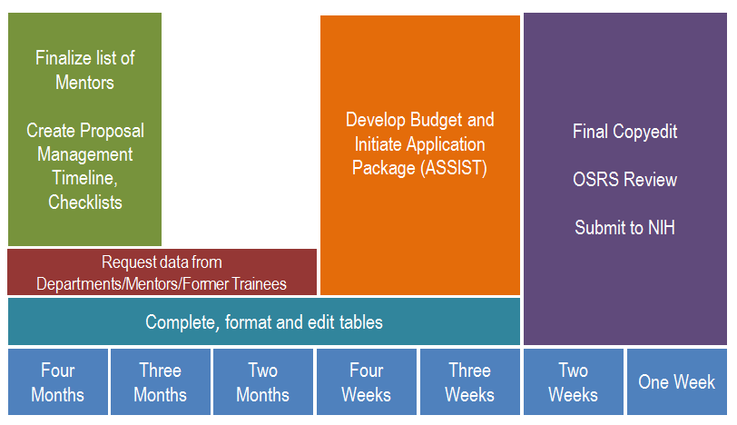
When to start?

Slide 13

Remember!!!
$500,000 direct costs or more per year
(Check specific IC website to be certain this applies)
Contact the IC program staff at least 6 weeks before submission (must be countersigned by Institutional Official!)
(Some ICs have specific request forms)
Obtain agreement from staff to accept the application
Identify the IC staff member in mandatory cover letter submitted with the application (the acceptance letter must be included with the cover letter)
NIH will not accept application without documentation of permission to submit!

Slide 14

PD/PI Preliminary Preparation
Identify the mentors/preceptors/trainers
Determine the type of “slots” (trainees)
  Undergrads
  Pre-docs (Graduate Students)
  Post docs
  “short-term research training” (3-6 months)
    students in health professional degree programs
Determine number of “slots” to request

Slide 15
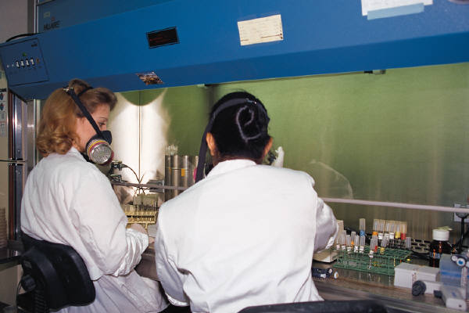
What is a Mentor/Preceptor/Trainer?
Individuals who contribute to the training program and are involved in the area of research that is the focus of the training program
Faculty who will mentor the trainees appointed to the training grant

Slide 16
What does a mentor provide for submission?
NIH Biosketch – 5 page format (T. 240)
Mentoring Record (Table 2)
Research Interests (Table 2)
Research Support (Table 4) https://grants.nih.gov/grants/forms/othersupport.htm
How identified preceptors have cooperated, interacted and collaborated in the past (T. 420, B. Program Plan, b. Program Faculty)
Publications of trainees (Table 5)
Information regarding resources available to trainees (T. 220)
Other information as may be required for the tables
  Keep checking with the PD/PI for updates to the list of preceptors!

Slide 17

SF424 Training Instructions – T. 200
SF 424 R & R Form - Standard Information required, Institutional, PD/PI specific, AOR, application type, application title, etc.
12. Proposed Project
  Typical start date:

Slide 18
SF424 Training Instructions – T. 200
SF 424 R & R Form
21. Cover Letter Attachment
  No longer used to designate review
  Not shared with peer reviewers
  Should include:
    Application title
    Identification of funding opportunity announcement (PA or RFA)
    Rationale if changed/corrected application
    Explanation of any subaward budget components not active for all proposed periods
    Advanced approval to submit
    Intent to submit a video
    Genomic Data Sharing policy (if applicable)

Slide 19
SF 424 Training Instructions, T. 210
Special Instructions for Cover Page Supplement
3. Program Income – Check “No”
Inventions and Patents – Check “No”
Change of Investigator/Change of Institution

Slide 20

SF 424 Training Instructions, T. 220
Other Project Information Form
1. Human Subjects – Check “Yes” if training
plans include or potentially will include involvement of trainees in projects that include human subjects
2. Vertebrate Animals – Check “Yes” if training plans include or potentially will include trainees in projects involving the use of vertebrate animals at any time during the proposed project period

Slide 21
SF 424 Training Instructions, T. 220
Other Project Information Form
7. Project Summary/Abstract (30 line maximum)
  Objectives, rationale and design of the research training program.
  Research areas and scientific disciplines encompassed by the program.
  Description of levels of trainees and length of training experience

Slide 22

SF 424 Training Instructions, T. 220
Other Project Information Form
8. Project Narrative ( 2-3 sentences)
  Relevance of this research training program to public health (lay language)
9. Bibliography & References Cited
  References supporting the need, rationale and approach for the training program. Do not include publications of project directors, mentors or trainees
10. Facilities/Resources
  Used in the training program
  How organization will support the training
11. Equipment
12. Other Attachments – per the FOA

Slide 23
SF 424 Training Instructions, T. 230
Project/Performance Site Locations
      List all of the locations where training, program management, and research training experiences as described in the Research Training Program Plan will be performed, including any foreign sites

Slide 24
SF 424 Training Instructions, T. 240
Senior/Key Person Profile (Expanded) Component
  Only for PD/PI and other individuals whose contributions are critical to Research Training Program Plan
  Do not include proposed mentors and training faculty members in this section
    Included in the PHS 398 Research Training Program Plan
  If MPI, assign the PD/PI role to all

Slide 25

SF 424 Training Instructions, T. 300
Research & Related Budget Form
Do not use for NRSA Institutional Training Grants unless
required in an FOA or IC specific notice
Research & Related Subaward Budget Form
Do not use for NRSA Institutional Training Grants unless
required in an FOA or IC specific notice

Slide 26
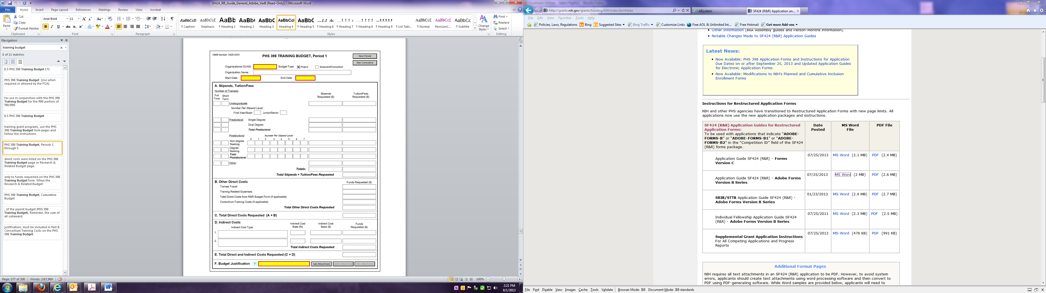

Slide 27

SF 424 Training Instructions, T.330
PHS 398 Training Budget Form
  Part A. Stipends
  Enter # of trainees
  Total stipend amount
  Use current rates available at
  https://grants.nih.gov/grants/guide/notice-files/NOT-OD-18-175.html (Appendix C)
  If a category contains different stipend levels, itemize in the appropriate blocks
  No escalation in future years except for tuition and perhaps travel (per IC guidelines)
  Enter the total stipends for all categories

Slide 28

SF 424 Training Instructions, T. 330
PHS 398 Training Budget Form
Part A. Tuition/Fees
  Tuition at postdoc level is limited to specified courses to be described in Budget Justification (Section F), and may depend on whether postdocs will be in a formal degree granting program.
  Tuition and fees requested must equal that charged to regular non-Federally supported predoc and postdoc fellows
    As needed, divide trainees into non-degree-seeking and degree-seeking categories
  Health insurance is not part of this budget category!
  Escalation in future years allowable
  Request full needs - current formula will be applied by NIH awarding component at the time of award

Slide 29

SF 424 Training Instructions, T. 330
PHS 398 Training Budget Form
Part B. Other Direct Costs
Trainee Travel
    Awarded on a per trainee basis
    Allowability and amounts vary between institutes – Check the FOA and the Institutes website!
    Normally used for travel to scientific meetings
    Travel between residence and domestic training site not allowed (with exceptions)
    Travel to foreign institutes may be allowable
      Fly America/Open Skies

Slide 30

SF 424 Training Instructions, T. 330
  Part B. Other Direct Costs
  Training Related Expenses (TRE)
    Formula calculated on a per trainee basis
  Currently $4,200 for Predoctoral trainees, $9,850 for Postdoctoral trainees
    Awarded as a lump sum
  May be used for:
  health insurance staff travel
  PD/PI and/or staff salaries equipment
  consultant costs research supplies
  other expenses directly related to the training program
  Current TRE level will be applied at time of award

Slide 31

Remember!!
Health insurance/fees – part of Training Related Expenses
  Can be re-budgeted
  Family coverage is an allowable expense
  NIH will not award supplemental funding for family coverage

Slide 32
NRSA Stipend & Other Budgetary Levels Effective for FY 2018 (Appendix C)
Institutional Training Grants
Award Category | Predoctoral | Postdoctoral
Stipend (FY18) | $24,324 | $48,432-$59,736
Tuition/Fees | 60% up to $16,000 | 60% up to $4,500
 | 60% up to $21,000 for dual degree | 60% up to $16,000 for additional degree
Training Related Expenses | $4,200 | $9,850
 | (includes health insurance) | (includes health insurance)
Trainee Travel | $400 - $1,000 (typical range; varies by NIH awarding component)
(per trainee)
F&A (New) | 8% (excludes tuition/fees, equipment, subawards > $25K)

Slide 33
SF 424 Training Instructions, T. 330
Part C. Total Direct Costs Requested
Part D. Indirect Costs
  8%, excluding tuition/fees, subawards > $25K
Part E. Total Costs (Direct and Indirect)
Part F. Budget Justification
  Detailed for the entire project period
  Itemize tuition and fees; describe specific courses for postdocs; state purpose of travel; justify number of slots
  Cumulative Budget
33

Slide 34
SF424 Training Instructions, T. 340
PHS 398 Training Subaward Budget
Extractable form to allow subawardee to complete
Does not allow for budgets that are not active for all budget periods of the grant
Special instructions on fields that must be complete to submit
34

Slide 35
Basic Definitions
How do you classify a Trainee?
NIH Definition: May refer to both predoctoral (graduate) and postdoctoral individuals, regardless of their source of support. For the last 10 years, provide the record for mentoring predoctorates and postdoctorates who have been or are currently engaged in research training under the faculty member’s primary supervision. Exclude predoctorates doing research rotations, and clinical interns and residents unless they have been or are currently engaged in full-time, mentored research training in the faculty member’s research group.
What is the difference between research-related and research-intensive?
“Research-intensive” career is defined as an occupation in which research is performed in any venue, including industry, academia, government or entrepreneurial pursuits. “Research-related” positions generally require a doctoral degree, and may include activities such as teaching, administering research or higher education programs, science policy, and technology transfer.
What does Training Grant Eligible Mean?
Several tables request data on Kirschstein-NSRA training grant eligible (TGE) trainees. Only U.S citizens, non-citizen nationals, and permanent residents are eligible for Kirschstein-NRSA support.

Slide 36
Basic Definitions (Continued)
Diversity Recruitment/Inclusion
Training Program
Entering Year and Training Period (or years in Program)
Individuals identified as under-represented in Health Sciences on a national basis (Blacks or African Americans, Hispanics or Latinos, American Indians or Alaska Natives, Native Hawaiians and other Pacific Islanders)
Individuals with disabilities
Individuals from disadvantaged backgrounds (only applies to programs focused on high school and undergraduate candidates)
A set of activities (courses, seminars, exams, retreats, research experiences, etc.) that will be undertaken by ALL participants supported by the training grant AND those who are NOT supported by the training grant and have the identical training experience as those appointed to the grant but are supported by other NIH or HHS awards (e.g., fellowships or research grants)
For Predoc training, the entering year is the first year that the trainee began graduate studies at the applicant institution, even if they did not become associated with the training program until later
Training period is measured from the entering year through the award of the degree or departure from the program
For Postdocs, the entering year is the first year of postdoc research experience, excluding non-research clinical training
Special notes may be needed to explain exceptions, such as trainees who moved to the institution after several years of training at another institution

Slide 37
SF 424 Training Instructions, T. 420
PHS 398 Research Training Program Plan Form
READ the FOA!
  CONTACT the INSTITUTE!
  Formatting attachments
  http://grants.nih.gov/grants/how-to-apply-application-guide/format-and-write/format-attachments.htm
  Page Limitations http://grants.nih.gov/grants/forms_page_limits.htm
    Introduction (if applicable) 3 pages
    Program Plan 25 pages
    Plan for the Instruction in RCR 3 pages
    Biographical Sketch 5 pages
    Required data tables 1-8 No page limit
    Additional tables Within the 25 pages above

Slide 38

What is xTRACT
Extramural
Trainee
Reporting
And
Career
Tracking

Slide 39
xTRACT
Mandatory in 10/1/19!
Module within eRA Commons to create research training tables for inclusion in progress reports and institutional training grant applications
Able to pre-populate some training data by using xTrain appointment and related data (trainee names, selected characteristics, institutions, grant numbers, subsequent NIH and other HHS awards
Allows for manual entry of data for information not found in Commons or xTrain then stores that data so it can be re-used for subsequent training table submissions
Access for Signing Officials, Principal Investigators and Assistants
Institution Data section
  Maintain funding sources
  Upload funding sources
105

Slide 40
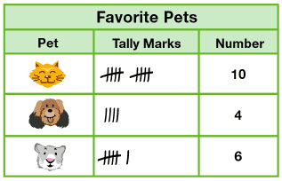
SF 424 Training Instructions, T. 420
Research Training Program Plan
Required data tables
  Sponsored Office, Graduate Studies and/or Department Administrators are key offices to acquire data
  Use the faculty other support pages as a resource
    (NOT submitted with the application)
  Faculty’s CV should identify list of trainees
  Training program directors will be your resource for information about trainees and publications
  Realistically - the internet

Slide 41
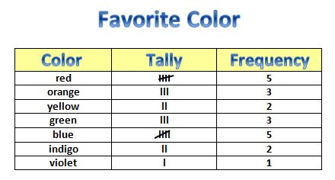
SF 424 Training Instructions, T. 420
Research Training Program Plan Component
Required data tables identified by number
  Pre-numbered, formatted tables available online
  Tables not required by particular grant mechanism or FOA and intentionally left blank should be included and titled appropriately.
  Additional tables identified by letter
    not required, may be included
      Will be counted as part of the 25 page limit
    Identify by letter, not number to avoid confusion

Slide 42
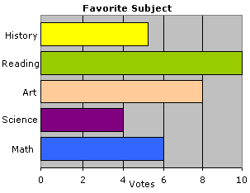
SF 424 Training Instructions, T. 420
Research Training Program Plan
  Introduction to Data Tables – READ THIS FIRST
  https://grants.nih.gov/grants/funding/datatables/datatables_intro.pdf
  (Appendix A)
  Instructions for Data Tables 1-8C are located at: http://grants.nih.gov/grants/funding/datatables/Consolidated_Training_Tables.pdf
  (Appendix B)
    Gather as much information from your Institution, PI and participating faculty before starting your tables
    Utilize Institution to produce reports and Department Administrators to acquire grant information

Slide 43
SF 424 Training Instructions, T. 420
Research Training Program Plan Attachments
General Guidelines
  Text attachments should be converted to PDF
  Avoid scanning text attachments to convert to PDF
  Save files with descriptive file names like “Program Plan”, “Proposed Training” etc.

Slide 44
SF 424 Training Instructions, T. 420
Research Training Program Plan Component
Research Training Program Plan Attachments
  No header or footer on attachments - system generated with name of PD/PI
  Page numbers – system generated
  Attachments are specific to Training Grant Programs
  eRA system will recognize and validate the sections
  In eRA Commons, all will be linked together as a single Research Plan
  Begin each text section with a section header (Introduction, Background, Program Plan, etc.)

Slide 45
SF424 Training Instructions, T. 420
Research Training Program Plan
  include sufficient information to evaluate the proposed program independent of any other document
  Be specific, informative
  Avoid Redundancies
  Follow SF424 Instructions! (Reference data tables appropriately)
47

Slide 46
SF424 Training Instructions, T. 420
1. Introduction
  Required for resubmission and revisions
  Summarize substantial additions, deletions and changes
  Respond to issues and criticism raised in the summary statement
  Separate pdf upload
48

Slide 47
SF 424 Training Instructions, T. 420
2. Program Plan
  Part of the 25 page limit, unless otherwise stated in FOA
  A. Background
  Rationale for the proposed research training program, relevant background history, need
  How does proposed program relates to current training at institution
  Summarize the research training activities of the participating units/departments

Slide 48
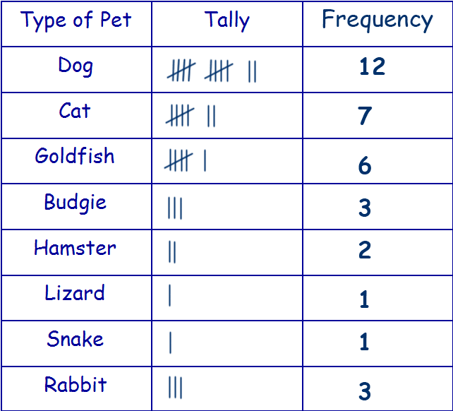
SF 424 Training Instructions, T. 420
2. Program Plan A. Background (cont’d)
Use the narrative to describe:
the organization of the proposed training program,
the participating departments and interdepartmental programs,
the extent to which faculty, graduate students, and/or postdocs from those departments/interdepartmental programs participate in the programmatic activities to be supported by the training grant.
Refer to the data in the following tables
    Table 1 – Census of Participating Departments and Interdepartmental Programs
    Table 2 – Participating Faculty Members
    Table 3 – Federal Institutional Research Training Grants and Related Support Available to Participating Faculty Members

Slide 49
Table 1 – Census of Participating Departments and Interdepartmental Programs
Rationale for the table:
Insight into the environment in which the proposed training will take place.
  Is there enough faculty/support and/or eligible students to appoint?
Allows reviewers to assess whether the program has the "critical mass" of trainees and faculty
  in the case of interdepartmental programs, representation/distribution of scientific disciplines, to be effective.
51

Slide 50
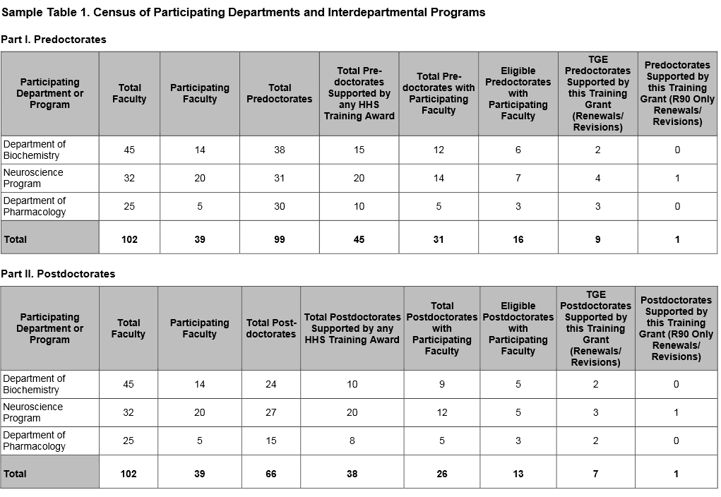
Table 1 – Census of Participating Departments and Interdepartmental Programs
HHS = Health and Human Services (e.g. NIH, CDC, AHRQ)
Source of information: Department Administrative Staff and / or Graduate Education Office
52

Slide 51
Table 2– Participating Faculty Members
Rationale for the table:
Allows reviewers to assess the distribution of participating faculty by rank (junior vs. senior), by research interests, and by department or interdepartmental program.
In addition, data on the mentoring records of faculty permit an evaluation of the experience of participating faculty in facilitating the progression of predocs and postdocs in their careers.
The data concisely summarizes information about the training faculty.
Source of information: Preceptors and Departmental Administrative Staff
53

Slide 52
Table 2– Participating Faculty Members
Use the narrative to:
Describe the distribution of participating faculty by academic rank, department or interdepartmental program, areas of research emphasis, and the rationale for the faculty selected to participate in the training grant.
Analyze the data in terms of the overall experience of the faculty in training predoctorates and/or postdoctorates.
Comment on the inclusion of faculty whose mentoring records may suggest limited, recent training experience at either training level (predoctoral or postdoctoral).
54

Slide 53
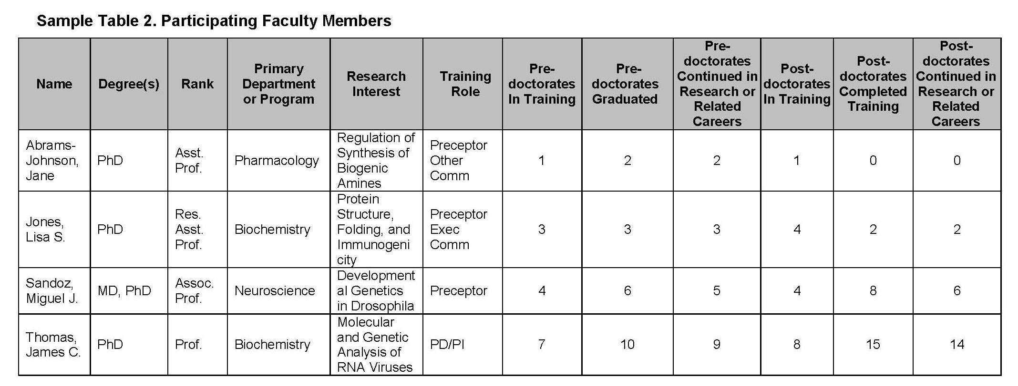
Table 2– Participating Faculty Members
Current trainees
For last 10 years
Data required for the last 10 years on both predocs and postdocs
55

Slide 54
Table 3 – Federal Institutional Research Training Grants and Related Support Available to Participating Faculty Members
Rationale for the table:
Evaluation of the current level of support for related research training and the extent to which the proposed training grant has overlap in participating faculty.
Useful in assessing:
  the institutional environment
  determining the number of training positions to be awarded.
56

Slide 55
Table 3 – Federal Institutional Research Training Grants and Related Support Available to Participating Faculty Members
Use the narrative to:
Summarize the level of research training support at the institution.
Comment on instances where the tabular data indicate that there may be substantial overlap of participating faculty.
57

Slide 56
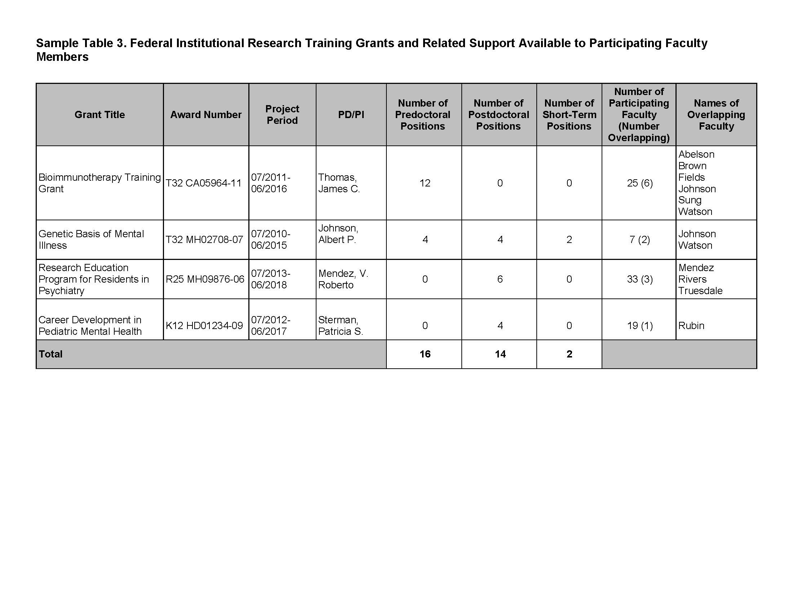
Table 3 – Federal Institutional Research Training Grants and Related Support Available to Participating Faculty Members
For all currently active, federal institutional training (e.g., NIH T32, T35, AHRQ T32), career development, and research education (e.g., NIH R25, K12/KL2, TL1) support available to the participating faculty members.
Source of information: Sponsored Programs Office / NIH Reporter / PD
No need to include your own training grant on this list when applying
58

Slide 57
Question
As PI, do I have to devote effort to a T32 grant?
Yes. PIs typically set aside 1.2 person months (or 10 percent effort) of a calendar year appointment towards overseeing the training program.
59

Slide 58
SF 424 Training Instructions, T. 420
2. Program Plan
B. Program Plan
  Program Administration
  Program Director’s qualifications for providing leadership, scientific background, current research areas, experience in research training. Show PD/PI’s effort devoted to the program
  Describe the administrative structure and the distribution of responsibilities within it, including the means by which the Program Director will obtain continuing advice with respect to the operation of the program
  b) Program Faculty – reference Table 2, Participating Faculty
        Describe each faculty member’s research that is relevant to the program and indicate how trainees will participate in that research
        Provide information on how faculty members have cooperated, interacted and collaborated in the past (joint publications and joint sponsorship of students, etc.) Complete and refer to data in Tables 4-5

Slide 59
SF 424 Training Instructions, T. 420
2. Program Plan
B. Program Plan
  Goal: to document the ability of the faculty to support the research activities of the proposed trainees (Table 4), the training record of faculty members and the success of their trainees in generating publishable research results (Table 5A and 5B).
  For faculty lacking research training experience, present a plan to ensure successful trainee guidance.
  Describe criteria used to appoint and remove faculty and to evaluate their performance.

Slide 60
Table 4 – Research Support of Participating Faculty Members
Rationale for the table:
Evidence of the strength of the research environment
the availability of funds to support research conducted by the trainees
the appropriateness of the participating faculty in terms of their active research support.
63

Slide 61
Table 4 – Research Support of Participating Faculty Members
Use the narrative to:
Analyze the data in terms of total and average grant support
Comment on the inclusion of faculty without research grant support in the proposed training program and explain how the research of trainees who may work with these faculty members would be supported.
64

Slide 62
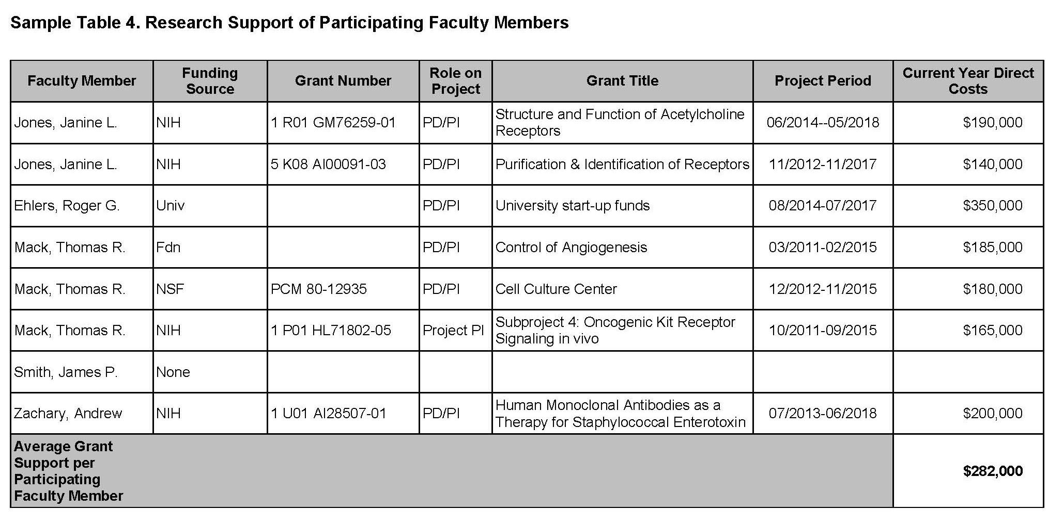
Table 4 – Research Support of Participating Faculty Members
Exclude applications pending review or award.
65

Slide 63
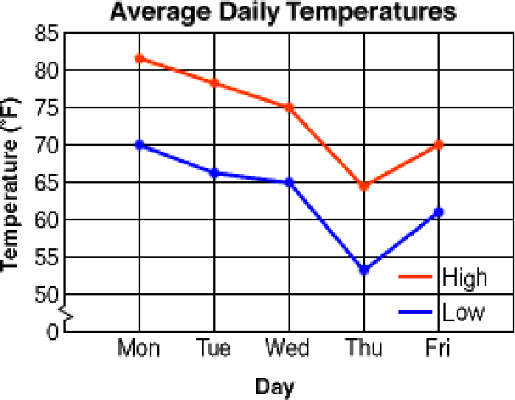
Table 5 – Publications of Those in Training
Rationale for the table:
Provides an indicator of the ability of each faculty member to foster trainee productivity through generation of publishable results
Allows assessment of the research quality and authorship priority of trainees.
Source of information: Preceptors / lab websites
5A – Predoctoral
5B – Postdoctoral
5C - Undergraduate
66

Slide 64
Table 5 – Publications of Those in Training
Use the narrative to:
Summarize these data
Include, for example:
  The average number of publications
  How many students published as first author
  How many students completed doctoral training without any first-author publication resulting from their graduate research.
67

Slide 65
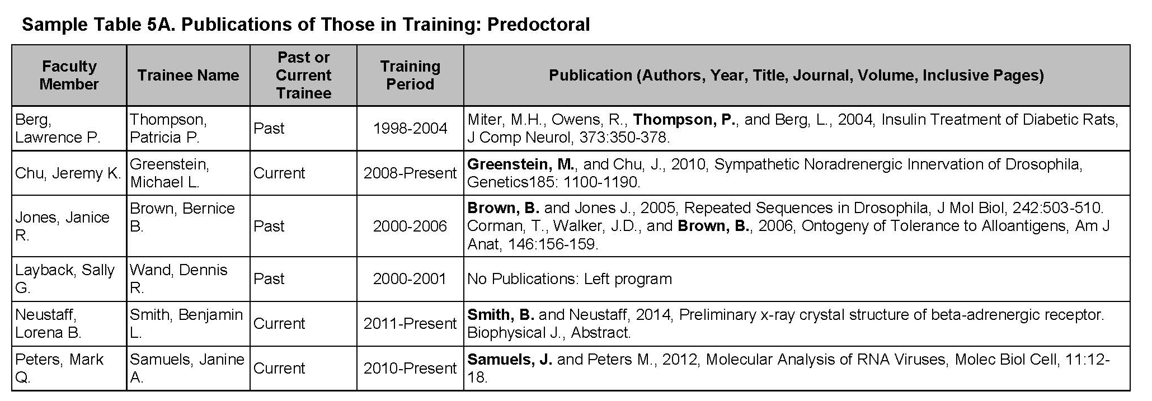
Table 5 – Publications of Those in Training
NIH only wants pubs related to training program; The OTG typically recommends you use the training period and 2-3 years following this period to account for the length of time it takes to publish.
New applications. list all publications of representative, previous predoctorates from the last 10 years and all current predoctorates. Only include individuals who would have been eligible for appointment to this training program. Exclude individuals undertaking short-term (12 week or less) training experiences with a faculty member.
Renewal/revision applications. list the publications of all current trainees and those appointed to the grant for up to the past 10 years, with the exception of those appointed to short-term training positions.
68

Slide 66
Publication Tables:
NIH Public Access Policy - Overview
Applies to ALL peer-reviewed articles that arise, in whole or in part, from direct costs funded by NIH, that are accepted for publication on or after April 7, 2008.
Anyone submitting an application, proposal or progress report to the NIH must include the PMCID or NIH Manuscript Submission reference number when citing applicable articles that arise from their NIH funded research.
    Out of compliance if no PMCID 3 months post publication
Where? - BioSketches, References Cited, and Progress Report Publications List. http://publicaccess.nih.gov/determine_applicability.htm
69

Slide 67
Table 5A & B – Publications of Those in Training
While PMCID numbers are NOT required for the data tables, all publications listed must be in compliant with NIH Policy:
When citing articles that fall under the Public Access Policy, were authored or co-authored by the trainee and arose from NIH support, provide the NIH Manuscript Submission reference number (e.g., NIHMS97531) or the PubMed Central (PMC) reference number (e.g., PMCID234567) for each article. If the PMCID is not yet available because the Journal submits articles directly to PMC on behalf of their authors, indicate "PMC Journal - In Process." A list of these Journals is posted at:
http://publicaccess.nih.gov/submit_process_journals.htm

Slide 68
SF 424 Training Instructions, T. 420
2. Program Plan
B. Program Plan
Proposed Training
  Describe the proposed training program
    For postdoc trainees, indicate the proposed distribution by degree
    Describe course work, research opportunities and the extent to which trainees will participate directly in research, activities designed to develop technical and/or professional skills and the duration of training.
    For multi-disciplinary and/or multi-departmental programs, indicate how the individual disciplinary and/or department components of the program are integrated and coordinated.

Slide 69
SF 424 Training Instructions, T. 420
Program Plan
Program Plan
c) Proposed Training
    For training programs emphasizing research training for clinicians describe interactions with basic science departments and scientists
      Include plans for ensuring that the training of these individuals will provide a substantive foundation for a competitive research career
      Generally, a minimum of 2 years of research training is required for all postdoc trainees with health professional degrees

Slide 70
SF 424 Training Instructions, T. 420
2. Program Plan
B. Program Plan
c) Proposed Training
    Curricula, degree requirements, didactic courses, laboratory experiences, qualifying examinations, other training activities
    Describe how trainer and research areas are chosen
    Provide representative examples of programs for individual trainees
    How will trainee’s program be guided
    How will trainee’s performance be monitored and evaluated
    Include detailed mentoring plans as appropriate

Slide 71
SF 424 Training Instructions, T. 420
2. Program Plan
B. Program Plan
d) Training Program Evaluation
  Describe an evaluation plan to review and determine the quality and effectiveness of the training program
    Include plans to obtain feedback from current and former trainees
    Describe plans for assessing trainee’s career development
    Be sure evaluation results are included in a renewal and the final progress report

Slide 72
SF 424 Training Instructions, T. 420
2. Program Plan
B. Program Plan
Training Candidates
  Describe the size and qualifications of the pool of trainee candidates, in general terms
  Describe recruitment plans and how they will implemented
  Describe the nomination process to select candidates
  Complete Tables 6A and 6B as applicable

Slide 73
Table 6 - Applicants, Entrants, and their Characteristics for the Past Five Years
Rationale for the table:
Permit the evaluation of the ability of participating departments /interdepartmental programs to recruit trainees.
Useful in assessing:
  Selectivity of the admissions process
  Competitiveness of the training program
  Appropriate number of training positions to be awarded.
6A: predoctoral
6B: postdoctoral
76

Slide 74
Table 6 - Applicants, Entrants, and their Characteristics for the Past Five Years
Use the narrative to:
Analyze the data in terms of:
  Overall numbers of potential trainees
  Credentials
  Characteristics
  Eligibility for support
  Enrollment trends.
77

Slide 75
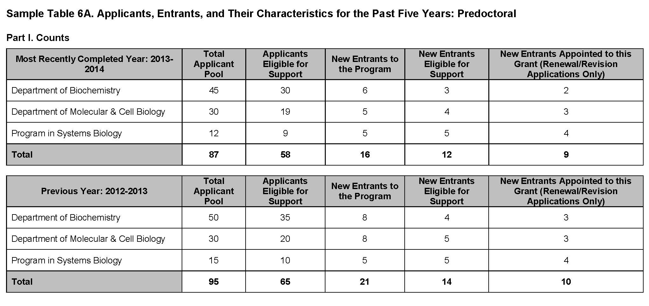
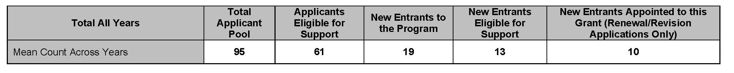
Table 6 - Applicants, Entrants, and their Characteristics for the Past Five Years
Enter the most recently completed year
Renewals Only
Training Grant Eligible
78

Slide 76
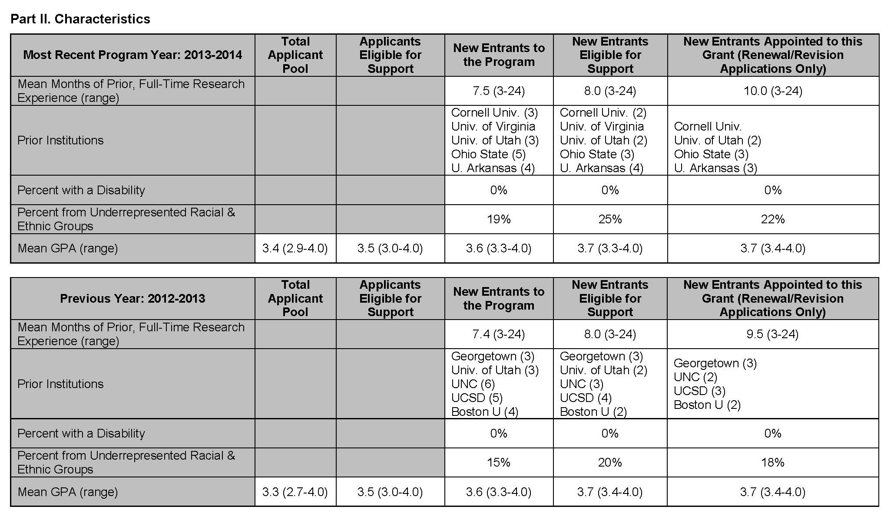
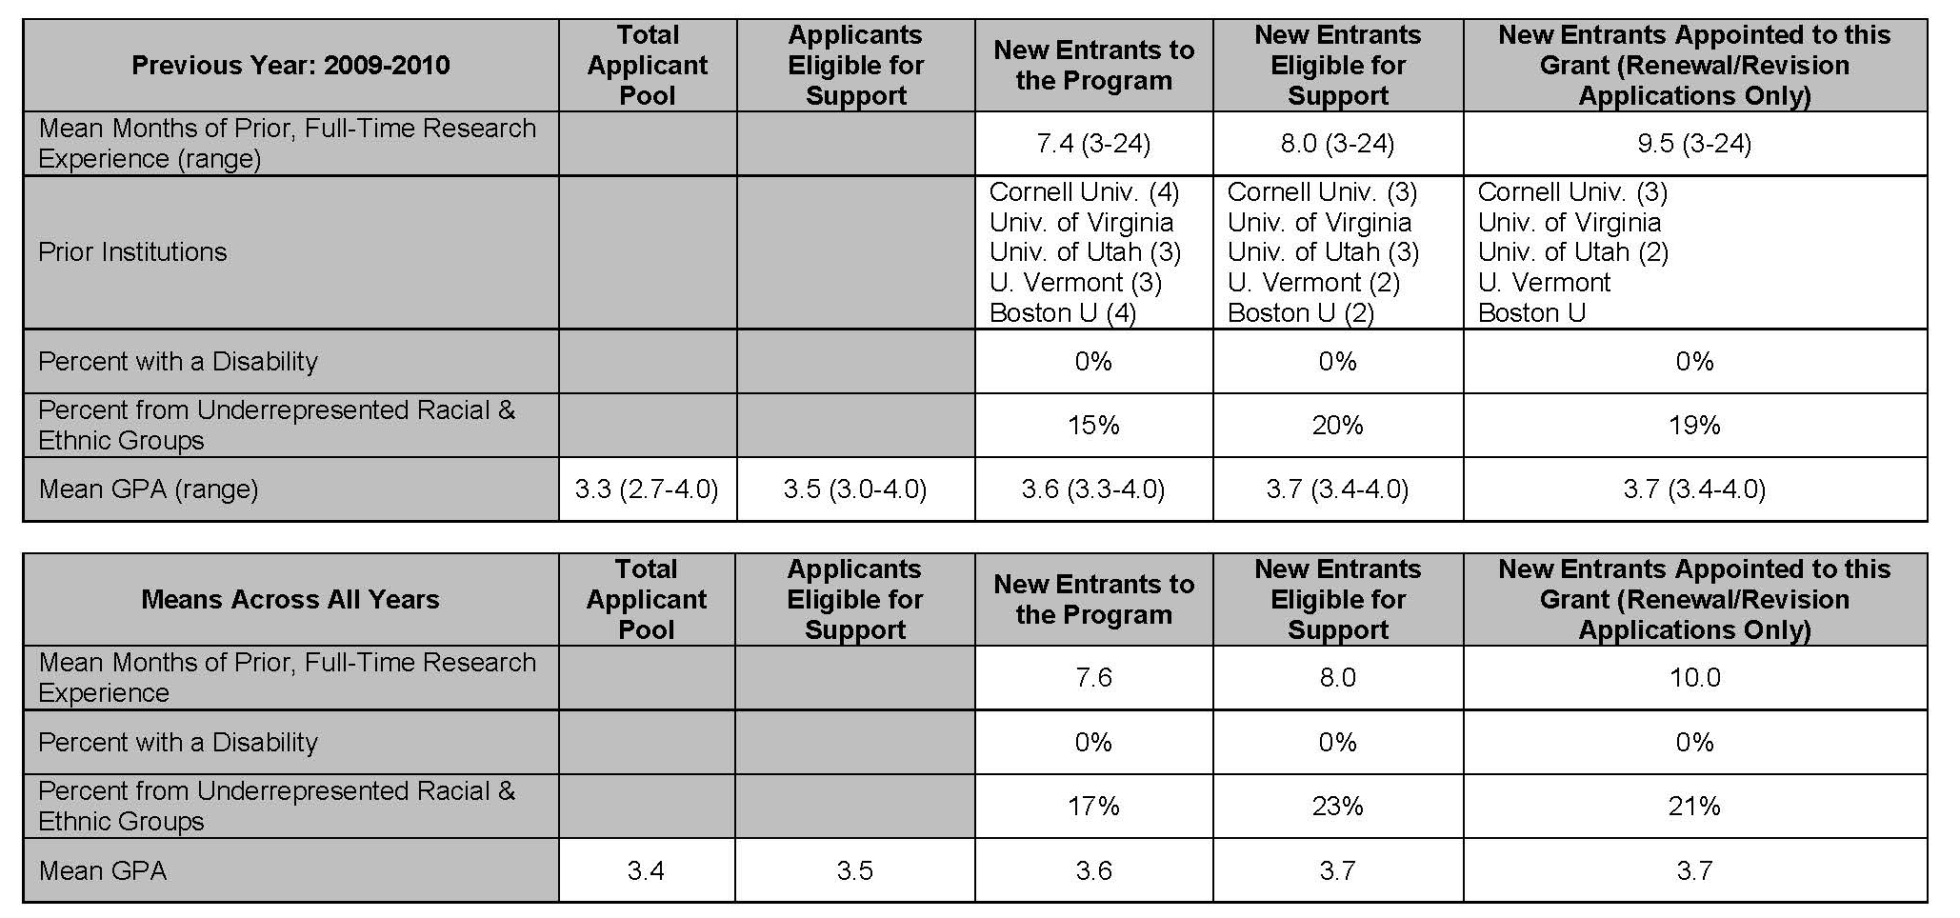
Table 6 - Applicants, Entrants, and their Characteristics for the Past Five Years
Mean Months of Prior, Full-Time Research Experience (range). the mean number of months of prior, full-time research experience
79

Slide 77
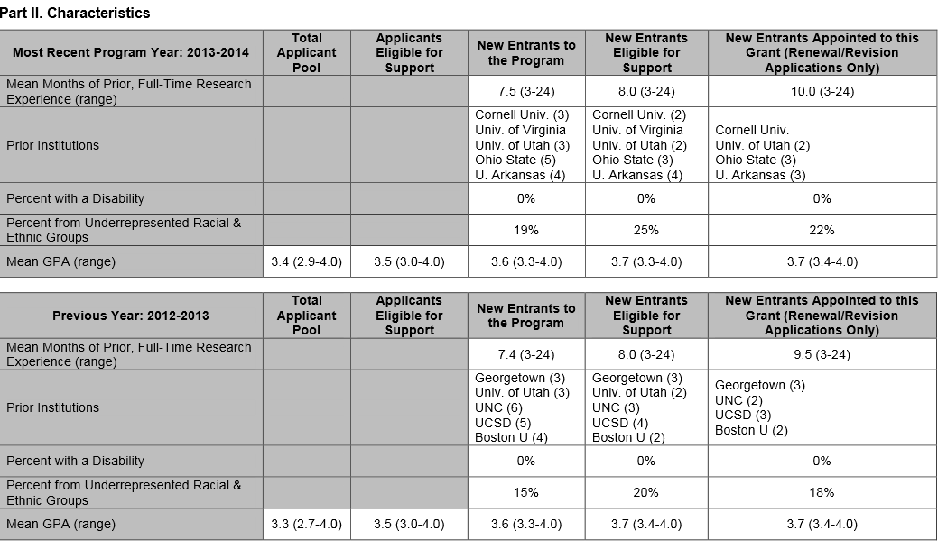
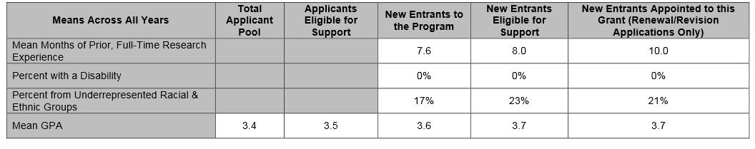
Table 6A – Applicants, Entrants, and their Characteristics for the Past Five Years: Predoctoral
80

Slide 78
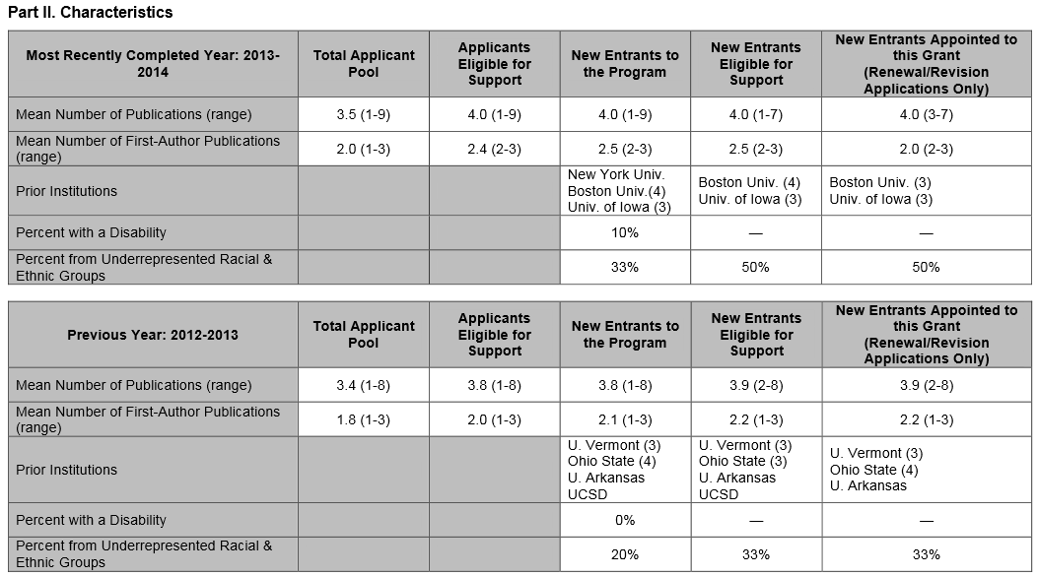
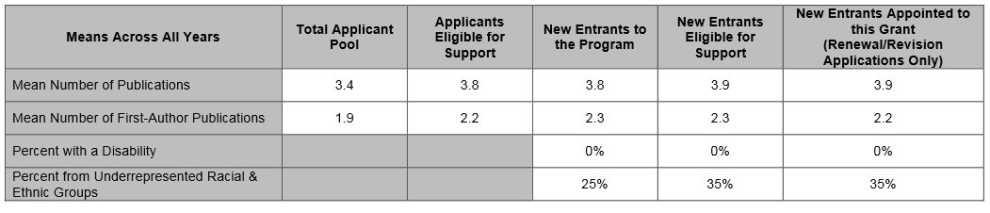
Table 6B. Applicants, Entrants, and Their Characteristics for the Past Five Years: Postdoctoral

Slide 79
SF 424 Training Instructions, T. 420
Program Plan
B. Program Plan
Institutional Environment and Commitment to Training
  Include information that documents institutional and participating units/departments’ support and commitment to goals of training program
    Space
    Shared facilities and equipment
    Funds for curriculum development
    Release time for faculty
    Support for additional trainees
    Creative ways to improve the climate for trainees

Slide 80
SF 424 Training Instructions, T. 429
2. Program Plan
B. Program Plan
g) Qualifications of Applicants
Describe the ability of the participating departments to recruit and retain trainees, the selectivity of the admissions process, and the success of the departments/programs in recruiting individuals from diverse backgrounds
Discuss the quality and depth of the applicant pool and the competitiveness of the program, referring to data in Tables 6A and 6B if applicable.
Report the number and characteristics of current program participants and their distribution by department and mentor
Use all of the above to justify the number of slots requested
If required by the FOA, complete and refer to data in Tables 7 & 8.

Slide 81
Table 7 - Appointments to the Training Grant for Each Year of the Current Project Period
(Renewals/Revision ONLY)
Rationale for the table
Evaluation of the use of awarded training positions.
Counts for the number of “Appointed” trainees will be editable in the event that recent updates are not yet reflected in the system.
84

Slide 82
Table 7 - Appointments to the Training Grant for Each Year of the Current Project Period
Use the narrative to:
Provide an explanation for:
  Any trainee positions were not filled,
  Any trainees terminated early
  If the distribution of appointed positions differs from the distribution of awarded positions
Also useful to refer to these data within the Recruitment and Retention Plan to Enhance Diversity Section of the Research Training Program Plan.
85

Slide 83
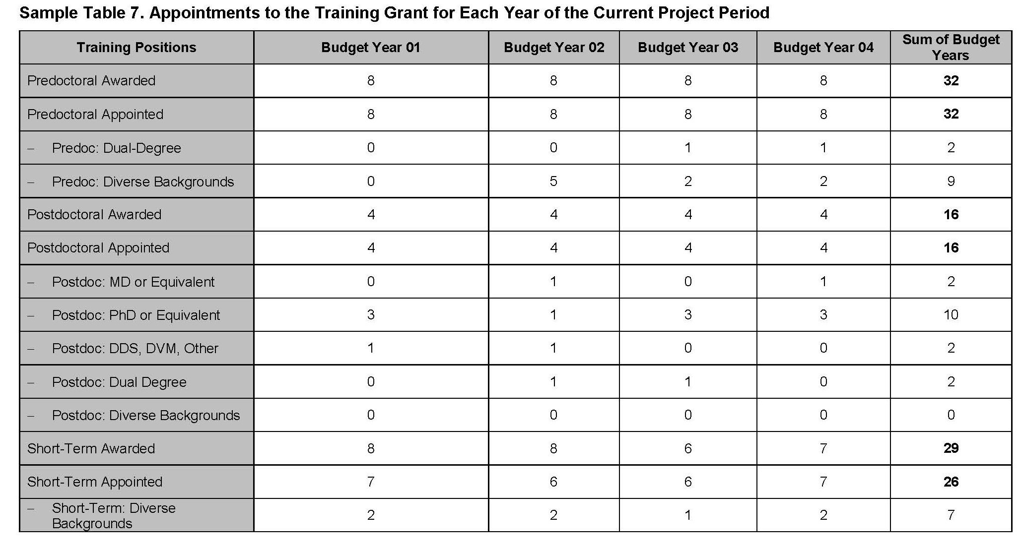
Table 7 - Appointments to the Training Grant for Each Year of the Current Project Period
(Renewals/Revision ONLY)
Note that counts for “Awarded” and “Appointed” trainees will be auto-filled.
86

Slide 84
Table 8 - Program Outcomes
Rationale for the table:
New: provides information on the effectiveness of the proposed training program.
Renewal: provides information about the use of predoctoral training positions (e.g., distribution by faculty member, year in program, years of support per trainee).
The data also permit an evaluation of the effectiveness of the supported training program in achieving the training objectives of the prior award period(s) for up to 15 years.
87

Slide 85
Table 8 - Program Outcomes
Use the narrative to:
Summarize the data from Parts I-III (as applicable) in the Research Training Program Plan, either in the Program Plan Section or the Progress Report Section, as appropriate.
88

Slide 86
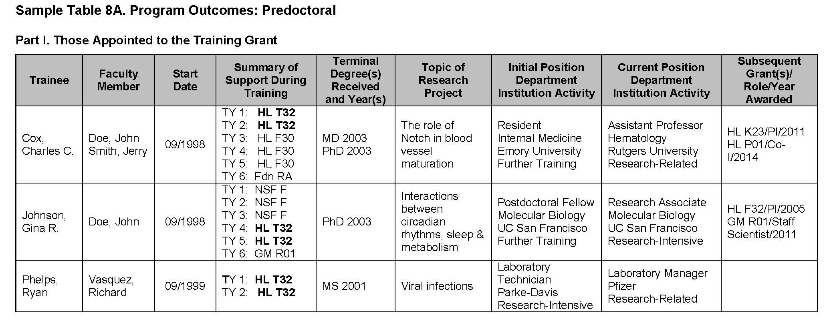
Table 8 - Program Outcomes
(Renewals/Revision ONLY)
In Part I, list sequentially, by year of entry into the graduate program, all trainees who have been supported by this grant at any time during the last 15 grant years, including those who did not complete the training program for any reason. If the grant has been active for less than 15 years, list all trainees to date.
Summarize primary source of support during each 12 month training period. (e.g. TY1 CA R01) POSTDOCS: don’t list individual mentored career award here – this should be reported under subsequent grants
List all subsequent Grants/Role/Year Awarded
This is the table required for RPPRs
89

Slide 87
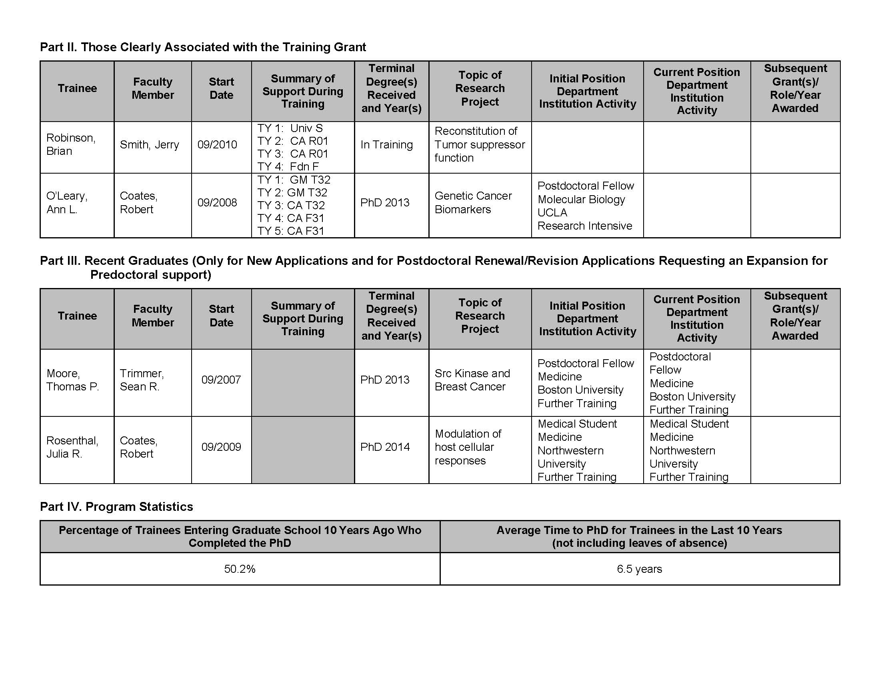
Table 8 - Program Outcomes
(Renewals/Revision ONLY)
In Part II, list any current Pre/Postdoc trainees clearly associated with this grant who have been supported by NIH and other HHS funds but not by this grant, and provide the information described in Part I, items 1-8, above, for each student. “Clearly associated” students are those with a training experience identical to those appointed to this grant, but who are supported by other NIH or HHS awards (e.g., fellowships or research grants).
90

Slide 88
Table 8 - Program Outcomes
In Part III (only for new applications and postdoctoral renewal/revision applications requesting an expansion to predoctoral support), list sequentially all students graduating from the proposed program in the last five years who would have been eligible for appointment, if an NIH or other HHS training or related award were available (in most cases, these will be U.S. citizens or permanent residents). For each student, provide the information described in Part I, items 1-3 and 5-8, above.
Summarize the data from Parts I-III (as applicable) in the Research Training Program Plan, either in the Program Plan Section or the Progress Report Section, as appropriate.
91

Slide 89
Table 8 - Program Outcomes
Programs that have not received support for at least 10 years should not include the first section of the table the (i.e., the percentage of trainees completing their degrees within 10 years).
New programs that have not yet had any trainees complete the PhD should not include this table at all.
In calculating these program statistics, students leaving graduate school to transfer to medical school or other doctoral-level professional programs should be counted as part of the entering pool, but not as having earned a PhD-equivalent degree.
Individuals transferring to or from PhD programs in similar fields at other institutions should be excluded from both the entering and graduating cohorts in calculating completion and time to degree.
For RPPRs, summarize these data in the Accomplishments Section, in responding to the question, “What opportunities for training and professional development has the project provided?”
92

Slide 90
SF 424 Training Instructions, T. 420
Program Plan
Recruitment and Retention Plan to Enhance Diversity – within the 25 page limit
NIH Grants Policy Statement, Section 11.3.3.4 (Diversity groups)
  Required for all training grant activity codes except T34, T36, U2R and all D-series activity codes
  In order to recruit most talented researchers from all groups and:
    Improve quality of educational and training environment
    Balance, broaden the perspective in setting research priorities
    Improve the ability to recruit subjects from diverse backgrounds into clinical research protocols
    Improve the Nation’s capacity to address and eliminate health disparities

Slide 91
SF 424 Training Instructions, T. 420
2. Program Plan
C. Recruitment and Retention Plan to Enhance Diversity
  To diversify student and faculty populations, increasing participation of underrepresented individuals in the biomedical, clinical, behavioral, and social science such as:
    Individuals from underrepresented racial and ethnic groups
      Minority at NIH means: African Americans, Hispanic Americans, Native Americans, Alaskan Natives, Hawaiian Natives, and natives of U.S. Pacific Island
    Individuals with disabilities
    Individuals from socially, culturally, economically or educationally disadvantaged backgrounds that have inhibited their ability to pursue a career in health-related research

Slide 92
SF 424 Training Instructions, T. 420
2. Program Plan
C. Recruitment and Retention Plan to Enhance Diversity
  New applications: Description of plans to enhance recruitment of traines from underrepresented backgrounds and may include data in support of past accomplishments
  Renewal applications: Must include a detailed account of experiences recruiting individuals from underrepresented groups
  Describe steps to identify and recruit graduate students and postdocs from diversity groups A, B and C (when applicable).
  Consider the success and/or failures of past recruitment strategies.
  Describe the specific efforts to be undertaken by the training program and how they might relate to the recruitment efforts of the institution.
  Attached as a pdf file

Slide 93
SF 424 Training Instructions, T. 420
3. Plan for Instruction in the Responsible Conduct of Research (RCR) – REQUIRED, NO longer part of 25 page limit; has its own separate page limit of 3 pages
  Must address incorporation of five instructional components in training program
    Format of instruction
    Subject matter
    Faculty participation
    Duration
    Frequency
  How will instruction be monitored?

Slide 94
SF 424 Training Instructions, T. 420
3. Plan for Instruction in the Responsible Conduct of Research http://grants.nih.gov/grants/guide/notice-files/not-od-10-019.html
  Trainees participating in research involving human subjects must meet NIH requirements for education in human subject protections
    Trainees participating in research with live vertebrate animals must enroll in institutional animal welfare training program
  Renewal programs should describe any changes and weaknesses of current RCR Training
    All faculty who served as course directors, speakers, lecturers, in the past period must be named
4. Plan for Instruction in Methods for Enhancing Reproducibility
  Not yet required

Slide 95
SF 424 Training Instructions, T. 420
Multiple PD/PI Leadership Plan
  ONLY if submitting a Multiple PD/PI proposal!
  Be sure all multiple PD/PIs have the PD/PI role
  Leadership Plan
    Emphasize how it will benefit the program and the trainees
    Single contact PD/PI must be named
    Mentors are not multiple PD/Pis

Slide 96
SF 424 Training Instructions, T. 420
6. Progress Report/Renewals
State the period covered and briefly describe the accomplishments of the program
  Describe any effects of the training program on curriculum and/or research directions
  Describe how the Training Related Expenses (Institutional Allowance) funds were used to benefit the program
For each trainee supported during the period covered
  Indicate their mentor and briefly summarize the research conducted by the trainee including the following:
    -Degrees working toward or held -Mentor(s)
    -Description of trainees’ research and progress
    -Coursework -Conference presentations
    -Role of trainees role in any planned or published papers resulting from research
    -Fellowships or other support
    -Workshops attended -Career development activities

Slide 97
SF 424 Training Instructions, T. 420
6. Progress Report/Renewals (cont’d)
  Indicate whether Institution utilizes Individual Development Plans (IDPs) and describe how they were used to manage the training and career development of trainees
  Use narrative to provide information not readily presented in the required tables
  Must include experiences in recruiting individuals from underrepresented groups.
  If required, complete data tables
    Table 5
    Table 7
    Table 8

Slide 98

SF424 Training Instructions, T. 420
Research Training Program Plan
Faculty, Trainees and Training Record
Participating Faculty Biosketches
  Personal statement not required
  Attach as a single PDF document
Letters of Support
  From all individual confirming their roles in the program
  Signed letter on institutional letterhead from senior administration official describing the institution’s commitment to the planned program
  Any others required as noted in the FOA

Slide 99
SF424 Training Instructions, T. 420
Research Training Program Plan
Faculty, Trainees and Training Record
  Data tables
    One PDF attachment
    Utilize user-defined bookmarks in the attachment to facilitate easy navigation between tables
    Start each numbered table on a new page
    Separately bookmark each table in the attachment

Slide 100
FAQs – Section E. Research Training Data Tables
http://grants.nih.gov/grants/forms_updates_faq.htm
We’re preparing a training grant application for the September 25, 2017 due date, but don’t have all the historical data requested in the new data tables, such as the length of prior, full-time research experience for trainees entering the program five years ago. What should we do?
Because reviewers are asked to assess a training program and its record based, in part, on data presented in the tables, applicants should provide as much data as reasonably possible. Where complete historical data are not available, applicants should indicate that in their applications and begin collecting the relevant information, so that it will be available in the future.
103

Slide 101
SF424 Training Instructions, T 420
Other Training Program Section
10. Vertebrate Animals
  Complete if you answer “yes” to the question, “Are vertebrate animals used?”
  Describe how institution will ensure that trainees only participate in IACUC approved vertebrate animal research when: (a) the training program uses live vertebrate animas only as part of other research project grants, and (b) The Training Grant Award does not support the purchase, use, or husbandry of live vertebrate animals for this research

Slide 102
SF424 Training Instructions, T. 420
Other Training Program Section
  11. Select Agent Research
    If participating faculty are conducting or plan to conduct research involving select agents in which trainees may participate, follow instructions in 400 – PHS 398 Research Plan Form, Select Agent Research.

Slide 103
SF424 Training Instructions, T. 420
Other Training Program Section
12. Consortium and Contractual Arrangements
  Describe any programmatic, fiscal, or administrative arrangements between the applicant organization and other participating organizations

Slide 104
SF424 Training Instructions, T. 420
Other Training Program Section
13. Appendix
New guidelines as of January 25, 2018:
The only allowable appendix materials are:
Blank data collection forms, blank survey forms, blank questionnaire forms or screenshots thereof
Simple list of interview questions
Blank informed consent/assent forms
FOA-specified items
  If appendix materials are required in the FOA, review criteria for that FOA will address those materials, and applications submitted without those appendix materials will be considered incomplete and will not be reviewed.
NOTE: APPLICATIONS THAT DO NOT FOLLOW THE APPENDIX REQUIREMENTS WILL NOT BE REVIEWED.

Slide 105
SF424 Training Instructions, T. 500
PHS Human Subjects and Clinical Trials Information
Not applicable to T32 proposals
Necessary for K12 and D43 proposals
(Read the Additional Instructions for Training Boxes!!)

Slide 106
SF424 Training Instructions, T. 600
PHS Assignment Request Form
To communicate specific application assignment and review requests
Previously included in the Cover Letter attachment
Will not become part of the application nor provided to reviewers
Optional – However, only mechanism to impact assignment

Slide 107
“Just in Time”
Institutional Training Grants (T awards)
IACUC/IRB protocols
Updated Other Support

Slide 108
Congratulations you have an award!

Slide 109
Notice of Award
T Awards
  Watch for number of slots.. Did you get cut?

Slide 110
Award Process
  Pre-award costs under T are normally unallowable
  Typical budget period of 12 months

Slide 111
Recruitment
  Keep in mind:
  Trainees must be citizens or non-citizen nationals or admitted for permanent residence
  Predocs must have received their bachelor’s degree by the start date of their appointment and enrolled in a program leading to a Ph.D.
  Postdocs must have received their doctoral degree by the start date of their appointment

Slide 112
Recruitment
  Trainees may not be studying for an M.D. or D.D.S or other clinical training EXCEPT when in a formal combined program such as the M.D./Ph.D.
  NRSA training grants will not support residency programs

Slide 113

Recruitment
  Don’t forget minority recruitment in underrepresented groups in biomedical and behavioral research!
    Minority at NIH means: African Americans, Hispanic Americans, Native Americans, Alaskan Natives, Hawaiian Natives, and natives of U.S. Pacific Islands

Slide 114
Appointment
  Keep in mind:
  Trainees are required to pursue their training full-time
    minimum of 40 hours per week
    work = class time + study time + lab time
  Part-time (minimum of 50% effort) requests are handled on a case-by-case basis, submitted in writing and countersigned by trainee, program director & authorized institutional official
  Training must continue to be at least 50%. Anything less requires leave of absence
  Stipend will be prorated during the period of any approved part-time training. Part-time training may affect the rate of accrual or repayment of the service obligation for postdoctoral trainees

Slide 115

Appointment
  Important tip:
  Close-out process will be easier if you
  appoint individuals at the beginning of pay
  Period

Slide 116
Periods of Appointments
Appointment periods may overlap budget periods

Slide 117
Appointment
  No one may receive more than 5 years of aggregate NRSA support at the predoctoral level or 3 years aggregate support at the postdoctoral level without prior approval
  An extension may be requested for the following exceptions:
    Individuals in a combined program (M.D./Ph.D.)
    Interruptions in planned research training
    Extension for opportunity to use exceptional training resource

Slide 118
Appointment
  At the time of initial appointment and at each subsequent annual appointment a new or revised Statement of Appointment form must be submitted (X-Train) (Appendix D)

Slide 119
Payback
  At the time of initial appointment a signed Payback Agreement must be submitted for each postdoc trainee (PHS 6031, Appendix E)
  Important Note: The Program Director must explain the terms of the payback service requirement to all prospective postdoctoral training candidates
  When central pre-award personnel sign your training grant progress reports, they are certifying that the terms of the payback requirement have been explained to all appointed postdoctoral trainees
  Payback Agreements must still be mailed to NIH

Slide 120
Acceptable Payback - Service
  Health-related biomedical or behavioral research
  Health-related teaching
  Direct administration or review of health-related research
  Any combination of these activities
  Service must begin within 2 years of termination

Slide 121
Financial Payback
  Can be voluntary or involuntary
  Amount owed is total stipend received (plus interest when applicable)
  Most people pay back with service!
    Less than 2 percent of all NRSA recipients with obligations (more than 110,000 individuals) have had waivers (relief due to disability, hardship, or cancelled upon death) or have engaged in financial payback

Slide 122
Question?
Is a Payback Agreement required for all postdoc trainees on the first year of my grant?
Not necessarily! If they incurred a payback obligation under a previous NRSA appointment, they will not incur a second payback obligation under your NRSA.

Slide 123
Administration
  Stipend level for first year is determined by number of full years of relevant postdoc experience at time of appointment (relevant experience may include industrial, teaching assistantship, internship, residency, clinical duties or other time spent in a health related field beyond the qualifying doctoral degree). This is calculated based on the month/year that their degree was conferred
  Stipend for each additional year of support is the next level in the stipend structure and does not change mid-year
  Subsistence allowance to help defray living expenses, not a salary

Slide 124
Administration
  Stipend supplementation for postdocs:
  Positively no PHS funds may be used for supplementation
  From Non-Federal funds with no obligation to the trainee (exception – with specific authorization, Federal Educational Loan funds or VA benefits)
  Amount of stipend supplementation determined by grantee policy and consistently applied

Slide 125
Administration
  Employee benefits
  Trainee, not employee
  Inappropriate and unallowable to charge training grants employee benefits (FICA, worker’s compensation, unemployment insurance)
Cost principles
Allowable
Allocable
Reasonable
Consistent

Slide 126
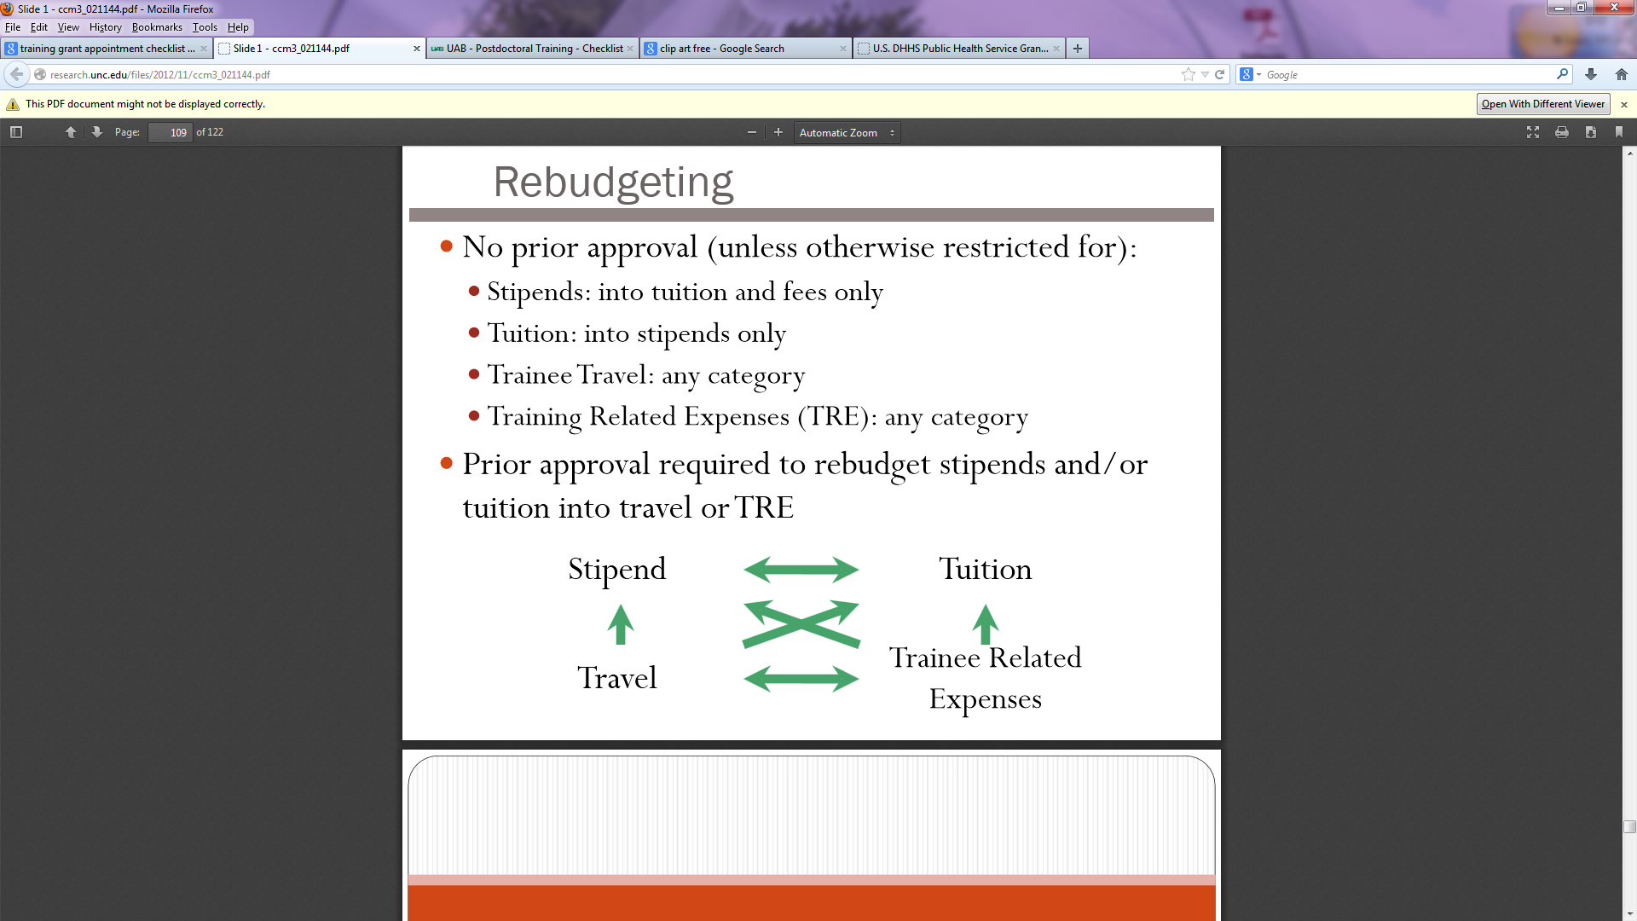
Rebudgeting
No prior approval necessary (unless otherwise restricted for):
  Stipends: into tuition and fees only
  Tuition: into Stipends only
  Training Related Expense (TRE): into any category
  Prior approval required to rebudget stipends and/or tuition into travel or TRE

Slide 127
xTrain
  As of January 1, 2011, the xTrain module of the Commons is required to electronically prepare and submit PHS 2271 Statement of Appointment form (Appendix D) and the PHS 416/7 Termination Notice (Appendix F)

Slide 128
Benefits of xTrain
Facilitates the NIH approval process
Reduces data entry errors
Provides institutional and NIH users with ongoing record of status

Slide 129
xTrain – Getting Started
Before processing your first xTrain document go to the following website for tutorials and helpful hints: http://era.nih.gov/era_training/xtrain.cfm

Slide 130

xTrain Roles and Responsibilities https://era.nih.gov/files/xTrain_Overview_and_Functions.pdf
Program Director (PD/PI)
PD/PI Delegate (ASST Role)
Trainee
Sponsor
Sponsor Delegate
Signing Official or Business Official

Slide 131
Trainee Appointments

Slide 132
xTrain Trainee Appointments
Before initiating an Appointment Form in xTrain verify the following:
  Trainee does not already have an eRA profile (always use existing profile if already set up)
    If no profile exists create one
  When PD/ASST creates New Appointment they are prompted for Trainee’s User ID
Once Trainee has been identified, or new profile created, you will be directed to the Appointment Form to enter basic information about the appointment

Slide 133
xTrain Trainee Appointments
Before initiating an Appointment Form in xTrain verify the following:
  Trainee citizenship verification
  Budget period of appointment
  Current email address for trainee
  Appointment start and end dates
  Amounts for stipend, tuition/fees and travel

Slide 134
xTrain Trainee Appointments
Has the trainee previously been appointed to any other training grant?
    What was the grant number?
    How long were they appointed to that grant?
If in doubt of which stipend level to use for Postdocs always send a copy of the trainee’s CV to your GMS for verification and be sure to note any variance in the comment section
Pay attention to the grant year on the form. You may have to change the year and save the document in order for the stipend amounts to be correct
A box at the bottom of the screen will prompt you to “Invite Trainee Now” or “Invite Trainee Later”

Slide 135
xTrain Trainee Appointments
Save & Route to Trainee - -
  The system will check for errors prior to routing to trainee
  Errors must be corrected before you can continue
  Warnings will go through the system without problem but should be reviewed
    A common warning is that period of appointment cannot extend past period of award (this can be ignored except for the last year of your project period, you will get a Fail). You must request a no cost extension by sending a written request signed by the PI and business official requesting the extension to enable appointments past the end date.
You can add a personalized message to trainee in the comments section if desired
After verification, click “save and route to trainee” button

Slide 136
Trainee Information in eRA Commons and xTrain
Trainees receive an automated email from xTrain notifying them they have been appointed to a grant and they are directed to the xTrain website
Trainees should complete their eRA Commons Personal Profile and verify:
  Correct name spelling
  SSN (last 4 digits)
  Email
  Degrees
  Specialty board
  Dual degree (if applicable)
  Prior NRSA support
  Citizenship status (this must be completed)

Slide 137
Trainee Appointments

Slide 138
Trainee Appointments

Slide 139
Trainee Information in eRA Commons and xTrain
Once trainee has verified all information in the profile and on the Appointment Form they should click “Save”
  If they have any questions, they can contact the PI and/or ASST prior to routing the document further
  Once all questions have been resolved the trainee should click “Save and Route to PI”

Slide 140
Trainee Appointments

Slide 141
Trainee Information in eRA Commons and xTrain
Trainee should view the PDF document and print a copy of the Appointment Form for their records
  Note: Personal information is validated when form is routed back to the PI/PD. It will not appear in the 2271 Appointment Form until it has been validated.
All Permanent Resident trainees appointed must have original notarized copy of their Permanent Residency Card mailed to the NIH or the appointment will not be approved!

Slide 142
Termination Process

Slide 143
xTrain Termination Notice (Appendix F)
PI or ASST initiates the Termination Notice in xTrain
Pre-populated Termination Notice is in xTrain with information pulled from Trainee profile
Click the “save and route to Trainee” button
You have the opportunity to send the trainee a message when the Termination Form is routed
Trainee receives automated message from the Commons requesting completion of the form
Majority of information requested is entered by Trainee
Once complete, trainee clicks “Save and Route to PI”
PI and ASST are sent an automated message to review and finalize the document

Slide 144
xTrain Termination Notice
PI/ASST sends the document to the University Business Official
Be sure to send the form to the correct Business Official
Once the Business Official verifies stipend payments and dates they will click “Save and Route to Agency”
Agency reviews and accepts the Termination Notice
Automated email from Agency is sent to PI/Trainee/ASST stating document is finalized and fully accepted version can be accessed via xTrain
ASST saves a complete version of the notice in electronic/paper file
Stipends paid as stated on Termination Notice must equal stipend amount actually paid

Slide 145
xTrain Helpful Hints
When completing summary of training field
  The system will not accept:
    Blank lines in summary
    Exceeding the 2,000 character limit
    If copying summary from Word, note that special characters do not transfer
Remind trainee to route document back to PI
  Many trainees click “Save” thinking they have routed the document
If the Trainee terminates early, click the “Modify Termination Date” button and the system will automatically amend the end date and recalculate stipend

Slide 146
Prior Approvals Required
  Changes in the program objectives as related to the area of research training
  Absence of the Program Director for more than 3 consecutive months
  Transfer of a grant from one domestic institution to another
  Carry forward as stated in your NOGA

Slide 147
Leave
  Trainees may receive the same vacations and holidays available to individuals in comparable training positions and continue to receive stipends during vacations and holidays
  Sick leave and other leave – can continue to receive stipend for up to 15 calendar days of sick leave per year. Can be extended under exceptional circumstances by NIH in response to a written request
  Sick leave may be used for medical conditions related to pregnancy and childbirth

Slide 148
Leave
  Stipends for up to 60 calendar days (8 work weeks) of parental leave per year for the adoption or the birth of each child. Either parent is eligible for parental leave. Trainees must provide advance notification to the grantee institution prior to taking parental leave. Notification to supervisors about plans to use leave must be consistent with the organization’s policy and consistently applied regardless of the source of funds.
  Unpaid leave - must be approved in advance by the NIH awarding IC. Documentation to suspend the period of appointment must be completed by submitting an amended Statement of Appointment form and a Termination Notice to NIH

Slide 149
Progress Reports
  RPPR Progress report must be submitted for noncompeting continuation support
  https://grants.nih.gov/grants/rppr/rppr_instruction_guide.pdf
    T Awards, Section 7.4, Page 112

Slide 150
Progress Reports
  Can be due up to 6 months in advance of the start date of the new budget year.
  Progress reports must include
    B.1. – Description of the training objectives and goals
    B.2 – What was accomplished under those goals
    B 4. – What opportunities for training and professional development has the project provided?
      Trainee Diversity Report – Diversity of the Trainees supported (Appendix G)
        http://grants.nih.gov/grants/funding/2590/2590.htm
      Paragraph for each trainee describing activities and progress
      Individual Development Plans
      Updated Table(s) 8A, 8B ad 8C
    B .6 – Plans during the next reporting period to accomplish the goals
    C. 1.- Publications of trainees
    D.2.b – New training faculty with biosketches
    F.1. – Changes in approach and reasons for change
    F.3. – Significant changes to human subjects, vertebrate animals, biohazards, select agents
    G.2. – Responsible Conduct of Research
    H. - Budget

Slide 151
Progress reports
Non- SNAP (Streamlined Noncompeting Award Process
  PD/PIs cannot submit
  Must be submitted by individual with submission authority

Slide 152
Carry forward
T Awards
  Most institutional training grants do not allow for unexpended balances to be carried forward without prior approval
  Check your NoGA
  Even if carry forward is allowed it may be restricted

Slide 153
Periods of Appointments
Appointment periods may overlap budget periods

Slide 154
Unliquidated Obligations – Stipends, Tuition, and F & A Costs
Grant period: July 1, 2016-June 30, 2017 (Yr. 3 of grant)
The entire 12 months of stipends were awarded in Year 3 of the grant
Trainee appointed January 1, 2017 for 12 months
The budget for 6 months of stipend and tuition (July 1, 2017-Dec. 31, 2018) will be unliquidated obligations available in Year 4
Unspent Travel and Training Related Expenses are NOT unliquidated obligations

Slide 155
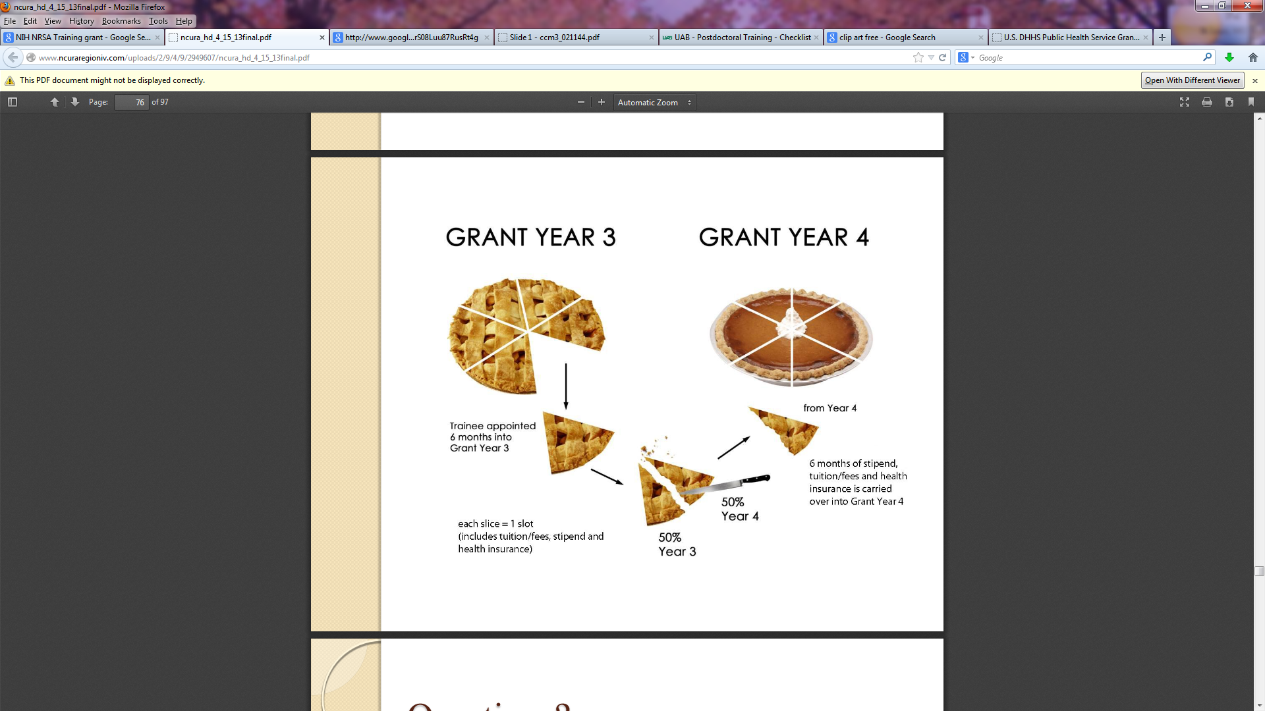
Unliquidated Obligations – Stipends, Tuition, and F & A Costs

Slide 156
Grant Termination
  May be terminated if grantee has materially failed to comply with terms and conditions of award or to carry out the purpose for which it was made
  IC will notify grantee of this determination to terminate, giving the reason, the effective date and the right to appeal the decision, all in writing
  Grantee may also request termination

Slide 157
Closeout
No invention statement required
T award closeout process occurs annually
  Remember unliquidated obligations
  Remember! Stipends paid as stated on Termination Notice must equal stipend amount actually paid
    Internal correction might be needed

Slide 158
Helpful Links
Ruth L. Kirschstein National Research Service Award policy information, stipend levels, FAQ’s
http://grants.nih.gov/training/nrsa.htm
NIH Forms & Applications
http://grants.nih.gov/grants/forms.htm
NIH xTRACT site
  https://era.nih.gov/erahelp/xtract/
xTrain Site
http://era.nih.gov/services_for_applicants/other/xTrain.cfm
eRA Commons
https://era.nih.gov/registration_accounts.cfm

Slide 159
Questions

