Slide 1
Sponsored Award Closeout
(Non Clinical Trials)
Created by Stefanie Fingler
August 22, 2023

Slide 2
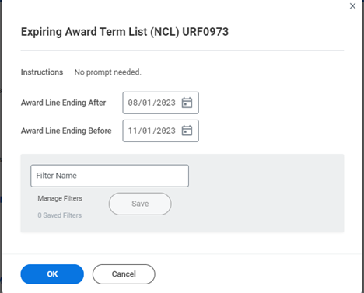
Expiring Award Term List
On a quarterly basis departments should be running the Expiring Award Term List (NCL) URF0973 report from URFinancials. This shows the awards that are coming to an end in the near future.
Common Action(s) Required
No Cost Extension Needed – Should be requested 60 days in advance of current end date. If yes, have we reached out to the sponsor to request the extension, if not, we need to. Visit ORPA for NIH studies
Multiyear award, waiting on next year of funding to be authorized, for example a 5 year R01 ending year 1 – make sure that we have submitted any required annual reports as the sponsor typically does not release funding for the following year until reporting requirements are fulfilled.
Subawards- If those needs to be extended, either by Rochester or another institution, it is our job to work on the amendments and ensure they are in process
Award is closing – if so, ensure that you are letting PI know and ensuring that all expenses will be incurred and close on the ledgers in the next three months so that your accountant can then prepare for closeout and inactive the award with ORACS - refer to following slides for closeout

Slide 3
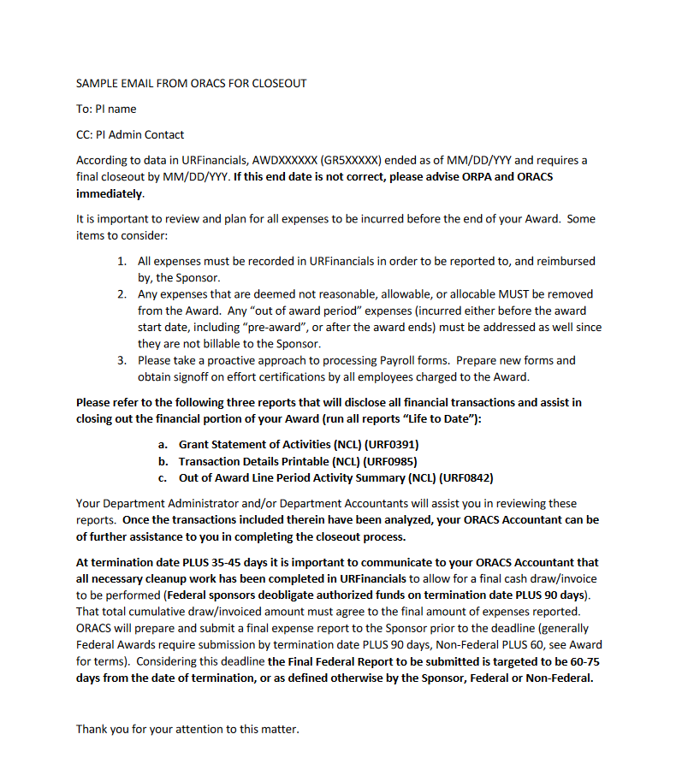
Final Financial Report
Once an award has officially ended a final financial report (Commonly referred to as a FFR for NIH awards) will need to be completed and the award will need to be inactivated.
  Final reports typically due within 60-90 days. Refer to sponsor agreement for exact due date.
  ORACS will typically send an email to the department/division referencing the award number and associated GR(s) that is ended, as a courtesy. DO NOT RELY ON ORACS to tell you when report is due; it is the administrator and accountant responsibility to keep up with this, just as equally

Slide 4
Process for Closeout
Step 1: To Department runs workday reports. Reports should be ran of the current date.
  Grant Statement of Activities (NCL) URF0391
    Organization should be Award, Period should be most recent month, Time Period should be life to date
  Transaction Details Printable (NCL) URF0985
    Organization should be Award, Period should be most recent month, Time Period should be life to date
    Filter out sal cap FAOs and F&A
  Out of Award Line Period Activity Summary (NCL) URF0842
    Organization should be Award
    Year – select all FYs to date
Step 2: Department runs any additional reports from their shadow system (i.e. URGEMS, or equivalent) showing what expenses are outstanding, that have not hit workday yet. Refer to additional checklist for administrators (See slide 6)
Step 3: Department uses the above reports to complete the Closeout workbook
Step 4: Department emails ORACS Staff Accountant their final spend and closeout workbook to confirm final spend. DO NOT APPEND URGEMS REPORT – THIS IS NOT THE REPORT OF RECORD
  Department should include backup for any open expenses that have not hit workday yet (See slide 5 for sample email to ORACS)
Step 5: Once spend has been confirmed by department and ORACS, department should save a copy of the closeout workbook in grant folder on their share drive and ensure that if there is a deficit write-off, the write-off amount is accounted for as an outstanding obligation on the OP/GF account.

Slide 5
Sample email from department to ORACS Staff Accountant confirming final spend on award
Hi “ORACS Staff Accountant”
Dr. Smith’s AWD00002695 ended on 5/31/23. We have ran all required reports and confirm our final spend is as follows:
GR501627 - $1,259,358.64
Total grant life to date expenses in workday is $1,257,545.12 less a $104.80 adjustment needed by ORACS for rounding on supplier discounts & a 37-cent adjustment for rounding on indirects
Additionally, there are outstanding expenses in the amount of $1,918.69 (net change from the attached payroll reallocation form plus indirects) for Jason Cunningham that is still open.
GR510895 - $64,244.35
GR510896 - $107,414.00
TOTAL: $1,431,016.99
Since the total award is $1,434,266 – there is no deficit; funds will be returned to the sponsor.
If applicable: There is $X in GOOA charges on GR5XXXXX that do not belong and have been moved off. The JE reference number is AJEXXXXXXXX
If applicable: There is a direct deficit OR surplus in the amount of $X, please use OPXXXXXX (MAKE SURE THIS IS APPROVED BY YOUR DEPARTMENT)
Please review and let us know if you agree.
Thanks!

Slide 6
Additional Checklist for Administrators

