Slide 1
Reframe Aging:
A Generation’s Work
Trish D’Antonio
VP, Policy & Professional Affairs
Gerontological Society of America
Executive Director
National Center to Reframe Aging
June 3, 2024
Notes:
The National Center to Reframe Aging is dedicated to ending ageism by advancing an equitable and complete story about aging in America.
The center is the trusted source for proven communication strategies and tools to effectively frame aging issues.
It is the nation’s leading organization, cultivating an active community of individuals and organizations to spread awareness of implicit bias against older people and influence policies and programs that benefit us all of us as we age.

Slide 2

Ageism Defined
Stereotypes: How we think
Prejudices: How we feel
Discrimination How we act
Interpersonal
Compassionate
Systemic/ Institutional
Self-directed
Ageism exists in several forms
Ageism exists on multiple levels
Notes:
TRISH
The WHO report: https://www.who.int/teams/social-determinants-of-health/demographic-change-and-healthy-ageing/combatting-ageism/global-report-on-ageism
Outlined ageism in several forms:
Ageism refers to the stereotypes (how we think),
prejudice (how we feel) and discrimination (how we act)
directed towards people on the basis of their age.
And on multiple levels –
Interpersonal ageism arises in interactions between two or more individuals
Compassionate ageism – otherwise known as elder speak.
Institutional ageism refers to the laws, rules, social norms, policies and practices of institutions that unfairly restrict opportunities and systematically disadvantage individuals because of their age.
while self-directed ageism occurs when ageism is internalized and turned against oneself
Ageism starts in childhood and is reinforced over time. From an early age, children pick up cues from those around them about their culture’s stereotypes and prejudices, which are soon internalized.
People then use these stereotypes to make inferences and to guide their feelings and behavior towards people of different ages and towards themselves.

Slide 3
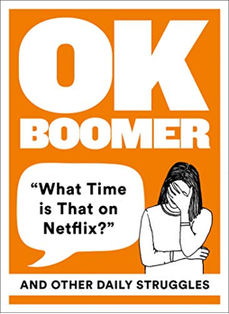
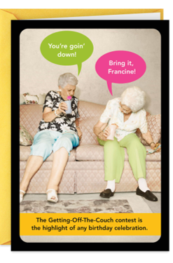
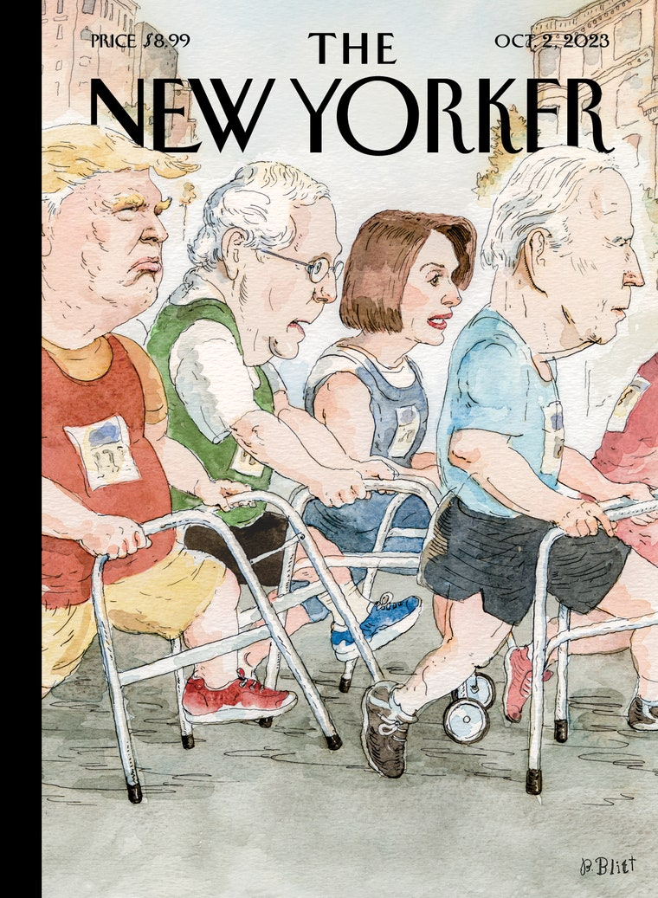
Everyday Messages
Notes:
Trish
Here is the thing –
Ageism results from the images and messages we receive throughout our life.
Starting at an early age…
It’s the jokes we hear our parents tell, the characters we see on TV
The things advertisers and magazines tell us about aging
They all train us to see older people a certain way and thereby treat them a certain way.
These seemingly minor incidents get under our skin and impact not only how we think about others, it impacts how we think about ourselves.
The metaphor of the Silver Tsunami is particularly problematic.
What happens in a tsunami?
Run for the hills and everybody dies.

Slide 4
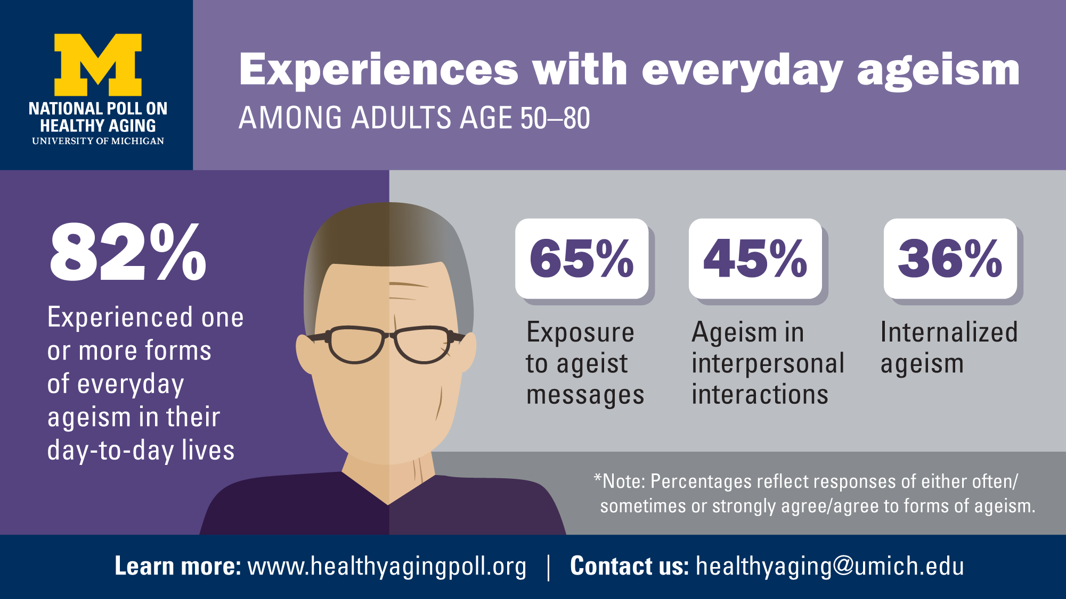
Notes:
You are not alone…a poll from the University of Michegan Center on Healthy Aging showed that 82% of adults age 50-80 experience one or more forms of ageism in their day to day lives.
Ageist messages
Interpersonal interactions
Internalized ageism

Slide 5
Implicit Bias Defined
Implicit bias refers to the attitudes or stereotypes that affect our understanding, actions, and decisions in an unconscious manner.
Simply being aware of our implicit bias reduces ageism.
Busso DS, Volmert A, Kendall-Taylor N. "Reframing aging: Effect of a short-term framing intervention on implicit measures of age bias." The Journals of Gerontology: Series B 74.4 (2019): 559-564.
The Kirwan Institute for the Study of Race and Ethnicity​
Notes:
Trish
Underlying ageism is implicit bias.
Also called unconscious bias these are the attitudes and mental models that are
activated automatically -- without an individual’s awareness or intentional control.
The implicit associations we harbor in our subconscious cause us to have feelings and attitudes about other people based on characteristics such as race, ethnicity, age, and appearance.
These associations develop over the course of a lifetime
As I mentioned before – we begin shaping these biases at an early age.
FrameWorks’ conducted research that found exposure to an explanation of implicit age bias actually reduced people’s implicit bias.
just being aware of our biases makes us less likely to act on them and more likely to treat people fairly.

Slide 6
Research Identified the Challenge
Public Perceptions about older people that are incomplete and unrealistic: older people are either living a life of leisure or are frail, decrepit, and dependent.
Cultural Models are cognitive short cuts that we rely on to interpret and understand all sorts of experiences, thoughts and feelings. They are taken-for-granted and largely automatic assumptions.
Ageism is not considered a “problem.” For ex., the Age Discrimination in Employment Act that prohibits workplace discrimination should take care of this.

Slide 7


Why we need to reframe aging
Aging Field
Public
Embrace
How should we approach aging?
Battle
What determines outcomes and who is responsible?
Environments
Individuals
How big of a concern is ageism?
Important concern
Absent from thinking
What can be done to ensure wellbeing in older age?
Plenty
Nothing much
What is the role of public policy?
Central
Limited role
Notes:
Trish
Let’s talk about what the researchers found when they “mapped the terrain” by interviewing experts and thought leaders in the field of aging. The researchers also surveyed the public. This graphic highlights some of the stark differences they found between attitudes of aging experts and the public.
-- highlight examples
But let’s be clear – we are members of the public too. We are experts in the field of aging, but we also have some of the same reactions and responses as the public does.
We generally talk about aging as being a deficit vs. abundance. Which was what was found in the research.
Our research……
Why do I need to change? Remember this is based on research…more than focus groups.

Slide 8
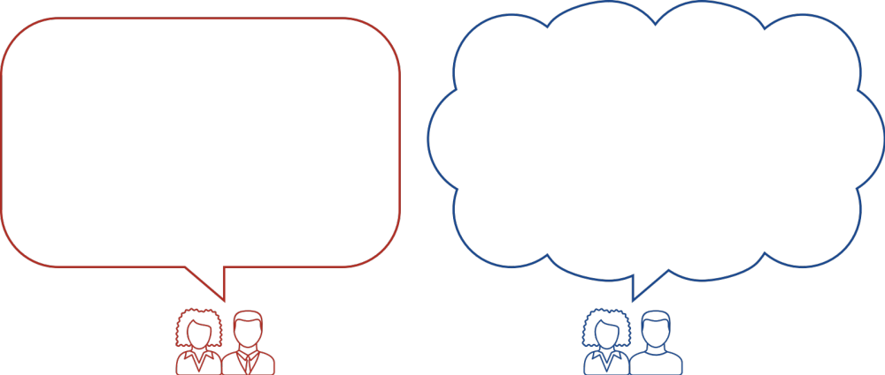
You Say...They Think
“The Elderly”
Frail,
Dependent
Aging Professional/Advocate
Public
Notes:
Trish
- A primary reason that framing matters is that communicators face a big challenge, one we can call a “You Say, They Think” problem.
That’s where an expert puts out a message that sounds perfectly reasonable in the office or when shared with colleagues, but that, somehow, elicits a totally different response from a public audience than the one intended.
An example is using the term The Elderly.
When we say “the elderly,” for us, with our knowledge of older people and our many years of experience in the field of aging, it’s just a short cut term for someone older maybe 70 years or 80 years of age. But to the public, the term “the elderly” automatically leads to thinking of someone frail, dependent, and needy.
This is why it’s up to us to tell the a more complete story of aging, the “rest of the story” that the public doesn’t readily know or accept. That aging isn’t all about doom and gloom. That being older doesn’t mean we suddenly become useless. We need to convey that growing older has benefits for families and communities and the whole society.
These assumptions and beliefs about aging are the result of Implicit Bias, which is an unconscious response we develop over the course of our lives, starting when we are very young. These implicit biases lead to Patterns of Thinking that influence our behaviors and actions.

Slide 9
You Say...They Think
Collective Responsibility
and
Collective Benefit
“We are all aging”
Aging Professional/Advocate
Public
Notes:
This is our goal – our communication drives inclusive thinking where we work together and benefit together.

Slide 10
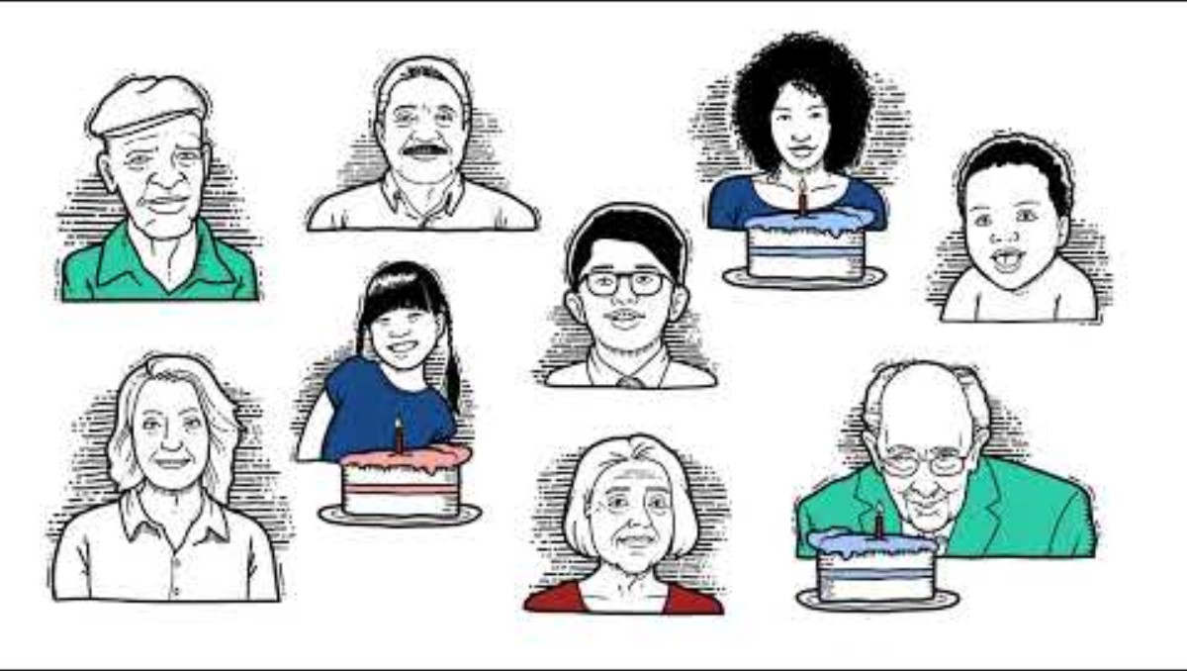
Frame of Mind:
Notes:
Trish

Slide 11


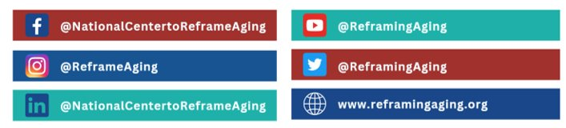
Frame On!
Productive perceptions of
aging are priceless
Join in the conversation!
Notes:
Changing American culture is challenging.
Changing attitudes and behaviors around the universal experience of aging is especially difficult.
It is a generational change.
Changing American culture is challenging and changing attitudes and behaviors around the universal experience of aging is especially difficult. It is a generational change, but positive perceptions of aging are priceless!

