Slide 1

SNAP
Supplemental Nutrition
Assistance Program
Presented by: Legal Assistance of Western New York, Inc.

Slide 2
Janice Griffin & Yawana Dearring
Monroe County jgriffin@lawny.org & ydearring@lawny.org
585-450-3686 / 585-504-2963
585-325-2520 intake
Notes:
Also please visit our website at Lawny.org for our online intake form
Also our number has changed our old number was 295-5624 and the new number is 450-3686
We can assist with screening for eligibility, reviewing current SNAP budgeting, application assistance, recertification assistance, submitting documentation for HH changes, and answering questions about SNAP benefits

Slide 3
Daniel Palermo
Livingston County dpalermo@lawny.org
(585) 572-1714
585-325-2520 intake
Notes:
Also please visit our website at Lawny.org for our online intake form
Also our number has changed our old number was 295-5624 and the new number is 450-3686
We can assist with screening for eligibility, reviewing current SNAP budgeting, application assistance, recertification assistance, submitting documentation for HH changes, and answering questions about SNAP benefits

Slide 4

What is SNAP?
Supplemental Nutrition Assistance Program
also known as Food Stamps

Slide 5
HOW CAN
WE
HELP?
Tell you if you may be eligible for SNAP.
Calculate a budget to give you an estimate of your SNAP benefits.
Help you understand and prepare the documents you need to apply for SNAP.
Help you complete the application and submit it to DSS for you.
Give you information on how to use your EBT card.
Help you if you have difficulties applying for SNAP.
Review the amount of SNAP benefits you received if you feel DSS might have made an error.
Give you referrals to other programs you might benefit from and are interested in.
Help you recertify

Slide 6
What are some benefits of SNAP?
SNAP provides benefits that can be used at most large grocery stores, and at many small grocery stores and bodegas, to purchase food and beverages.
SNAP can be used at many farmers’ markets.
SNAP can be used to buy most foods!
SNAP can be used to buy plants and seeds to grow vegetables!
Notes:
Among the many good things about SNAP are – review slide.

Slide 7
SNAP can help when you are…
Retired and on a fixed income, and having a hard time making ends meet.
Skipping meals to afford college costs.
Living with a disability and cannot afford enough food for a month.
Working full-time or part-time and are struggling to afford enough food for your family.
A household in need of more and better nutrition.
Notes:
SNAP can help many households, for example – review slide.
For households like these and many others SNAP can help.

Slide 8
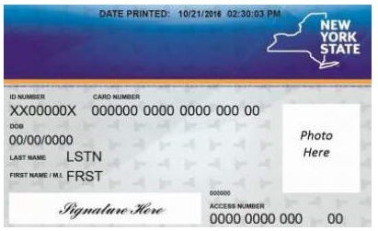
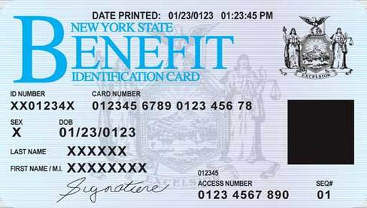
How SNAP works
Benefits are added to the EBT or CBIC card. (Electronic Benefit Transfer or Common Benefit ID Card).
Same card used for other benefits like Medicaid.

Slide 9
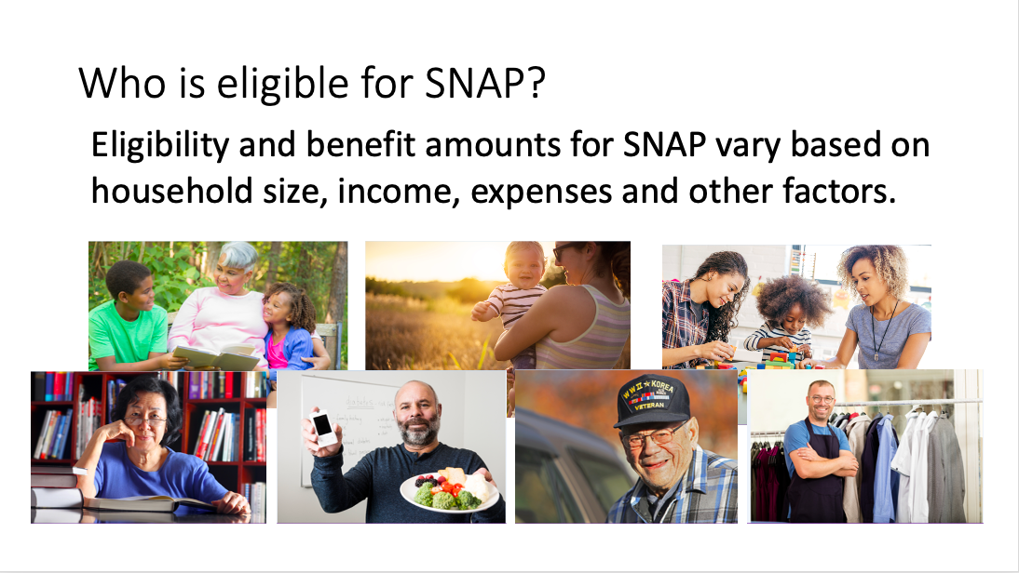

Slide 10
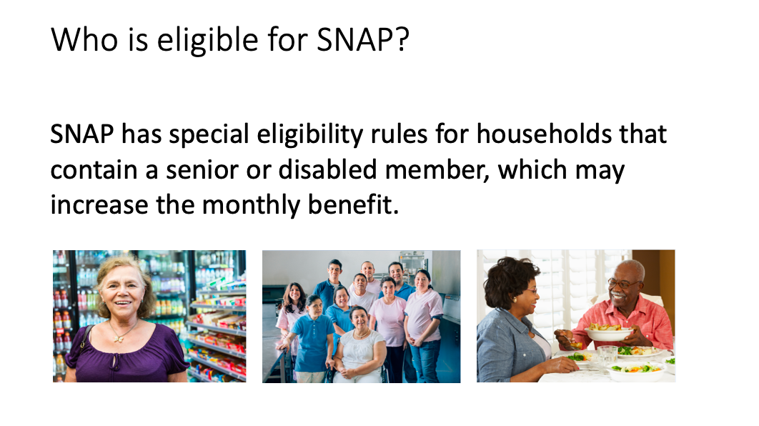

Slide 11
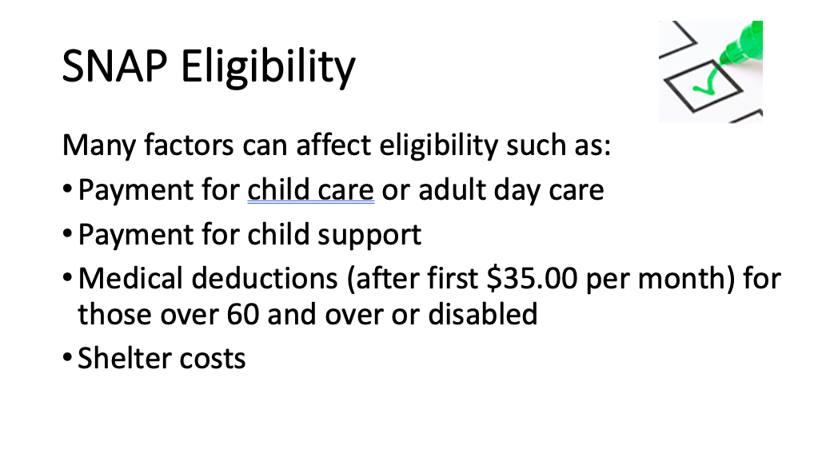

Slide 12
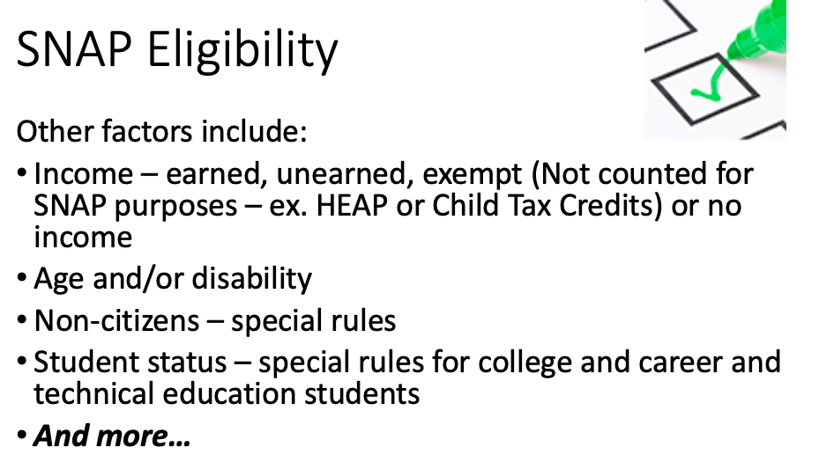

Slide 13
Changes to SNAP Benefits
Expanded eligibility for students
As of October 2020, NYS expanded eligibility to students in qualified career and technical education programs. individuals attending a SUNY, community college, technology college and enrolled at least half-time in a qualified program meet the criteria to be considered an “eligible student” for SNAP. (This is a permanent change)
This rule does not apply to students in four-year degree programs at SUNY/CUNY universities or colleges. However, these students may be eligible for SNAP under other student exemptions.
Notes:
The Thrifty Food Plan is the lowest cost of the four. It represents the cost of a nutritious, practical, cost-effective diet prepared at home for a family of four, which is defined in law as an adult male and female, ages 20-50, and two children, ages 6-8 and 9-11.
The income guidelines increase every on October 1, 2021 which can increase eligibility for HH’s that did not qualify in the past

Slide 14
Student Eligibility
A student is any person who is:
18 through 49 years of age
Physically and mentally fit
Enrolled at least half-time in an institution of higher education
Institution of Higher Education:
Any institution at the post high school level that normally requires a high school diploma or equivalency certificate for enrollment, including but not limited to:
Colleges
Universities
Business schools
Trade or technical vocational schools
schools
Correspondence schools
Online courses
Colleges or universities that offer degree programs regardless of whether a high-school diploma is required

Slide 15
Student Eligibility Continued
Enrolled in a College Meal Plan:
Students receiving 50% or more of their meals (based on 3 meals for seven days equaling 21 meals) from a college meal plan are not eligible to receive SNAP as they are considered to be living in an institution.
The SNAP office must screen each student to identify the number of meals the student is granted under their meal plan.
Under these rules, students who are 18 to 49 years old and enrolled at least halftime in an institution of higher learning cannot get SNAP unless they meet at least one of the following exceptions:

Slide 16
Student Eligibility Continued
Student is working:
Employed an average of 20 hours a week or more
Self-employed, working an average of 20 hours a week and making an average income equal to the federal minimum wage multiplied by 20 hours
Student has one or more of these individual characteristics:
17 years old or younger
50 years old or older
Physically or mentally unfit for work: the individual has an illness, condition or life circumstance, whether temporary or permanent, that reduces or affects their ability to work 20 hours a week.
Primary caretaker of a household member who is under age 6 or is incapacitated
Primary caretaker of a household member between the ages of 6 and 11, if no adequate childcare is available that would make it possible to work and go to school
A single parent enrolled full time who is responsible for the care of children under age 12

Slide 17
Student Eligibility Continued
Student participates in qualified government program:
Receives Temporary Assistance for Needy Families (TANF)
Receives unemployment benefits
Participating in state or federal work-study
Attends a State University of New York (SUNY) or City University of New York (CUNY) community, comprehensive, or technology college and is enrolled in a qualified certificate or degree Career and Technical Education (CTE) program
Attends an Educational Opportunity Center (EOC) and is enrolled in a qualified CTE program, remedial courses, basic adult education, literacy, or English as a second language
In school through SNAP Employment and Training (E&T), Workforce Innovation and Opportunity Act (WIOA) or the Department of Labor program

Slide 18
Student Eligibility Continued
Eligible students remain eligible between school breaks (vacations, summer, etc.) unless the student graduates, is suspended or expelled, drops out, or does not intend to register for the next school term (excluding summer semesters).
Exception: Students who have work-study lose their SNAP eligibility between semesters if the break is a full month or longer and in summer months, unless the work-study continues, or they fit into another exemption.

Slide 19
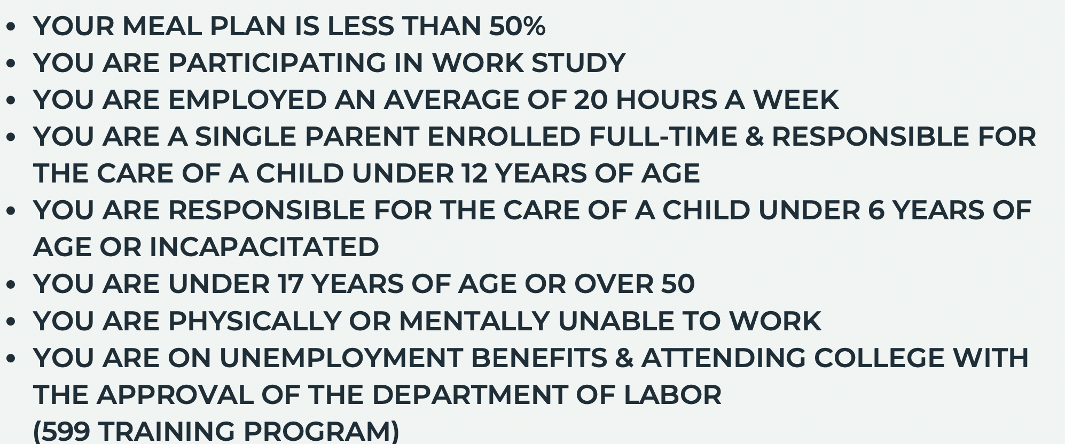

Slide 20
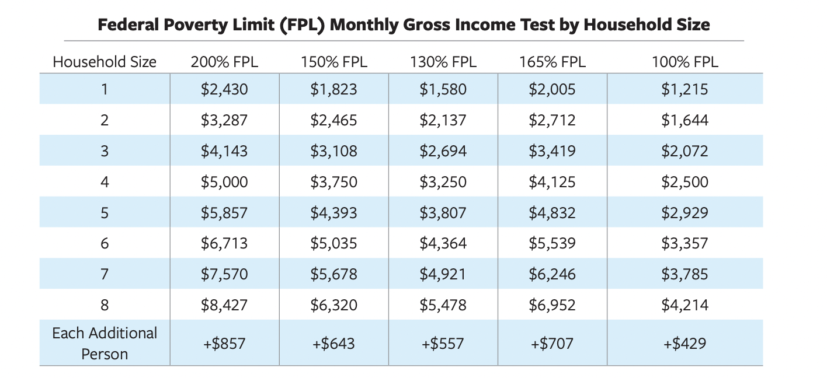
Income Guidelines
200% FPL: households containing elderly and/or disabled/members or that have out-of-pocket dependent care costs
150% FPL: households with earned income
130% FPL: households with unearned income or no-income
October 1, 2023 - September 30, 2024

Slide 21
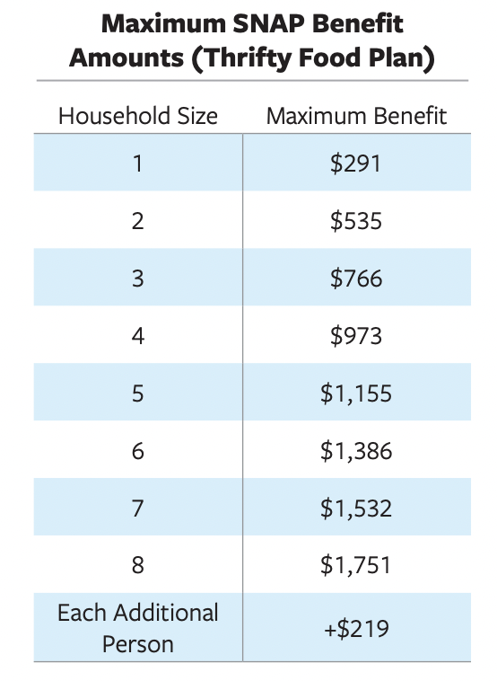
Monthly SNAP Benefits
2023-2024
Notes:
Minimum for a HH of 1 is $20
This chart shows the maximum, this does not mean the HH is eligible for the maximum

Slide 22
How to apply?
Complete an application
Eligibility Interview
Required Documentation
Wait for the decision

Slide 23
Helpful Tips!
Read your notice
Review your notice for incorrect information
Keep proof of submitting documentation
Sign the application
Leave it blank if your unsure of the information
Be honest
Never share your pin number
Answer the phone on the day of your interview
Report household changes
Use NYDocsubmit an app to upload documentation
Benefits expire 274 days after they are issued

Slide 24
Reporting changes in household income
Reporting Requirements – when should you report a change?
Households with 6-Month Reporting Rules
must report change in income that causes the household to be over 130%, must report it immediately.
Households with Periods Longer than Six Months
will receive a change report form to be filled out at the six-month point of their SNAP certification.
Households that are 10-Day Reporters
must report almost changes in household within the 10th day of the month following the month of the change.
(Households with unearned income and all the adults are elderly or disabled • Group home residents receiving SSI/SSD • Households with no income • Migrant workers • Homeless households)
Notes:
Any failure to report information when it is required may result in an overpayment, and the SNAP office will try to get the overpaid amount back, either by “recouping” it from future benefits or through a “claims” process.

Slide 25
Reporting changes in household income cont.
Failure to report information when it is required may result in an overpayment.
Just ask if you are not sure.
Keep documentation of when you submit income changes, it is defense against fraud.
Notes:
Any failure to report information when it is required may result in an overpayment, and the SNAP office will try to get the overpaid amount back, either by “recouping” it from future benefits or through a “claims” process.
Reporting Rules: Households with Six-Month Reporting Rules The only thing these households must report during the six-month period is:. Households with Certification Periods Longer than Six Months • These households will receive a change report form to be filled out at the six-month point of their SNAP certification. • The change report form is mailed at the end of the fifth month of certification. • The household should complete the form and return it to the local SNAP office to continue receiving benefits. 10/2020 67 Keeping and Using Benefits • These households must do the following under reporting rules: • Return the 6-month report form. • Report any change in household income above 130% of poverty. Households with certification periods of six months or more do not have to report any other changes in circumstances until their next SNAP recertification interview. Households that are 10-Day Reporters: Some households cannot take advantage of the six-month reporting rules. Instead, they are required to report almost all changes in household information within the 10th day of the month following the month of the change. Ten-day reporting households include: • Households with unearned income where all the adults are elderly or disabled • Group home residents receiving SSI/SSD • Households with no income • Migrant workers • Homeless households • Households with a certification period of less than four months Even these households do not have to report certain changes in between certification periods. For example, it is not necessary for elderly households to inform the SNAP office when their Social Security benefits increase each January, so long as the increase is less than $50 per month. It is best to check reporting rules for specifics on what must be reported when and by which households. A helpful source of information is 04-INF-25.

Slide 26







Slide 27
Questions?
Do I have to apply with my roommates?
If my parents have SNAP, can I apply?
Will SNAP effect my financial aid?
How long will benefits stay on my card?
When can I use my benefits?
When will I receive my benefits?
Can I buy hot food?
???

Slide 28
Janice Griffin – Public Benefits Paralegal jgriffin@lawny.org
(585) 450-3686 Monroe County
Yawana Dearring – Public Benefits Paralegal ydearring@lawny.org
(585)504-2963 Monroe County
Daniel Palermo – Public Benefits Paralegal dpalermo@lawny.org
(585) 572-1714 Livingston County
Yolanda Sheffa – Supervising Paralegal
(585) 504-2961 Livingston & Monroe

