Slide 1
Learning in Digital Spaces
Module A1
Jayne Lammers, facilitator

Slide 2
Agenda
Framing:
Affinity Spaces
Anchoring:
3 short examples
Discussing:
Questions and Comments
Connecting:
Implications for you (your work/research)
Looking Ahead

Slide 3
FRAMING

Slide 4
What types of digital literacy practices are occurring “in the wild,” and how can they be leveraged for learning?
Guiding Question:
Notes:
First, we’ll define some terms

Slide 5
Defining Literacies
“socially recognized ways in which people generate, communicate, and negotiate meanings, as members of Discourses, through the medium of encoded texts”
(Lankshear & Knobel, 2011, p. 33)

Slide 6
Defining Digital Literacies
“socially recognized ways in which people generate, communicate, and negotiate meanings, as members of Discourses, through the medium of encoded [digital] texts”
(Lankshear & Knobel, 2011, p. 33)

Slide 7
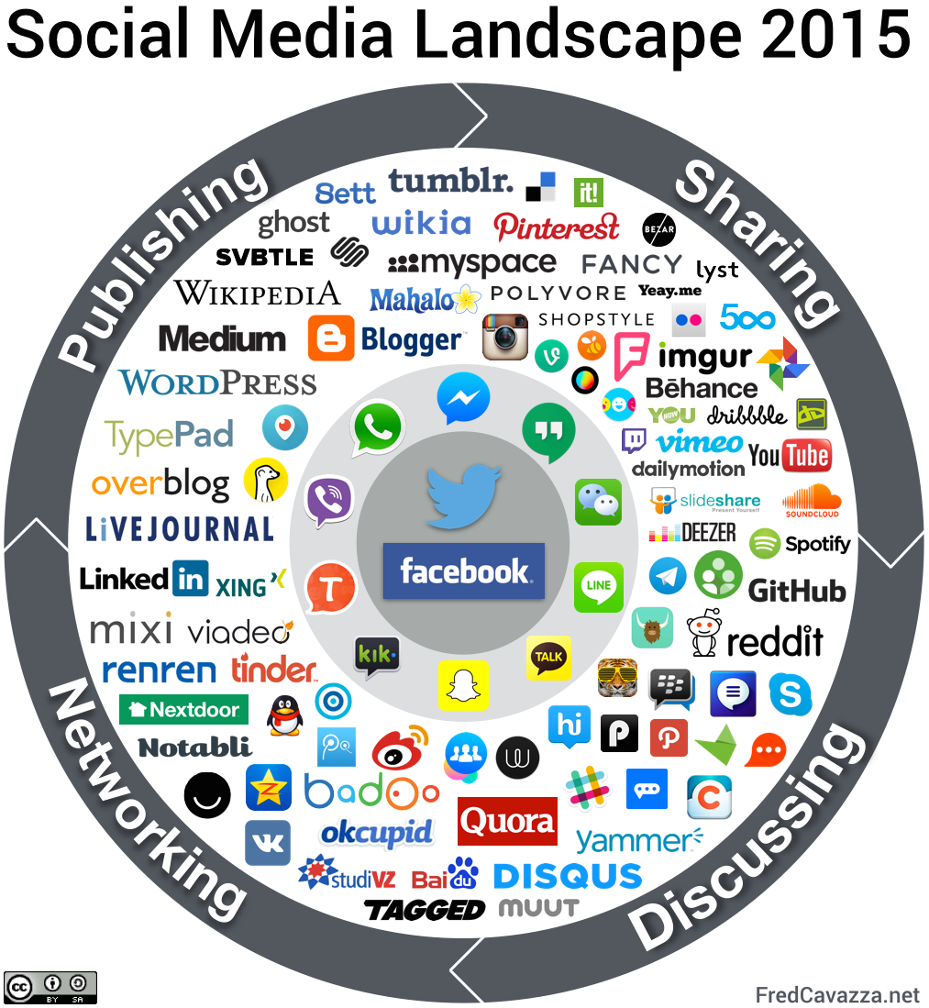
Notes:
Connect the particular digital literacy practices to a given SNS – maybe Twitter or FB could be an example.

Slide 8
Theorizing Affinity Spaces
Are physical, virtual or blended spaces where “newbies and masters and everyone else” interact around a “common endeavor” (Gee, 2004)
Are sites of informal learning offering multiple interest-driven trajectories and paths toward becoming an authentic participant (Jenkins, 2006; Squire, 2011)
Consist of interconnected portals that include various media, fan-created sites, and social networks, each contributing to the growth and dynamic practices of the space (Lammers, Curwood & Magnifico, 2012)

Slide 9
Theorizing Affinity Spaces
Are physical, virtual or blended spaces where “newbies and masters and everyone else” interact around a “common endeavor” (Gee, 2004)
Are sites of informal learning offering multiple interest-driven trajectories and paths toward becoming an authentic participant (Jenkins, 2006; Squire, 2011)
Consist of interconnected portals that include various media, fan-created sites, and social networks, each contributing to the growth and dynamic practices of the space (Lammers, Curwood & Magnifico, 2012)

Slide 14
Online Affinity Space Features
1. A common endeavor is primary.
2. Participation is self-directed, multi-faceted, dynamic.
3. Portals are often multimodal.
4. Affinity spaces provide a passionate, public audience for content.
5. Socializing plays an important role in affinity space participation.
(Lammers, Curwood, & Magnifico, 2012)

Slide 15
Online Affinity Space Features
6. Leadership roles vary within and among portals.
7. Knowledge is distributed across the entire affinity space.
8. Many portals place a high value on cataloging and documenting content and practices.
9. Affinity spaces encompass a variety of media-specific and social networking portals.
(Lammers, Curwood, & Magnifico, 2012)

Slide 16
Conceptualizing Online Affinity Spaces
ROOT WEBSITES
CREATIVE ARCHIVES
SOCIAL MEDIA TOOLS

Slide 17
Notes:
An example

Slide 18
Hunger Games Online Affinity Space
Mockingjay.net
HungerGamesRPG.com
HungerGamesTrilogy.com
HGGirlonFire.com
TheCapitol.pn
ROOT WEBSITES
CREATIVE ARCHIVES
SOCIAL MEDIA TOOLS
DeviantArt
YouTube
Fanfiction.net
Figment
Wattpad
Facebook
Twitter
Tumblr
(Curwood, 2013; Curwood, Magnifico & Lammers, 2013)

Slide 19
Affordances of Affinity Space Research
Tracing literacy practices within and across portals
Access to participants outside of our geographic proximity
Available record of affinity space practices
(Lammers, Curwood, & Magnifico, 2012)

Slide 20
Challenges of Affinity Space Research
Working to develop and maintain relationships with key informants
The instability and impermanence of web-based environments and artifacts
Porous boundaries of field sites
(Lammers, Curwood, & Magnifico, 2012)

Slide 21
ANCHORING
What kinds of questions can we ask in affinity spaces?

Slide 22
Example #1
1. A common endeavor is primary.
2. Participation is self-directed, multi-faceted, dynamic.
3. Portals are often multimodal.
4. Affinity spaces provide a passionate, public audience for content.
5. Socializing plays an important role in affinity space participation.
(Lammers, Curwood, & Magnifico, 2012)

Slide 23
Tensions in Online Affinity Spaces
“It’s supposed to be the Writer’s Hangout, and the chit chatting about random gossip…should come secondary”
(Lammers, 2012)

Slide 24
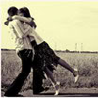
What about the Chit Chat?
“Our members shouldn’t post only there [in Chit Chat]. We have several new ones who join just to post in the games, fun, and venting section, and nothing in the Sims sections. It’s disheartening.” (Pamela, moderator)
“Chit Chat gives the Hangout a place where members become more than just random stories, but they become real people.” (Angela, reader/writer)

Slide 25
Example #2
1. A common endeavor is primary.
2. Participation is self-directed, multi-faceted, dynamic.
3. Portals are often multimodal.
4. Affinity spaces provide a passionate, public audience for content.
9. Affinity spaces encompass a variety of media-specific and social networking portals.
(Lammers, Curwood, & Magnifico, 2012)

Slide 26
Studying Online Affinity Spaces

Slide 27
Studying Online Affinity Spaces

Slide 28
Studying Online Affinity Spaces

Slide 29
Studying Online Affinity Spaces

Slide 30
Tracing Eve’s Participation
Website
Twitter
Celestial Myth
To Be or Not to Be... In Love
Flickr
Sims Writers’ Hangout
YouTube Channel
Oct 2005
July 2012

Slide 31
Tracing Eve’s Participation
Website
Twitter
Celestial Myth
To Be or Not to Be... In Love
Flickr
Sims Writers’ Hangout
YouTube Channel
Oct 2005
July 2012

Slide 32
Example #3
1. A common endeavor is primary.
2. Participation is self-directed, multi-faceted, dynamic.
3. Portals are often multimodal.
4. Affinity spaces provide a passionate, public audience for content.
5. Socializing plays an important role in affinity space participation.
(Lammers, Curwood, & Magnifico, 2012)

Slide 33
Laura’s Writing on Fanfiction.net

Slide 34
Introducing Laura
16-year-old
10th grade: AP English Literature and Composition (with 12th graders)
Passionate singer, dancer, actor, athlete, aspiring novelist
Joined Fanfiction.net at age 11
The Hunger Games and Broadway (Wicked, Cats) fanfiction
(Lammers & Marsh, 2015)

Slide 35
Expanding Access to an Audience
I got it done and I edited it like again like I think probably 1:00 in the morning and then I posted it, and I was very proud of myself cause I’d actually gotten it out there (Int. 4, August 27, 2013)
Sharing with the Fanfiction.net audience is easy, whenever she wants

Slide 36
Studying Audience Expectations
“I think [Queenbeefairy is] more likely to sway her ideas for a story based on what her reviewers want…it does bother me sometimes that [she] has over 200 reviews”(Int. 3, August 28, 2012)
Writing for Fanfiction.net requires understanding and conscious engagement with this abstract audience.
Notes:
Laura can study the interactions that another popular author has on FFN to learn about the audience’s expectations.

Slide 37
Interacting Directly with the Audience
About reviews she receives: “oh you actually read it; that was meaningful”
“she reviewed it but it was brief, but it was nice that she reciprocated…we’re just going back and forth”
(Int. 4, August 27, 2013)
Sharing with the Fanfiction.net provides access to a social audience that provides feedback and a sense of connection.

Slide 38
Open questions
What role can/should classroom-based writing instruction provide to support youth participation in online affinity spaces?

Slide 39
Open questions
What role can/should classroom-based writing instruction provide to support youth participation in online affinity spaces?
What happens when formal learning environments are designed/conceptualized as affinity spaces?

Slide 40
Open questions
What role can/should classroom-based writing instruction provide to support youth participation in online affinity spaces?
What happens when formal learning environments are designed/conceptualized as affinity spaces?
How do the masses, not exceptional cases, participate in digital spaces?

Slide 41
DISCUSSING

Slide 42
Discussing
Time for questions, comments, and discussion around the presentation and our guiding question:
What types of digital literacy practices are occurring “in the wild,” and how can they be leveraged for learning?

Slide 43
CONNECTING

Slide 44
Connecting
Going around the room, each person can take a turn (or pass, if they’d prefer) to share a connection they see between what we’ve discussed and their own work, research, personal interests in Learning in the Digital Age

Slide 45
LOOKING AHEAD

Slide 46
Looking Ahead
What’s on Blackboard
Follow-up to our discussion during the next LiDA session: November 18
Next study session question:
What are “high-leverage” online teaching practices and how can they best be developed?

