Slide 1
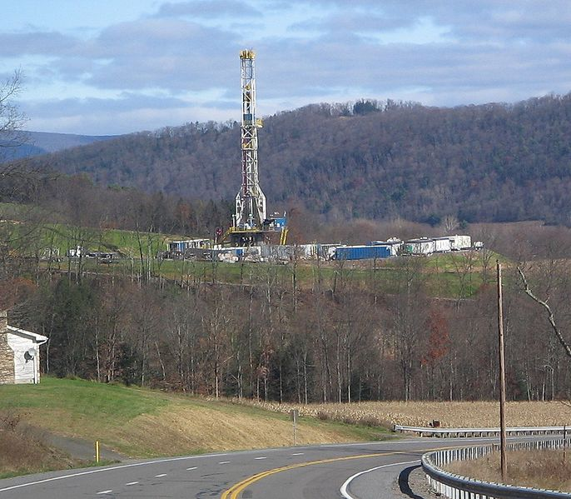
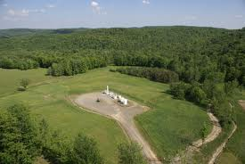
Life in an imperfect world: The case for hydrofracking
Kent Gardner, PhD
Chief Economist, Center for Governmental Research

Slide 2
No free lunch
Total consumption of electricity will rise as global incomes rise: U.S. per capita consumption is 3.4x that of China
Alternative sources of energy remains persistently more costly than energy from fossil fuels, particularly shale gas
Hydrofracking has driven down natural gas price, reducing the cost of home heating & electricity generation
Shale gas displaces
Foreign energy sources—IEA predicts U.S. energy independence
Coal—worse in human & environmental terms
These rewards don’t come without risk

Slide 4
Gee, Iris . . .

Slide 5
The cost of energy matters

Slide 6
The cost of energy matters

Slide 7
Environmental Benefits (from Environmental Defense Fund briefing paper)
Exchanging natural gas for coal can cut conventional air pollution, help reduce greenhouse gas emissions from the power sector
Half the carbon dioxide of coal when burned
Third as much of the nitrogen oxides that come from burning coal
Almost none of the mercury and sulfur dioxides from burning coal or oil
Could end mountaintop removal mining and other environmentally disastrous industry practices
Natural gas-fired power plants can cycle up quickly, they can be a nimble enabler of intermittent renewable energy sources in combination with demand response and emerging large-scale energy storage technologies

Slide 8
Other Shale Gas Benefits (from Environmental Defense Fund briefing paper)
Job creation: Rising demand for technical and prof services, for steel, pipelines and storage facilities, ancillary goods and services
Expansion in the American chemical industry, with Dow and DuPont now building new plants close to shale formations
Revival in U.S steelmaking and other manufacturing industries. Nucor, which uses natural gas to make steel, is building a $750-million facility in Louisiana, just eight years after shutting down a similar plant in the same state
Potential U.S. energy independence and enhanced energy security

Slide 9
Health Impacts
Claims of health impacts of hydrofracking are disputed in the public record
Health consequences of coal mining are undisputed
Deaths
Permanent disability (full/partial)
Mountaintop removal, impact of spoils

Slide 10
Coal Fatalities
06-10 avg: 383 accidents resulting in permanent disability
Annual average: 32

Slide 11
Health Impacts: HVHF
Cuomo Administration has been dragging its feet on a hydrofracking ruling—why?
2012 DEIS from NYS DEC concludes that "by implementing the proposed mitigation measures identified and required in this (report), the department expects that human chemical exposures during normal HVHF operations will be prevented or reduced below levels of significant health concern. Thus adverse impacts on human health are not expected from routine HVHF operations. When spills or accidents occur, the department has identified numerous additional mitigation measures ... so that significant exposures to people and resources on which they rely are unlikely."
These are DRAFT findings—but clearly reflect considerable sentiment within DEC that hydrofracking can be effectively regulated

Slide 12
Climate Change Impact
Displaces coal—reduction in GHG
Ingraffea disputes this point, but his paper (Howarth et al) has been challenged by other scientists

Slide 13
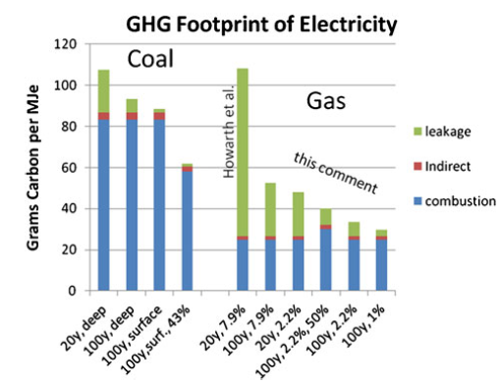
A commentary on “The greenhouse-gas footprint of natural gas in shale formations” by R.W. Howarth, R. Santoro, and Anthony Ingraffea Lawrence M. Cathles III & Larry Brown & Milton Taam & Andrew Hunter

Slide 14
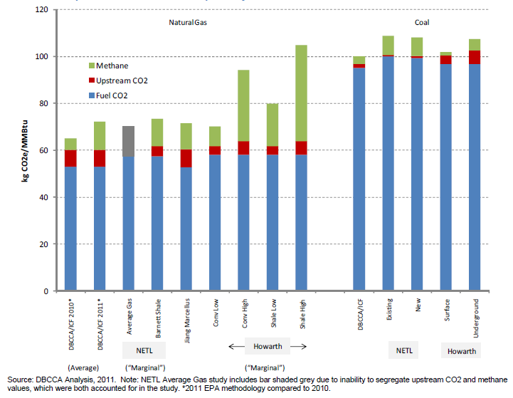
Deutsche Bank Climate Change Advisors , posted by Worldwatch Institute

Slide 15
Climate Change Impact
Displaces coal—reduction in GHG
Ingraffea disputes this point, but his paper (Howarth et al) has been challenged by other scientists
Environmental Defense Fund & Worldwatch Institute support proposition that shale gas reduced GHG emissions by displacing coal

Slide 16
What’s the policy response?
Regulation of HVHF practice
Tax the bad, don’t subsidize single solutions
Learn more

Slide 17
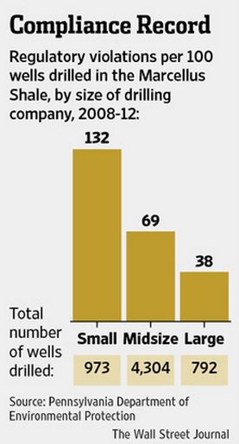
Regulation & voluntary compliance
Tentative agreement on voluntary regulation reached with drillers, EDF & regulators
Data suggests that compliance improves when small firms displaced by major energy firms

Slide 18
Policy response: Be careful what you wish for
Subsidies for corn ethanol continue through Renewable Fuel Standard, although explicit subsidy expired
40% of corn crop to ethanol (price increased fourfold since 2005)
Meeting 36m gallon RFS goal by 2022 would require entire field corn crop
Thanks to the Iowa Caucuses?

Slide 19
Policy response: Be careful what you wish for
Europe’s “Renewable Fuel Standard” subsidized renewable fuels
What’s “renewable”?
Europe declared wood to be “renewable” for its RFS—why not?
Credit worth $68/MWh

Slide 20
Back to Iris . . .

Slide 21
Policy response: Be careful what you wish for
Europe’s “Renewable Fuel Standard” subsidized renewable fuels
What’s “renewable”?
Europe declared wood to be “renewable” for its RFS—why not?
Credit worth $68/MWh
Canadian hardwood prices up 60% since 2011

Slide 22
Policy response:Be careful what you wish for
Solyndra’s ½ B loan guarantee?
Electric car subsidies: Transfer from poor to rich?
Economists solution: Tax what you don’t want, don’t subsidize what you think you do

Slide 23
More study
EPA/Interior/Energy agree in April 2012 to work together to improve knowledge
EPA studying drinking water implications through multiple studies and exhaustive analysis of the data
Let the numbers speak

